Slide 1



Africa Regional Workshop on Strengthening TB Monitoring and Evaluation Systems
16-19 April, 2024 • Dar es Salaam, Tanzania
Nigeria
Logo

Slide 2
Country TB Profile and TB Situation Snapshot

Slide 3
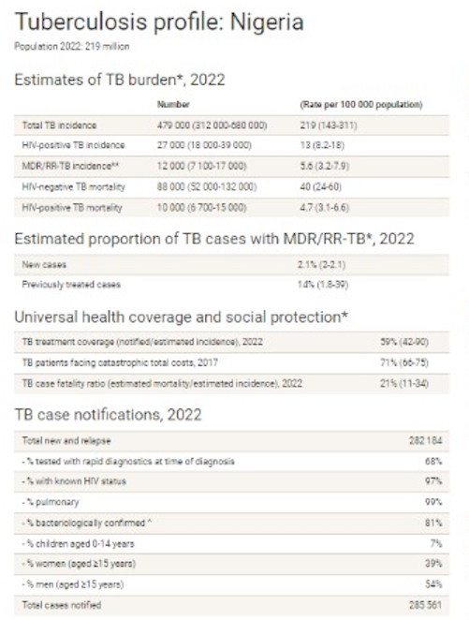
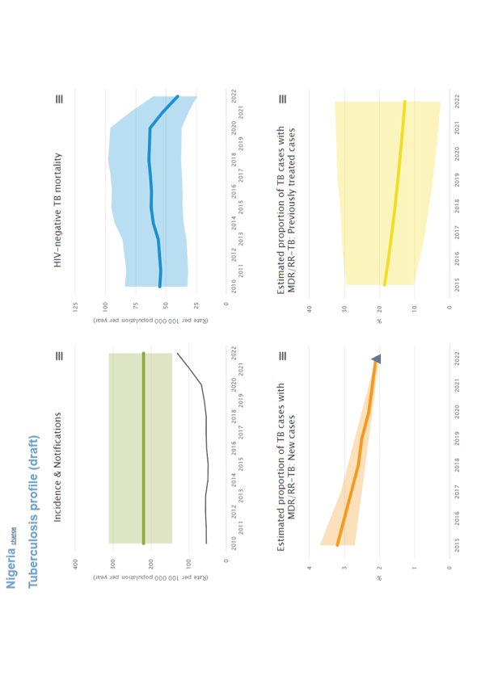
Country profile and TB situation snapshot
Ranked 6th among the TB high burden countries and 1st in Africa (Incidence rate – 219/100,000 pop)
Mortality rate (excluding HIV + TB) for all forms of TB is 40/100,000 population
TB Knowledge among general population – 24% (KAP survey 2017)
To retain our achievements, sustained data use is inevitable and most importantly at the sub-national level

Slide 4
Data-Driven Strategies: Update on national TB M&E, surveillance, and data use

Slide 5
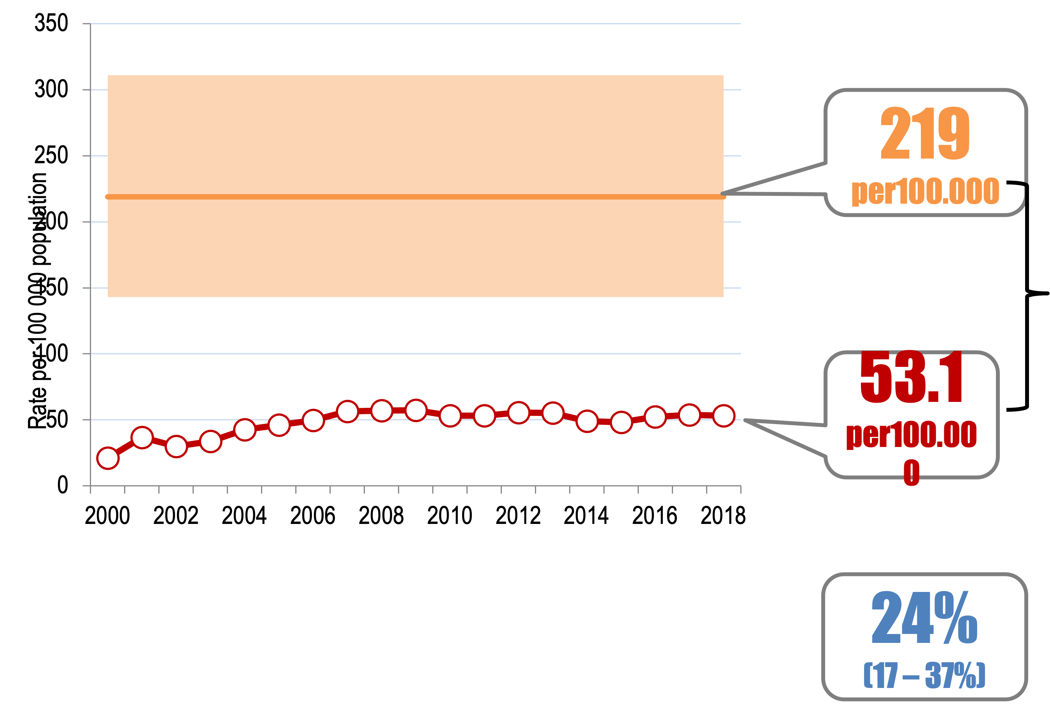
The initial flicker: Successful data-driven initiatives; success stories in TB data collection, analysis, and utilization
Seasonal Myth
Estimate?
Custom fix
Real time resolution

Slide 6
Strategies in place for effective use of National data
Stepped up in partnership coordination and multisectoral engagement
OWNERSHIP
Ensured intervention distribution (mapping) to avoid double funding
Expanded DOTs sites to include non-high burden states
Revitalization of Non. Reporting sites
Targeted community approach using CBOs for ACF
Case finding among key population –IDPs, NOMADs
OPD/PQE: Screening of OPD sites
X-ray for adult & Children
Increased access to TB diagnostic services and new innovations
Strategic focus on PPM
Integration into other services e.g nutritional services
Feed back to state
Corporate level strategy
Comprehensive analysis of programme performance
Review meetings at different levels
Triangulation at different levels
Harmonization
Stability strategy: Evaluation of past strategies and continue
Expansion strategy: Scaled up what has worked
Retrenchment strategy: redefine what's not working
Combination strategy.: Mixing up two parts that worked.

Slide 7

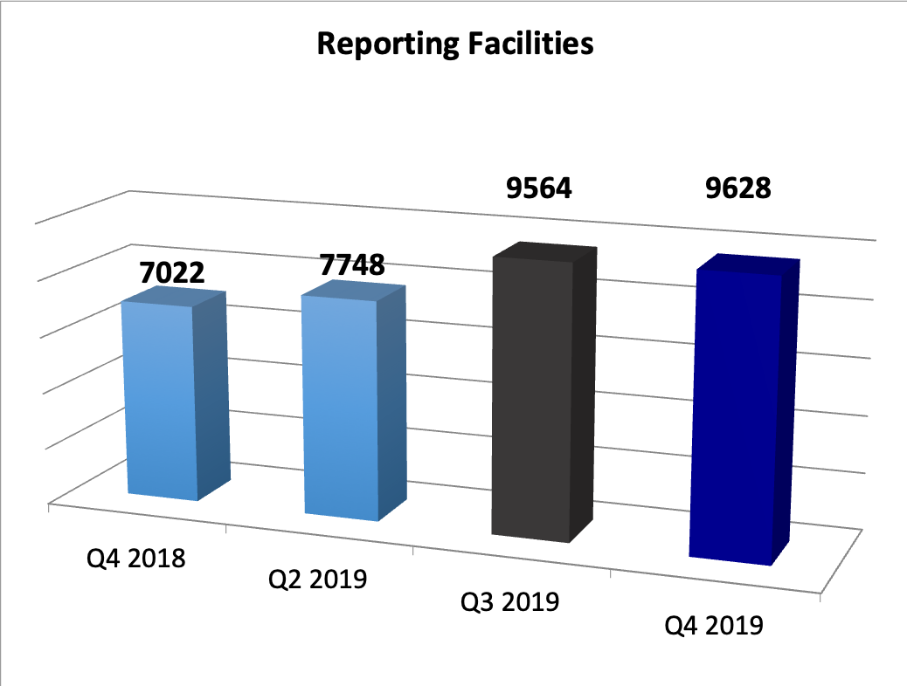
Successful data-driven initiatives; Revitalization of non-reporting facilities
(1) we instituted that 60% of supervised facilities each quarter be the Non Reporting ones to help activate them; (Use of ODK App for confirmation of visit). (2). Produced a one page document for LGA sup. on activating a non reporting facilities (not assuming that they know)
Supportive supervision
Developed a one pager for
LGA supervisors on how to
activate a non reporting facility.
Funds for hard to reach
OPD screening sites
Helped to integrate
DOT sites with special clinics in
big facilities
Quality Dots expansion
Strictly using the checklist
to choose sites; some new DOT sites
Started notifying cases immediately

Slide 8
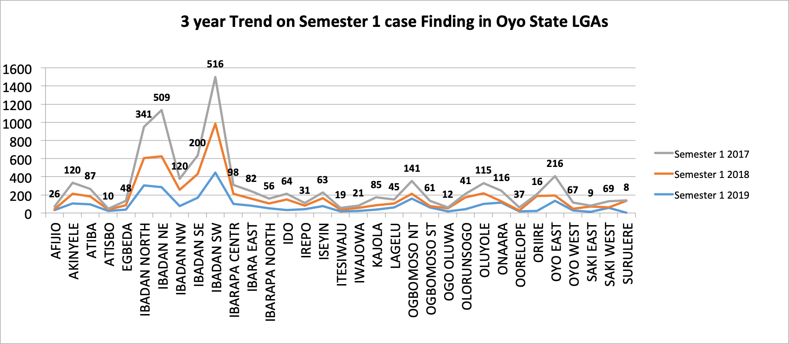
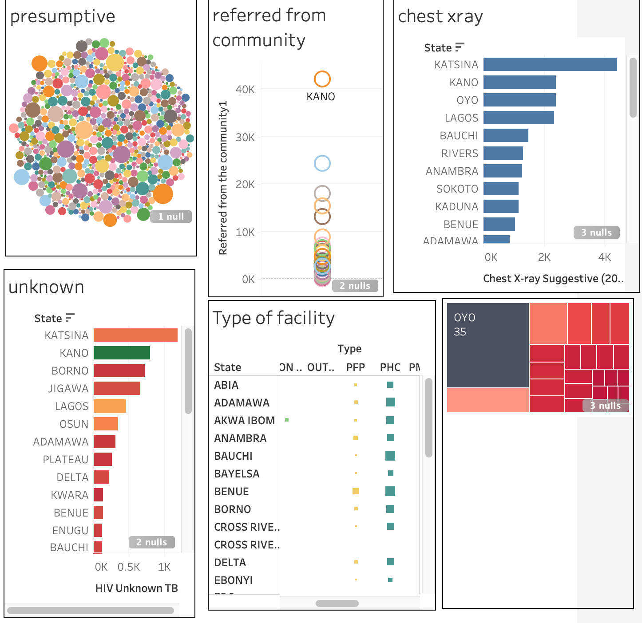
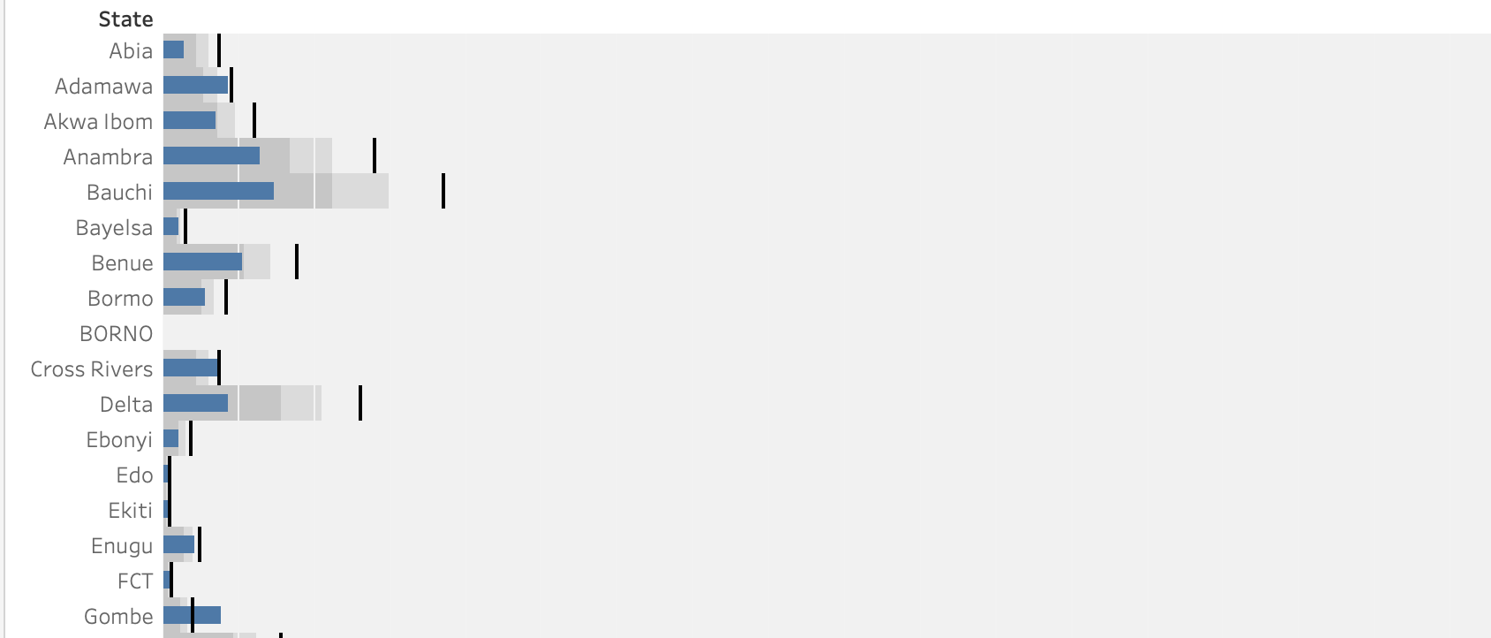
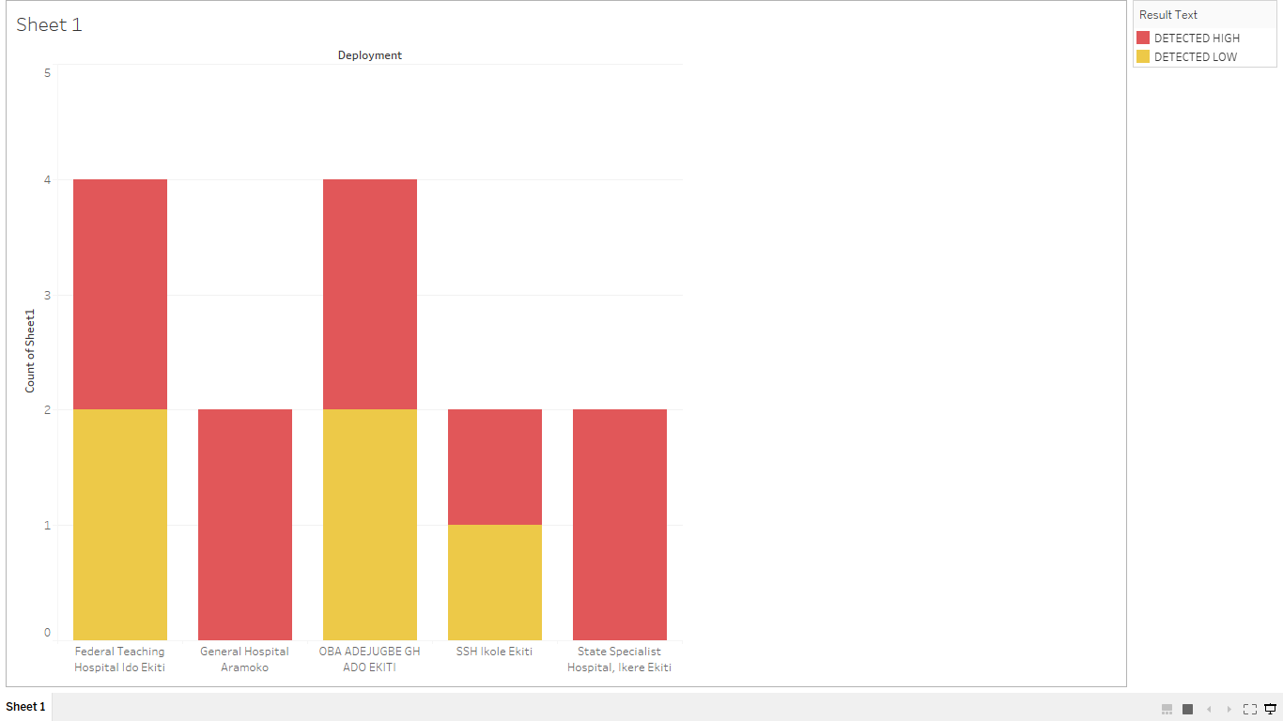
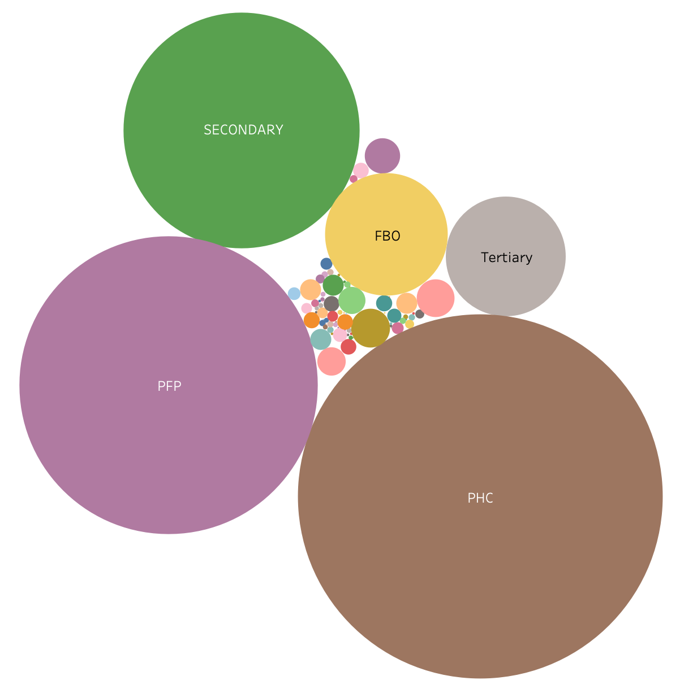
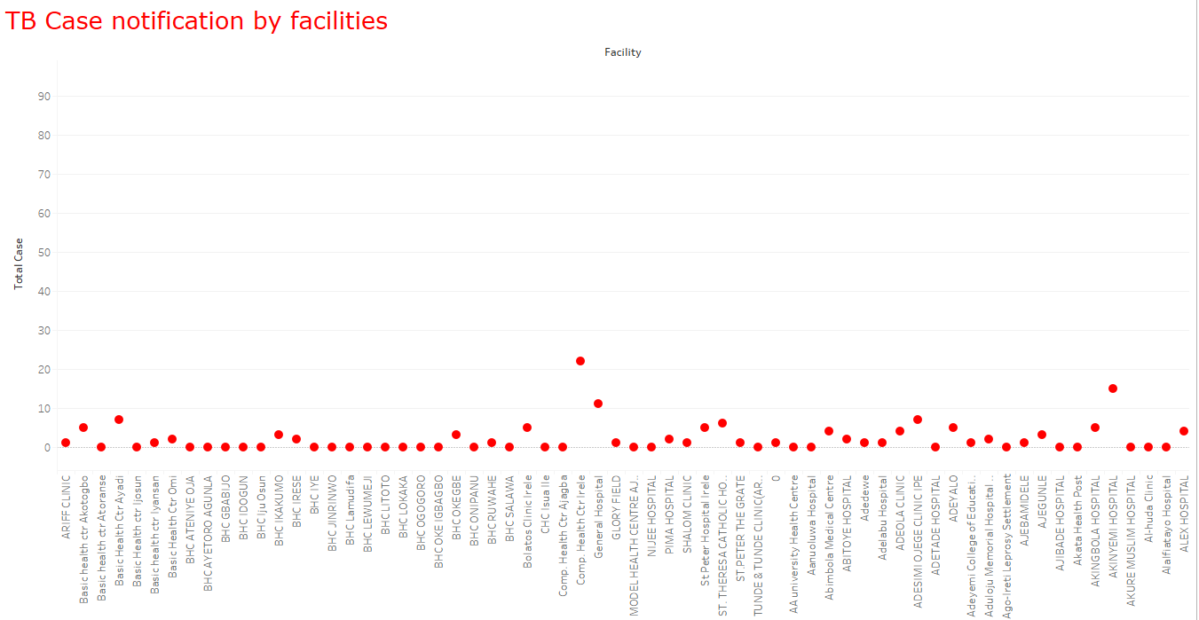
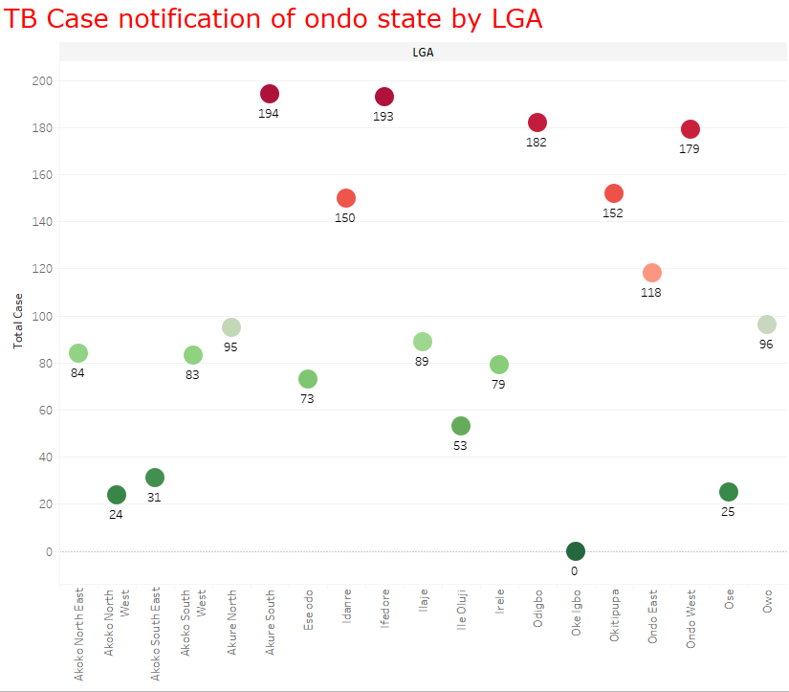
Improvements: Deep dive analysis, for informed decision

Slide 9
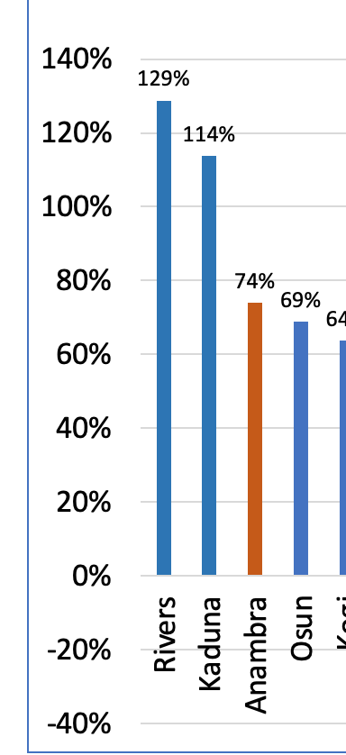
LGA reporting between 2018 and 2021
Learnt lesson that
any state can be high burden if the right intervention is applied
.
A lot more LGAs set to hit 1000 cases or more

Slide 10
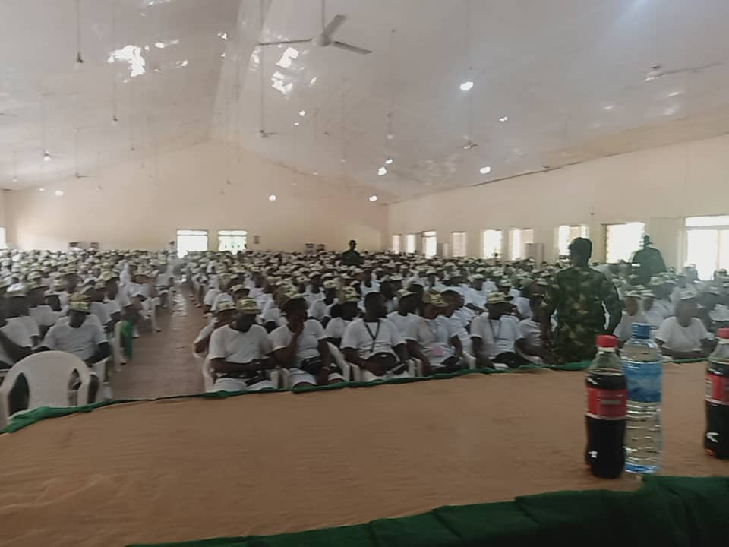
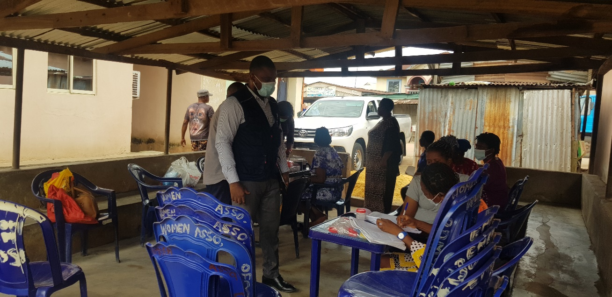

Results achieved: OPD screening & National testing week & screening for Youth Corp Members
More than 20,000 TB cases would have been missed if OPD screening was not instituted in high burden facilities.
National Youth Corp Members testing week
Over 80 TB cases diagnosed from an unexpected corp setting
FEATURED

Slide 11
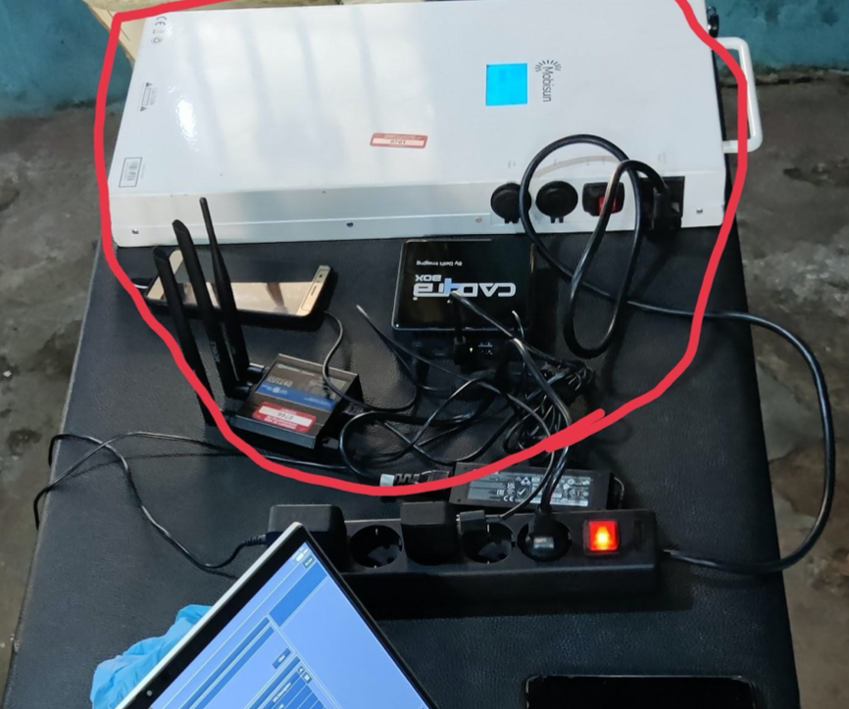
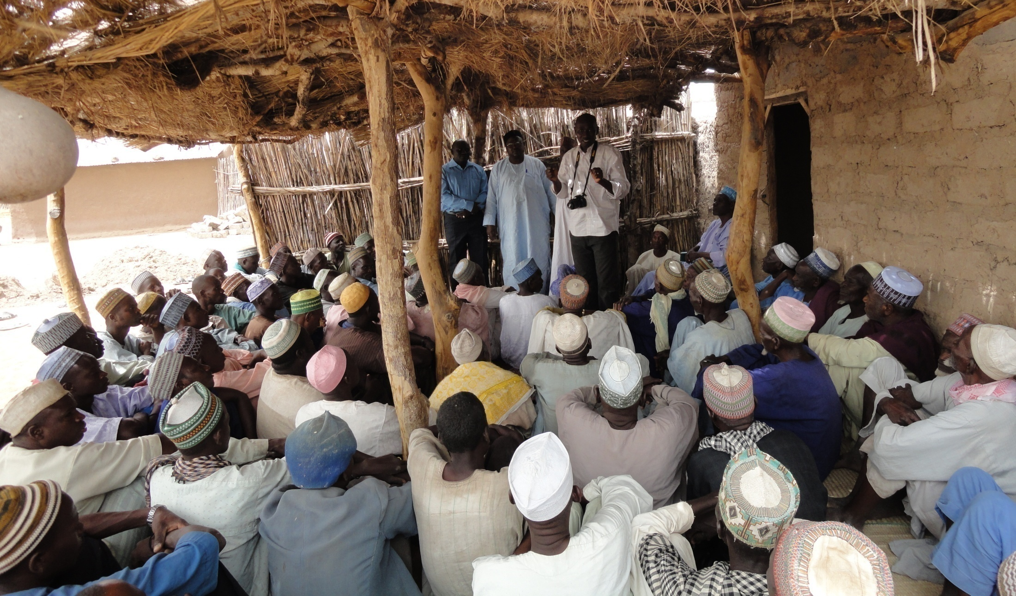
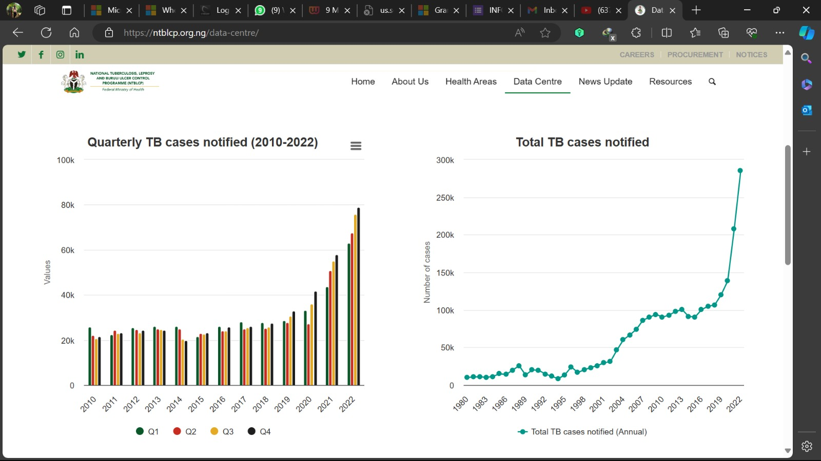

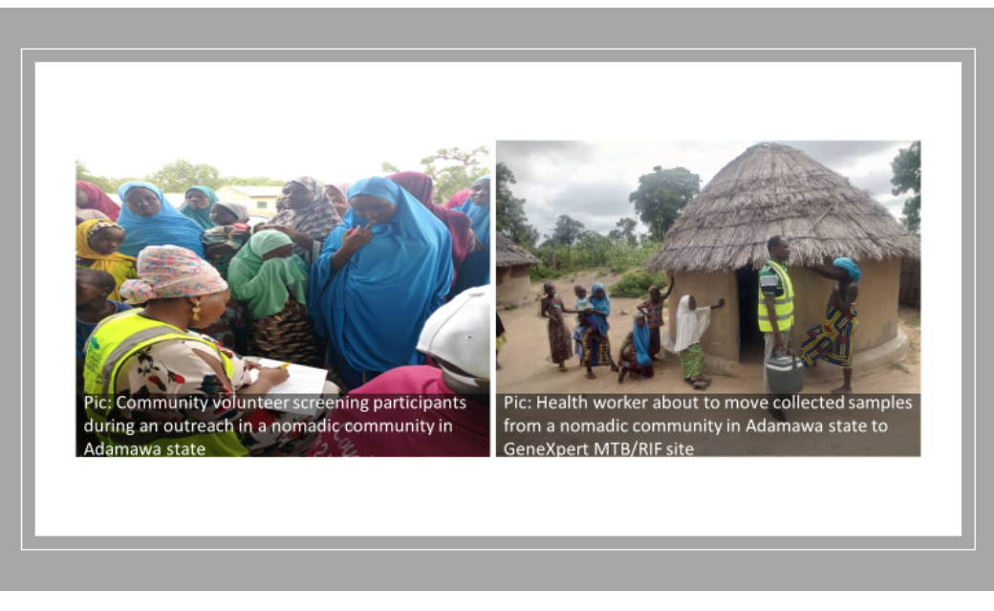

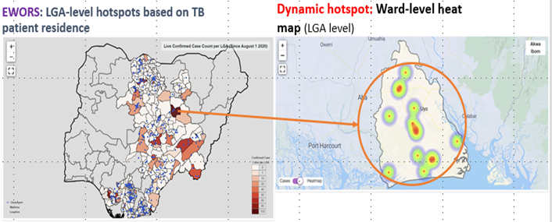
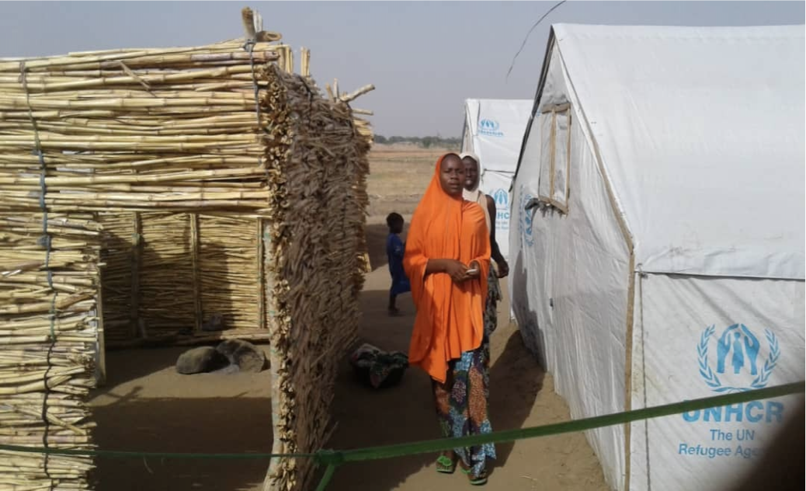
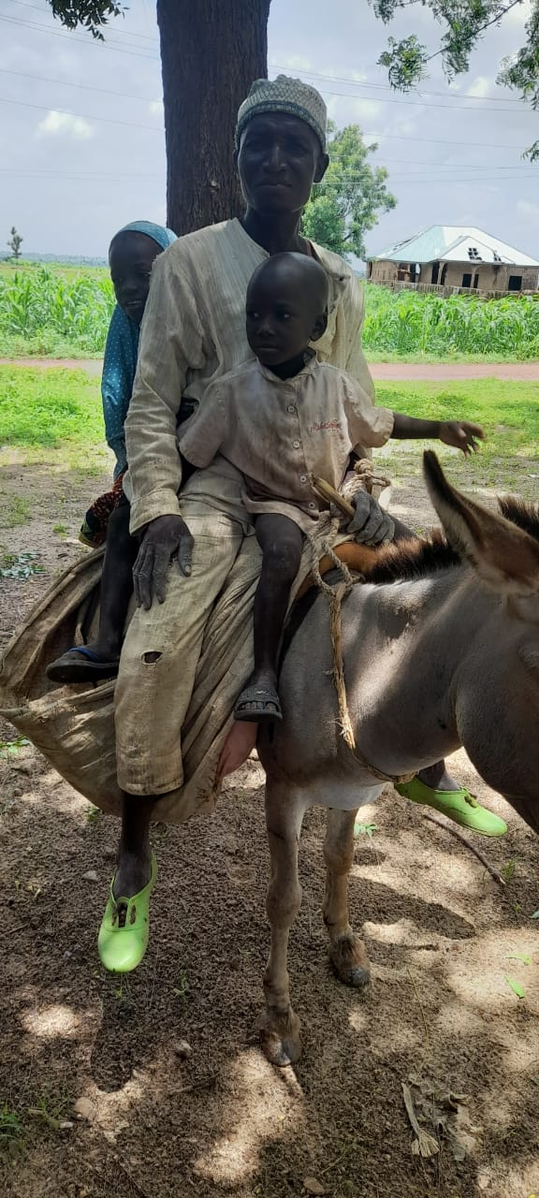
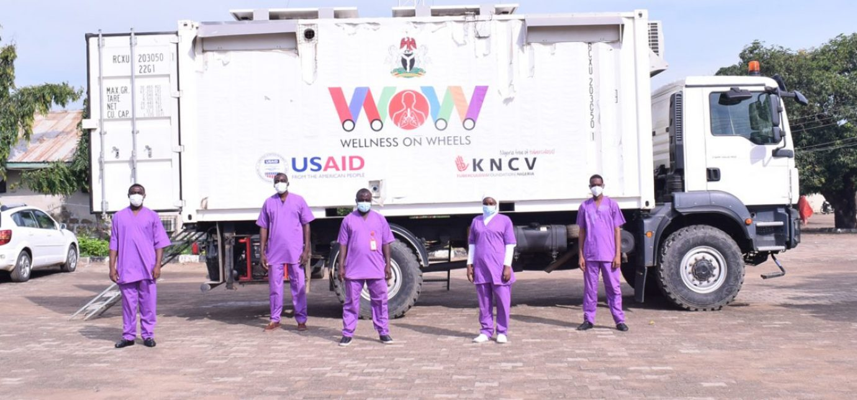
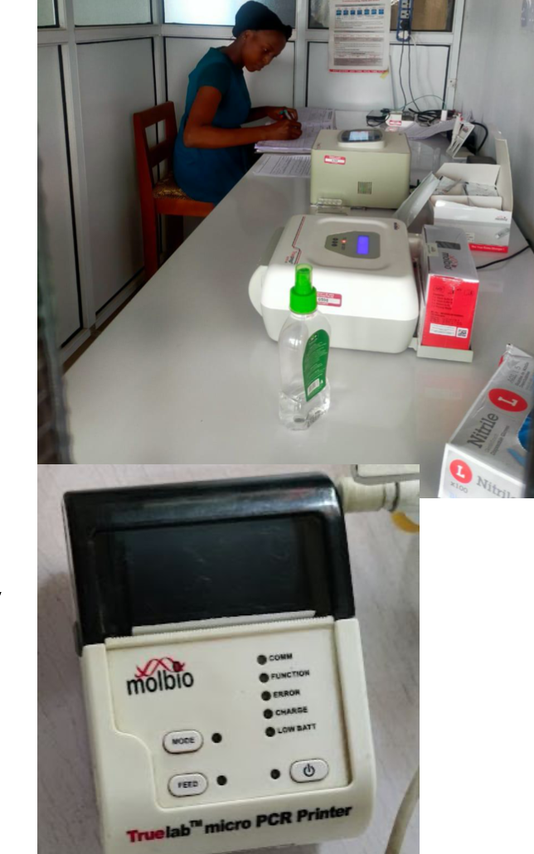
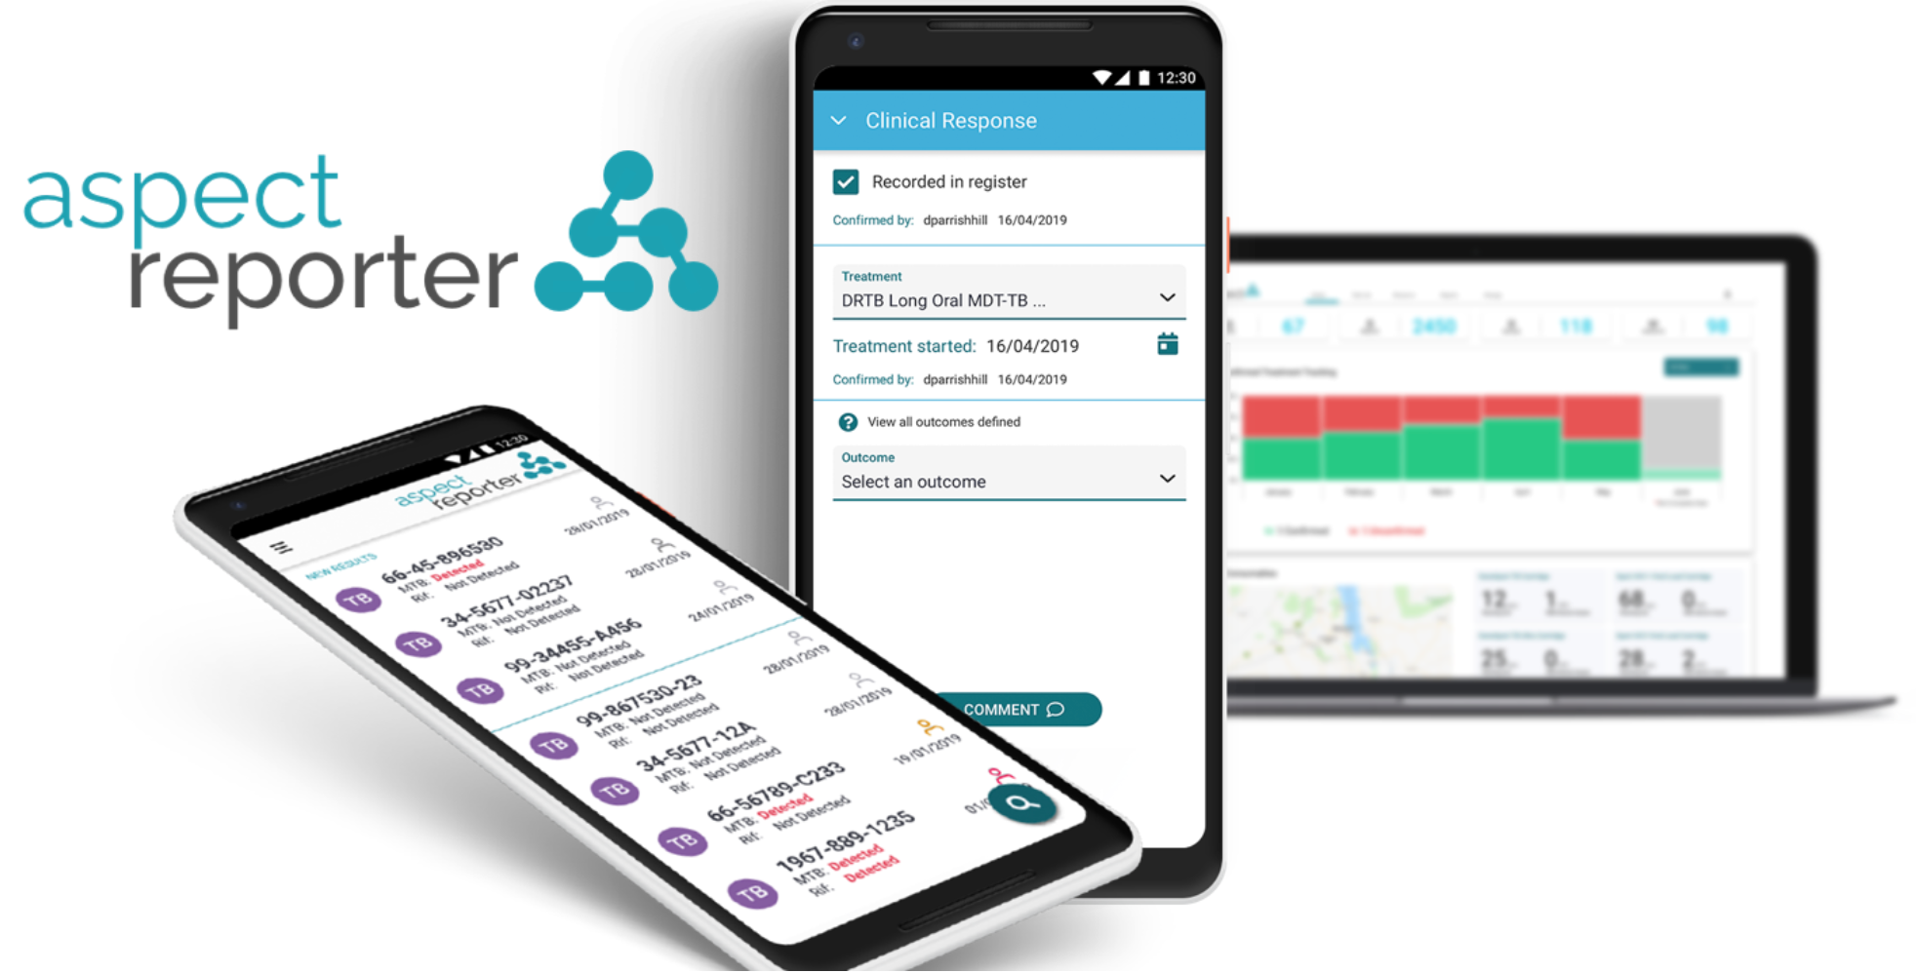
Innovations
https://ntblcp.org.ng/

Slide 12
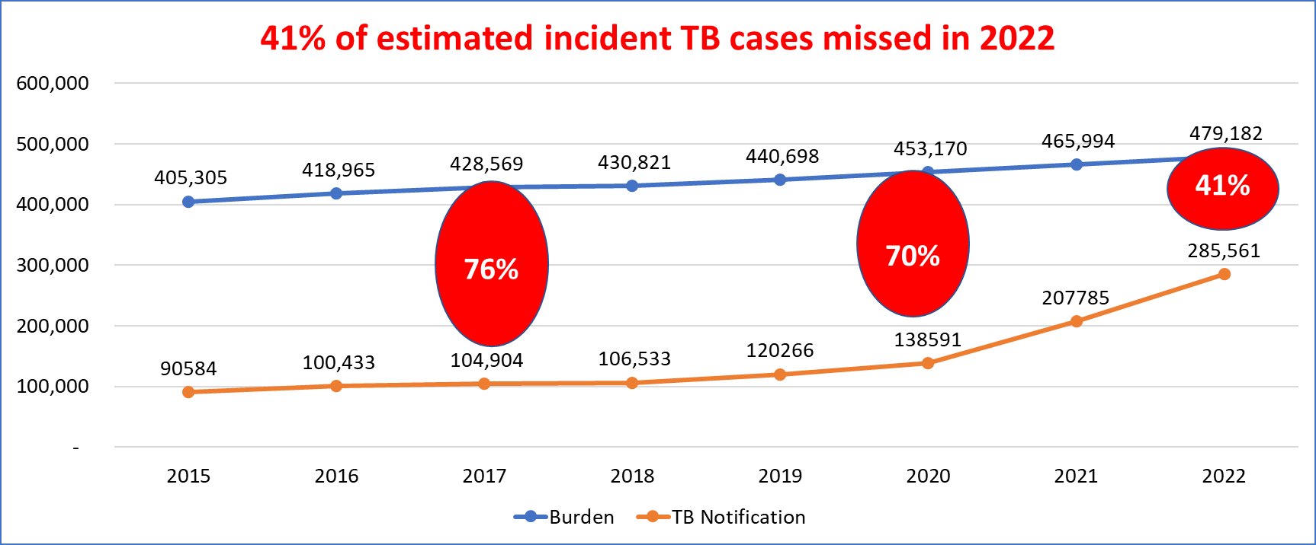
Looking closer: TB burden and case finding: Gap reduction
Improvement and recent changes in M&E data system

Slide 13
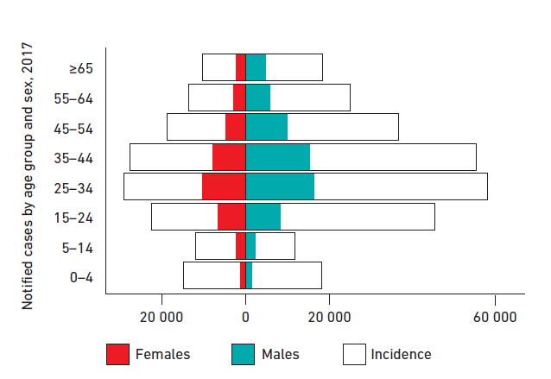
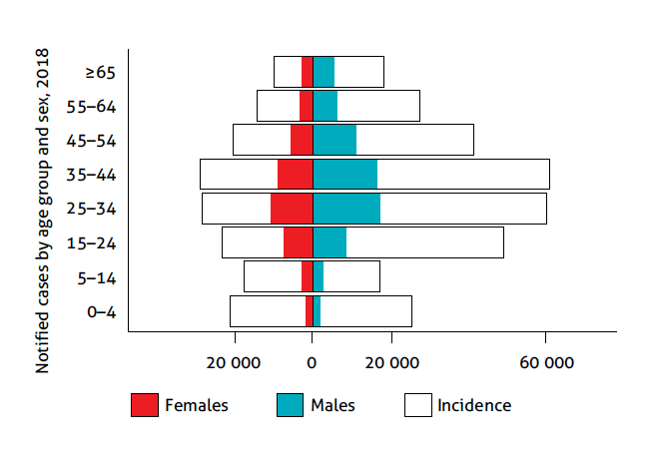
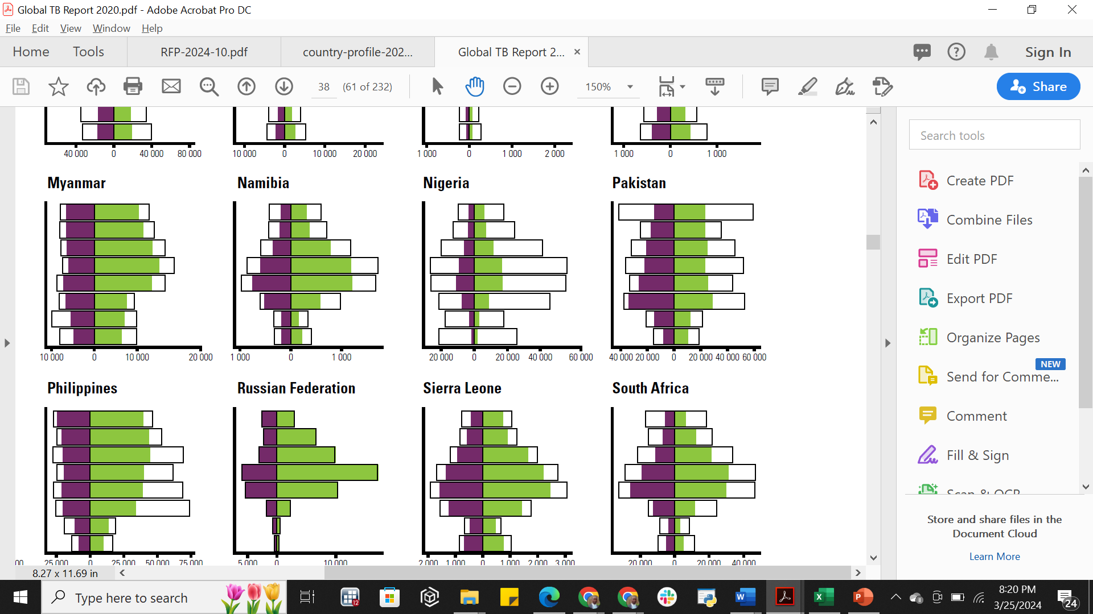
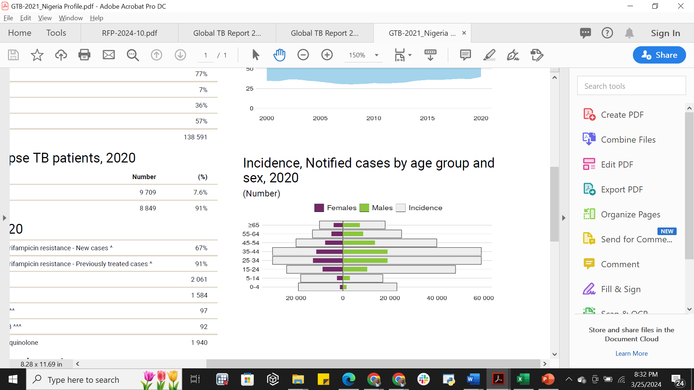
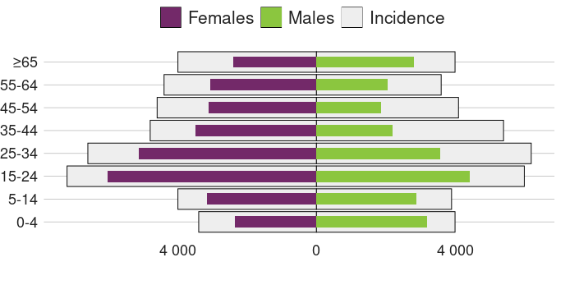
TB Incidence, Notified cases by age group and sex
2017
2018
2019
2021
2022

Slide 14
Challenges in data collection:, analysis and use Sub-optimal disaggregation; presumptive TB and result Cascade to see drops e.g. TPT EMR still work in progress sub-national analysis and use
Males
10% more cases in females
Females

Slide 15
In 2023, it got better at 70%
>320,000
14yrs trend of annual TB notified
2023

Slide 16


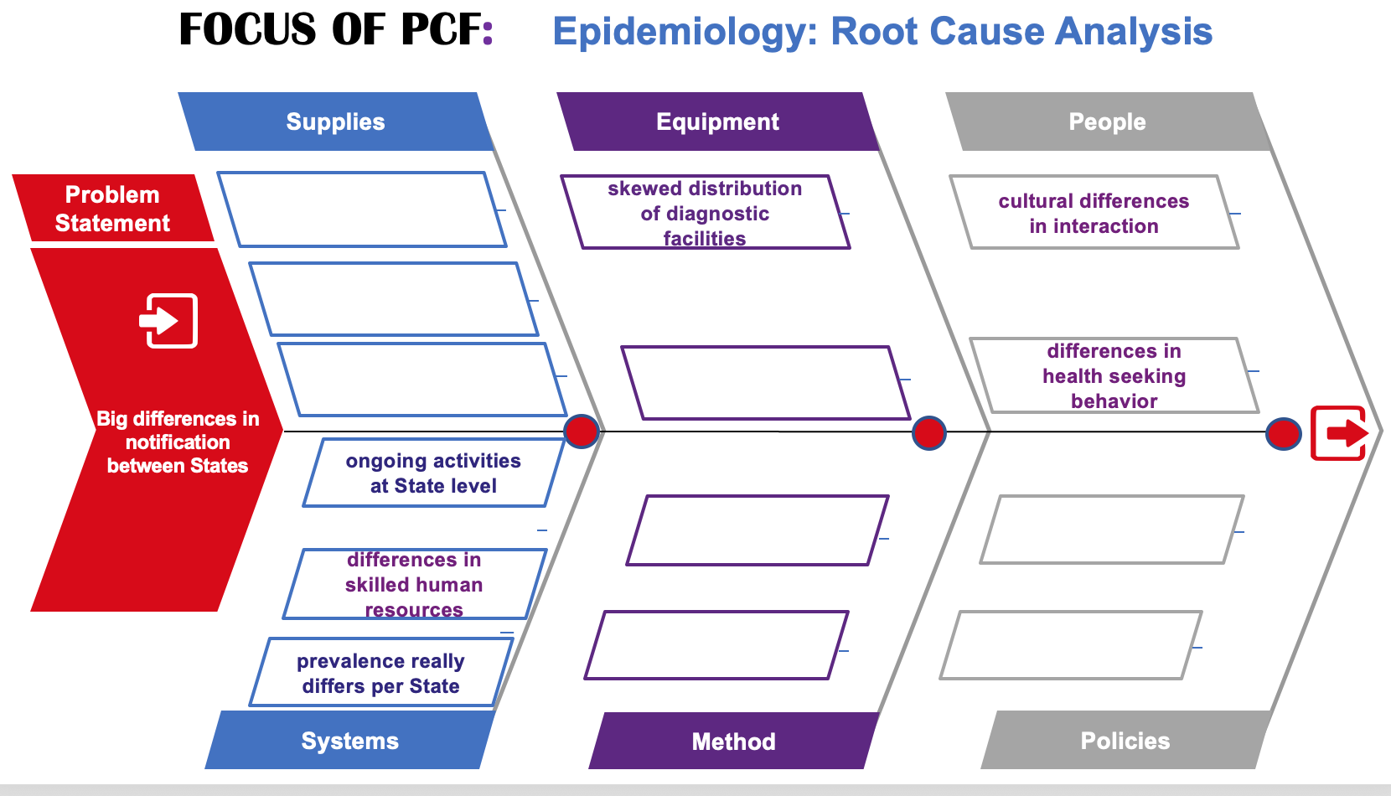
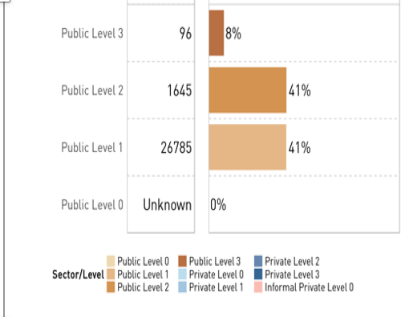
Not expecting less in 2023
Continue to invest in activities to improve case-detection and scale up wider.
Active screening among general (and other) OPD attendants
Expanded integration of DOTS services public and private health providers
Expand community-based screening and referral strategies including ACF
Case search among key population
PPA

Slide 17
Vision for the future of data-driven TB control in your country: Upcoming initiatives or plans
Electronic system with unified dashboard: infrastructure (human attitude burden)
Integrated M&E system with server domiciled in the programme: (big data issues anticipated with X-ray, system interactions and interoperability, real time upload using integrated EMR AI)
Tool update: comorbidities, to current trend, Closing gap
Real-time Monitoring using supervision checker (DOTs expansion); flags critical feedbacks
Capacity building for data analysis and utilization at the sub-national level
Result based approach: Cascade meeting with implementing partners
Re-calculating our estimates: Prevalence survey & DRS(ongoing)
NGS to meet up with the future of surveillance.

Slide 18
TB M&E Beyond Numbers: Understanding trends in PBMEF core indicators

Slide 19
Treatment coverage rate and Child TB contribution

Slide 20
Treatment coverage rate

Slide 21
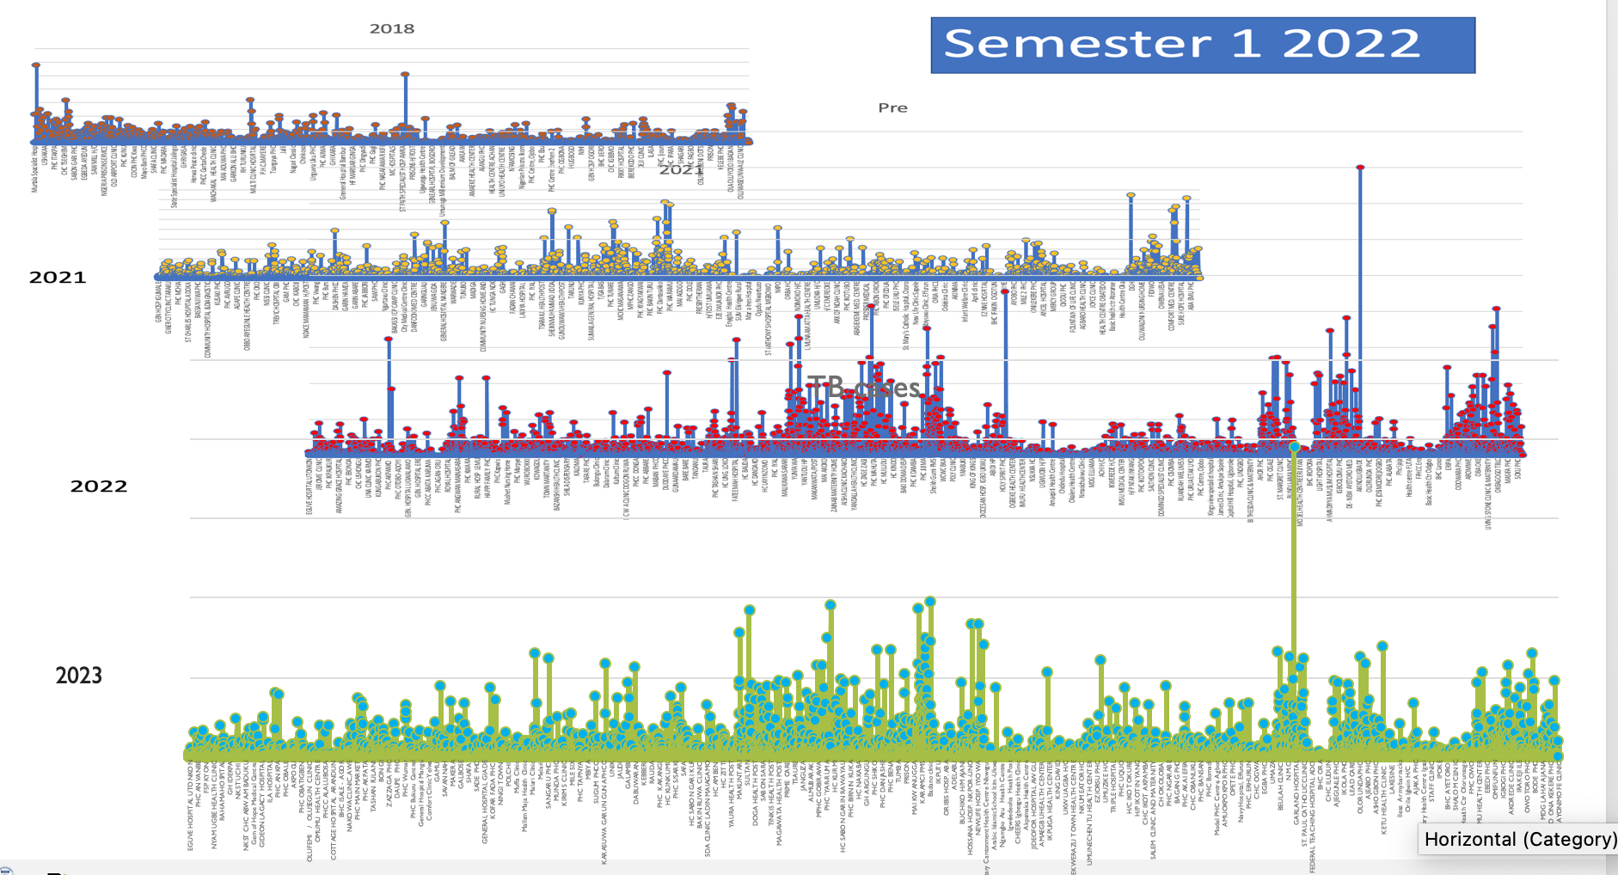
Visualizing the cases

Slide 22
Nigeria success story highlighted in GTB report 2022
Notifications in both 2020 and 2021 were higher than in 2019, with Nigeria being the most striking example.

Slide 23

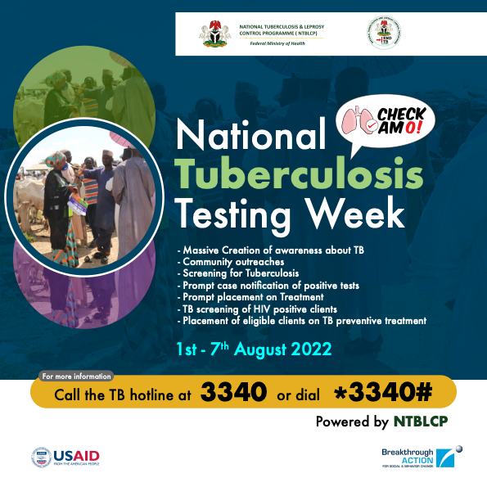

Child TB testing week
Child TB contribution
No of children Encountered | Total screened | No of presumptive identified | Total No of presumptive tested | No of child TB cases
1,231,436 | 636,369 | 177,570 | 159,783 | 7,806

Slide 24

Thank You

