Slide 1



Africa Regional Workshop on Strengthening TB Monitoring and Evaluation Systems
16-19 April, 2024 • Dar es Salaam, Tanzania
NTP UPDATES: Democratic Republic of Congo

Slide 2
Democratic Republic of Congo (DRC)

Slide 3
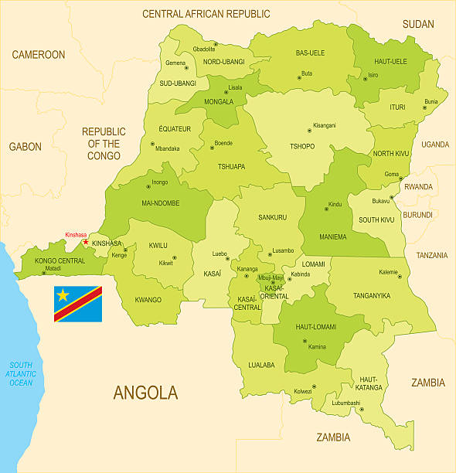
TB PROFILE Country presentation
DRC among the 10 TB high burden countries, TB/HIV and PR TB

Slide 4
TB PROFILE - Resources , diagnostic guidelines, and structures
Area: 2,345,409 km²
Pop: 102 Million (2023)
Countries with low domestic contribution (1.3% according to WHO)
39% of the TB budget unfunded
Free processing throughout
Guidelines and management tools
PSN 2024-2028
PATI 6
PATI LAB
PATI PED
PATI MED
PATI OR
Structures
  Central Unit +27 CPLT
  519 ZS
  2132 CDT (2023)
  1 LNRM
  3 CULTURE LAB
  27 LPR
Diagnostic
Microscopy: 2249
Rx : 82 fxl
GeneXpert: 375
Truenat: 38
TB LAM
TB testing in stools

Slide 5
TB PROFILE
Incidence: 233 (WHO:316)
Notification
257,786 incident TB cases
Treatment coverage 74%
Successfully treated
95%
2022
2023
5% Increase
Child​
13%
Tested for HIV
79%
TBVH + 7%
90 % On ARV
Notification
MDR-TB
n = 1415 (32% NSP Target)
80%
treated
Notes:
Excellent

Slide 6
Data-Driven Strategies:
Update on national TB M&E, surveillance, and data use

Slide 7
Strategies in place for effectively using national TB data (1/2)
National strategic plan supported by an M&E Plan
Integration of DHIS 2 since 2018
Evaluation of the DRC M&E system with the WHO Benchmark tool
Integration of the recommendations of this evaluation except for civil status data
Adaptation of data management guidelines and tools according to new WHO definitions and guidelines (TPT, etc. )
Editing of the quarterly epidemiological bulletin
Monthly data reporting instead of quarterly reporting
Quarterly data meetings in each province
Regular capacity building of stakeholders
Regular data quality audit

Slide 8
Strategies in place for effectively using national TB data (2/2)
Quarterly data meetings in each province
Regular capacity building of certain actors (9 provinces)
Regular data quality audit
M&E task force bringing together all support partners
Carrying out several operational research: QTSA

Slide 9
Challenges
Weak M&E funding : Insufficient/Reduction in funding for activities (supervision, data validation, sample shipping, etc.)
Lack of electronic medical record for TB patients (digitalization of patients)
Low data quality: inconsistency, outliers, non-existent data, completeness and timeliness
Low performance on certain indicators
Capacity building for managers and service providers
Notes:
Express challenges in the same way

Slide 10
Strategies to improve the use of data for effective TB control
Advocacy with partners for the mobilization of additional resources
Improve training coverage: M&E / DHIS2 throughout the country (17/26 provinces)
Capacity building for managers and service providers
Development of DHIS2 dashboards
Organization of data quality audit missions (e.g. RDQA)
Supervision, coaching and support for actors at all levels of the health pyramid
Development of SOPs for data validation and certification
Quality approach

Slide 11
TB M&E Beyond Numbers: Understanding trends in
PBMEF core indicators

Slide 12
REACH – TB Notification all forms from 2018-2023
Notes:
Think about explaining and if possible the reasons for this performance?

Slide 13
REACH : Pediatric TB Notification vs TB All Forms from 2017-2023
IN DANCE
Notes:
This graph shows the proportion of reported Pediatric TB cases compared to total cases, from 2017 to 2023. It remained stationary at 11% from 2017 to 2020 then increased by 13% in 2021 then stationary until today.

Slide 14
CURE – MDR-TB Notification and Treatment from 2018 - 2023

Slide 15


