Slide 1

Africa Regional Workshop on Strengthening TB Monitoring and Evaluation Systems
Monitoring, Evaluation, and Learning (MEL) Plan Template and Integrating Performance Based Monitoring and Evaluation Framework (PBMEF) Indicators into MEL Plans

Slide 2
Outline
Description of a MEL plan
Creating the Project MEL Plan for TB Projects: Template and Guidance
What the template contains
How to access the template

Slide 3
Description of a MEL Plan

Slide 4

What is a MEL plan?
MEL plans are used by implementing partners (IPs) to guide their activities over the life span of the project and by donors to manage projects and track their investments.
A MEL plan measures whether a project is achieving programmatic results and generating learning to inform the adaptation of activities based on evidence.
The MEL plan should be based on the planned activities and goals of the project and what has been proposed in the workplan.

Slide 5

True or False: MEL plans should be updated annually.
TRUE! MEL plans should be updated annually to reflect learning and adaptive changes based on a project’s workplan.
Notes:
A MEL plan is a document that helps to track and assess the results of the interventions throughout the life of a program

Slide 6
Creating the Project MEL Plan for TB Projects: Template and Guidance

Slide 7
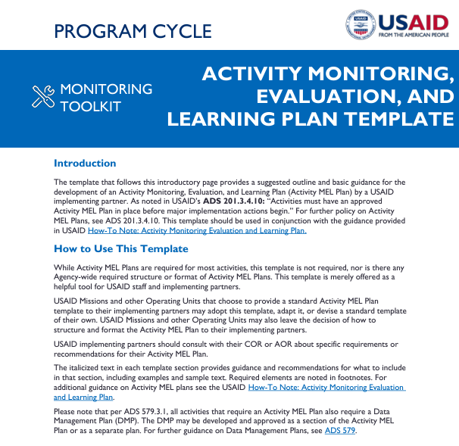
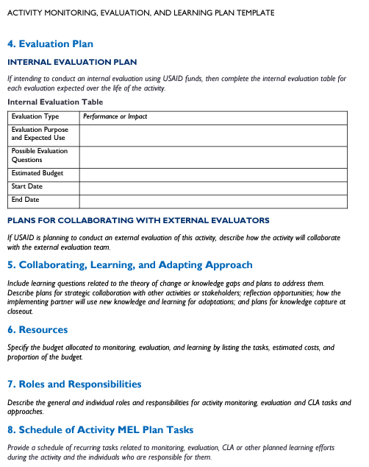
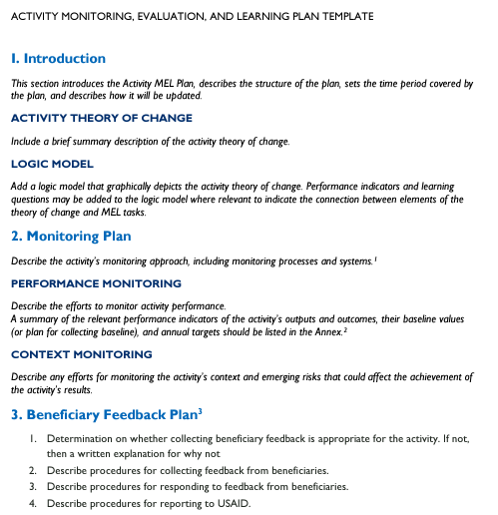
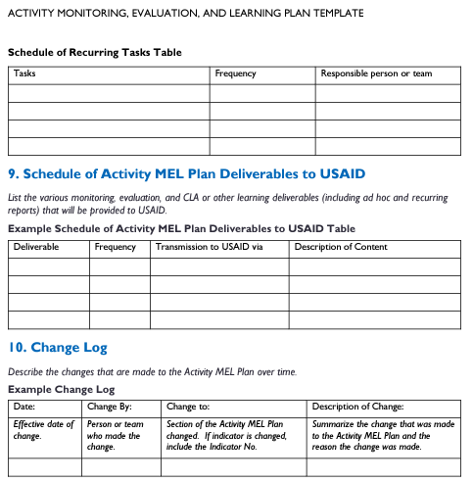
USAID’s MEL Plan Template

Slide 8
What need does this TB-specific MEL plan meet?
The ASK → Create a MEL plan template that is TB- and PBMEF-focused, includes more guidance, and is user-friendly.
Includes USAID’s Global TB Strategy
Incorporates the PBMEF and explain how PBMEF indicators should be incorporated into MEL plans
Provides more explanations and practical guidance for users
Includes links to additional resources
Provides an example of a completed MEL plan
Provides a blank MEL plan template

Slide 9

Result
A new template that provides guidance for the development of a project MEL plan for USAID IPs working in the field of TB.
Primary audience for this guidance:
IPs who are awarded USAID TB funds and are required to develop a MEL plan.
Additional users include USAID CORs/ AORs, activity managers, and M&E specialists.
Notes:
The primary audience for this guidance is IPs who are awarded USAID TB funds and are required to develop a MEL plan. Additional users include USAID Contracting Officer’s Representatives (CORs)/Agreement Officer’s Representatives (AORs), activity managers, and M&E specialists.

Slide 10
True or False: It is a requirement for USAID-funded IPs to use this template.
FALSE! Use of this template is not required, nor is there any agency-wide required MEL plan structure or format. However, using this template is strongly recommended.

Slide 11
What the Template Contains

Slide 12
PART 1: MEL PLAN TEMPLATE WITH INSTRUCTIONS

Slide 13
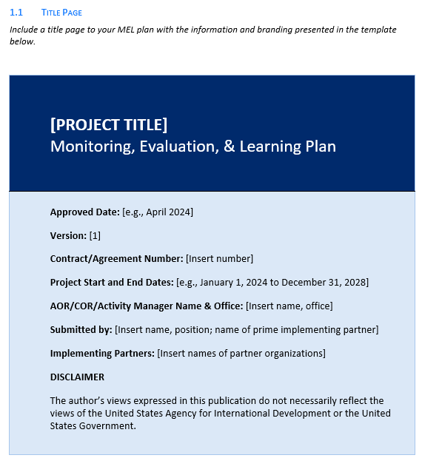
1. Overview
Title page
List of abbreviations
Table of contents

Slide 14
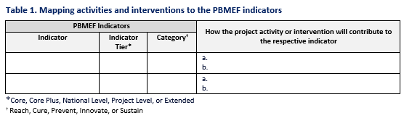
II. Introduction
Project’s theory of change
Results framework
Critical assumptions
Key Message: A results framework should clearly demonstrate how a project is contributing to the 90-90-90+ prevention strategic results.
Notes:
The template includes several useful tables, such as this one, with IPs may want to include in their MEL plans to show how the project’s planned activities or interventions will contribute to reaching the targets set using the PBMEF’s essential list of indicators.

Slide 15
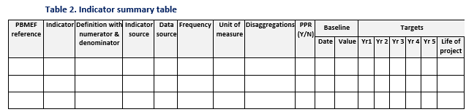
III. Monitoring Plan
Performance monitoring
Context monitoring
Key Message: Every project that is receiving USAID TB funds—even if it is a relatively small amount in an integrated project—must include PBMEF indicators to demonstrate their contribution to the TB indicators.
Notes:
This is where we talk about indicators, indicator reference sheets, and what is required with an indicator summary table. Annex I of the template provides detailed guidance on what is needed for an indicator summary table and provides an example of a completed table.
To fulfill the PBMEF requirement, IPs must include core indicators plus any other relevant PBMEF indicators.

Slide 16
True or False: For the core indicators included in a project’s MEL plan, IPs should report on both project and national level data.
TRUE! This allows IPs to demonstrate the project’s contribution to national level targets.
Notes:
National level baselines and targets may be found in global reports.

Slide 17
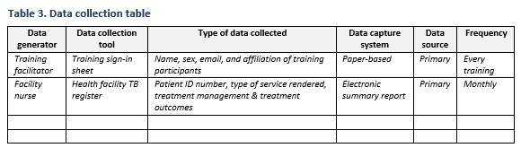
1V. Data Collection
Data collection
Data analysis
Notes:
This is where you will detail your data collection processes. Relevant details about types of data collection issues such as sampling, tool design, use of sub-contractors and project staff for data collection, etc. would go in this section.

Slide 18
Sections V and VI
Section V: Data Management and Quality Assurance
This explains how data will be managed at all stages. This includes data collection, quality assurance, repository, security, analysis, sharing, and use.
Section V1: M&E of Gender
Explain how your M&E activities can help determine whether your TB activities promote gender equity or may exacerbate gender inequalities. Describe how gender is being addressed under your project’s results and approaches.
Key Message: USAID has a requirement that holds IPs “responsible for complying with obligations under the contract or agreement to integrate gender in programming, which may include developing gender-sensitive indicators that measure specific gender-related goals for each project and/or activity, where relevant.”

Slide 19
Sections VII, VIII, IX, and X
Section VII: Evaluation Plan
Internal evaluation
Plans for collaborating with external evaluators
Section VIII: Collaborating, Learning, and Adapting Approach
Include the project’s learning priorities and how the project will communicate its achievements and learning.
Section IX: Stakeholder Feedback Plan
Determine whether collecting stakeholder feedback is appropriate for the project.
Section X: Resources
Specify the budget allocated to MEL activities.

Slide 20
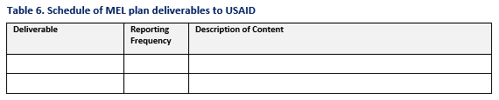
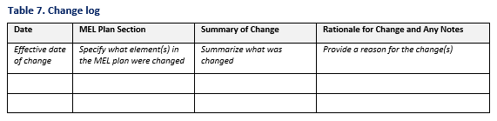
Sections X1 and XII
Section X1: Roles, Responsibilities, and Schedules
Schedule of project MEL plan tasks
Schedule of MEL plan deliverables to USAID
Section XI1: Change Log
Notes:
This may be a short section, but it is important. Many MEL plans do not include these sections, particularly the Change Log, but it is important.
Describe the general and individual roles and responsibilities of key IP staff for M&E and CLA tasks and approaches.

Slide 21
According to USAID’s Program Cycle Operational Policy, a MEL plan must include what:
Multiple Choice
Monitoring plan
Monitoring plan and stakeholder feedback plan
Monitoring plan, stakeholder feedback plan, and theory of change
Monitoring plan, stakeholder feedback plan, theory of change, and data collection plan
B! Technically, just a monitoring plan and stakeholder feedback plan are required, but ALL of the above should be included.
Notes:
Technically, just a monitoring plan and stakeholder feedback plan are required, according to ADS Chapter 201, but ALL of the above should be included.

Slide 22
PART 2: SAMPLE MEL PLAN

Slide 23

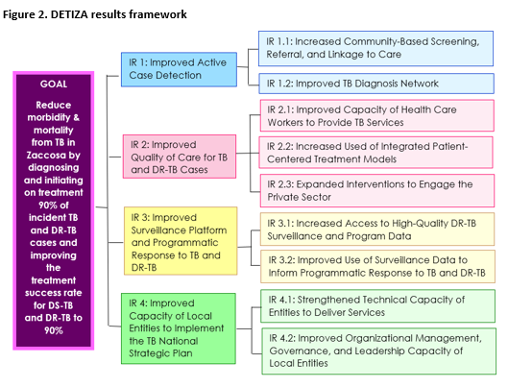
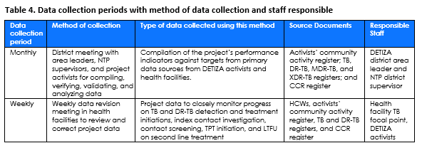
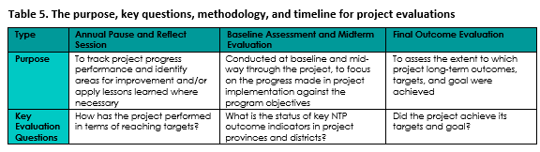
Decreasing Tuberculosis in Zaccosa (DETIZA)

Slide 24
PART 3: BLANK MEL PLAN TEMPLATE

Slide 25
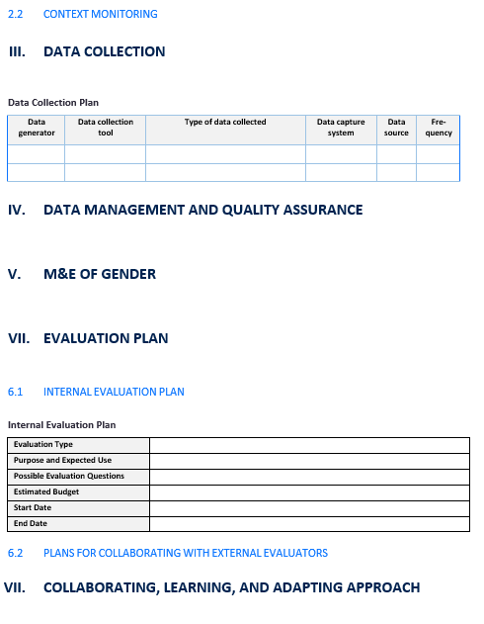
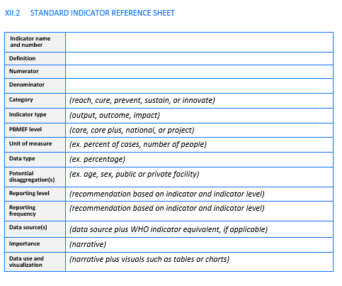
25

Slide 26
How to Access the Template

Slide 27

TB DIAH Website
https://www.tbdiah.org/assessments/pbmef/
The website includes a PDF of the TB MEL plan template and a Word version so IPs can draft their own MEL plans.

Slide 28
Boilerplate

