Slide 1

Africa Regional Workshop on Strengthening TB Monitoring and Evaluation Systems
Overview of the TB DIAH Project
April 16, 2024
Notes:
Karibu! Good morning and welcome. Thank you for joining the Africa Regional Workshop on Strengthening TB Monitoring and Evaluation Systems.
We come from 19 different countries.
All 11 of the USAID priority TB countries are represented at this workshop, we also have representatives from SADC (Southern Africa Development Community) and ECSA-HC (Eastern, Centrral, Southern Africa Health Community.
Let’s recognize each table/country present. Please stand when I call your country!
Let’s start with representatives from the host country – Tanzania!
Table 13 has representatives from eSwatini, Namibia, Angola and Sierra Leone!
South Africa
Zambia
Zimbabwe
Nigeria
Ugana
Kenya
Mozambique
Ethiopia
DRC
Thank you to representatives from WHO, Global Fund and the STOP TB Partnership for joining us.
Ann Fitzgerald, Deputy Director of the TB DIAH project.
My brief presentation shares about the TB DIAH project, with a focus on the activities most relevant to this workshop.

Slide 2

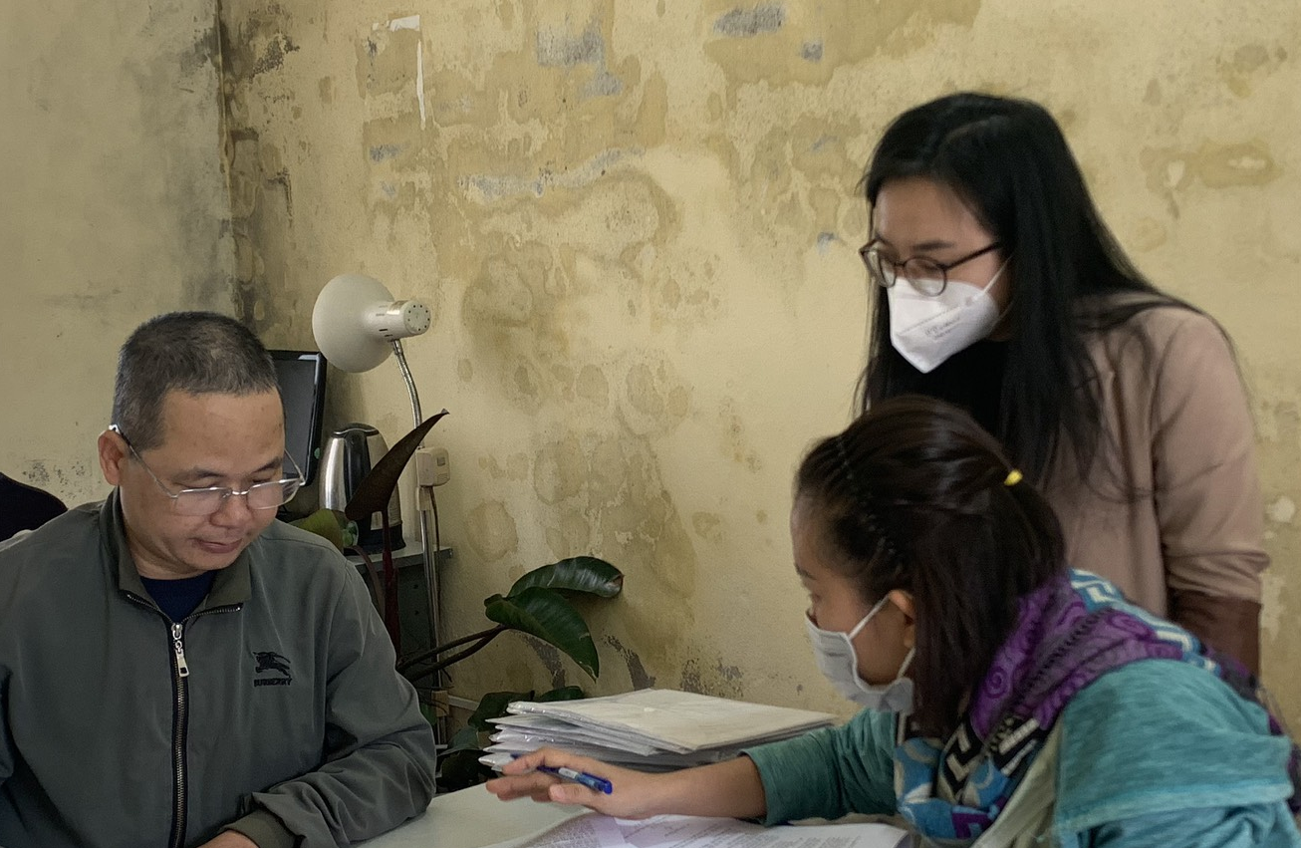
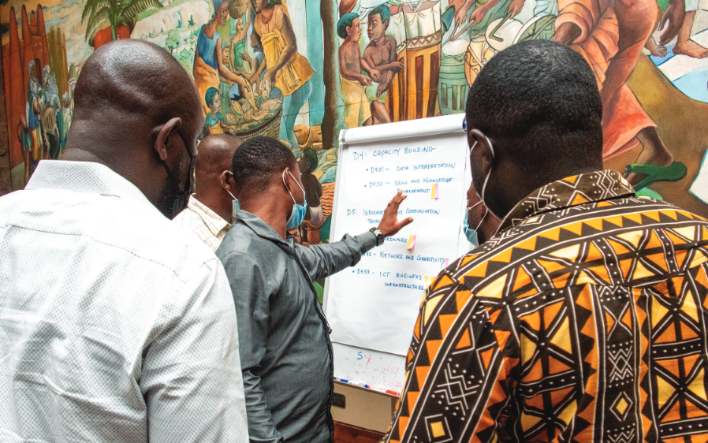
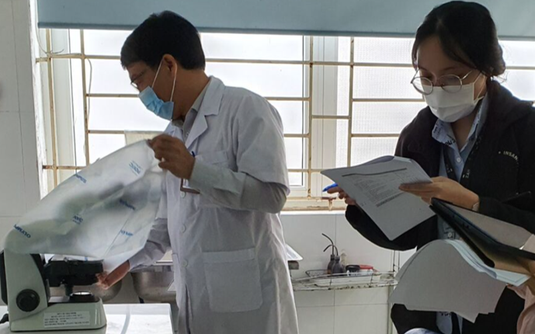
Part of the Global Accelerator to End TB
Global, five-year (2018-2023) associate award, $36M cooperative agreement
Small team of M&E and TB experts working to clarify TB data in way that helps USAID monitor its TB investments in its TB priority countries
Helps countries use data to share their story
Notes:
TB Accelerator – other activities include (TIFA, STAR, LON) – {define}
Goal: 40 million people on treatment from 2018-2022
Strategic objective
Ensure demand, analysis, and use of tuberculosis (TB) data for performance management and to inform interventions and policies
The mechanism assists with developing and implementing performance-based measurement systems to maximize resources.
We are in no cost time extension.

Slide 3
What does TB DIAH do?
Surveillance
(Data)
Reporting
(Information)
Communications (Knowledge)
1
Result 1: Strengthen the collection, analysis, and use of routine and surveillance TB data
2
Result 2: Improve performance-based (M&E) frameworks and information gathering processes: tools, methods, and technical guidance to meet user needs
3
Result 3: Strengthen reporting and communication to address knowledge gaps and share methods, tools, and approaches
Notes:
Based on 3 results –
Core activities relate to these three results areas
Mission funded work also

Slide 4
What does TB DIAH do? – Core Activities
Performance-based M&E Framework
Contains the essential and extended indicators to help Missions track progress against TB targets and manage USAID’s TB investments—all in one place
PBMEF
M&E and Surveillance Systems Assessment
An overview of M&E and surveillance systems in each USAID TB priority country
MESSA
Assessment of Data Collection, Reporting and Analysis Capacity
Measures a country’s capacity to collect, report, and analyze PBMEF indicators
WORK STREAMS
ARC
Surveillance System Strengthening Plan
Systematic and multi-faceted assessment of a country’s TB M&E and surveillance system
Identifies strengths and gaps across the system, examines the quality of the data, and develops the implementation of a costed action plan
STEP
Quality of TB Services Assessment
Provides periodic data to inform NTPs, USAID missions, and other stakeholders of the current state of quality of TB care and what strategic investments and actions may be needed to improve TB services
QTSA
Notes:
Framework is the cornerstone
Assessments relate to the M&E/Surveillance climate and specifically look at two aspects –
ROUTINE DATA COLLECTION: PBMEF preparedness (ARC) and strengths and gaps across the M&E/Surveillance system (STEP AND D2AC)
QTSA: Quality of TB Services Assessment

Slide 5

What does TB DIAH do?
TB Data-to-Action Continuum
Measures the progress of countries as they work toward improving their TB M&E and surveillance systems
D2AC
Centers of Excellence
Establish Centers of Excellence to test and model best practices in TB M&E and surveillance
COEs
National TB Programs Websites
Work with priority countries’ NTPs to adapt their websites and increase their transparency scores using the Stop TB Partnership’s Governance of TB Programs criteria
WORK STREAMS
NTPW
TBDIAH.org – Knowledge and Data Hubs
A one-stop shop website offering public and secure work areas to support USAID TB program managers, technical advisors, and country stakeholders with data analysis and reporting, and access to tools, resources, and guidance to contextualize and apply data to their programming
TBDIAH.org
E-Learning –Online courses for frontline workers, community health staff and in TB Contact Investigation, Finding cases among those living with HIV, and TB Monitoring & Evaluation
E-Learning
Notes:
COE, WEBSITES (Nigeria) TB

Slide 6
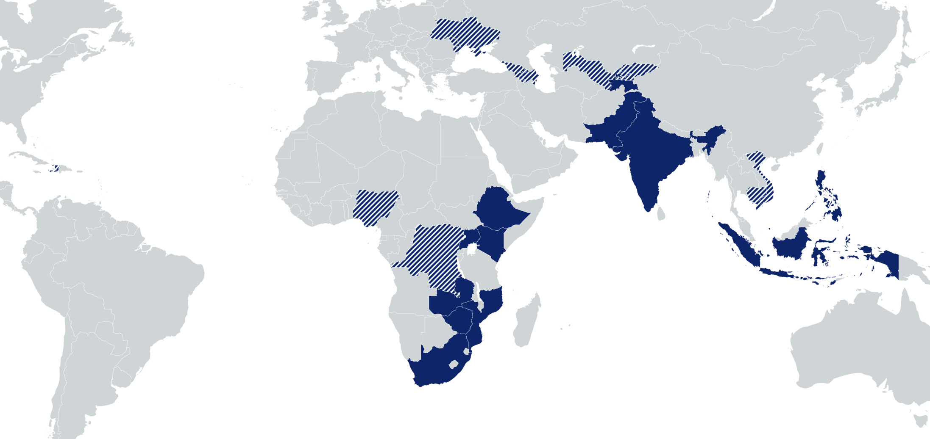
Where does TB DIAH work?
Kyrgyz Republic: Capacity building for NTP for TB surveillance, reporting, and M&E skills ; M&E plan; GHS; QTSA support
Eastern Europe & Eurasia:
Regional Center of Excellence and support to 4 countries; semiannual regional meetings
Uzbekistan: ARC, MESSA, D2AC, Training
Haiti: M&E plan and ARC
Vietnam: QTSA
Nigeria: TB Situation Rooms and APPR analyses; Assessed and improved M&E surveillance; strengthened M&E capacity; NTP website supported
Cambodia: M&E planning and capacity assessment; ARC implementation; research capacity building
DRC: Assessed and improved M&E surveillance; strengthened M&E capacity; QTSA study
USAID TB priority countries
Countries with TB DIAH activities
Notes:
Mission buy in from one region and 6 countries.
The workplans in each country often align with the core workstreams and provide the opportunity to create a focused and country specific approach to strengthen their M&E surveillance activities.
DRC: QTB Services Assessment and an emphasis on data quality and training, and operations research.
Nigeria: TBSR and support to the Mission for the APPR analyses as well as M&E surveillance and support to update data reporting on the NTBLCP website.

Slide 7
TB DIAH Core Activities
Notes:
Focus on several core activities , not all.
Further information : relevant to the workshop.

Slide 8
Performance-Based M&E Framework (PBMEF)
Cornerstone of USAID’s efforts to ensure effective accountability of investments in TB at global, regional, and country levels and accelerate progress to end the TB epidemic.
The PBMEF provides:​
  A set of standardized indicators to measure essential TB program outputs and outcomes​
  Details on the performance of TB programs in specific technical areas (e.g., diagnosis, treatment, TB/HIV, private sector, etc.)​
  Treatment cascades and patient pathways that are critical to understanding where gaps are and where efforts need to be strengthened
Core
Essential List of Indicators
Core Plus
National Level
Project Level
Extended*
Notes:
https://www.tbdiah.org/resource-library/pbmef/
This is the focus of our discussion during this week.

Slide 9
TBDIAH.ORG
Knowledge and Data Hubs

Slide 10
TBDIAH.ORG
Knowledge Hub
Data Hub
TBDIAH.ORG
A curated compilation of thought leadership as a global resource
Online portal with public and secure work areas for data analysis and reporting
A one-stop shop for TB data access, customized analyses, and tools and capacity building for data contextualization and use

Slide 11

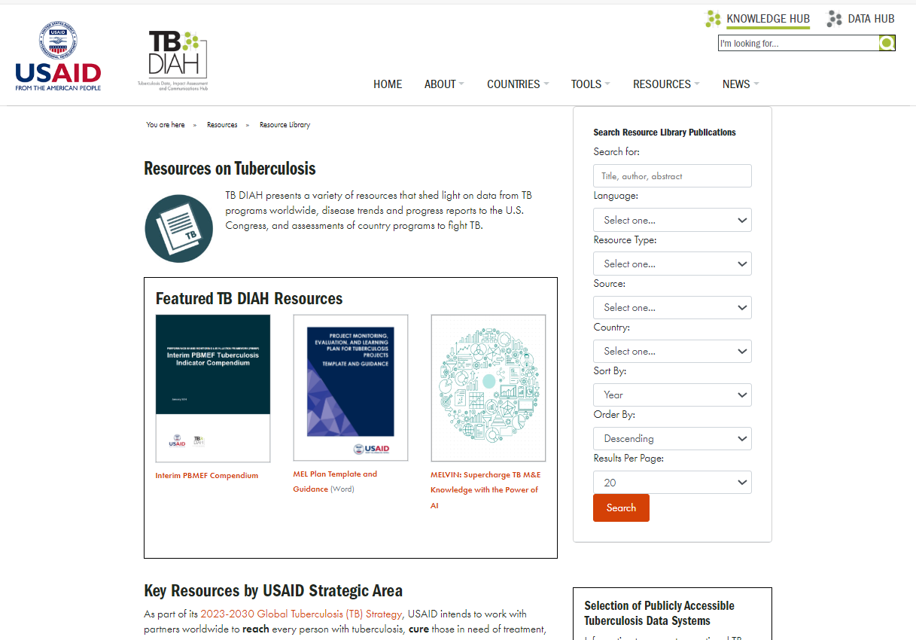
The Knowledge Hub
A collection of the latest surveys and analyses of routine and non-routine information, reporting, guidance, and tools to help TB experts make informed decisions in their design and management of TB programs
https://www.tbdiah.org
11
Notes:
The Learning Hub offers:
Guidance and tools from TB DIAH and other key technical organizations, including the WHO, USAID, and Ministries of Health and National TB Programs
Infographics illustrating key data and technical concepts
Journal and news articles published by TB DIAH, as well as the latest from peer-reviewed and grey literature
Training materials produced by USAID, TB DIAH, Ministries of Health and National TB Programs, and other key technical organizations including the WHO
Reports and briefs based on findings from TB DIAH’s assessments and other works, as well as from key industry organizations

Slide 12
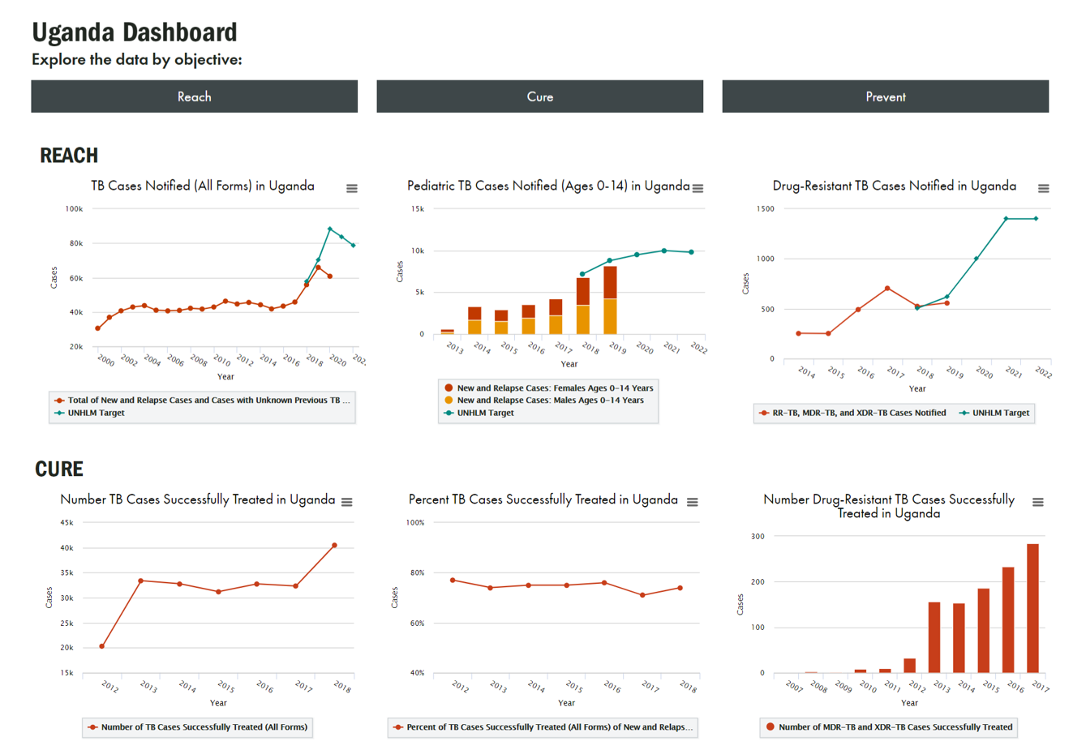
The Data Hub
Online portal for TB program managers, TB technical advisors, and key country stakeholders including National TB Program (NTP) staff to access global and national-level data to support their performance-based management of TB programs.
Offers visualizations of publicly available World Health Organization data as well as a secure, password-protected work areas for USAID TB priority country stakeholders to enter, analyze, and review TB data requested by USAID/Washington.
https://hub.tbdiah.org
Notes:
Online portal for TB program managers, TB technical advisors, and key country stakeholders including National TB Program (NTP) staff to access global and national-level data to support their performance-based management of TB programs.
Offers visualizations of publicly available WHO data as well as a secure, password-protected work area for USAID TB priority country stakeholders to enter, analyze, and review TB data requested by USAID/Washington, such as reporting on prevention

Slide 13
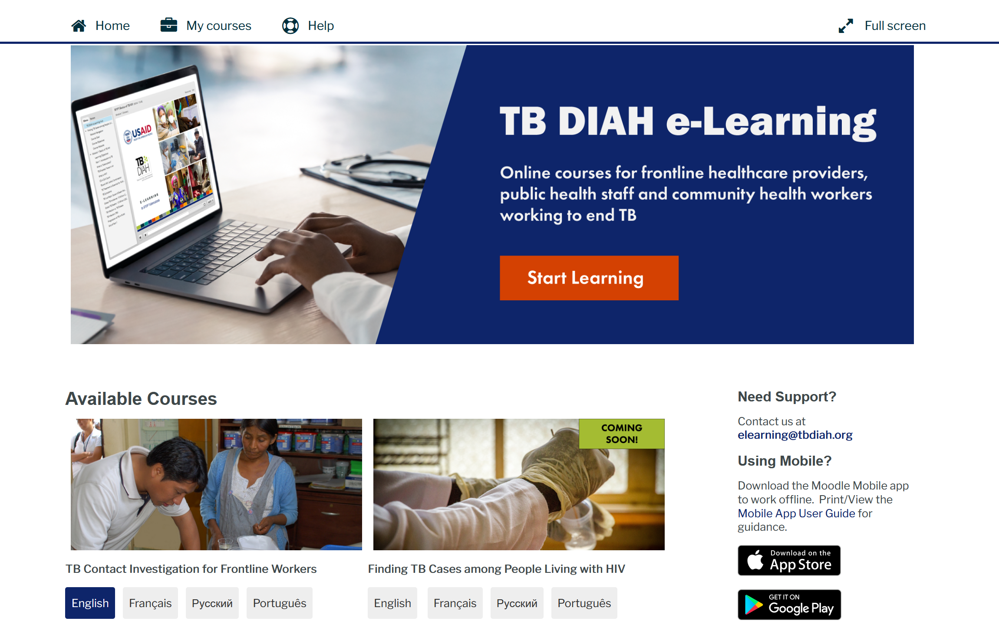
TB e-Learning
A series of interactive and globally accessible online courses for frontline healthcare providers, community health workers, and M&E specialists working to end TB.
Courses will be available in English, French, Russian and Portuguese.
https://training.tbdiah.org/

Slide 14
TB Contact Investigation (TBCI) for Frontline Workers e-Learning Course
Target Audience:
Frontline healthcare providers, public health staff, and community health workers
Course Goal:
Provide essential information to enable TBCI program implementation on the ground level, including conducting effective interviews, referring contacts of those with TB for screening, testing and treatment, and recording and reporting indicators
Available in:
English
Français
Português
Русский

Slide 15





TBCI for FLW: Course Content
Navigation Guides provide learners with step-by-step guidance for taking the course on a computer or a mobile device
Pre-test assesses what learners already know about the topics covered in the course
1
The Basics of TB (3 Parts) 40 minutes
Basics of TB Contact Investigations (2 Parts) 45 minutes
Steps in TB Contact Investigation (2 parts) 50 minutes
Communication Skills and Ethics (2 parts) 45 minutes
TBCI Data, Monitoring and Evaluation 25 minutes
2
3
4
5
Post-test is available once a learner has completed all five modules. The passing grade is 80%.
A learner may retake the test if they do not pass.
Course evaluation is available to learners who pass the post-test
Certificate of Completion may be downloaded and printed once a learner passes the post-test and completes the course evaluation

Slide 16

TBCI for FLW: Course Objectives
Explain what tuberculosis (TB) is and its global prevalence
Distinguish between TB infection and TB disease
Discuss how TB is transmitted, diagnosed, and treated
Define TBCI and its role in TB eradication
Describe the steps of the TBCI process
Discuss needed communication skills for TB contact investigators
Discuss ethical issues relevant to TB contact investigations
Explain the collection and use of data for monitoring and evaluation (M&E) of TBCI programs

Slide 17
Finding TB Cases among People Living with HIV (PLHIV)
Target Audience:
Frontline healthcare providers, public health staff, and community health workers
Course Goal:
Provide essential information needed by frontline healthcare providers, public health staff, and community health workers in TB priority countries to provide and scale up TB screening and diagnostic activities among PLHIV
Available in:
English
Français
Português
Русский

Slide 18
TB/HIV: Course Content
Navigation Guides providing step-by-step guidance for taking the course on a computer or a mobile device
Pre-test assesses what learners already know about the topics covered in the course
1
Basics of Tuberculosis, including among PLHIV (3 parts) 40 minutes
TB Screening and Diagnosis among PLHIV (3 Parts) 70 minutes
Integrating TB Service Provision into ART Service Models (2 parts) 37 minutes
Diagnostic Data Recording, Monitoring, and Evaluation (2 parts) 35 minutes
Program Management Basics for TB among PLHIV (2 parts, supplemental) 40 minutes
2
3
4
5
Post-test is available once a learner has completed all five modules. The passing grade is 80%.
A learner may retake the test if they do not pass.
Course evaluation is available to learners who pass the post-test
Certificate of Completion may be downloaded and printed once a learner passes the post-test and completes the course evaluation

Slide 19
TB/HIV: Course Objectives
Explain what TB is and its global prevalence
Discuss TB/HIV co-infection and why it is essential to identify TB cases among PLHIV
List and describe tools and instruments for TB screening, testing, and diagnosis, especially for PLHIV
Explain TB preventive treatment for TB infection and curative treatment
for TB disease
List benefits of integrating TB case finding within decentralized
HIV health care services
Define M&E principles and concepts for TB and HIV programs,
and for TB cases among PLHIV
Discuss importance of recording and reporting data, maintaining data quality, and using M&E data in TB/HIV programs
Explain key program management principles for TB/HIV programs.

Slide 20
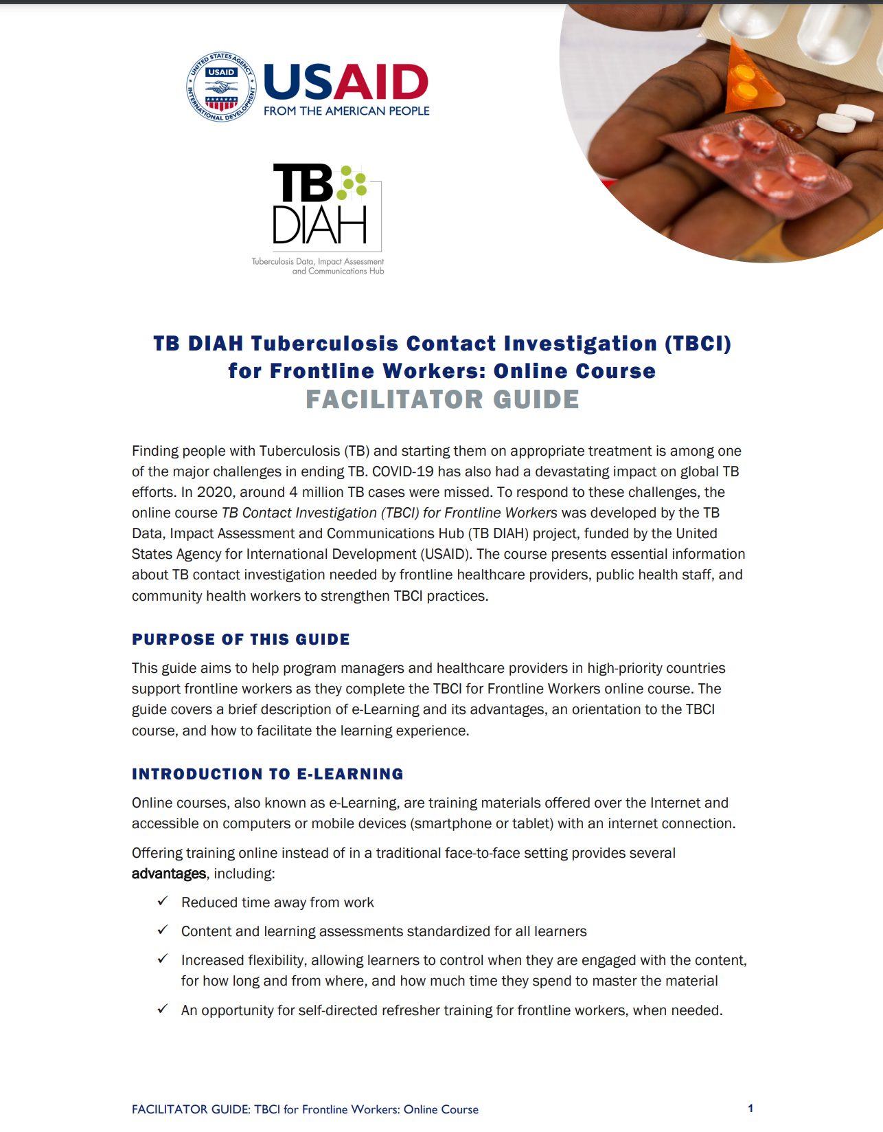
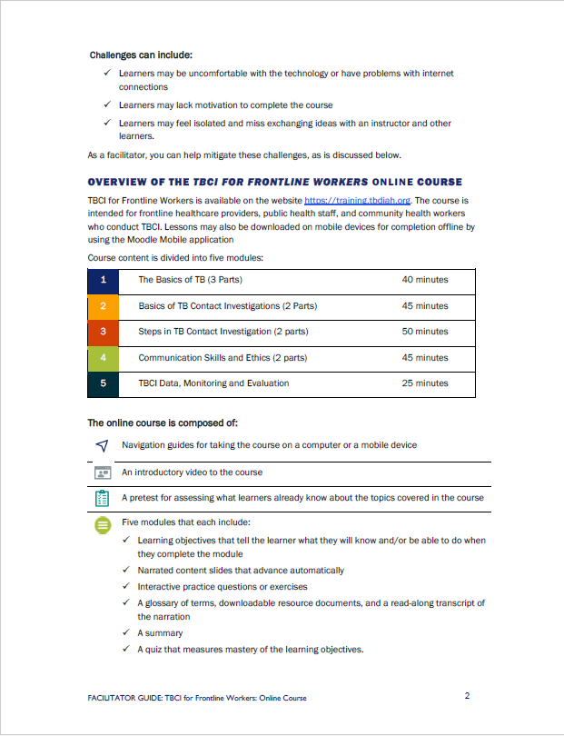
Facilitator’s Guide
Available to help program managers and healthcare providers support to frontline workers as they complete the TBCI
e-learning courses.
The guide covers a brief description of e-learning and its advantages, an orientation to the TBCI courses, and how to facilitate the learning experience.
Download Guide at:
https://tbdiah.github.io/learning/TBCI-Facilitator-Guide.pdf

Slide 21
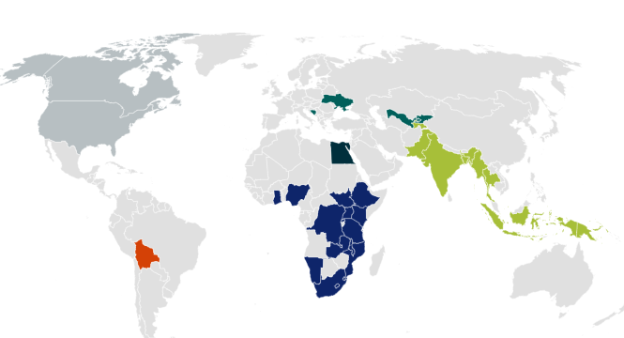


TBCI for FLW : Course Statistics (2024)
GLOBAL REACH
Learners came from over 33 countries around the world
COURSE PARTICIPATION
1,326 total learners
enrolled in the TBCI course
English: 1072
Portuguese: 87
French: 80
Russian: 88
527total learners
received a course certificate
Top 10 countries with the most course participation
1 | Nigeria | 6 | Bangladesh
2 | Mozambique | 7 | Tanzania
3 | Tajikistan | 8 | Lesotho
4 | DRC | 9 | Kenya
5 | Uganda | 10 | Malawi
KNOWLEDGE GAINED
88%
AVERAGE
POST-TEST SCORE
COURSE FEEDBACK
AVERAGE
PRE-TEST SCORE
Over 95% of learners agreed or strongly agreed that: “The online course was an effective way for me to learn this content and was a worthwhile investment of my time.”
51%
+37%
knowledge increase

Slide 22
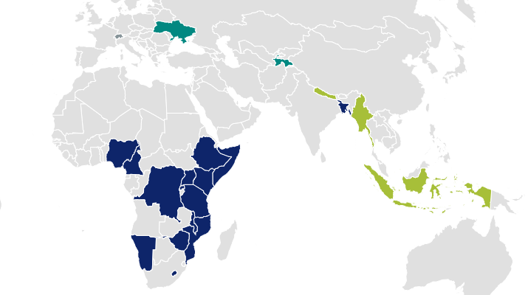
Finding TB among PLHIV : Course Statistics (2024)
GLOBAL REACH
Learners came from 22 countries around the world
Course launched in June 2023
COURSE PARTICIPATION
187 learners
enrolled in the TB/HIV course
41 total learners
received a course certificate
Top 10 countries with the most course participation
KNOWLEDGE GAINED
1 | Nigeria | 6 | Tajikistan
2 | Kenya | 7 | Indonesia
3 | Tanzania | 8 | Uganda
4 | DRC | 9 | Myanmar
5 | Cameroon | 10 | Malawi
92%
AVERAGE
POST-TEST SCORE
AVERAGE
PRE-TEST SCORE
44%
+48%
knowledge increase
COURSE FEEDBACK
Over 95% of learners agreed or strongly agreed that: “The online course was an effective way for me to learn this content and was a worthwhile investment of my time.”

Slide 23
New e-Learning Courses Coming Soon
TB Contact Investigation for Program Managers
TB M&E: Using the PBMEF to Strengthen TB Programs
English coming in April 2024…
English coming soon…

Slide 24
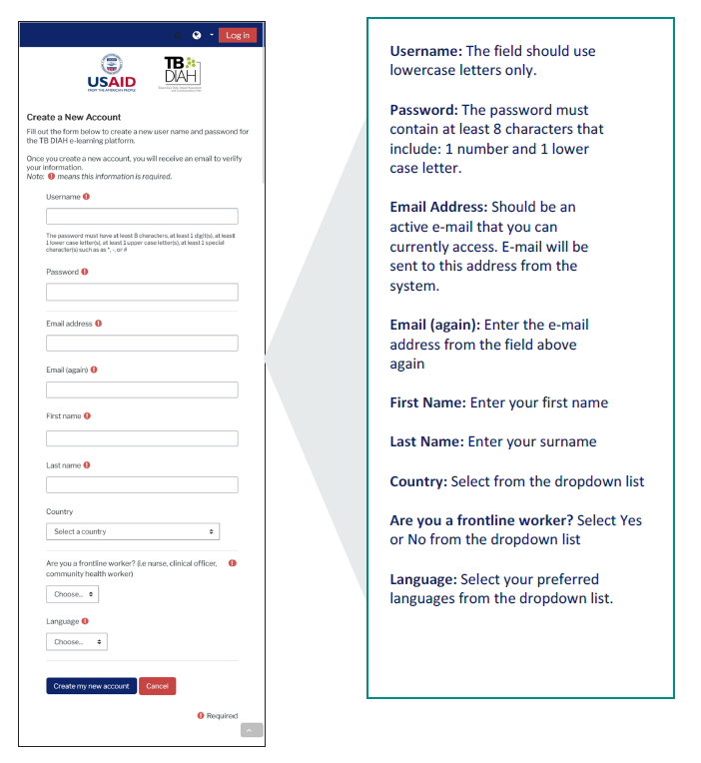
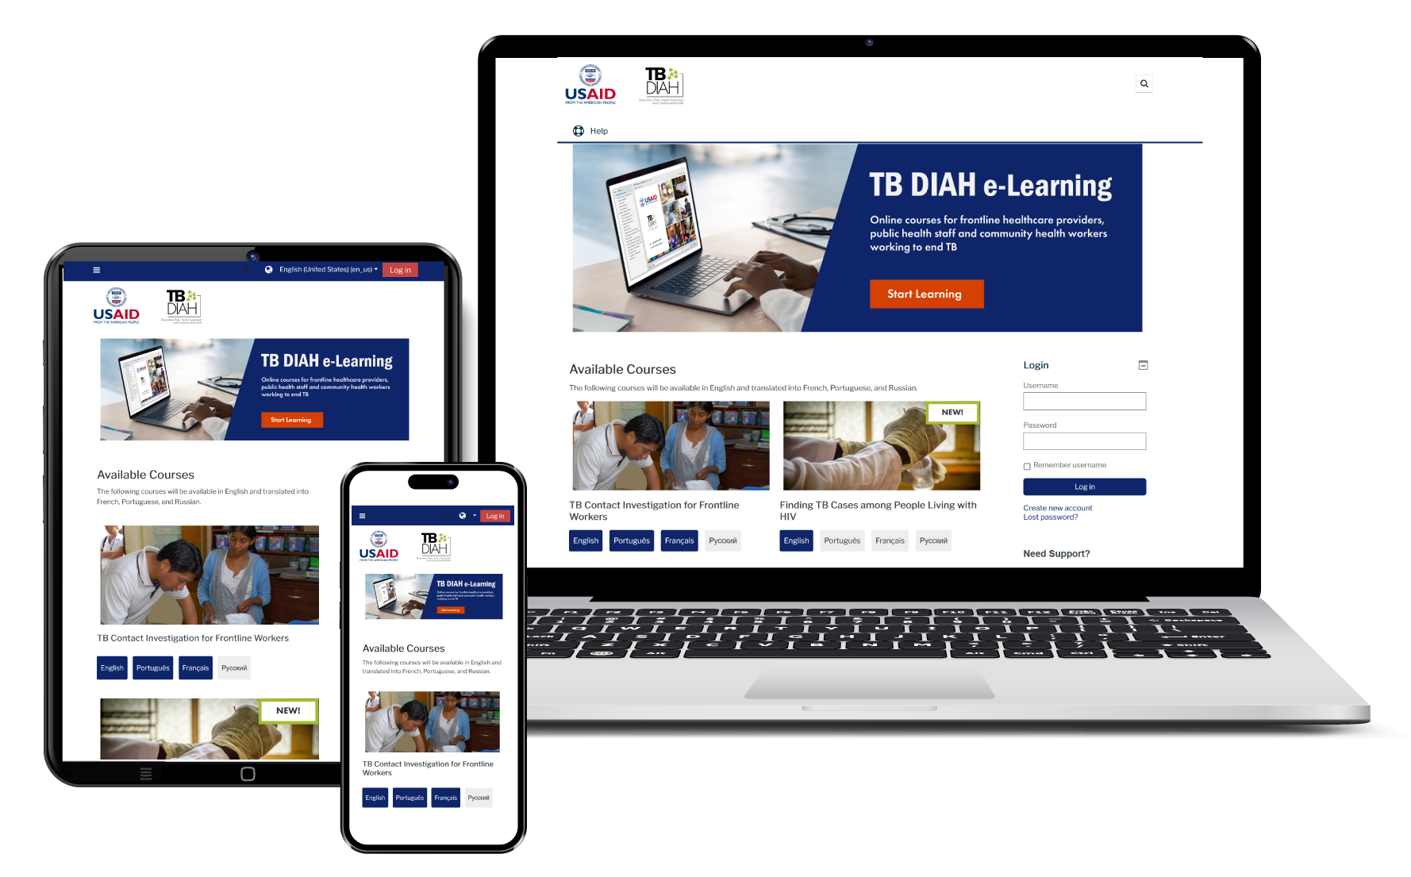
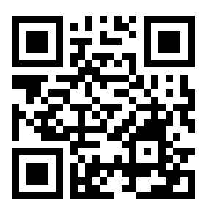



https://training.tbdiah.org/
How to Access Courses:
Access on your laptop, tablet, or phone

Slide 25
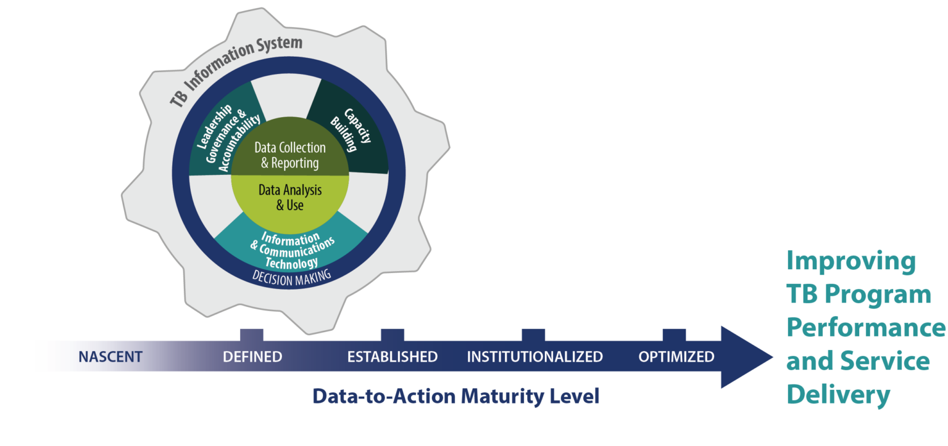
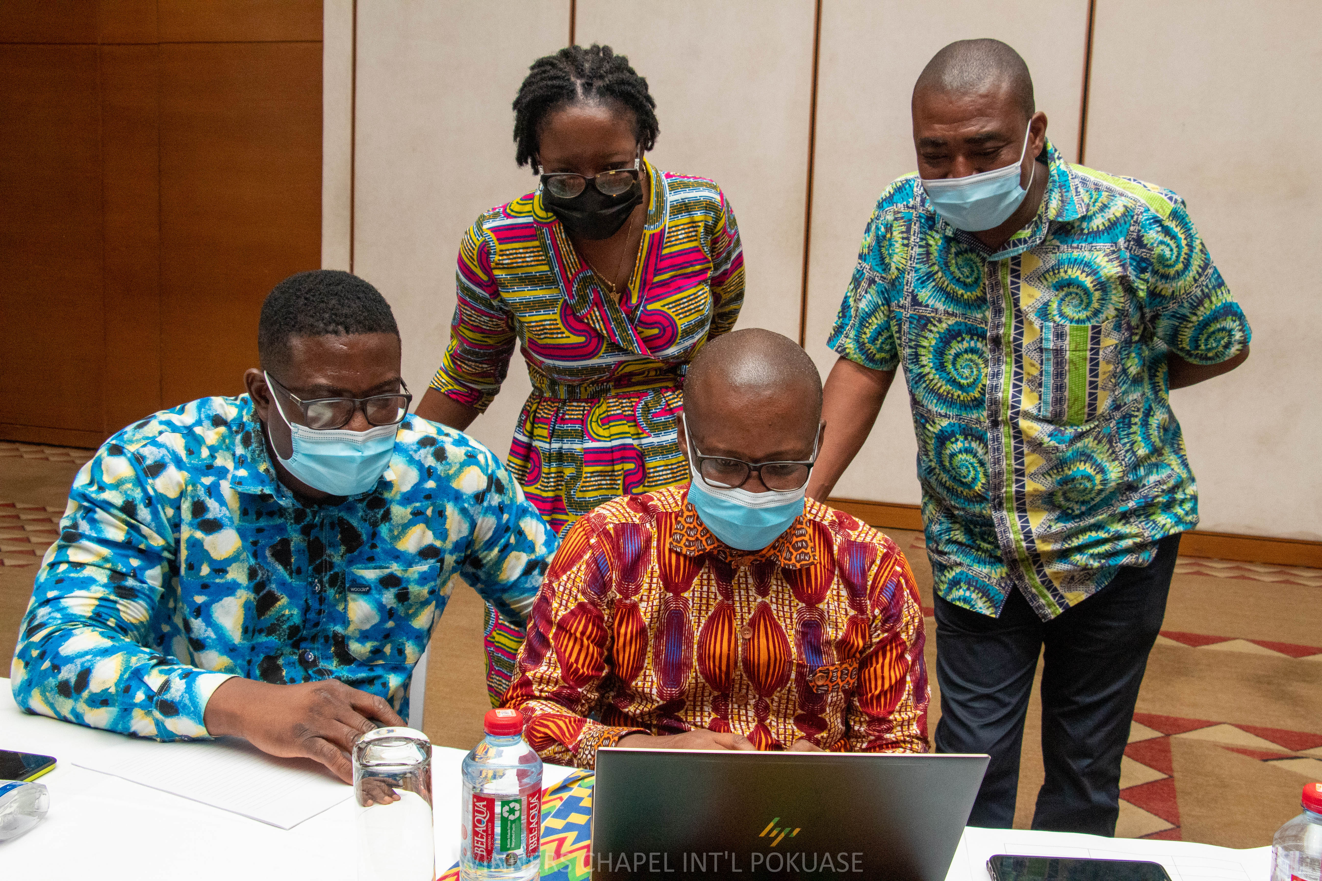
Data-to-Action Continuum (D2AC) Tool
Measuring the progress of countries as they work toward improved use of TB data for programmatic decision making
Notes:
https://www.tbdiah.org/assessments/d2ac
Maturity model
Digital format that countries can pick and use directly
Tested in Ghana and Nigeria, applied in Kyrgyz Republic and Bangladesh
Uses domains, individual and group evaluations

Slide 26
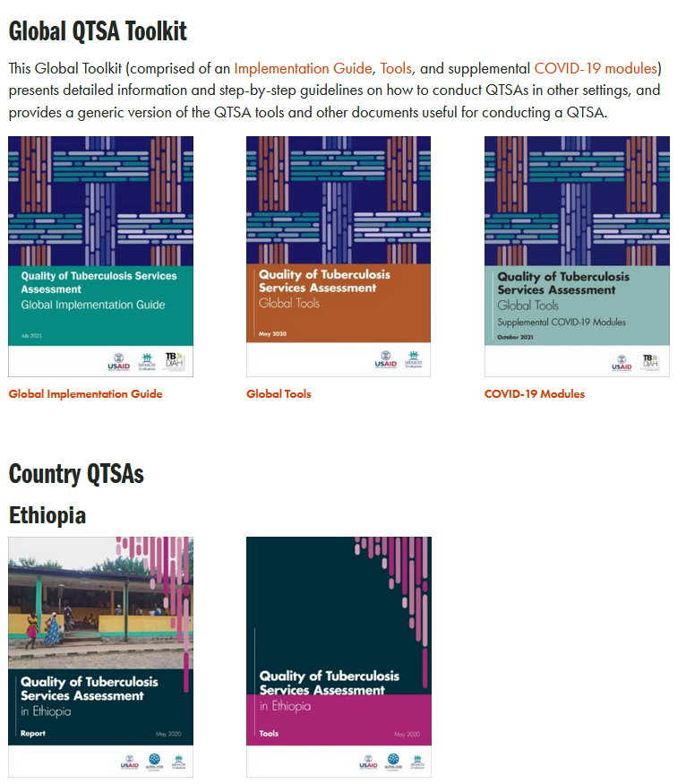
Quality of TB Services Assessment (QTSA)
A comprehensive health facility assessment to identify where services are of high quality, where there are gaps, and ensure that TB patients receive high-quality care.
Employs facility audits, extraction of TB data from facility-based registers and records, interviews with TB service providers, and interviews with TB patients
Informs NTPs, USAID Missions, and other stakeholders of the current state of quality of TB care and strategic investments and actions for improvement
Completed or ongoing QTSAs: Afghanistan, DRC, Ethiopia, Kyrgyzstan, Nigeria, Philippines, Uganda, and Vietnam
Notes:
https://www.tbdiah.org/assessments/quality-of-tuberculosis-services-assessments/
QTSAs have been conducted in Nigeria, Ethiopia, Uganda, and most recently DRC.

Slide 27
COE
Center of Excellence https://coe.tbdiah.org/
Notes:
Use this slide as a divider slide if presenting the COE as part of a larger presentation.
If presenting the COE as a stand-alone topic, delete this slide and start with slide 1.

Slide 28





TB DIAH in Eastern Europe and Eurasia (EEE)
The COE is the hub for TB DIAH support in the EEE region to ensure synergy, sustainability, and effective use of resources.
TB DIAH's approach in the region builds upon the COE model as a means of providing technical assistance to five EEE priority countries that USAID provides bilateral and regional TB support to:
Armenia
Georgia
Ukraine
Azerbaijan
Moldova

Slide 29
COE Concept
What is the COE?
Virtual COE in TB M&E that was established in the Republic of Georgia in 2022
Team of dedicated TB M&E individuals managed from a common central point
  Leads the way in exploring and adopting new approaches, technologies, tools, techniques, or practices
What is the goal of the COE?
To establish a COE in the EEE region to serve as a model for best practices in TB M&E and surveillance and to strengthen the TB M&E system in the COE host country to:
  Document successful practices and experiences addressing identified areas for improvement
  Promote intercountry collaboration
  Foster cross-fertilization of knowledge
Notes:
Working under the country engagement workstream, TB DIAH has established a COE to contribute to TB monitoring and evaluation (M&E) research, dissemination, expertise, and teaching in the EEE region.

Slide 30
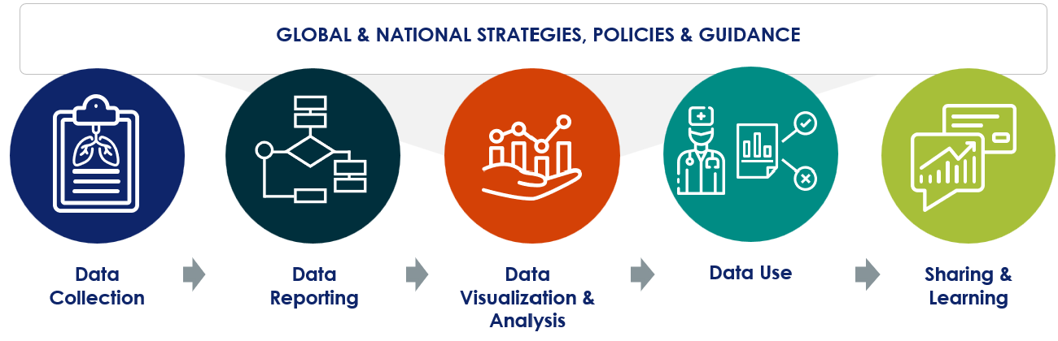
COE Functions
The COE team functions as follows:
Documents best practices with TB data collection, reporting, visualization, analysis, and use
Engages NTPs with necessary support and assistance
Develops tools and templates as well as reports and publications
Organizes regional workshops for networking, experience sharing, and learning
Conducts trainings on TB M&E and surveillance
Established a COE virtual platform

Slide 31

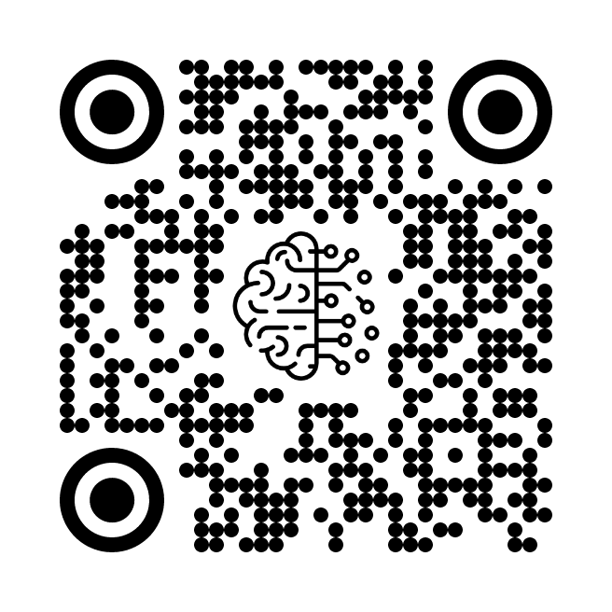
Key Feature of the COE Website
MELVIN is a conversational AI chatbot aimed at expanding Monitoring and Evaluation knowledge and enhancing Learning experiences in the field of TB. It’s our Vision to harness the power of emerging technology to navigate professionals toward relevant resources and Information.
ASK MELVIN: https://melvintb.ai/
MELVINTB.AI
Notes:
Customized Training Objective: Unlike generic public models, MELVIN has a specific training objective tailored for TB expertise.
Controlled Behavior: MELVIN offers more controlled behavior due to its customized nature
Quality Control: MELVIN's training data and process are carefully overseen, ensuring the delivery of high-quality and accurate TB-context responses.
Feedback Loop Integration: MELVIN is designed with integrated feedback mechanisms. This feature enables it to continuously refine its responses, ensuring that it stays updated.
Dynamic Adaptation: MELVIN is adaptive and isn't static in its knowledge base. It has the potential to be periodically updated and retrained.

Slide 32
Asante Sana!
Photo by Emmanuel Owusu, at the TB DIAH D2AC workshop, Ghana, 2022
Notes:
We look forward to learning from each and everyone of you, over the next few days about how the PBMEF is used or could be applied in your settings, your questions, as well as your feedback on the TB DIAH tools and your experiences using these tools to support TB M&E and Surveillance in your country.
Asante sana!
Photo by Emmanuel Owusu, at the TB DIAH D2AC workshop, Ghana, 2022

Slide 33
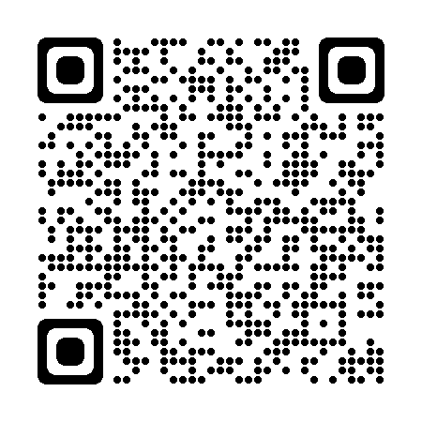

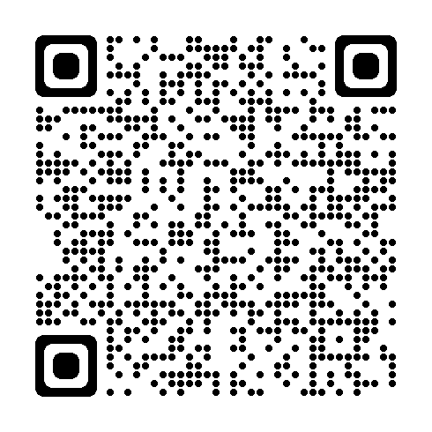
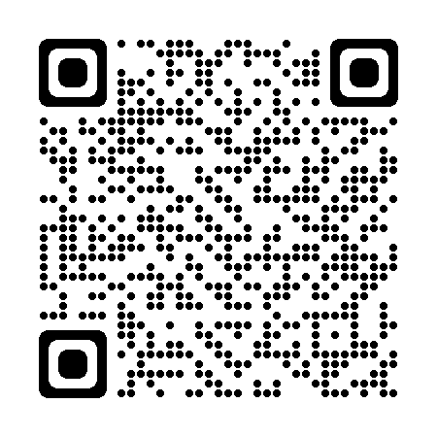
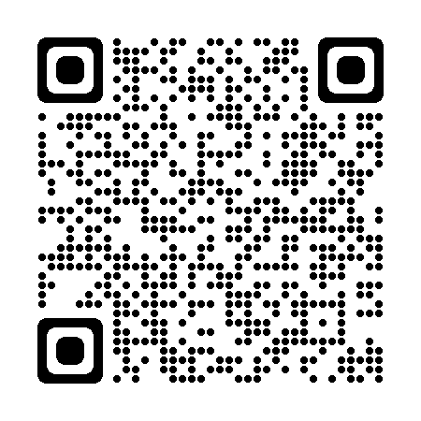
Key Links
TBDIAH.org
http://www.tbdiah.org
https://www.tbdiah.org/resources/publications/navigating-tuberculosis-indicators-a-guide-for-tb-programs/
PBMEF
E-Learning
https://training.tbdiah.org/
Data Analysis & Visualizations
http://hub.tbdiah.org

Slide 34

For more information
Sevim Ahmedov
TB/HIV, Prevention and M&E Team Lead
AOR TB DIAH
sahmedov@usaid.gov

Slide 35
Boilerplate

Slide 36
Country Engagement Activities
Country | Principle Workstreams
Afghanistan | QTSA conducted and completed. Data has been shared for future planning.
Cambodia | Strengthen the TB M&E and Surveillance systems: support implementation of Cambodia’s TB M&E plan, Support DQR process at national and subnational levels, training and TB M& e-Learning modules Strengthen research capacity: through situation analysis report, TB Research Guidelines and protocol , TB research capacity building training (5 modules) Developed 2 working manuscripts and support to CENAT research unit.
DRC | QTSA Harmonize TB M&E surveillance system; ARC assessment; facilitate data review meetings Strengthen M&E capacity; conduct TOTs in TB surveillance; support provincial step-down trainings Operations research agenda and implementation of 2 OP research exercises
Nigeria | Assessment of current TB M&E surveillance system conducted with the NTP Support routine operations and maintenance of TBSR in 5 states and 1 national TBSR; Strengthen M&E capacity through mentoring Support and Strengthen TB IP’s reporting and monitoring system to promote data use
Kyrgyz Republic | Support NTP to strengthen the TB Surveillance system – finalize TB M&E guidelines, Support the new Dept of strategic development; develops rayon level dashboards for all 9 oblast rayon level staff; Build capacity to report and use country ad PBMEF core TB indicators
Eastern Europe/ Eurasia regional office | Support and streamline functioning of the EEE regional Center of Excellence Synthesize the finding of the regional M&E and Surveillance system assessments. Strengthen TB M&E Surveillance systems through regional M&E curriculum; Support Georgia’s M&E plan development 2024 Regional Conference on TB data reporting, analysis and use

