Slide 1
Setting the scene: overview of epidemiological reviews and strengthening surveillance
Marek Lalli

Slide 2
Background

Slide 3
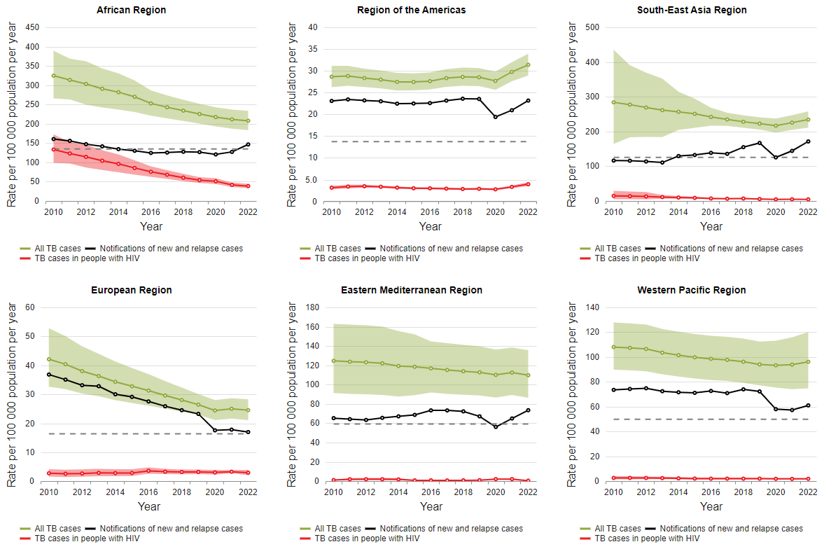
Background
A major goal of TB surveillance is to provide an accurate measure of the number of new episodes of TB (and related deaths) that occur over a given time period in a specified population, and to monitor these trends over time.
Fig. 1.1.7 Trends in estimated TB incidence rates by WHO region, 2010–2022
The overall TB incidence rate is shown in green
The incidence rate among people living with HIV is shown in red.
The black solid lines show case notifications of people newly diagnosed with TB, for comparison with estimates of the overall incidence rate.
Shaded areas represent 95% uncertainty intervals.
The horizontal dashed line shows the 2025 milestone of the End TB Strategy
Notes:
The series of graphs show a comparison between TB case notifications and estimated TB incidence the six WHO regions.
The black line shows the trend in new and relapse TB case notifications and the green line shows the trend in estimated TB incidence (burden).
We can consistently see across all WHO regions and globally that there is a gap between the trend in notifications and estimated incidence.
It is important to note that it is not feasible to measure TB incidence in a population through an epidemiological survey.
Therefore, the goal is to be able to rely on TB notification data as an accurate proxy for measuring TB burden (in the form of incidence) and provide a comprehensive assessment of how the burden is changing over time, by geography and by specific populations.
In order for us to reliably use our TB surveillance data for this purpose, the TB surveillance system needs to have high coverage and quality. Such a system, will also provide more accurate insight on the impact of TB response activities on the epidemic as well as better information for guiding further programmatic action.

Slide 4
Background
Notified cases of TB are our “window” to the TB epidemic in the country.
Total country population: 1,000,000
This is a hypothetical example to demonstrate the importance of a reliable surveillance system.
In this example, let’s take a hypothetical country with a population of 1,000,000 people.

Slide 5
Background
Notified cases of TB are our “window” to the TB epidemic in the country.
Total country population: 1,000,000
This is a hypothetical example to demonstrate the importance of a reliable surveillance system.
In this example, let’s take a hypothetical country with a population of 1,000,000 people.
In one year, 200 TB cases were notified.
200 cases notified

Slide 6
Background
Notified cases of TB are our “window” to the TB epidemic in the country.
Total country population: 1,000,000
This is a hypothetical example to demonstrate the importance of a reliable surveillance system.
In this example, let’s take a hypothetical country with a population of 1,000,000 people.
In one year, 200 TB cases were notified.
In the same year, 500 people were diagnosed with TB.
300 people were diagnosed but not notified (under-reporting)
500 people were diagnosed
200 cases notified

Slide 7
Background
Notified cases of TB are our “window” to the TB epidemic in the country.
Total country population: 1,000,000
This is a hypothetical example to demonstrate the importance of a reliable surveillance system.
In this example, let’s take a hypothetical country with a population of 1,000,000 people.
In one year, 200 TB cases were notified.
In the same year, 500 people were diagnosed with TB.
300 people were diagnosed but not notified (under-reporting)
However, there were actually 600 people who developed TB.
100 people with TB were not diagnosed (under-diagnosis)
600 people develop TB in one year
500 people were diagnosed
200 cases notified

Slide 8
Background
Notified cases of TB are our “window” to the TB epidemic in the country.
Total country population: 1,000,000
This is a hypothetical example to demonstrate the importance of a reliable surveillance system.
In this example, let’s take a hypothetical country with a population of 1,000,000 people.
In one year, 200 TB cases were notified.
In the same year, 500 people were diagnosed with TB.
300 people were diagnosed but not notified (under-reporting)
However, there were actually 600 people who developed TB.
100 people with TB were not diagnosed (under-diagnosis)
The surveillance system is “blind” to the
under-reported and under-diagnosed TB cases.
600 people develop TB in one year
500 people were diagnosed
200 cases notified

Slide 9
Background
Notified cases of TB are our “window” to the TB epidemic in the country.
Total country population: 1,000,000
We want to close the gap in under-reporting by improving data recording and reporting practices.
This will help us understand the TB epidemic better and use these data for programmatic action.
600 people develop TB in one year
500 people were diagnosed
200 cases notified

Slide 10
Background
Notified cases of TB are our “window” to the TB epidemic in the country.
Total country population: 1,000,000
We want to close the gap in under-reporting by improving data recording and reporting practices.
This will help us understand the TB epidemic better and use these data for programmatic action.
Now the surveillance system is capturing all the cases that were diagnosed in the country, but it’s still not providing a direct measurement of TB burden (incidence), because of the under-diagnosis.
600 people develop TB in one year
500 people were diagnosed
500 cases notified

Slide 11
Background
Notified cases of TB are our “window” to the TB epidemic in the country.
Total country population: 1,000,000
We want to close the gap in under-reporting by improving data recording and reporting practices.
This will help us understand the TB epidemic better and use these data for programmatic action.
We want to close the gap in under-diagnosis by improving the access to and coverage of TB diagnostic and treatment services.
600 people develop TB in one year
500 people were diagnosed
500 cases notified

Slide 12
Background
Notified cases of TB are our “window” to the TB epidemic in the country.
Total country population: 1,000,000
When we close the gap in under-reporting and under-diagnosis we can now say that the surveillance system has high coverage.
If the data collected are also of high quality, then we can say that the surveillance data are reliable:
The surveillance system is accurately measuring TB incidence.
Our notification data are able to accurately reflect changes in TB epidemiology.
We are able to track the impact of programmatic actions on the epidemic more effectively.
600 people develop TB in one year
600 people were diagnosed
600 cases notified

Slide 13
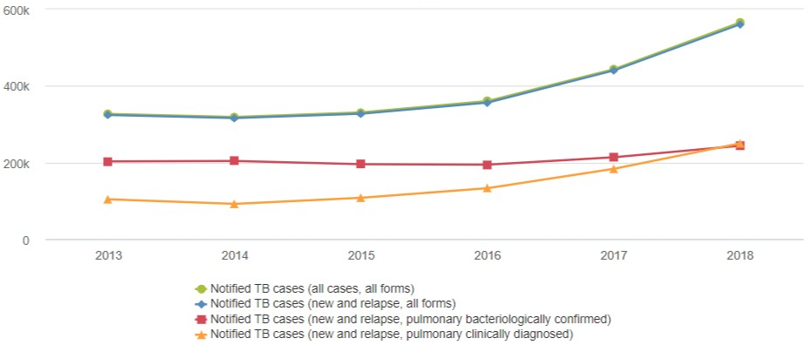
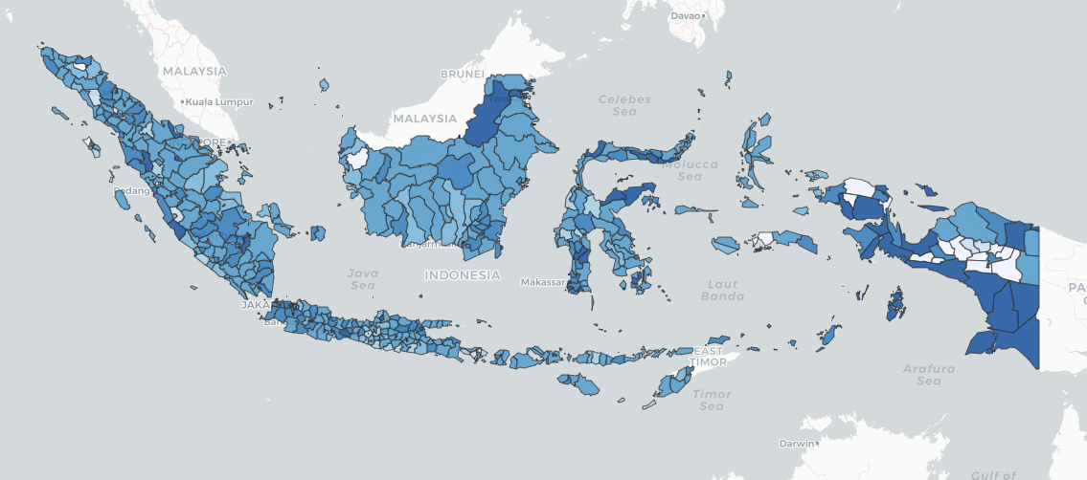
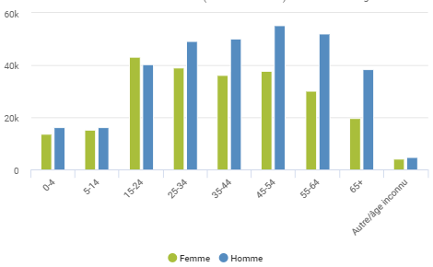
Background
Power of reliable TB surveillance data
Reliable TB surveillance data should be routinely used to monitor TB trends over time, by geography and for specific populations at risk to inform TB care and prevention activities, guide resource allocation and track progress made.
Time:
Number of TB notifications
2013-2018
Geography:
TB notification rate in 2018
by district
Populations:
Number of TB notifications in 2018
by age and sex
Informed decisions on TB prevention and care activities as well as resource allocation for impact.

Slide 14
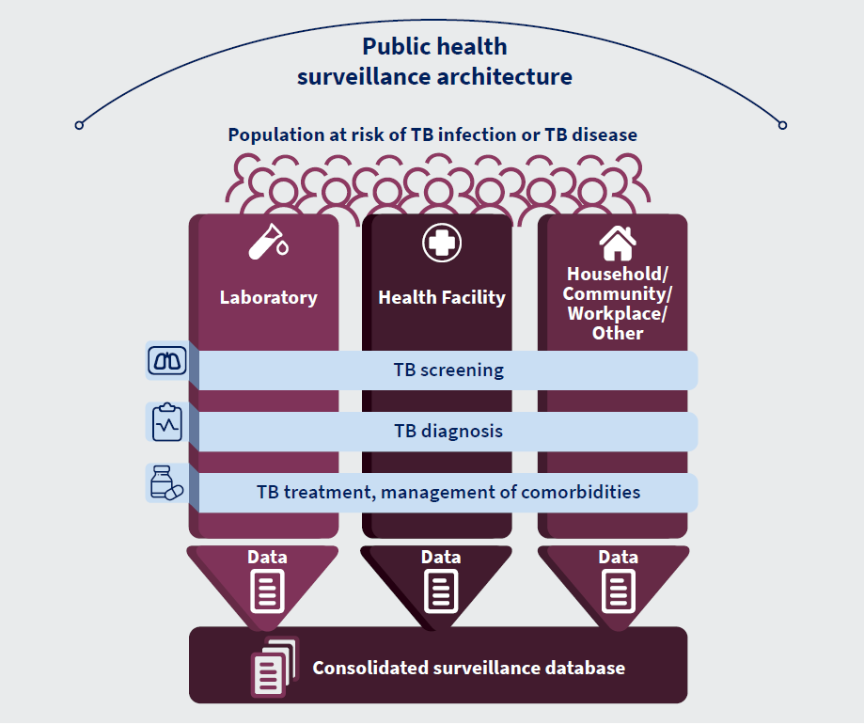
Background
Vision: unified, digital, case-based environment for TB surveillance.
Capturing, analysing and using data along the whole pathway of TB prevention and care.
Consolidation of data sources, avoiding fragmentation of information systems & project-based solutions.
Promoting integration with overall HIS plans.

Slide 15
Global monitoring of the TB epidemic

Slide 16
Global TB Report: data collection
TME focal point: Hazim Timimi, Katherine Floyd
Member states submit aggregate data annually onto the TME data collection platform (April/May)
Data collected for the following areas:
Diagnosis and treatment
Surveys and services
Finance
Data are reviewed by GTB colleagues and comments or questions are provided to the country when inconsistency is detected (May/June).
Burden estimates are generated and reviewed by TME colleagues.
Burden estimates and draft country profiles are reviewed by countries.
Data analysis and report writing.
Publication of Global TB Report and mobile app (mid-October).
New since 2020:
Member states requested to submit provisional number of new and relapse TB cases notified to health authorities by month or quarter.

Slide 17
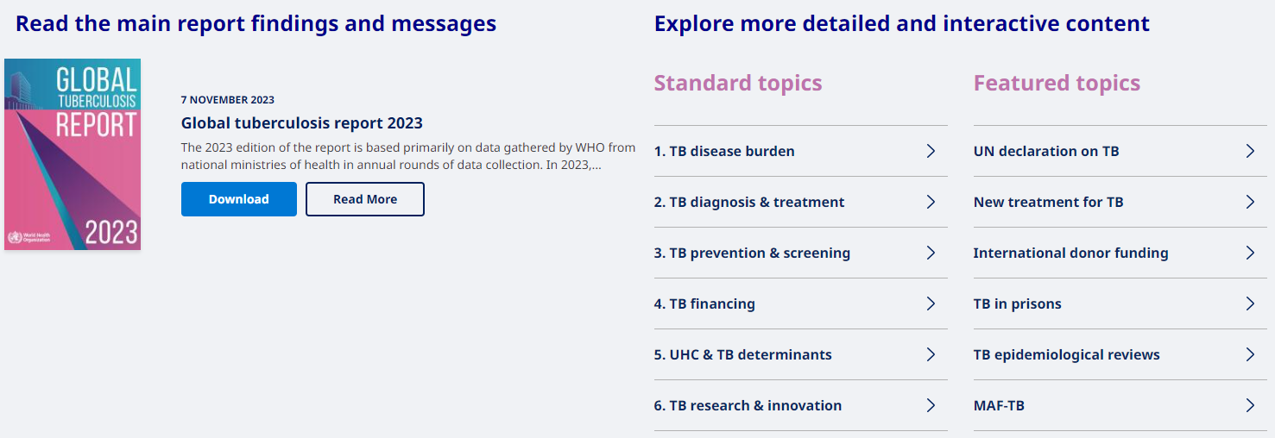
Global TB Report: digital publication
https://www.who.int/teams/global-tuberculosis-programme/tb-reports/global-tuberculosis-report-2023

Slide 18
Global TB Report: mobile application
Key features:
Summary of key messages & update on progress towards targets.
Visualise data for national, regional, global levels.
Customise country groups and calculate values for key indicators.
Compare countries/regions.
Works offline.
Available in English, French, Russian and Spanish (switch between languages)

Slide 19
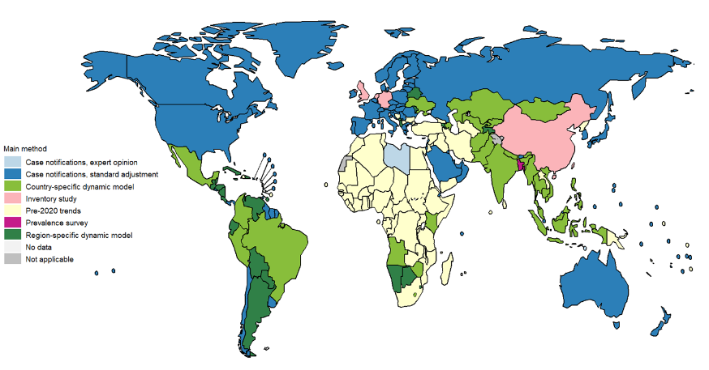
Global TB Report: burden estimates (incidence)
Summary of methods 2020-2023:
Results from prevalence survey or inventory study.
Case notifications with standard adjustment accounting for under-reporting, under/over-diagnosis.
Case notification data with expert opinion about case-detection gaps.
Dynamic modelling (country-level or region-level)
Link to incidence page for 2023 GTB Report Link to technical appendix
Burden estimation methods rely on assumptions where needed (e.g. case detection gaps, model parameterisation).
Degree of uncertainty around the estimates
Methods are not perfect, but it is the best we have at the moment.
Notes:
TME is responsible for estimating TB incidence and mortality at national, regional and global levels.

Slide 20
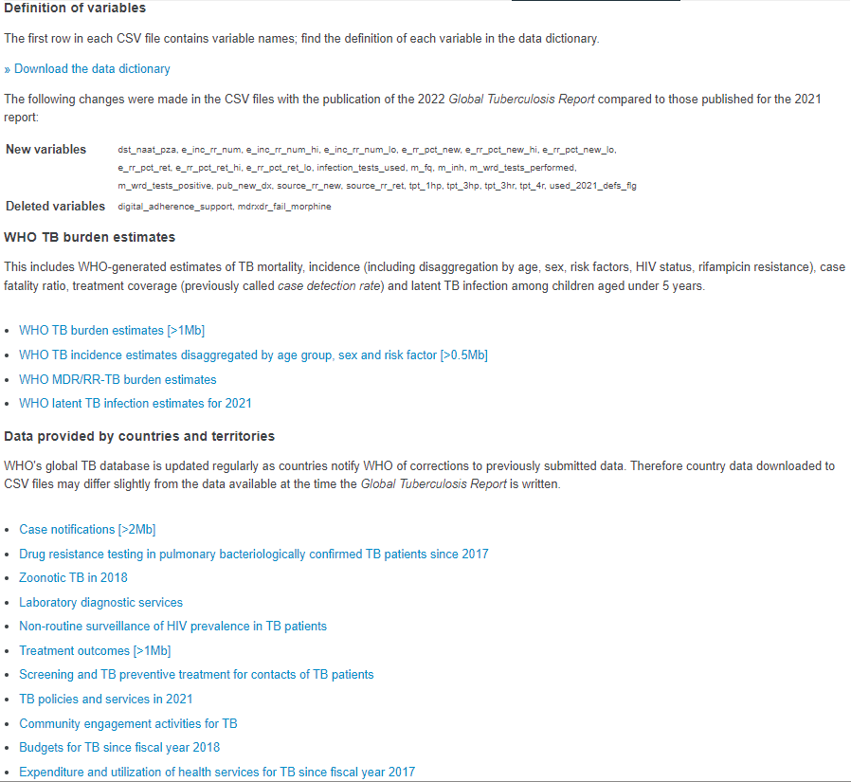
Global TB Report: WHO global TB database
TME focal point: Hazim Timimi
CSV files of data are available for download: https://www.who.int/teams/global-tuberculosis-programme/data
Data dictionary, with updates to variables highlighted.
Datasets for WHO TB burden estimates.
Datasets for data which were reported by member states.

Slide 21
Strengthening routine TB surveillance

Slide 22
WHO Task Force of TB Impact Measurement
(Est. 2006)
Secretariat WHO Global TB Programme, TB Monitoring, Evaluation and Strategic Information Unit
https://www.who.int/groups/global-task-force-on-tb-impact-measurement
National TB Programmes of many countries
& key technical and funding agencies

Slide 23
WHO Task Force of TB Impact Measurement
Strategic areas of work:
Strengthen national notification systems for direct measurement of TB cases, including drug-resistance and HIV-associated TB.
Strengthen national vital registration systems for direct measurement of TB deaths.
Periodically measure TB disease burden, through priority studies.
Periodic review of methods used by WHO to estimate the burden of TB disease and latent TB infection.
Analysis and use of TB data at country level, including:
Disaggregated analyses (e.g. age, sex, location) to assess inequalities and equity.
Guidance and tools.
Capacity building.

Slide 24
WHO Task Force of TB Impact Measurement
Strategic areas of work:
Strengthen national notification systems for direct measurement of TB cases, including drug-resistance and HIV-associated TB.
Strengthen national vital registration systems for direct measurement of TB deaths.
Periodically measure TB disease burden, through priority studies.
Periodic review of methods used by WHO to estimate the burden of TB disease and latent TB infection.
Analysis and use of TB data at country level, including:
Disaggregated analyses (e.g. age, sex, location) to assess inequalities and equity.
Guidance and tools.
Capacity building.

Slide 25
Epidemiological reviews
Country-level systematic and standardised assessment of a country’s TB surveillance system, M&E activities and TB epidemiological situation.
Activity based of standardised ToR and implementation process
https://www.who.int/publications/i/item/9789240085817

Slide 26
Epidemiological reviews
Reviews are undertaken for the entire system from the central to theoperational level:
Understand TB epidemiological situation and how this is changing with programmatic and external factors
Understand how well the system is reflecting burden of TB
Understand best practices carried out in the country
Identify gaps in surveillance, M&E and data use
Identify gaps in programmatic activities
Understand how to better strengthen surveillance, M&E, data use (further investigation of root causes or intervention)
Set of global resources are available to support the activity:

Slide 27
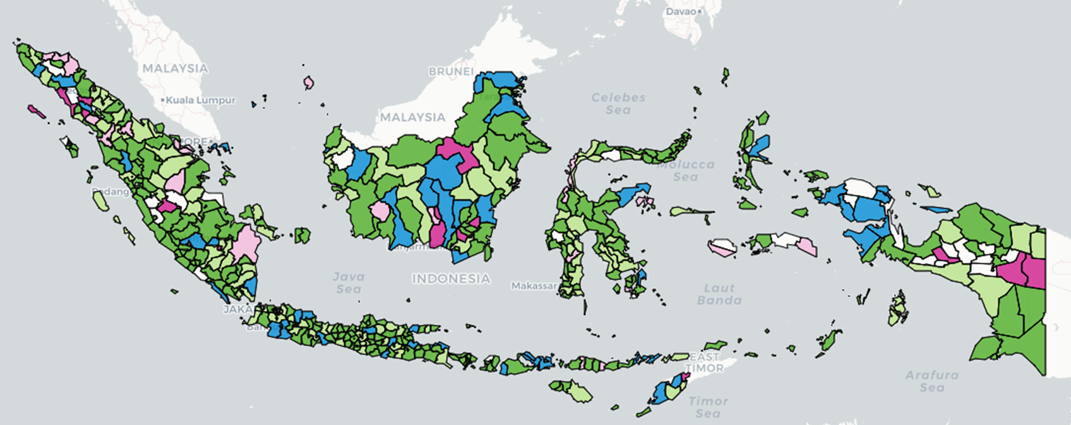
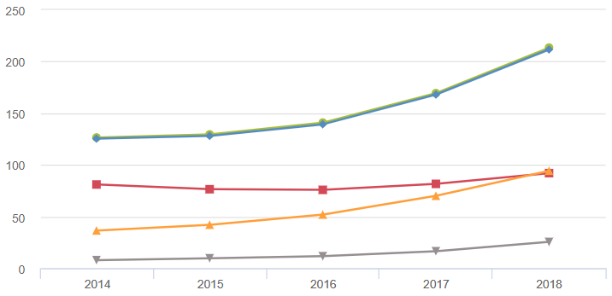
Epidemiological reviews
Two main components to the assessment:
Evaluation of the capacity of the surveillance system to correctly measure the magnitude of the TB epidemic (in terms of incidence and mortality).
Analysis of surveillance data to determine the level and trends of TB burden as well as possible causes to variations observed over time, by geography and for specific populations.
Standards and Benchmarks Checklist: dimensions of data quality, system coverage, surveillance of specific sub-groups
Standards are general statements about the characteristics of a high-performing TB surveillance system.
Benchmarks define in quantitative terms (where possible), the level of performance of the surveillance system under evaluation.

Slide 28
Epidemiological reviews
Summary of primary objectives for an epidemiological review:
Component 1: Standards and Benchmarks Checklist
Describe and assess current national TB surveillance and vital registration system and its capacity for measuring TB burden using the Standards and Benchmarks Checklist.
Component 2: Epidemiological analysis
Assess the level of, and trends in, TB disease burden using available surveillance, survey, programmatic and other data;
Assess whether observed variations are due to programmatic interventions, taking into account external factors (e.g. differences in TB determinants or risk factors);
Dissemination of findings and recommendations:
Define the investment and technical assistance needed to address gaps identified;
Provide feedback to the NTP, WHO, Global Fund and partners, as deemed appropriate by the NTP;
Additional:
Build capacity for epidemiological reviews in country by involving members of the NTP;
Review progress made since last TB Epidemiological Review (if applicable)

Slide 29
Epidemiological reviews
Summary of primary objectives for an epidemiological review:
Component 1: Standards and Benchmarks Checklist
Describe and assess current national TB surveillance and vital registration system and its capacity for measuring TB burden using the Standards and Benchmarks Checklist.
Component 2: Epidemiological analysis
Assess the level of, and trends in, TB disease burden using available surveillance, survey, programmatic and other data;
Assess whether observed variations are due to programmatic interventions, taking into account external factors (e.g. differences in TB determinants or risk factors);
Dissemination of findings and recommendations:
Define the investment and technical assistance needed to address gaps identified;
Provide feedback to the NTP, WHO, Global Fund and partners, as deemed appropriate by the NTP;
Additional:
Build capacity for epidemiological reviews in country by involving members of the NTP;
Review progress made since last TB Epidemiological Review (if applicable)

Slide 30
Epidemiological reviews
Component 1: Standards and benchmarks checklist
Describe and assess current national TB surveillance and vital registration system and its capacity for measuring TB burden (in terms of incidence and mortality).
Qualitative component
Desk review of available policy documents and guidelines
Discuss checklist items with the NTP and stakeholders involved in TB activities
Interview health facility and lab staff involved in recording and reporting TB data
Quantitative component
Data analysis on key indicators for internal and external consistency of data.
Interpretation of relevant data outside of TB programme (e.g. understand access to care and vital registration).

Slide 31
Epidemiological reviews
Component 1: Standards and benchmarks checklist
Describe and assess current national TB surveillance and vital registration system and its capacity for measuring TB burden (in terms of incidence and mortality).
Part A: 18 questions, with structured outcomes, to serve as a standardized framework for characterizing the TB surveillance system.
Part B: 17 standards, with associated benchmarks, to assess the capacity of the TB surveillance system.
Section 1 (10 core standards): data quality, system coverage, vital registration
Section 2 (3 standards for specific populations): DR-TB, TB/HIV, childhood TB
Section 3 (2 standards for care): quality of treatment outcomes data
Section 4 (2 standards for prevention): quality of programmatic management of TPT data
Summary of updates in 2nd Edition:
Updates to the benchmarks for standards B1.6, B1.9, B1.10, B2.1 and B2.3, otherwise refer to Edition 1 User Guide.
New standards: B3.1, B3.2, B4.1, B4.2.

Slide 32
Epidemiological reviews
Component 1: Standards and benchmarks checklist
Describe and assess current national TB surveillance and vital registration system and its capacity for measuring TB burden (in terms of incidence and mortality).
Part A: 18 questions, with structured outcomes, to serve as a standardized framework for characterizing the TB surveillance system.
Part B: 17 standards, with associated benchmarks, to assess the capacity of the TB surveillance system.
Section 1 (10 core standards): data quality, system coverage, vital registration
Section 2 (3 standards for specific populations): DR-TB, TB/HIV, childhood TB
Section 3 (2 standards for care): quality of treatment outcomes data
Section 4 (2 standards for prevention): quality of programmatic management of TPT data
Summary of updates in 2nd Edition:
Updates to the benchmarks for standards B1.6, B1.9, B1.10, B2.1 and B2.3, otherwise refer to Edition 1 User Guide.
New standards: B3.1, B3.2, B4.1, B4.2.

Slide 33
Epidemiological reviews
PART A. Structured description of the surveillance system.
Objectives:
Map out recording and reporting tools (paper and digital) and how these are linked.
Understand policies and guidelines in place for TB M&E activities and surveillance, and how these are carried out in practice.
Understand the patient flow at the health facility level and what data are collected along the way.
Understand the flow of data from the health facility to the national level.
Identify good practices as well as problems with registering TB cases, recording data, and reporting within routine surveillance.
Identify opportunities for strengthening training staff on M&E at all levels.
Verify availability and use of recording and reporting tools at the operational level.
Understand the user experience from front line workers and challenges they face.
Process:
Questions can be responded initially with the M&E team at the national level.
Responses are verified at lower levels and validated by observations at the service delivery level.
Iterative process: details are gathered throughout the review

Slide 34
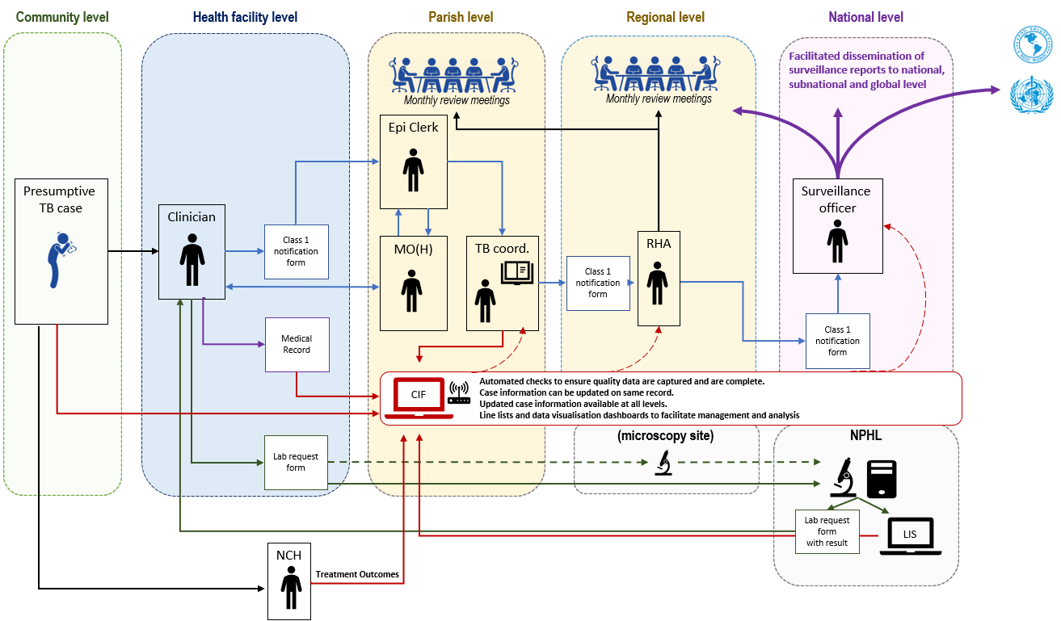
Epidemiological reviews
PART A. Structured description of the surveillance system.

Slide 35
Epidemiological reviews
Component 1: Standards and benchmarks checklist
Describe and assess current national TB surveillance and vital registration system and its capacity for measuring TB burden (in terms of incidence and mortality).
Part A: 18 questions, with structured outcomes, to serve as a standardized framework for characterizing the TB surveillance system.
Part B: 17 standards, with associated benchmarks, to assess the capacity of the TB surveillance system.
Section 1 (10 core standards): data quality, system coverage, vital registration
Section 2 (3 standards for specific populations): DR-TB, TB/HIV, childhood TB
Section 3 (2 standards for care): quality of treatment outcomes data
Section 4 (2 standards for prevention): quality of programmatic management of TPT data
Summary of updates in 2nd Edition:
Updates to the benchmarks for standards B1.6, B1.9, B1.10, B2.1 and B2.3, otherwise refer to Edition 1 User Guide.
New standards: B3.1, B3.2, B4.1, B4.2.

Slide 36
Epidemiological reviews
TB surveillance system data quality
B1.1 Case definitions are consistent with WHO guidelines.
B1.2 TB surveillance system is designed to capture a minimum set of variables for reported TB cases.
B1.3 All scheduled periodic data submissions have been received and processed at the national level.
B1.4 Data in quarterly reports (or equivalent) are accurate, complete, and internally consistent
(for paper-based systems only)
B1.5 Data in national database are accurate, complete, internally consistent, and free of duplicates
(for electronic case-based or patient-based systems only).
B1.6 TB surveillance data are externally consistent.
B1.7 TB surveillance data are internally consistent.
TB surveillance system coverage
B1.8 All diagnosed cases of TB are reported.
B1.9 Population as good access to health care.
Quality and coverage of vital registration system
B1.10 Vital registration system has high national coverage and quality.

Slide 37
Epidemiological reviews
Supplementary checklist for surveillance
B2.1 Surveillance data provide a direct measure of drug-resistant TB in new cases.
B2.2 Surveillance data provide a direct measure of the prevalence of HIV in TB cases.
B2.3 Surveillance data for children reported with TB (defined as ages 0-14 years) are reliable and accurate and all diagnosed childhood TB cases are reported.
Supplementary checklist for TB prevention and care (new in 2nd Edition)
B3.1 Monitoring treatment outcomes is consistent with WHO guidelines.
B3.2 Recording and reporting of TB treatment outcomes are accurate, complete and consistent
B4.1 Monitoring for PMTPT are consistent with WHO guidelines.
B4.2 PMTPT data are accurate, complete and consistent.

Slide 38
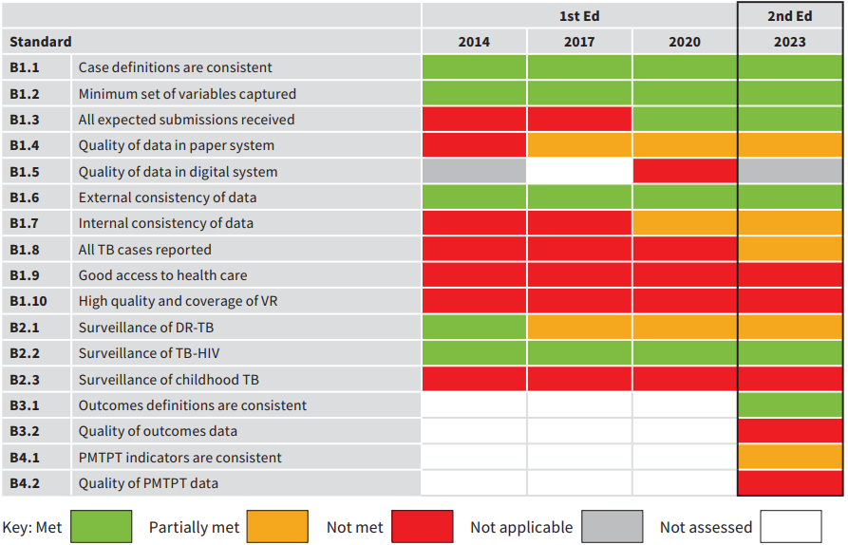
Epidemiological reviews
Multiple reviews help monitor progress in strengthening surveillance and identify systematic gaps.
Improvements in TB surveillance
Systematic gaps

Slide 39
Epidemiological reviews
Summary of primary objectives for an epidemiological review:
Component 1: Standards and Benchmarks Checklist
Describe and assess current national TB surveillance and vital registration system and its capacity for measuring TB burden using the Standards and Benchmarks Checklist.
Component 2: Epidemiological analysis
Assess the level of, and trends in, TB disease burden using available surveillance, survey, programmatic and other data;
Assess whether observed variations are due to programmatic interventions, taking into account external factors (e.g. differences in TB determinants or risk factors);
Dissemination of findings and recommendations:
Define the investment and technical assistance needed to address gaps identified;
Provide feedback to the NTP, WHO, Global Fund and partners, as deemed appropriate by the NTP;
Additional:
Build capacity for epidemiological reviews in country by involving members of the NTP;
Review progress made since last TB Epidemiological Review (if applicable)

Slide 40
Epidemiological reviews
Component 2: Epidemiological analysis
Analysis of TB data to determine the level and trends of TB burden and explain observed variation.
Analysis for national and sub-national surveillance data:
TB notifications
TB treatment outcomes
DR-TB
TB/HIV
Other data that are made available by TB programme (e.g. TPT)
Analysis/review of data from other sources:
Socio-economic determinants
Risk factors
Periodic surveys: inventory study, prevalence survey
Other population-based studies carried out
Interpretation and outcomes:
Explain observed trends and variations by time, geography and population
Identify gaps in programmatic activities
Generate hypothesis where an observation cannot be explained

Slide 41
Epidemiological reviews
Component 2: Epidemiological analysis
Analysis of TB data to determine the level and trends of TB burden and explain observed variation.
Available here (English or French): https://apps.who.int/iris/handle/10665/129942
Chapter 1: Analysis of aggregated TB notification data
Chapter 2: Analysis of case-based TB notification data
Chapter 3: Using genotyping data for outbreak investigation
Chapter 4: Analysis of factors driving the TB epidemic
Chapter 5: Drug-resistant TB: analysis of burden and response
Chapter 6: HIV-associated TB: analysis of burden and response
Chapter 7: Estimating TB mortality using vital registration and mortality survey data
Chapter 8: Combining surveillance and survey data to estimate TB burden
Topics particularly relevant for epi review analysis: Chapters 1, 2, 4, 5, 6

Slide 42
Epidemiological reviews
Two main components to the assessment:
Evaluation of the capacity of the surveillance system to correctly measure the magnitude of the TB epidemic (in terms of incidence and mortality).
Analysis of surveillance data to determine the level and trends of TB burden as well as possible causes to variations observed over time, by geography and for specific populations.
Standards and Benchmarks Checklist: dimensions of data quality, system coverage, surveillance of specific sub-groups
Standards are general statements about the characteristics of a high-performing TB surveillance system.
Benchmarks define in quantitative terms (where possible), the level of performance of the surveillance system under evaluation.

Slide 43
Epidemiological reviews
Summary of primary objectives for an epidemiological review:
Component 1: Standards and Benchmarks Checklist
Describe and assess current national TB surveillance and vital registration system and its capacity for measuring TB burden using the Standards and Benchmarks Checklist.
Component 2: Epidemiological analysis
Assess the level of, and trends in, TB disease burden using available surveillance, survey, programmatic and other data;
Assess whether observed variations are due to programmatic interventions, taking into account external factors (e.g. differences in TB determinants or risk factors);
Dissemination of findings and recommendations:
Define the investment and technical assistance needed to address gaps identified;
Provide feedback to the NTP, WHO, Global Fund and partners, as deemed appropriate by the NTP;
Additional:
Build capacity for epidemiological reviews in country by involving members of the NTP;
Review progress made since last TB Epidemiological Review (if applicable)

Slide 44
Epidemiological reviews
Expected uses of findings and recommendations in strategic planning:
Help guide the organization and focus of subsequent National TB Programme review
Inform the development of National Strategic Plans and M&E plans
Development of investment plan for strengthening surveillance, M&E and data use
Development of domestic and international funding requests
Guide the allocation of resources

Slide 45
Epidemiological reviews
Summary of primary objectives for an epidemiological review:
Component 1: Standards and Benchmarks Checklist
Describe and assess current national TB surveillance and vital registration system and its capacity for measuring TB burden using the Standards and Benchmarks Checklist.
Component 2: Epidemiological analysis
Assess the level of, and trends in, TB disease burden using available surveillance, survey, programmatic and other data;
Assess whether observed variations are due to programmatic interventions, taking into account external factors (e.g. differences in TB determinants or risk factors);
Dissemination of findings and recommendations:
Define the investment and technical assistance needed to address gaps identified;
Provide feedback to the NTP, WHO, Global Fund and partners, as deemed appropriate by the NTP;
Additional:
Build capacity for epidemiological reviews in country by involving members of the NTP;
Review progress made since last TB Epidemiological Review (if applicable)

Slide 46
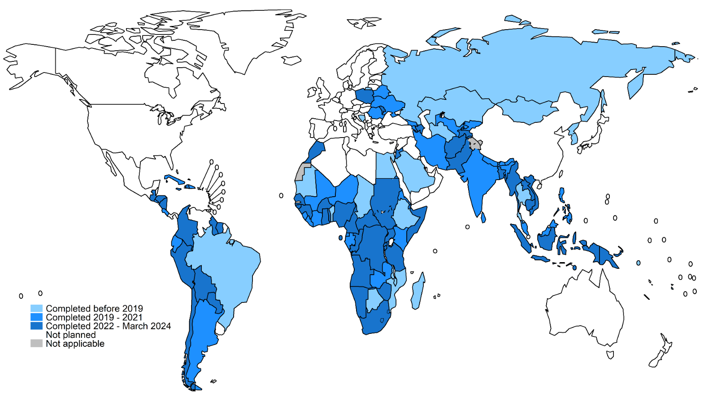
Epidemiological reviews: progress to date (2013 – March 2024)
106 countries
at least one review
22 countries
before 2019
32 countries
between 2019 - 2021
52 countries
between 2022 – March 2024
countries
first review planned in 2023

Slide 47
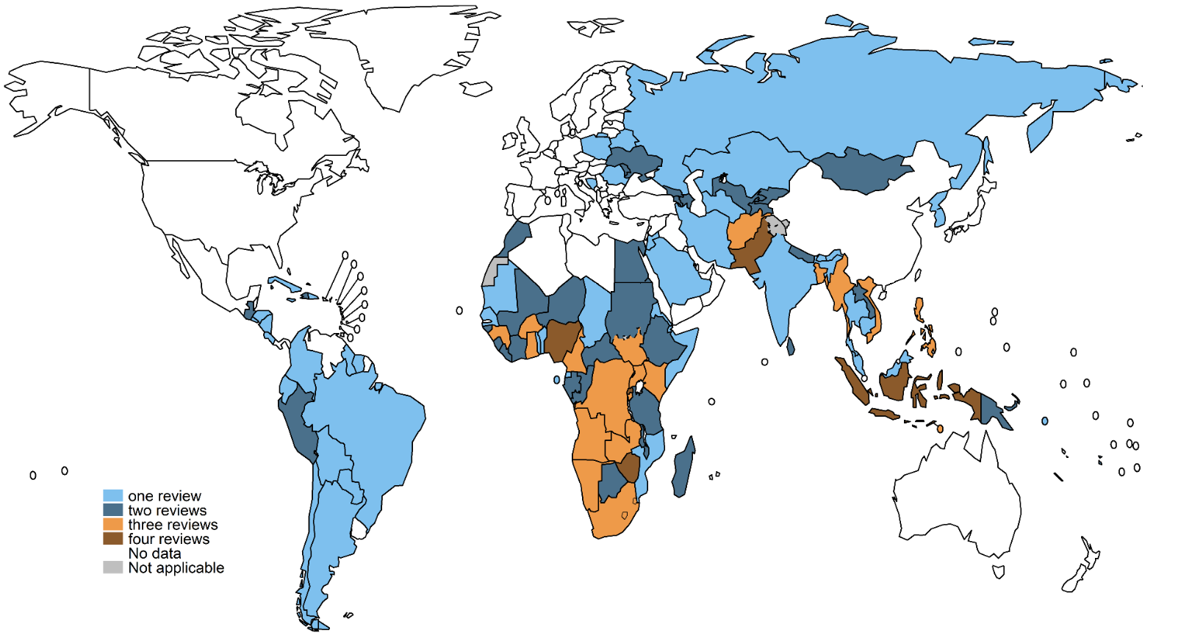
Epidemiological reviews: progress to date (2013 – March 2024)
46 countries
one review
33 countries
two reviews
21 countries
three reviews
5 countries
four reviews

Slide 48
Questions

Slide 49
Setting the scene: global synthesis of epidemiological review findings and prioritised recommendations
Marek Lalli

Slide 50
Background

Slide 51
Background
Global synthesis carried out for 2020 Task Force meeting
Purpose of the exercise:
Provide an overview of the global progress in implementing TB surveillance assessments using the WHO checklist since 2013;
Provide a synthesis of the key findings from TB surveillance assessments using the WHO checklist, with attention to progress in strengthening surveillance based on repeat surveys;
Provide a synthesis of key recommendations from TB surveillance assessments;
Assess the extent to which recommendations from TB surveillance assessments have been aligned with the gaps identified using the TB surveillance checklist;
Propose updates and refinements to the TB surveillance checklist based on experience of its use in the last 8 years.
Synthesis focussing on high TB burden countries in process of official publication.

Slide 52
Background
Global synthesis carried out for 2020 Task Force meeting
Purpose of the exercise:
Provide an overview of the global progress in implementing TB surveillance assessments using the WHO checklist since 2013;
Provide a synthesis of the key findings from TB surveillance assessments using the WHO checklist, with attention to progress in strengthening surveillance based on repeat surveys;
Provide a synthesis of key recommendations from TB surveillance assessments;
Assess the extent to which recommendations from TB surveillance assessments have been aligned with the gaps identified using the TB surveillance checklist;
Propose updates and refinements to the TB surveillance checklist based on experience of its use in the last 8 years.
Synthesis focussing on high TB burden countries in process of official publication.

Slide 53
Background
Two main components to the assessment:
Evaluation of the capacity of the surveillance system to correctly measure the magnitude of the TB epidemic (in terms of incidence and mortality).
Analysis of surveillance data to determine the level and trends of TB burden as well as possible causes to variations observed over time, by geography and for specific populations.
Standards and Benchmarks Checklist: dimensions of data quality, system coverage, surveillance of specific sub-groups
Standards are general statements about the characteristics of a high-performing TB surveillance system.
Benchmarks define in quantitative terms (where possible), the level of performance of the surveillance system under evaluation.

Slide 54
Background
1st Edition
Standards and Benchmarks checklist
13 standards
10 core standards
3 supplementary standards
7 standards on data quality
2 standards on system coverage
1 standard on vital registration
1 standard on drug resistant TB
1 standard on TB/HIV
1 standard on childhood TB
(B1.1-B1.7)
(B1.8-B1.9)
(B1.1-B1.10)
(B1.10)
(B2.1)
(B2.2)
(B2.1-B2.3)
(B2.3)

Slide 55
Synthesis of findings from latest assessment

Slide 56
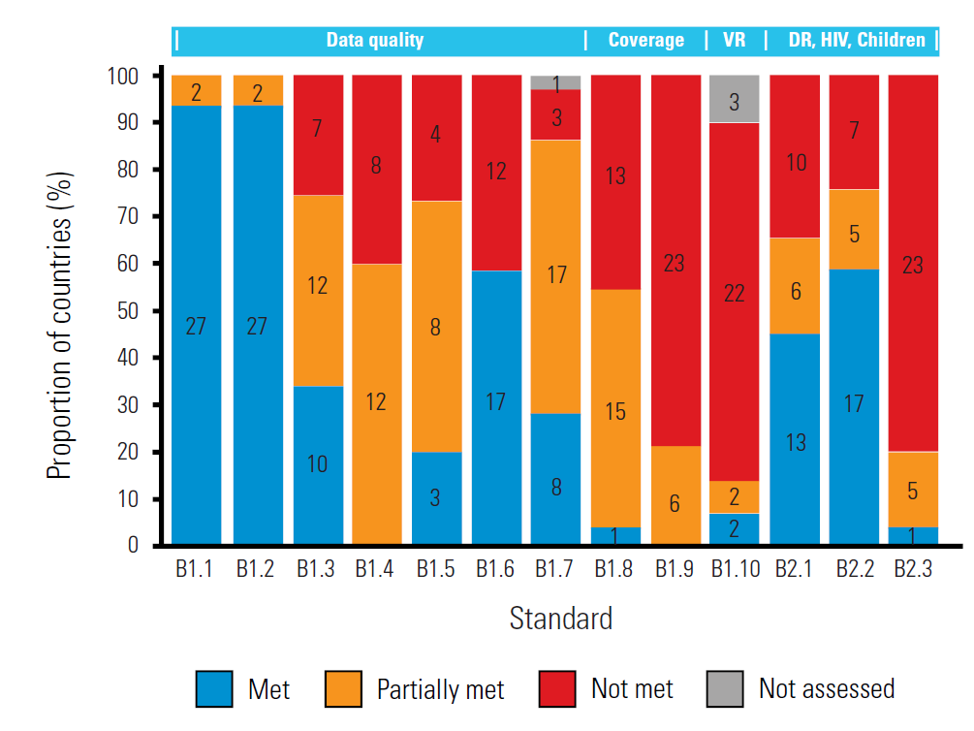
Aggregate findings from most recent assessment, by standard
Data quality:
Impressive standardisation and consistency for case definitions (B1.1) and data collected (B1.2).
Completeness of reporting to nation level requires improvement (B1.3).
Transition from paper to digital case-based systems capturing data that are accurate, complete and consistent remains key priority (B1.4, B1.5).
Data are more often externally consistent (B1.6) than internally consistent (B1.7).
System coverage:
Major gaps in ensuring individuals have good access to care (B1.9) and that all diagnosed TB cases are reported (B1.8).
Vital registration:
National vital registration systems require strengthening (B1.10).
Surveillance in specific populations:
Surveillance of drug resistant TB (B2.1) and HIV infection among TB patients (B2.2) are of medium quality.
Systematic problems related to the diagnoses and reporting of childhood TB (B2.3).
29 (out of 30) high TB burden countries
The number of countries is shown within the bars; standard B1.4 was not applicable in 9 countries; standard B1.5 was not applicable in 14 countries

Slide 57
Aggregate findings from most recent assessment, by standard
Data quality:
Impressive standardisation and consistency for case definitions (B1.1) and data collected (B1.2).
Completeness of reporting to nation level requires improvement (B1.3).
Transition from paper to digital case-based systems capturing data that are accurate, complete and consistent remains key priority (B1.4, B1.5).
Data are more often externally consistent (B1.6) than internally consistent (B1.7).
System coverage:
Major gaps in ensuring individuals have good access to care (B1.9) and that all diagnosed TB cases are reported (B1.8).
Vital registration:
National vital registration systems require strengthening (B1.10).
Surveillance in specific populations:
Surveillance of drug resistant TB (B2.1) and HIV infection among TB patients (B2.2) are of medium quality.
Systematic problems related to the diagnoses and reporting of childhood TB (B2.3).
29 (out of 30) high TB burden countries
The number of countries is shown within the bars; standard B1.4 was not applicable in 9 countries; standard B1.5 was not applicable in 14 countries

Slide 58
Aggregate findings from most recent assessment, by standard
Data quality:
Impressive standardisation and consistency for case definitions (B1.1) and data collected (B1.2).
Completeness of reporting to national level requires improvement (B1.3).
Transition from paper to digital case-based systems capturing data that are accurate, complete and consistent remains key priority (B1.4, B1.5).
Data are more often externally consistent (B1.6) than internally consistent (B1.7).
System coverage:
Major gaps in ensuring individuals have good access to care (B1.9) and that all diagnosed TB cases are reported (B1.8).
Vital registration:
National vital registration systems require strengthening (B1.10).
Surveillance in specific populations:
Surveillance of drug resistant TB (B2.1) and HIV infection among TB patients (B2.2) are of medium quality.
Systematic problems related to the diagnoses and reporting of childhood TB (B2.3).
29 (out of 30) high TB burden countries
The number of countries is shown within the bars; standard B1.4 was not applicable in 9 countries; standard B1.5 was not applicable in 14 countries

Slide 59
Aggregate findings from most recent assessment, by standard
Data quality:
Impressive standardisation and consistency for case definitions (B1.1) and data collected (B1.2).
Completeness of reporting to national level requires improvement (B1.3).
Transition from paper to digital case-based systems capturing data that are accurate, complete and consistent remains key priority (B1.4, B1.5).
Data are more often externally consistent (B1.6) than internally consistent (B1.7).
System coverage:
Major gaps in ensuring individuals have good access to care (B1.9) and that all diagnosed TB cases are reported (B1.8).
Vital registration:
National vital registration systems require strengthening (B1.10).
Surveillance in specific populations:
Surveillance of drug resistant TB (B2.1) and HIV infection among TB patients (B2.2) are of medium quality.
Systematic problems related to the diagnoses and reporting of childhood TB (B2.3).
29 (out of 30) high TB burden countries
The number of countries is shown within the bars; standard B1.4 was not applicable in 9 countries; standard B1.5 was not applicable in 14 countries

Slide 60
Aggregate findings from most recent assessment, by standard
Data quality:
Impressive standardisation and consistency for case definitions (B1.1) and data collected (B1.2).
Completeness of reporting to national level requires improvement (B1.3).
Transition from paper to digital case-based systems capturing data that are accurate, complete and consistent remains key priority (B1.4, B1.5).
Data are more often externally consistent (B1.6) than internally consistent (B1.7).
System coverage:
Major gaps in ensuring individuals have good access to care (B1.9) and that all diagnosed TB cases are reported (B1.8).
Vital registration:
National vital registration systems require strengthening (B1.10).
Surveillance in specific populations:
Surveillance of drug resistant TB (B2.1) and HIV infection among TB patients (B2.2) are of medium quality.
Systematic problems related to the diagnoses and reporting of childhood TB (B2.3).
29 (out of 30) high TB burden countries
The number of countries is shown within the bars; standard B1.4 was not applicable in 9 countries; standard B1.5 was not applicable in 14 countries
Notes:
External consistency: comparing NTP data to glolobal epidemiology of TB.
Internal consistency: assessing the stability of trends in NTP data over time for a set of core indicators.

Slide 61
Aggregate findings from most recent assessment, by standard
Data quality:
Impressive standardisation and consistency for case definitions (B1.1) and data collected (B1.2).
Completeness of reporting to national level requires improvement (B1.3).
Transition from paper to digital case-based systems capturing data that are accurate, complete and consistent remains key priority (B1.4, B1.5).
Data are more often externally consistent (B1.6) than internally consistent (B1.7).
System coverage:
Major gaps in ensuring individuals have good access to care (B1.9) and that all diagnosed TB cases are reported (B1.8).
Vital registration:
National vital registration systems require strengthening (B1.10).
Surveillance in specific populations:
Surveillance of drug resistant TB (B2.1) and HIV infection among TB patients (B2.2) are of medium quality.
Systematic problems related to the diagnoses and reporting of childhood TB (B2.3).
29 (out of 30) high TB burden countries
The number of countries is shown within the bars; standard B1.4 was not applicable in 9 countries; standard B1.5 was not applicable in 14 countries

Slide 62
Aggregate findings from most recent assessment, by standard
Data quality:
Impressive standardisation and consistency for case definitions (B1.1) and data collected (B1.2).
Completeness of reporting to national level requires improvement (B1.3).
Transition from paper to digital case-based systems capturing data that are accurate, complete and consistent remains key priority (B1.4, B1.5).
Data are more often externally consistent (B1.6) than internally consistent (B1.7).
System coverage:
Major gaps in ensuring individuals have good access to care (B1.9) and that all diagnosed TB cases are reported (B1.8).
Vital registration:
National vital registration systems require strengthening (B1.10).
Surveillance in specific populations:
Surveillance of drug resistant TB (B2.1) and HIV infection among TB patients (B2.2) are of medium quality.
Systematic problems related to the diagnoses and reporting of childhood TB (B2.3).
29 (out of 30) high TB burden countries
The number of countries is shown within the bars; standard B1.4 was not applicable in 9 countries; standard B1.5 was not applicable in 14 countries

Slide 63
Aggregate findings from most recent assessment, by standard
Data quality:
Impressive standardisation and consistency for case definitions (B1.1) and data collected (B1.2).
Completeness of reporting to national level requires improvement (B1.3).
Transition from paper to digital case-based systems capturing data that are accurate, complete and consistent remains key priority (B1.4, B1.5).
Data are more often externally consistent (B1.6) than internally consistent (B1.7).
System coverage:
Major gaps in ensuring individuals have good access to care (B1.9) and that all diagnosed TB cases are reported (B1.8).
Vital registration:
National vital registration systems require strengthening (B1.10).
Surveillance in specific populations:
Surveillance of drug resistant TB (B2.1) and HIV infection among TB patients (B2.2) are of medium quality.
Systematic problems related to the diagnoses and reporting of childhood TB (B2.3).
29 (out of 30) high TB burden countries
The number of countries is shown within the bars; standard B1.4 was not applicable in 9 countries; standard B1.5 was not applicable in 14 countries

Slide 64
Aggregate findings from most recent assessment, by standard
Data quality:
Impressive standardisation and consistency for case definitions (B1.1) and data collected (B1.2).
Completeness of reporting to national level requires improvement (B1.3).
Transition from paper to digital case-based systems capturing data that are accurate, complete and consistent remains key priority (B1.4, B1.5).
Data are more often externally consistent (B1.6) than internally consistent (B1.7).
System coverage:
Major gaps in ensuring individuals have good access to care (B1.9) and that all diagnosed TB cases are reported (B1.8).
Vital registration:
National vital registration systems require strengthening (B1.10).
Surveillance in specific populations:
Surveillance of drug resistant TB (B2.1) and HIV infection among TB patients (B2.2) are of medium quality.
Systematic problems related to the diagnosis and reporting of childhood TB (B2.3).
29 (out of 30) high TB burden countries
The number of countries is shown within the bars; standard B1.4 was not applicable in 9 countries; standard B1.5 was not applicable in 14 countries

Slide 65
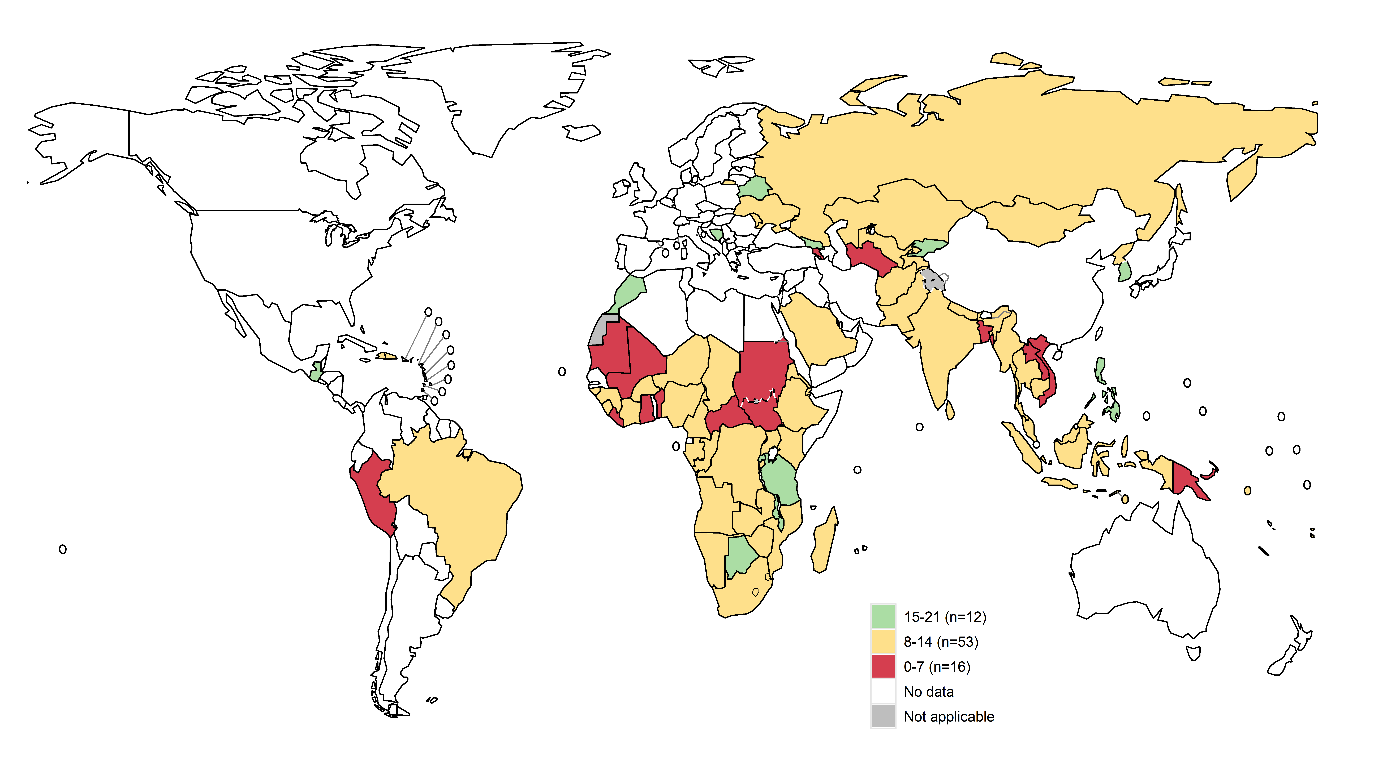
Data quality (B1.1-B1.7) summary scores
TB surveillance assessments from 81 countries (2013-April 2020)
Few countries (n=12) demonstrate high data quality
Most countries (n=53) capture data of medium quality
Some countries (n=16) have major data quality issues

Slide 66
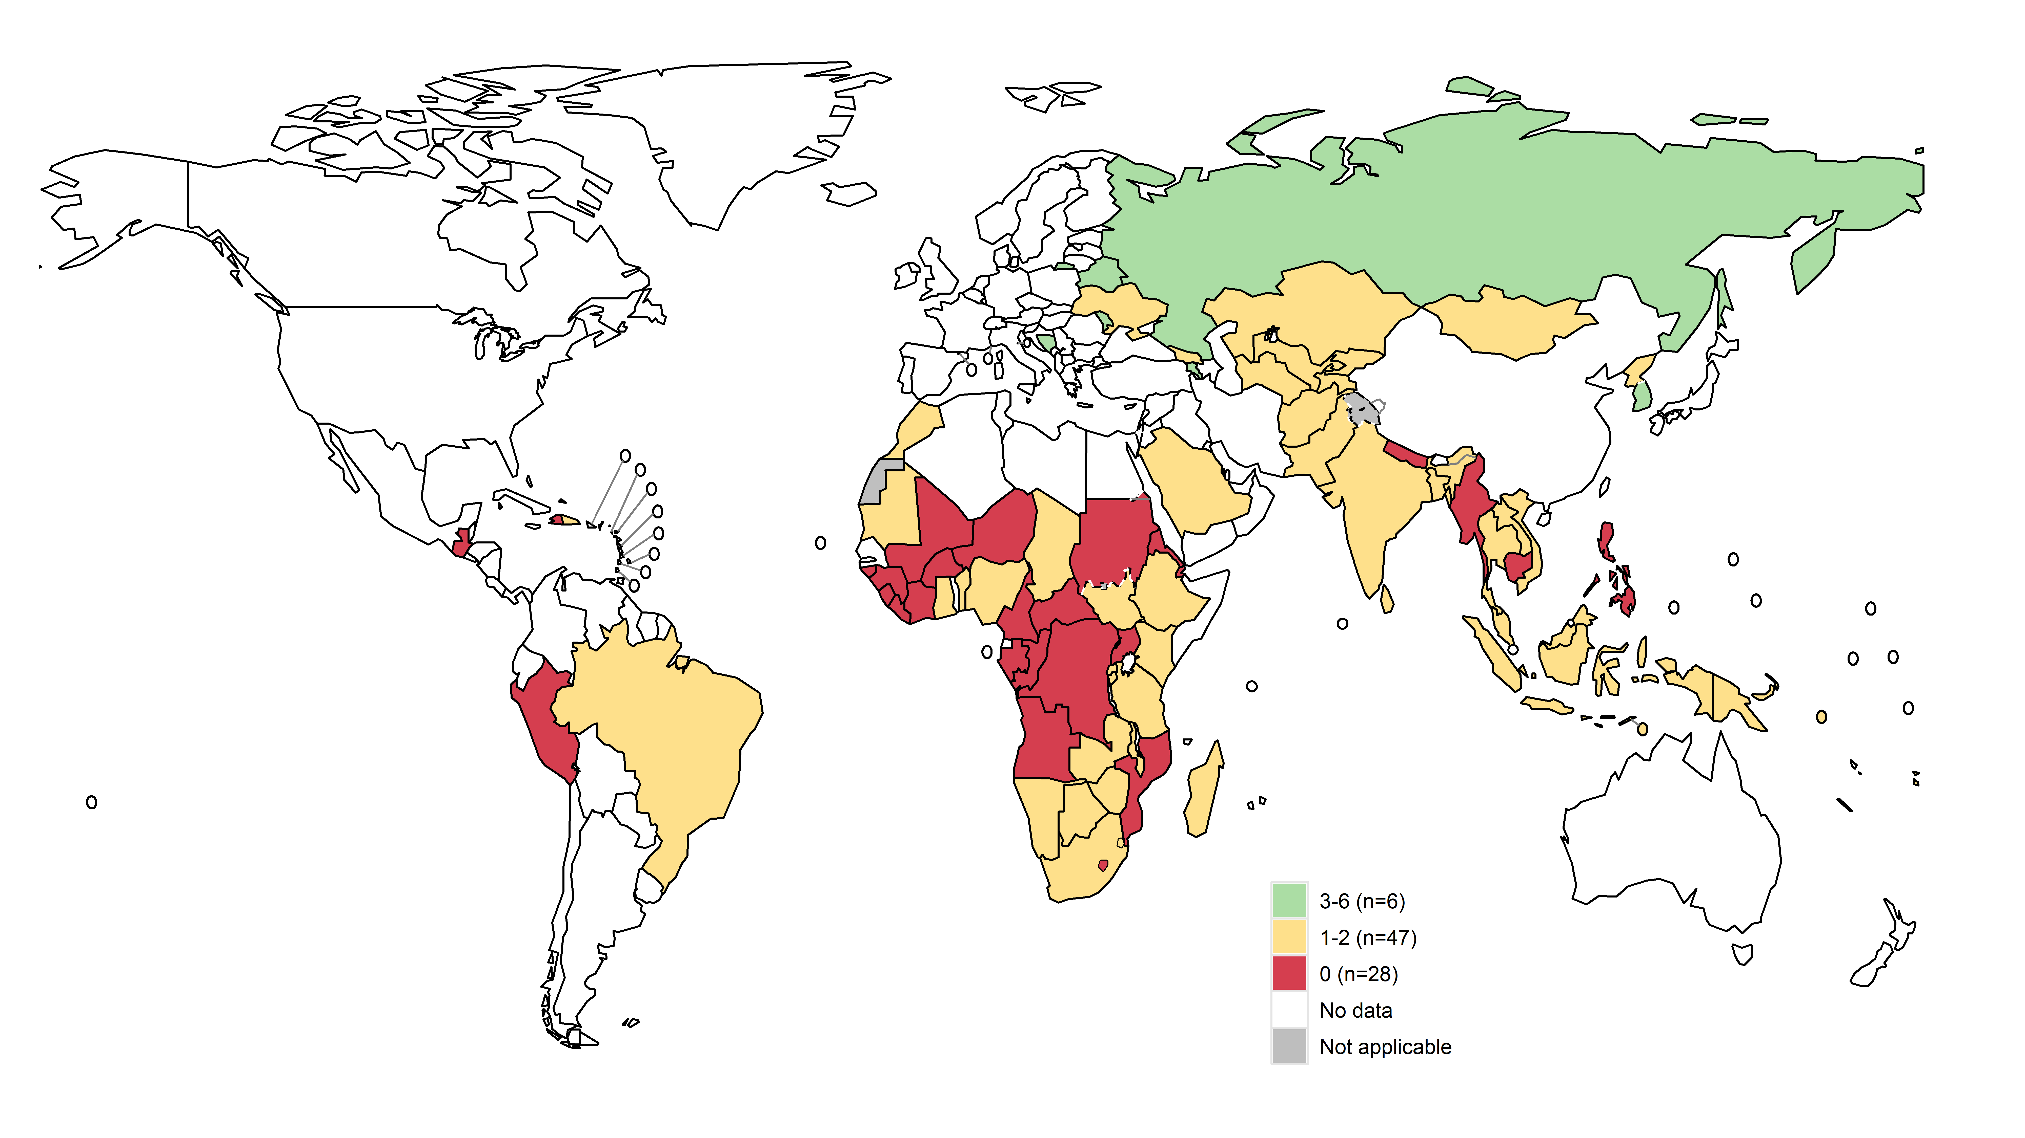
System coverage* (B1.8-B1.9) summary scores
*high coverage = population has good access to care and all people diagnosed with TB are recorded
TB surveillance assessments from 81 countries (2013-April 2020)
Very few countries (n=6) have high coverage
Most countries (n=47) have medium coverage
Many countries (n=28) have very low coverage

Slide 67
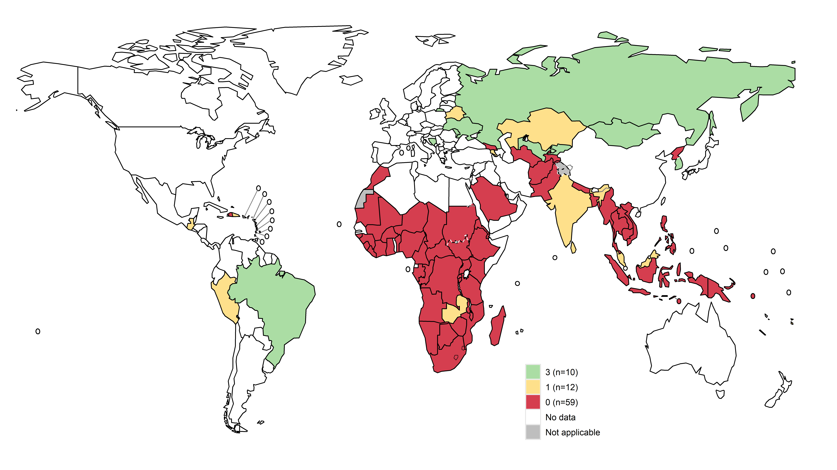
Vital registration* (B1.10) summary scores
*Vital registration is of high coverage and good quality
TB surveillance assessments from 81 countries (2013-April 2020)
Major gaps in vital registration.
Most countries (n=59) do not have a functional, high quality, vital registration system in place.

Slide 68
Synthesis of findings from repeat assessments

Slide 69
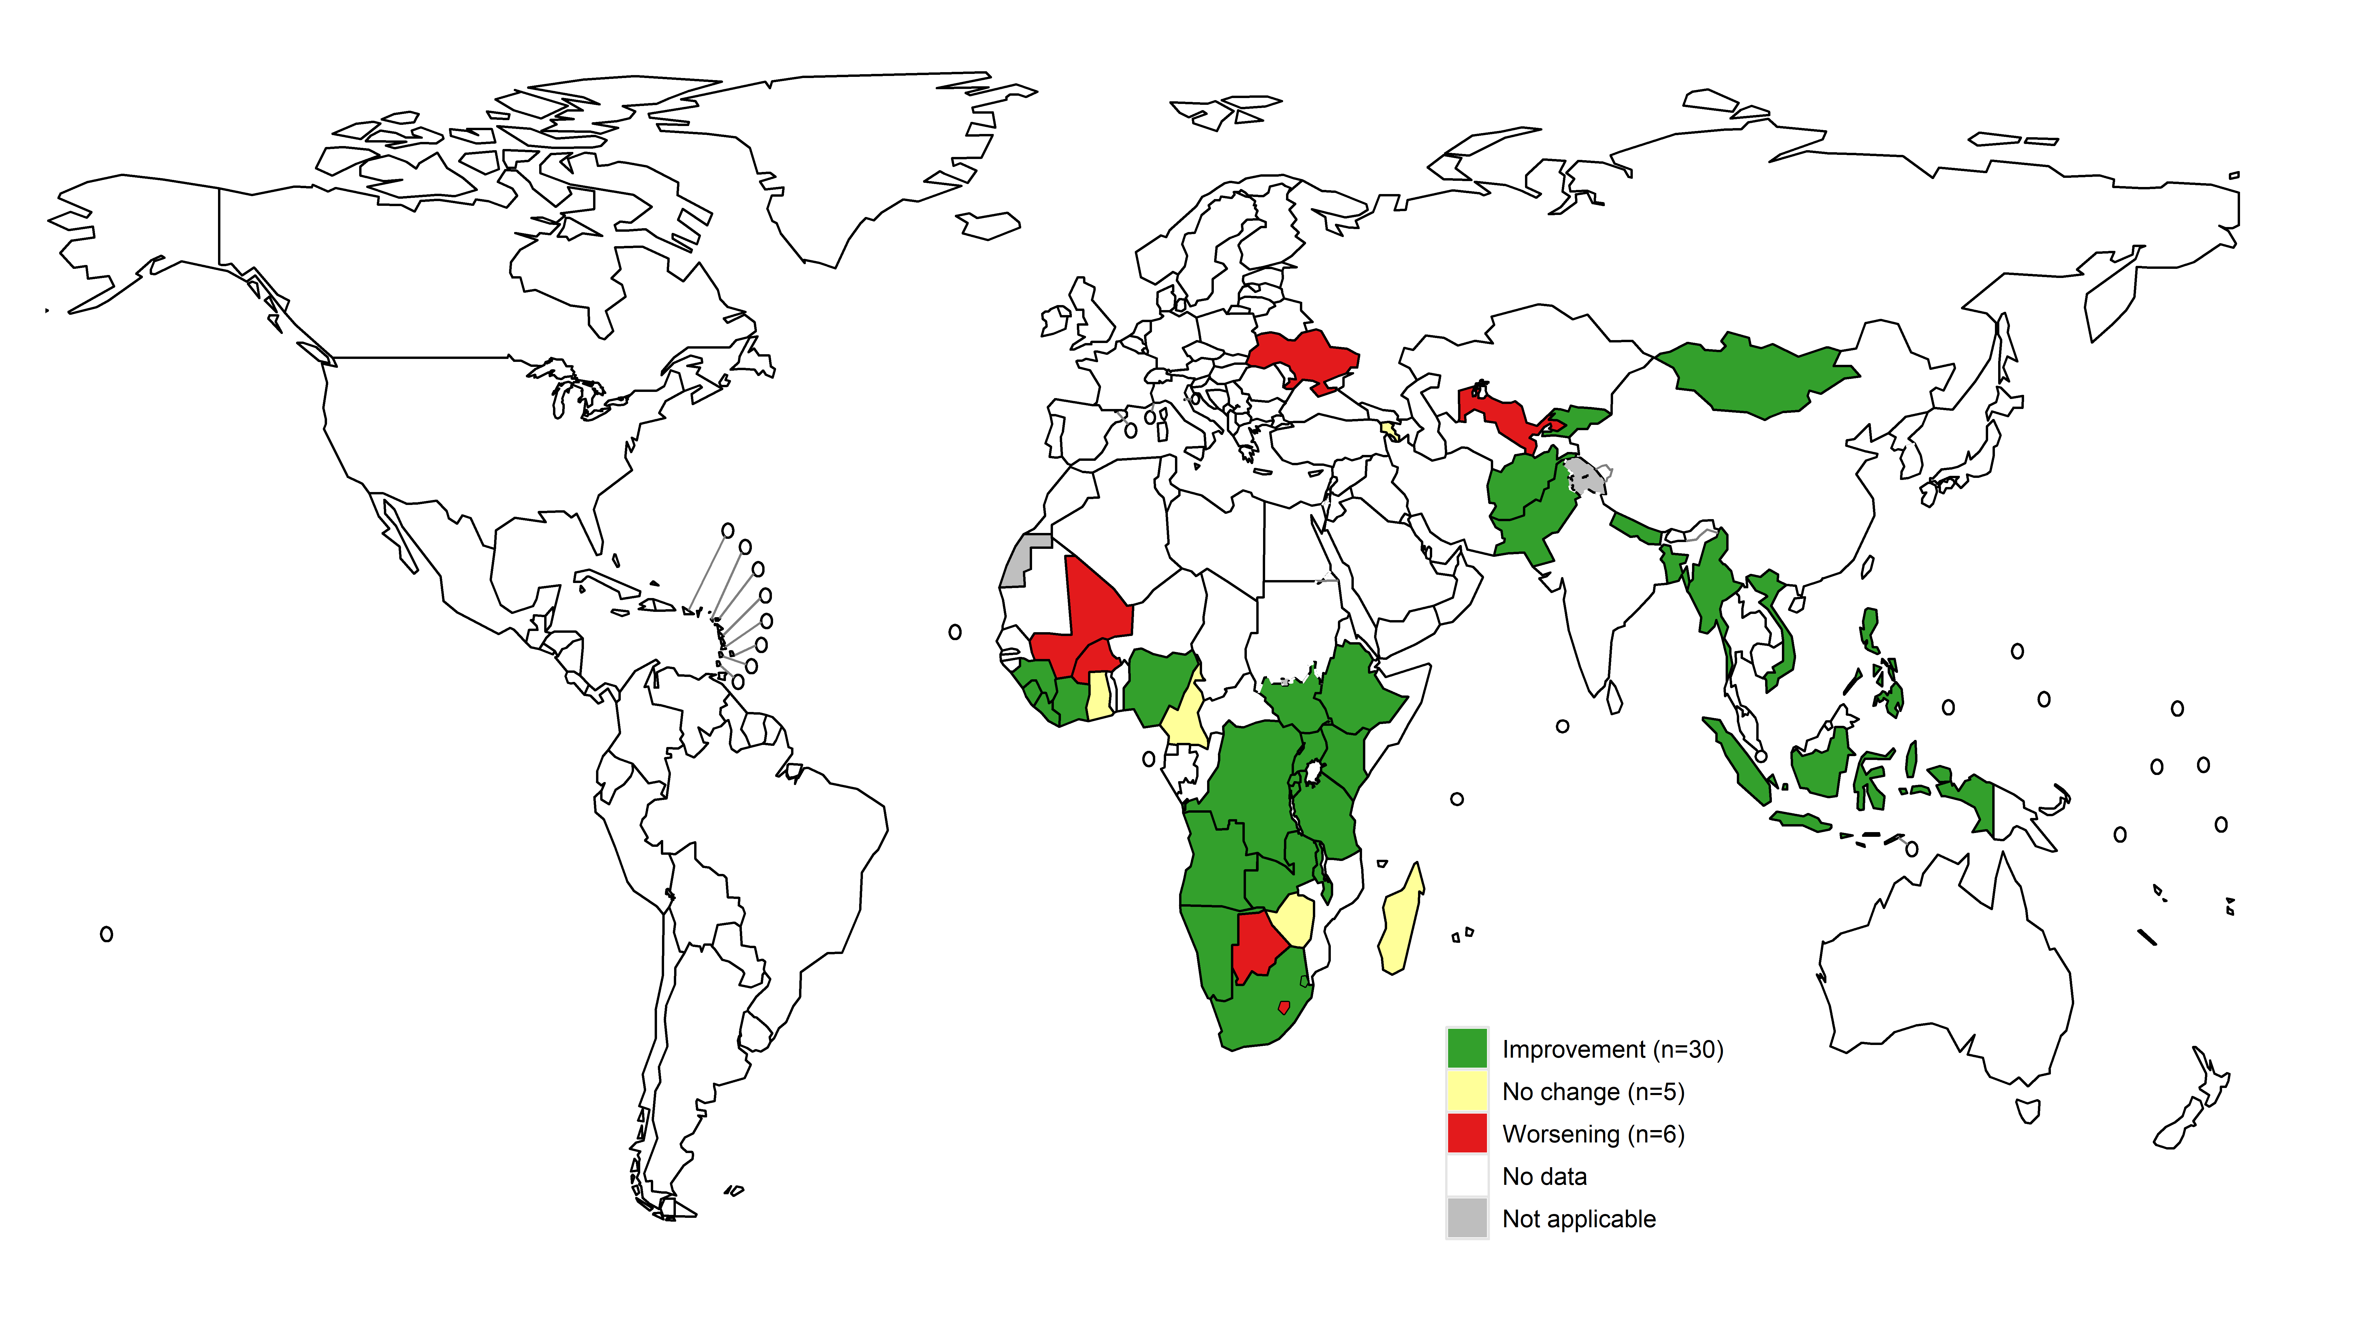
Net change in summary scores for all 13 standards
TB surveillance assessments from 41 countries with repeat assessment
(2013-April 2020)
Most countries (n=30) who carried out a repeat assessment show a positive net change (improvements in their surveillance systems).

Slide 70
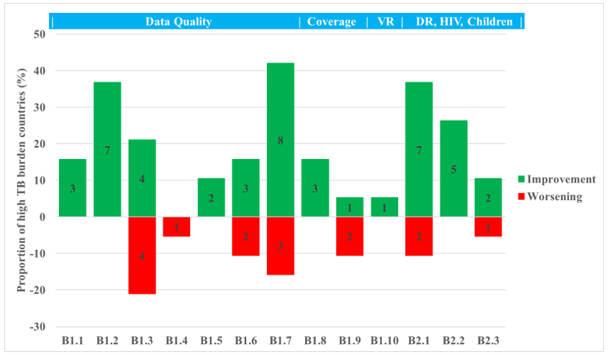
Aggregated findings from repeat assessments, by standard
19 high burden countries with repeat assessment
(2013-April 2020)
Standardisation of case definitions (B1.1) and the data collected (B1.2) consistently shows further improvement.
Little improvements in the transition from paper-based to digital, case-based surveillance and the quality of data the systems collect (B1.4, B1.5).
Further improvements made in surveillance of drug-resistant TB (B2.1) and HIV infection among TB patients (B2.2)
Systematic gaps observed in recording of TB cases (B1.8) access to health care (B1.9), vital registration (B1.10) and diagnosis and reporting of childhood TB (B2.3)
The number of countries is shown within the bars. The discrepancy between the numbers shown on within the bars and the total number of countries (n=19) is due to some showing no net change per standard.

Slide 71
Aggregated findings from repeat assessments, by standard
19 high burden countries with repeat assessment
(2013-April 2020)
Standardisation of case definitions (B1.1) and the data collected (B1.2) consistently shows further improvement.
Little improvements in the transition from paper-based to digital, case-based surveillance and the quality of data the systems collect (B1.4, B1.5).
Further improvements made in surveillance of drug-resistant TB (B2.1) and HIV infection among TB patients (B2.2)
Systematic gaps observed in recording of TB cases (B1.8) access to health care (B1.9), vital registration (B1.10) and diagnosis and reporting of childhood TB (B2.3)
The number of countries is shown within the bars. The discrepancy between the numbers shown on within the bars and the total number of countries (n=19) is due to some showing no net change per standard.

Slide 72
Aggregated findings from repeat assessments, by standard
19 high burden countries with repeat assessment
(2013-April 2020)
Standardisation of case definitions (B1.1) and the data collected (B1.2) consistently shows further improvement.
Further improvements made in surveillance of drug-resistant TB (B2.1) and HIV infection among TB patients (B2.2)
Little improvements in the transition from paper-based to digital, case-based surveillance and the quality of data the systems collect (B1.4, B1.5).
Systematic gaps observed in recording of TB cases (B1.8) access to health care (B1.9), vital registration (B1.10) and diagnosis and reporting of childhood TB (B2.3)
The number of countries is shown within the bars. The discrepancy between the numbers shown on within the bars and the total number of countries (n=19) is due to some showing no net change per standard.

Slide 73
Aggregated findings from repeat assessments, by standard
19 high burden countries with repeat assessment
(2013-April 2020)
Standardisation of case definitions (B1.1) and the data collected (B1.2) consistently shows further improvement.
Further improvements made in surveillance of drug-resistant TB (B2.1) and HIV infection among TB patients (B2.2)
Little improvements in the transition from paper-based to digital, case-based surveillance and the quality of data the systems collect (B1.4, B1.5).
Systematic gaps observed in recording of TB cases (B1.8) access to health care (B1.9), vital registration (B1.10) and diagnosis and reporting of childhood TB (B2.3)
The number of countries is shown within the bars. The discrepancy between the numbers shown on within the bars and the total number of countries (n=19) is due to some showing no net change per standard.

Slide 74
Aggregated findings from repeat assessments, by standard
19 high burden countries with repeat assessment
(2013-April 2020)
Standardisation of case definitions (B1.1) and the data collected (B1.2) consistently shows further improvement.
Further improvements made in surveillance of drug-resistant TB (B2.1) and HIV infection among TB patients (B2.2)
Little improvements in the transition from paper-based to digital, case-based surveillance and the quality of data the systems collect (B1.4, B1.5).
Systematic gaps observed in recording of TB cases (B1.8), access to health care (B1.9), vital registration (B1.10) and diagnosis and reporting of childhood TB (B2.3)
The number of countries is shown within the bars. The discrepancy between the numbers shown on within the bars and the total number of countries (n=19) is due to some showing no net change per standard.

Slide 75
Synthesis of recommendations

Slide 76
Description of the framework for recommendations
Core framework relating directly to standards and benchmarks
Improve data quality | Increase HR capacity for surveillance and M&E
 | Develop or review SOPs / tool for data quality and validity
 | Training of staff on recording and reporting to improve data quality
 | Strengthen routine supervision for data quality checks / validation workshops
 | TB module of Service Availability and Readiness Assessment for data validity and completeness
Transition from aggregate to case-based | Transition towards / strengthen case-based digital platform
Reduce under-reporting | Measure the level of under-reporting with inventory study
 | Make TB notification a legal requirement
 | Improve reporting from the public and private sectors
 | Ensure all people diagnosed with TB are notified
Reduce under-diagnosis | Improve capacity for diagnosis (e.g. TB in UHC package, improve health facility network)
VR | Improve availability and quality of TB mortality data
Childhood TB | Improve diagnosis and reporting of childhood TB
TB/HIV | Improve TB/HIV services / recording and reporting
DR-TB | Implement a drug resistance survey to estimate the burden of DR-TB in new cases
Developed framework for capturing specific recommendations.
Reviewed latest report from all 81 countries: 79 included recommendations.
Captured specific recommendations into high-level categories.
Recommendations prioritised based on number of countries.

Slide 77
Description of the framework for recommendations
Transition from aggregate to case-based | Review of existing paper recording and & reporting tools
 | Transition from paper to aggregate digital platform
 | Transition to electronic case-based systems (DR-TB only)
 | Transition to electronic case-based systems (all cases)
 | Review of existing digital platform
Disaggregation of recommendations captured for transitioning to case-based digital solutions
Supplementary recommendations from epidemiological reviews | Strengthen data analysis and use for decision-making
 | Strengthen operational and implementation research
 | Prevalence survey
 | Patient Pathway Analysis
 | Patient cost survey
 | Implement a unique ID
 | Review existing data (e.g. fill data gaps, data validation)
 | Safeguard data with tbhistoric DHIS2 platform
 | Implement ACF / ICF activities
Additional framework related to supplementary recommendations (not directly linked to standards and benchmarks)

Slide 78
Top recommendations
Top recommendations from TB surveillance assessments, globally, to address most common gaps:
Transition to or strengthen digital, case-based, real-time surveillance.
Develop or review SOPs/tools for data quality and validity.
Improve availability and quality of TB mortality data.
Measure level of under-reporting of diagnosed TB cases using an inventory study.
Strengthen routine supervision for data quality checks, including via data validation workshops.
Strengthen routine analysis and use of data at the national and subnational levels.

Slide 79
Top recommendations
Top recommendations from TB surveillance assessments, globally, to address most common gaps:
Transition to or strengthen digital, case-based, real-time surveillance.
Develop or review SOPs/tools for data quality and validity.
Improve availability and quality of TB mortality data.
Measure level of under-reporting of diagnosed TB cases using an inventory study.
Strengthen routine supervision for data quality checks, including via data validation workshops.
Strengthen routine analysis and use of data at the national and subnational levels.
Findings and recommendations used to guide global, regional, national priorities and direction in strengthening TB surveillance and analysis and use of TB data

Slide 80
Top recommendations
Top recommendations from TB surveillance assessments, globally, to address most common gaps:
Transition to or strengthen digital, case-based, real-time surveillance.
Develop or review SOPs/tools for data quality and validity.
Improve availability and quality of TB mortality data.
Measure level of under-reporting of diagnosed TB cases using an inventory study.
Strengthen routine supervision for data quality checks, including via data validation workshops.
Strengthen routine analysis and use of data at the national and subnational levels.
Findings and recommendations used to guide global, regional, national priorities and direction in strengthening TB surveillance and analysis and use of TB data
Global goods, tools and capacity building mechanisms have been developed (or are in development) to address these recommendations.

Slide 81
Top recommendations
Top recommendations from TB surveillance assessments, globally, to address most common gaps:
Transition to or strengthen digital, case-based, real-time surveillance.
Develop or review SOPs/tools for data quality and validity.
Improve availability and quality of TB mortality data.
Measure level of under-reporting of diagnosed TB cases using an inventory study.
Strengthen routine supervision for data quality checks, including via data validation workshops.
Strengthen routine analysis and use of data at the national and subnational levels.

Slide 82
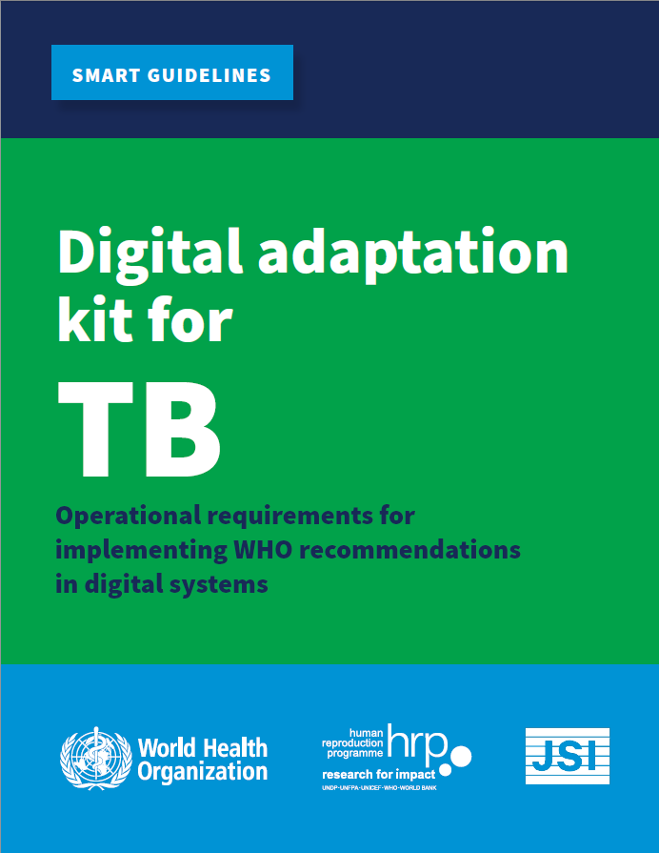
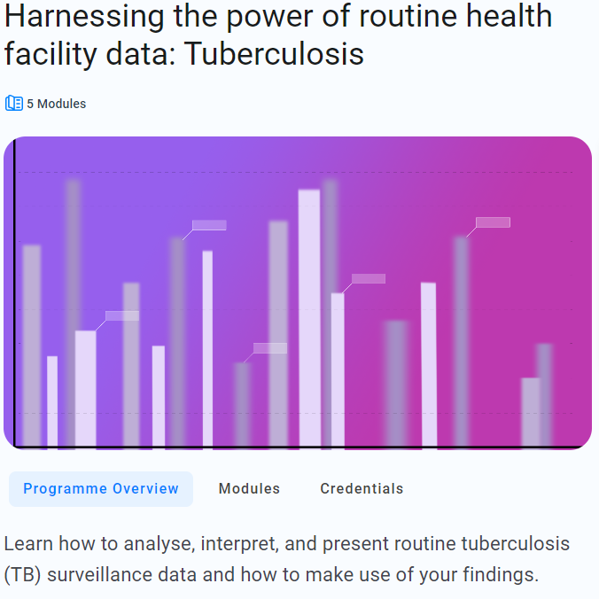
Addressing recommendations
1. Transition to or strengthen digital, case-based, real-time surveillance.
6. Strengthen routine analysis and use of data at the national and subnational levels.

Slide 83
Top recommendations
Top recommendations from TB surveillance assessments, globally, to address most common gaps:
Transition to or strengthen digital, case-based, real-time surveillance.
Develop or review SOPs/tools for data quality and validity.
Improve availability and quality of TB mortality data.
Measure level of under-reporting of diagnosed TB cases using an inventory study.
Strengthen routine supervision for data quality checks, including via data validation workshops.
Strengthen routine analysis and use of data at the national and subnational levels.

Slide 84
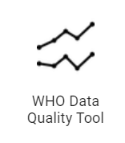
Addressing recommendations
2. Develop or review SOPs/tools for data quality and validity.
5. Strengthen routine supervision for data quality checks, including via data validation workshops.
Definitions and reporting framework updated: TB surveillance guidance.
Expanded scope compared to previous iterations.
Includes specific chapter on ensuring TB data are of high quality, at all administrative levels and along the pathway of prevention and care.
DHIS2 WHO TB package includes automated DQ rules.
Development of DQ dashboard and SOPs are under development.
DHIS2
Data quality
SOP

Slide 85
Top recommendations
Top recommendations from TB surveillance assessments, globally, to address most common gaps:
Transition to or strengthen digital, case-based, real-time surveillance.
Develop or review SOPs/tools for data quality and validity.
Improve availability and quality of TB mortality data.
Measure level of under-reporting of diagnosed TB cases using an inventory study.
Strengthen routine supervision for data quality checks, including via data validation workshops.
Strengthen routine analysis and use of data at the national and subnational levels.

Slide 86
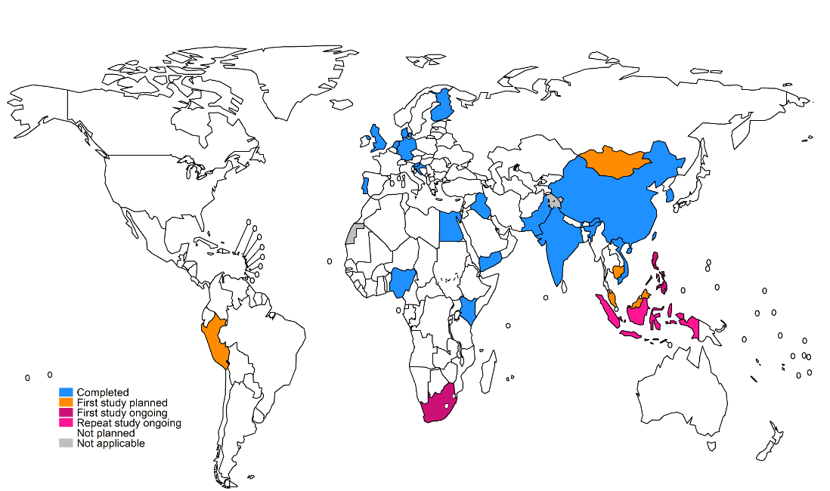
Addressing recommendations
4. Measure level of under-reporting of diagnosed TB cases using an inventory study.
Inventory studies for measuring the under-reporting of detected TB cases
2000-2024
Addressing underrepoting through record linkage exercises

Slide 87
Top recommendations
Top recommendations from TB surveillance assessments, globally, to address most common gaps:
Transition to or strengthen digital, case-based, real-time surveillance.
Develop or review SOPs/tools for data quality and validity.
Improve availability and quality of TB mortality data.
Measure level of under-reporting of diagnosed TB cases using an inventory study.
Strengthen routine supervision for data quality checks, including via data validation workshops.
Strengthen routine analysis and use of data at the national and subnational levels.

Slide 88
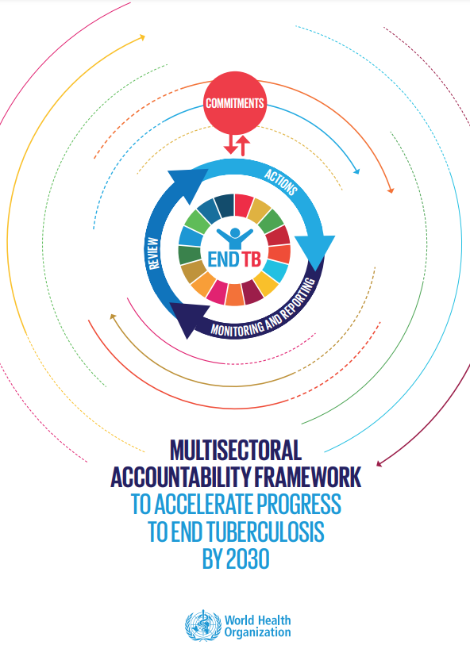
Addressing recommendations
3. Improve availability and quality of TB mortality data.
Not under the direct purview of the TB programme.
Multisectoral approach: requires buy-in and accountability across the health sector and from relevant departments and/or ministries.
Encourage closer collaboration and increased use of mortality data for routine analysis.
https://apps.who.int/iris/handle/10665/341911
https://apps.who.int/iris/bitstream/handle/10665/331934/WHO-CDS-TB-2019.10-eng.pdf

Slide 89
Key messages from global synthesis
The TB surveillance checklist provides systematic and standardised way of assessing TB surveillance systems.
Repeat assessments help identify improvements and systematic gaps.
Improvements and high level of consistency was observed for about half of the standards that are under the direct purview of the NTP.
Improving access to care and vital registration (two standards not directly under the purview of the NTP) are much more challenging and complex to address.
Surveillance of childhood TB (diagnosis and reporting) globally has seen minimal to no improvement.
Important gaps remain in quality of data recorded and completeness of reporting.
Transitioning from paper-based to digital surveillance is the top priority globally, and within each WHO region.
Improvements can be slow, requiring sustained political and financial commitment.

Slide 90
Commonly observed problems and associated solutions

Slide 91
Key messages from global synthesis
Inefficiences in the system (functionality, time, resources)
People with TB being missed and not counted
Impact on disease burden estimates
Unstructured decision-making

Slide 92
Thank you

