Slide 1


Africa Regional Workshop on Strengthening TB Monitoring and Evaluation Systems
16-19 April, 2024 • Dar es Salaam, Tanzania
NTP UPDATES: MOZAMBIQUE
Logo
Logo

Slide 2
Country TB Profile and TB Situation Snapshot

Slide 3
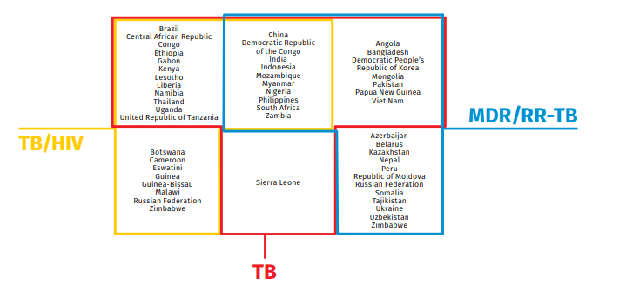
Mozambique – Country Profile
TB Prevalence: 361 por 100K Pop.
TB/HIV: 25%
MDR TB: 1.440
Pediatric TB: 12%
Bacteriology Confirmed Rate: 43%
Mortalilty rate: 29 por 100K Pop.
Treatment Coverage: 92%
Treatment Sucess Rate (all forms): 94%
Treatment sucess rate (TB MDR): 75%

Slide 4
UNHLM targets
TB All forms
Pediatric TB
MDR TB

Slide 5
Data-Driven Strategies:
Update on national TB M&E, surveillance, and data use

Slide 6
Improvements and changes made recently to the national TB M&E system
Updated NTP M&E Tools 2023
  Introduce the new WHO TB definitions revised in 2020
  Include new age group breakdowns
  Introduction of register and report tool for psychosocial support and monitoring of defaults.
  Accommodate documentation of new diagnostic technologies approved by WHO
Piloting of DHIS Tracker (SIS TB): electronic patient tracking system

Slide 7
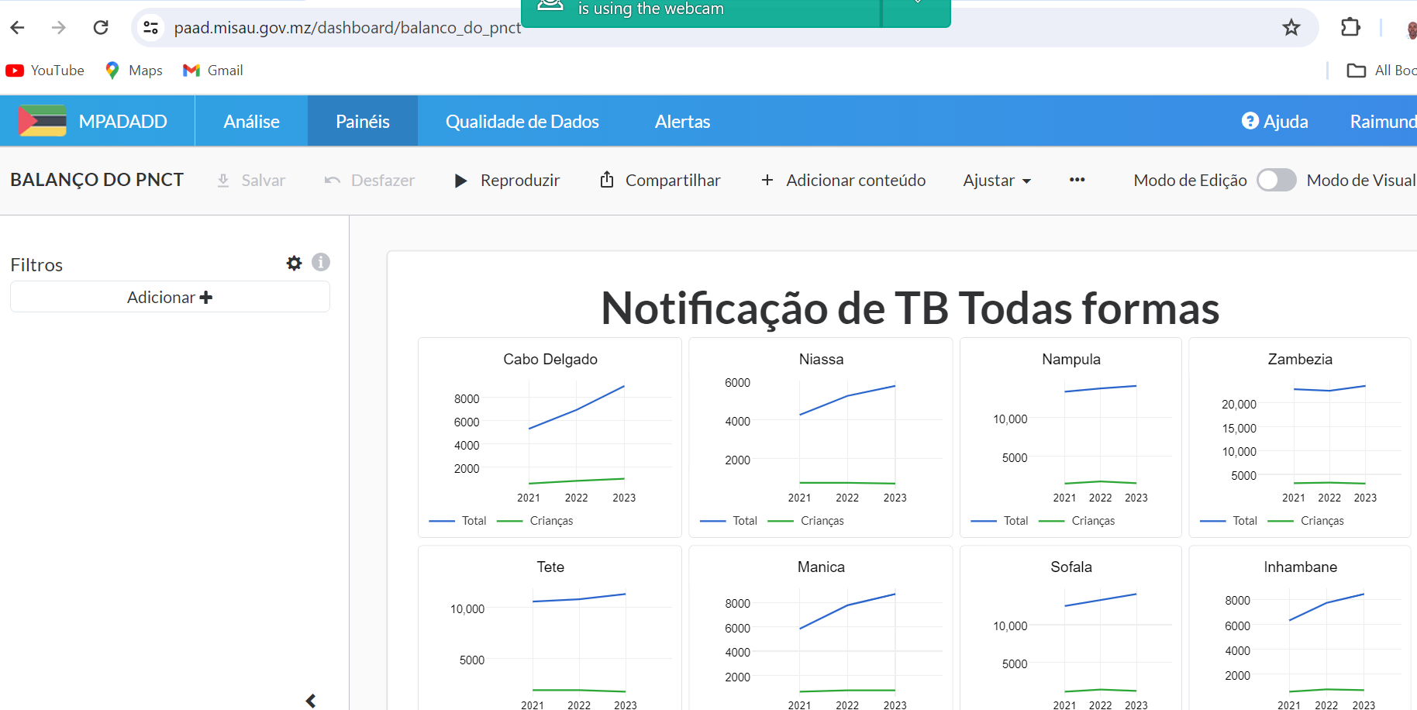
Strategies in place for effectively usingTB data
Implementation of advanced data analytics platform (PAAD) at Province level.
Monthly data analysis meeting (online) with provinces
Data Quality Assurance

Slide 8
Common challenges in TB data quality, collection, analysis, and utilization and potential solutions
Currently the system is paper based at health facilities
Data discrepancies between source document and SISMA
Lack of systematic data audit
Aggregated data makes detailed analysis difficult
Lack of TB M&E officers at Provincial and district levels
High turnover of health works

Slide 9
TB M&E Beyond Numbers: Understanding trends in
PBMEF core indicators

Slide 10
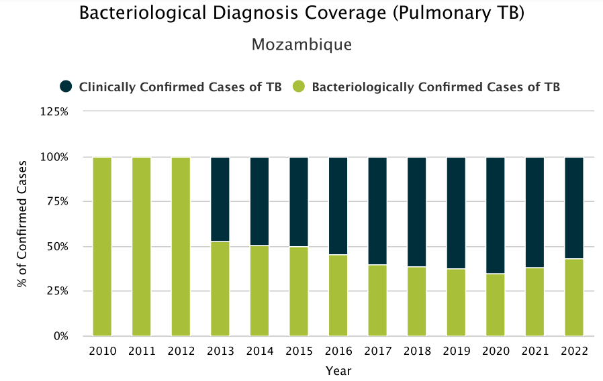
Bacteriological Diagnosis Coverage (Pulmonary TB)

Slide 11
Bacteriological Diagnosis Coverage (Pulmonary TB)

Slide 12
TB MDR Cases Notified, 2014 - 2023

Slide 13


