Slide 1
Strengthening TB M&E Systems:
Data Quality Assurance
April 19, 2024
Africa Regional Workshop
Dar es Salaam, Tanzania

Slide 2
Context for Today’s Discussion
Congress provides funding to USAID and expects us to generate results
$
US Congress
USAID
Data on Results
Notes:
Congress sends money and wants to know about the results

Slide 3


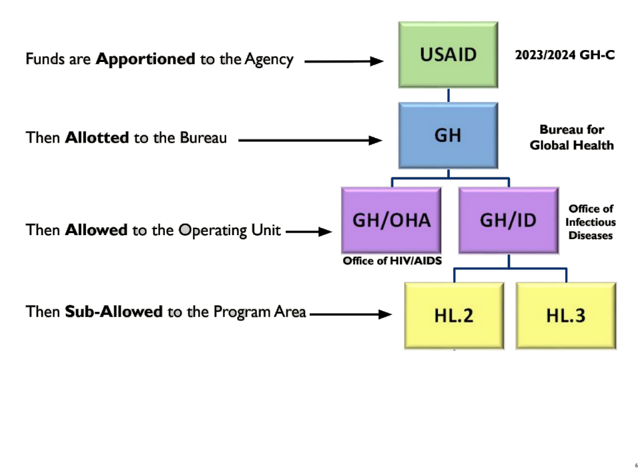

$$ TRAVELS FROM CONGRESS TO THE PROGRAM AREAS
$

Slide 4
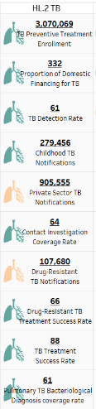

Performance Plan and Report (PPR)
... AND RESULTS ARE REPORTED FROM PROGRAM AREA TO U.S. CONGRESS AND THE AMERICAN PEOPLE
Data on Results
US Congress

Slide 5
BRINGING US TO TODAY’S TOPIC: DATA QUALITY ASSESSMENTS
ADS 597^: For any metric reported by the Agency to External Stakeholders, data quality assessments are required to be conducted.
External Stakeholders = Congress and The American People
ADS does not prescribe a specific way to conduct DQAs
A description of the DQA the processes should accompany the Mission’s OP
(OP = Operations Management Plan: A three-year strategic plan for each USAID Mission)
^ The ADS contains the policies and procedures that guide USAID's programs and operations.

Slide 6
BRINGING US TO TODAY’S TOPIC: DATA QUALITY ASSESSMENTS
ADS 597^: For any metric reported by the Agency to External Stakeholders, data quality assessments are required to be conducted.
External Stakeholders = Congress and The American People
ADS does not prescribe a specific way to conduct DQAs
A description of the DQA the processes should accompany the Mission’s OP
(OP = Operations Management Plan: A three-year strategic plan for each USAID Mission)
Missions: Do you know what your OP says about how data quality is assessed for TB?
^ The ADS contains the policies and procedures that guide USAID's programs and operations.

Slide 7
LET’S COME TOGETHER AND DEFINE DATA QUALITY ASSURANCE IN A WAY THAT MAKES SENSE FOR TB
The risk if we don't... Somebody else may define this for us to follow...

Slide 8

Agenda
Introduction to Case Study
Group Work
Ideation Session
Recap and Summary

Slide 9

Welcome to Zaccosia
NOT A REAL FLAG
NOT A REAL COUNTRY

Slide 10
Legal Disclaimer: This is a work of fiction. Unless otherwise indicated, all the names, facts, data, information, places, events and incidents in this case study are the product of imagination. Any resemblance to actual countries and events, past, present or future are purely coincidental.
ONCE AGAIN...
Zaccosia is NOT a real country.
The data we will be using is MADE UP

Slide 11
Q: But are we using real data?
A: NO!!! The data is 100% fabricated
Frequently Asked Questions:
Q: Is Zaccosia a real country?
A: NO!!! the country is a work of fiction

Slide 12
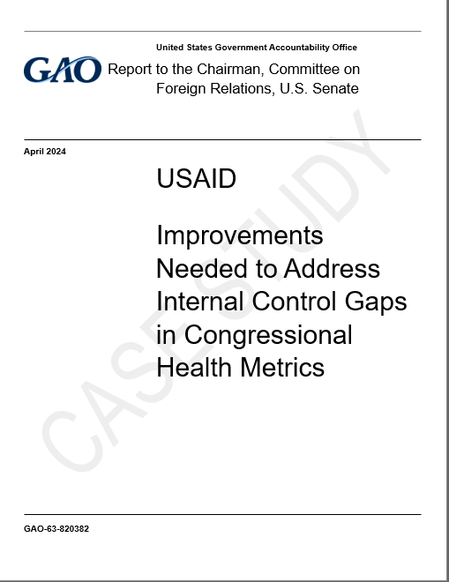

The Government Accountability Office (GAO) conducted a review of DQA protocols and results for USAID Health Program indicators.
Their report to congress found USAID’s data quality controls were OK for project-level data but are not sufficient for indicator data sourced from bilateral stakeholders.

Slide 13
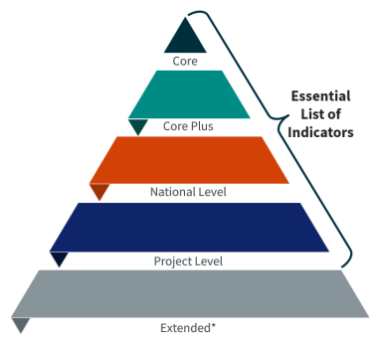
The Government Accountability Office (GAO) conducted a review of DQA protocols and results for USAID Health Program indicators.
Their report to congress found USAID’s data quality controls were OK for project-level data but are not sufficient for indicator data sourced from bilateral stakeholders.
<-- PPR Indicators
<-- Accelerator Call Indicators

Slide 14
In response, the program offices at every USAID mission begun reviewing and updating their OPs for non-project indicators which include the TB Indicators reported in the PPR.
Despite uniform TB indicators reported across countries, lack of consistent guidance on data quality resulted in different DQA protocols from the program offices in each mission, variations in technical approach and operational feasibility are expected.
In other words: We didn’t define a process,
and now a process is being defined for us to follow...

Slide 15
To get ahead of this, USAID TB begun drafting guidance to inform the DQA approach for TB programs and indicators.
As an M&E expert imbedded within Zaccosia MoH, you have earned a reputation for objective analysis. You have agreed to support an effort to inform this guidance.

Slide 16
You begin by visiting a facility and re-familiarizing yourself with the patient registers...

Slide 17
You begin by visiting a facility and re-familiarizing yourself with the patient registers...
A few rules:
Zaccosia adheres to the guidance attached on the tally sheet (WHO Definitions and reporting
framework for TB – 2013 rev)
Info may be missing from this guidance, please use knowledge and assumptions to fill gaps.
Patient treatment cards are not provided
(treatment history, weight, height, bmi, etc.)
There are not always a clear “right” answer for these
We’ve intentionally added ambiguity to emphasize
challenges with a standard approach

Slide 18
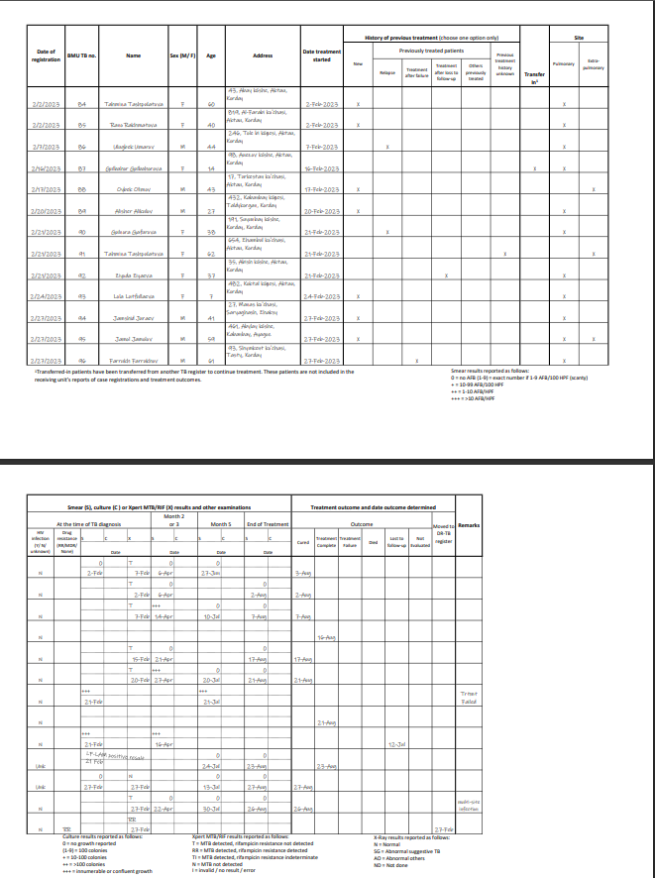
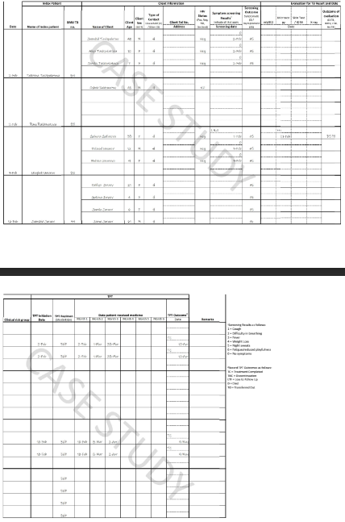
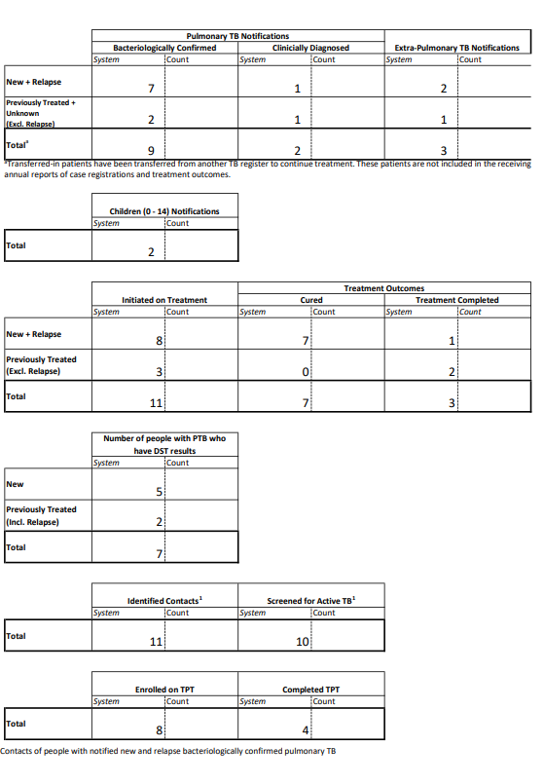
DISTRIBUTE REGISTERS
https://drive.google.com/file/d/1vseE-7NfLnI-TdVWlY10AnruNKf1PO3K/view?usp=drive_link
https://drive.google.com/file/d/1HVA5-FBKTq4ibBROGSTux274ARJCDr5K/view?usp=drive_link
https://drive.google.com/file/d/1R_EegNpUqGOf0AkZCFySvlrecThQcgtv/view?usp=drive_link

Slide 19
Key questions for discussion as you go through the process:
How would you change the register to help with counting / aggregation?
How did you handle missing / incorrect values?
Did your team agree on a methodology for counting each number?
Would a disaggregate (>10 different age disaggs) significantly increase risk of error?
How do we ensure data / reporting changes can be implemented?
While some countries conduct their own DQA, USAID is required by ADS to conduct one as well.
How can USAID’s DQA be designed to complement existing efforts?
What can USAID do to integrate DQA findings at the national level?
What are the key areas for USAD TB DQA guidance to address?

Slide 20
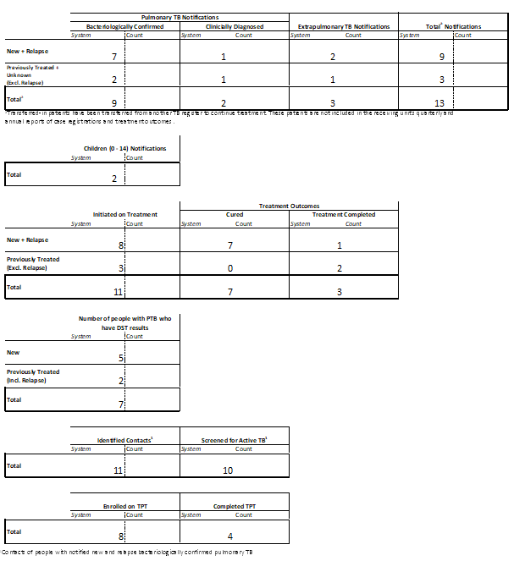
After-activity Discussion
How many people in total were logged in the DS-TB treatment register?
How “Total Notifications” were reported under the facility?
How many people reported under the facility are Bacteriologically confirmed?
Bonus question: Did you include all with a positive mWRD result?
How many cases reported by the facility were cured, how many completed treatment?

Slide 21
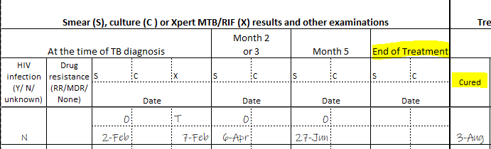
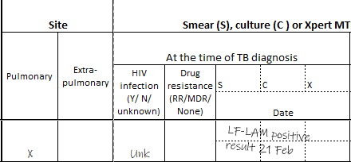
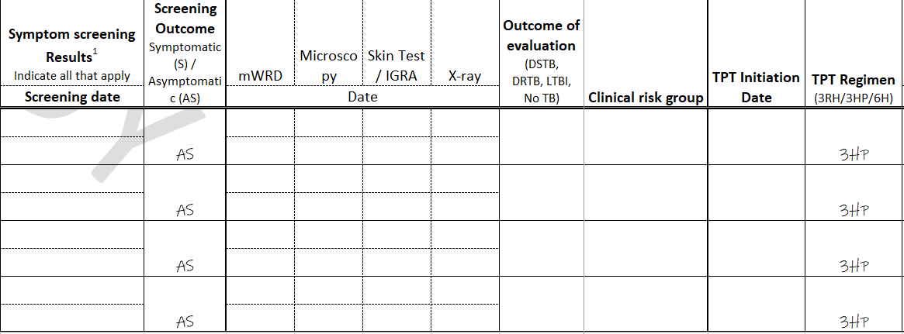
Should the accuracy of patient chart / register be in scope of the DQA?
Example:
No smear / culture result at end of treatment. Count ‘as marked’ or change the clinical records?
Clinician did not follow WHO recommendations, but client DID receive a mWRD and DID test positive.
TB screening date and results were not completed, should we still count as screened?

Slide 22
Should the accuracy of patient chart / register be in scope of the DQA?
Example:
No smear / culture result at end of treatment. Count ‘as marked’ or change the clinical records?
If we make a judgements on a case-by-case, how do we ensure a consistent and efficient DQA process?
One viewpoint: Unless we adjust the official record, we should interpret registers literally.
Clinician did not follow WHO recommendations, but client DID receive a mWRD and DID test positive.
TB screening date and results were not completed, should we still count as screened?

Slide 23
Questions for discussion
While some countries conduct their own DQA, USAID is required by ADS to conduct one as well.
How can USAID’s DQA be designed to complement national data quality activities?
What has USAID done to integrate findings at the national level?
How detailed should the DQA protocols be?
How would you change the design to help with counting / aggregation?
Consider how a new disaggregate (>10 different age disaggs) increase risk of error?
How do we ensure data / reporting changes can be implemented?
How did you handle missing / incorrect / conflicting values?
Did your team agree on a methodology for counting each number?

