Slide 1
Guidance on TB surveillance: overview of content
Marek Lalli

Slide 2
Background
1994 DOTS strategy: standardised recording and regular reporting of people with TB
https://apps.who.int/iris/handle/10665/58717
2006 update: more disaggregation of cases by age, sex, HIV status.
https://apps.who.int/iris/handle/10665/69608
2013 update: new case definitions following WHO approval of rapid molecular tests; minor tweaks in 2014: TB/HIV and 2020: LF-LAM.
https://apps.who.int/iris/handle/10665/79199
2023 update: expanded scope and content, informed by lessons learnt from epidemiological reviews and assessments of surveillance assessments.

Slide 3
Guidance of TB surveillance: content
CHAPTERS
Introduction
Purpose, principles, scope
Definitions
Core indicators to report and use NEW
Core data items to collect
Digital TB surveillance NEW
Data quality NEW

Slide 4
Guidance of TB surveillance: content
WEB ANNEXES
TB surveillance: commonly observed problems and suggested solutions NEW
WHO TB surveillance checklist (2nd edition) NEW
WHO guidance on record linkage NEW
Reporting templates (quarterly and annual data) + indicator formula calculations
Examples of reporting scenarios of diagnosis, start of treatment and treatment outcomes
Evaluation synthesis of case-based DHIS2 implementation in five countries NEW

Slide 5
Thank you

Slide 6
Guidance on TB surveillance: what’s new
Marek Lalli

Slide 7
Structure of presentation
Updates on terms and definitions
Reporting frequency
Updates to core indicators for surveillance (irrespective of type of system)
Additional indicators for surveillance (digital case-based systems only)
New methdologies
Updates to reporting template
Notes:
TO UPDATE

Slide 8
Updates on terms and definitions
Marek Lalli

Slide 9
Updated terms
Old term | New term | Definition | Reason for update
Relapse case | Recurrent case | A person with TB disease who has previously been treated for TB, was declared cured or treatment completed at the end of their most recent course of TB treatment and is now diagnosed with a new episode of TB. Same as previously | Better alignment with case definitions commonly used in clinical trials.

Slide 10
Updated terms
Old term | New term | Definition | Reason for update
Retreatment | Re-registered for treatment | A person with TB disease who has been notified previously as a TB case, who started treatment and took TB drugs for at least 1 month but who was not declared cured or treatment completed, and is now being started on a new course of TB treatment. Same as previously | More accurate descriptor for people who start a new regimen.

Slide 11
Updated terms
Old term | New term | Definition | Reason for update
New or relapse case | New episode | A person with TB disease who is classified as a new case, a recurrent case or a case with unknown previous treatment history (i.e. any case apart from a re-registered case). Same principle as previously | Simplified and more concise descriptor of people newly diagnosed with TB.

Slide 12
Updated terms
Summary of updated terms:
Definitions remain the same as previous definitions and reporting framework.
Instead of saying… | We now say…
Relapse | Recurrent
Retreatment | Re-registered (for treatment)
New or relapse | New episode

Slide 13
Updated Defintions
Old | New | Reason for update
N/A | Case outcomes | To allow for the assessment of outcomes for all patients registered as a TB case, irrespective if they started treatment.

Slide 14
Updated Defintions
Old | New | Reason for update
Different definitions for some treatment outcome categories for DS-TB and DR-TB. | Same definitions for all treatment outcome categories. | It allows for considerable simplification and streamlining of definitions, and is consistent with the outcomes of a WHO consultation convened in 2020.

Slide 15
Updated Defintions
Old | New | Reason for update
Patients transferred onto a new treatment regimen (e.g. first-line to second-line) were recorded as “transferred”. These patients were not included in the treatment success rate for the initial cohort (e.g. DS-TB). | Transfer onto a new regimen (e.g. from first-line to second-line) should be recorded as “treatment failure”. | Optimal treatment should be identified at the start of treatment. Ensures more accurate assessment of treatment outcomes.

Slide 16
Discussion on updated terms and definitions

Slide 17
Reporting frequency
Marek Lalli

Slide 18
Reporting frequency
Rapid (weekly or monthly): detect and act on sudden changes in number diagnosed with a new TB episode
Regular (quarterly): monitor provisional core indicators for epidemiological trends and programmatic responses
Consolidated (annually): monitor a final larger set of indicators for epidemiological trends and programmatic responses
Notes:
NEED TO UPDATE

Slide 19
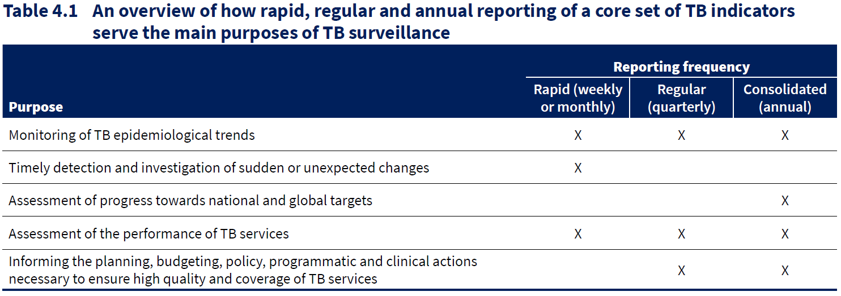
Reporting frequency
Notes:
NEED TO UPDATE

Slide 20
Discussion on reporting frequency

Slide 21
Core indicators for routine surveillance, irrespective of type of system
Marek Lalli

Slide 22
Core indicators
Table 4.6 – Core set of TB surveillance indicators for all countries irrespective of system in place
People diagnosed with TB disease
Coverage of testing for drug resistance among people with bacteriologically confirmed pulmonary TB
Results from testing for drug resistance among people with bacteriologically confirmed pulmonary TB
People requiring treatment for TB disease

Slide 23
Core indicators
Table 4.6 – Core set of TB surveillance indicators for all countries irrespective of system in place
People diagnosed with TB disease
Coverage of testing for drug resistance among people with bacteriologically confirmed pulmonary TB
Results from testing for drug resistance among people with bacteriologically confirmed pulmonary TB
People requiring treatment for TB disease
Business as usual
Updates

Slide 24
Core indicators
Table 4.6 – Core set of TB surveillance indicators for all countries irrespective of system in place
People requiring treatment for TB disease
Key updates: Treatment initiation

Slide 25
Core indicators
Table 4.6 – Core set of TB surveillance indicators for all countries irrespective of system in place
People requiring treatment for TB disease
Key updates: Treatment outcome
…etc for all outcome categories…

Slide 26
Core indicators
Table 4.6 – Core set of TB surveillance indicators for all countries irrespective of system in place
People requiring treatment for TB disease
Key updates: Case outcome
…etc for all outcome categories…

Slide 27
Discussion on updated core indicators

Slide 28
Additional considerations for countries with a case-based digital surveillance system
Marek Lalli

Slide 29
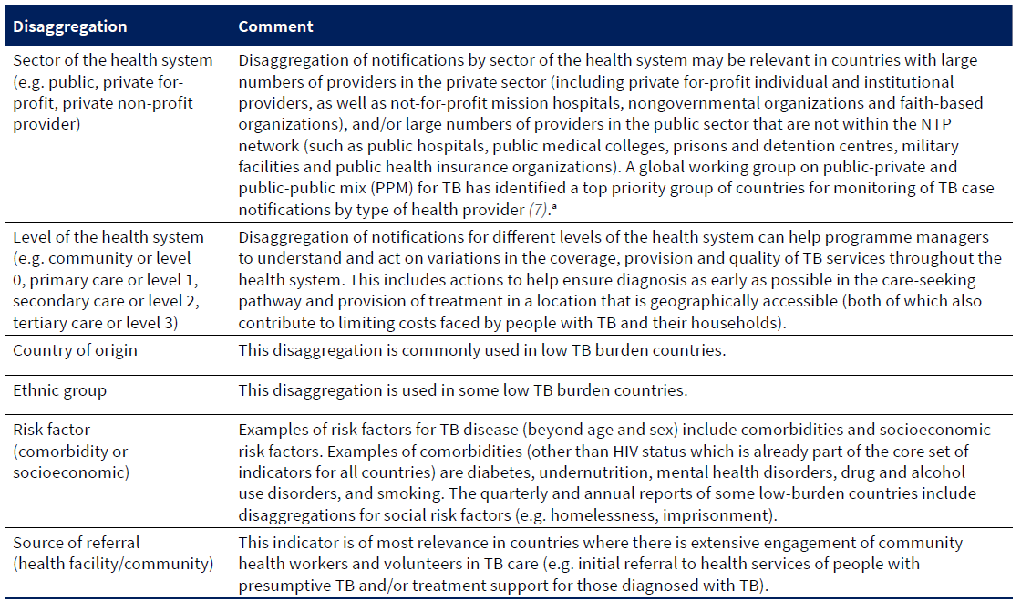
Additional considerations for case-based digital surveillance systems
Table 4.8 – Additional disaggregations of core indicators (case-based digital systems only)
Notes:
NEED TO UPDATE

Slide 30
Additional considerations for case-based digital surveillance systems
Additional recommended indicators (case-based digital systems only)
People with presumptive TB:
Number of diagnostic tests performed for TB using WRDs
Percentage of tests for TB that were positive using WRDs
People diagnosed with TB disease:
Rapid testing for TB: percentage of people diagnosed with a new episode of TB who were initially tested with a WRD
Contacts of people diagnosed with bacteriologically confirmed pulmonary TB disease
Contact investigation coverage: percentage of household contacts who were evaluated for TB
Preventive treatment of contacts: percentage of household contacts who were started on TB preventive treatment, out of those eligible.

Slide 31
Additional considerations for case-based digital surveillance systems
Additional optional indicators (case-based digital systems only)
People diagnosed with TB disease:
Indicator | Comments
Percentage of people with a new episode of TB that is clinically diagnosed who had a WRD test | Observed high proportion of clinically diagnosed cases who had a negative WRD test result, requiring monitoring.
Testing for bedaquiline resistance in people with RR-TB | Monitor scale-up of DST and emergence of resistance
Testing for linezolid resistance in people with RR-TB | Monitor scale-up of DST and emergence of resistance

Slide 32
Additional considerations for case-based digital surveillance systems
Additional optional indicators (case-based digital systems only)
People requiring treatment for TB:
Indicator | Comments
Treatment outcomes disaggregated by age group and sex | Monitor equity in provision of care. Monitor acceptability and adherence to treatment in different populations
Treatment initiation of treatment for RR-TB, disaggregated by fluroquinolone resistance status | Useful for countries with high levels of fluoroquinolone resistance
Treatment outcomes of treatment for RR-TB, disaggregated by fluoroquinolone resistance status | Useful for countries with high levels of fluoroquinolone resistance

Slide 33
Additional considerations for case-based digital surveillance systems
Additional optional indicators (case-based digital systems only)
Contacts of people diagnosed with bacteriologically confirmed pulmonary TB disease
:
Indicator | Comments
Completion rate for TB preventive treatment among contacts (under 5 years old vs above 5 years old). | To complete the cascade of TPT.

Slide 34
New methodologies
Marek Lalli

Slide 35
1. Notifications vs enrollment on treatment
All people diagnosed with TB should be notified (regardless of whether or not they started treatment for TB)
Track reasons for any gaps
Notes:
*hide disaggregation*
*writing a bit small*

Slide 36
1. Notifications vs enrollment on treatment
In the patient record:
Was treatment started? (Yes / No)
If no, reason why:
Died: The person died before TB treatment could be initiated.
Lost to follow-up: The person did not start treatment for any reason other than death.

Slide 37
2. Treatment outcomes vs case outcomes
Treatment outcomes restricted to those who started treatment (assesses treatment performance)
Case outcomes are for all people diagnosed with TB (notified cases), including those who did not start treatment (assesses programmatic performance)

Slide 38
3. Change of treatment regimen
Record outcomes of current treatment as failure
Create a new treatment record for the person, now as re-registered case
Record the new treatment regiment and new date of initation

Slide 39
4. Facility transfer and reporting of outcomes
Old:
Treatment outcomes should be reported back to the referring facility.
Outcomes are recorded and reported by the referring facility.
New:
Treatment outcomes should be recorded and reported by the facility where the patient completed TB treatment.

Slide 40
Reporting template
Marek Lalli

Slide 41
Reporting template
Block approach to build reporting templates.
Aggregate data from linelists to help calculate indicators.
Can be facilitated by digital systems to remove manual aggregation
Yellow shaded areas are for annual reporting only.

Slide 42
Reporting template
Updated language
Block 1. Notifications
 | New episodes |  |  |  | Re-registered cases
 | New cases | Recurrent cases | Unknown previous treatment history
Pulmonary, bacteriologically confirmed | REG.1 | REG.2 | REG.3 |  | REG.8
Pulmonary, clinically diagnosed | REG.4 | REG.5 | REG.6 |  | REG.9
Extrapulmonary, bacteriologically confirmed or clinically diagnosed | REG.7 |  |  |  | REG.10
Total new episodes | REG.11 = REG.1+REG.2+REG.3+REG.4+REG.5+REG.6+REG.7
Total notified | REG.12 = REG.1+REG.2+REG.3+REG.4+REG.5+REG.6+REG.7+REG.8+REG.9+REG.10
Notes:
same as before, but updated language. yellow = annual only.

Slide 43
Reporting template
New age disaggregation
Block 1. New episodes by age group and sex
 | 0−4 | 5−9 | 10−14 | 15−19 | 20−24 | 25–34 | 35–44 | 45–54 | 55–64 | ≥65 | Age unknown/not recorded
Female | REG.13 | REG.14 | REG.15 | REG.16 | REG.17 | REG.18 | REG.19 | REG.20 | REG.21 | REG.22 | REG.23
Male | REG.24 | REG.25 | REG.26 | REG.27 | REG.28 | REG.29 | REG.30 | REG.31 | REG.32 | REG.33 | REG.34
Total |  | REG.35 = Sum of REG.13 to REG.34
Notes:
highlighting the new age groups.

Slide 44
NEW
Blocks 4-7 are also new and follow similar structure
Reporting template
Block 4. Rifamipicin susceptibility testing among people with pulmonary bacteriologically confirmed TB
 | Among those who have never been treated for TB | Among those previously treated for TB (recurrent + re-registered) | Among those with unknown previous treatment history | Total
With documented test result for rifampicin | DST.1 | DST.2 | DST.3 | DST.4 = DST.1+DST.2+DST.3
Resistant to rifampicin (RR-TB) | DST.5 | DST.6 | DST.7 | DST.8 = DST.5+DST.6+DST.7

Slide 45
Reporting template
NEW
Block 8. Enrollment on treatment among all people diagnosed with a new episode of TB
Optional for calculating, not necessarily to be included in the reporting
Registered in this facility | Transferred in to start treatment after registration in another facility | Transferred out after registration to start treatment in another facility | Net registered in this facility after accounting for transfers | Died before treatment started | Lost to follow-up before treatment started | Started on treatment in this facility
ENR.1a | ENR.1b | ENR.1c | ENR.1 = (ENR.1a + ENR.1b – ENR.1c) | ENR.2 | ENR.3 | ENR.4 = (ENR.1 – ENR.2 – ENR.3)

Slide 46
Reporting template
NEW
Block 8. Enrollment on treatment among all people diagnosed with a new episode of TB
Regimen type appropriate for the person | Started on treatment in this facility
Regimens designed to treat rifampicin-susceptible TB (irrespective of HIV status) | ENR.5
Regimens designed to treat rifampicin-susceptible TB (people living with HIV) | ENR.5.H
Short (≤12 months) regimens designed to treat rifampicin-resistant TB (RR-TB/MDR-TB/pre-XDR-TB/XDR-TB) | ENR.6
Long (>12 months and ≤24 months) regimens designed to treat rifampicin-resistant TB (RR-TB/MDR-TB/pre-XDR-TB/XDR-TB) | ENR.7

Slide 47
Reporting template
Updated
Block 9. Treatment outcomes: short (≤ 12 months) treatment regimen
Regimen type appropriate for the person | Started treatment in this facility | Transferred in to continue treatment after starting treatment at another facility | Transferred out to continue treatment in another facility after starting treatment in this facility | Cohort size after accounting for transfers
Regimens designed to treat rifampicin-susceptible TB (irrespective of HIV status) | OUT.1a | OUT.1b | OUT.1c | OUT.1 = (OUT.1a+OUT.1b-OUT.1c)
Regimens designed to treat rifampicin-susceptible TB (people living with HIV) | OUT.1a.H | OUT.1b.H | OUT.1c.H | OUT.1.H = (OUT.1a.H+OUT.1b.H-OUT.1c.H)
Short (≤12 months) regimens designed to treat rifampicin-resistant TB (RR-TB/MDR-TB/pre-XDR-TB/XDR-TB) | OUT.8a | OUT.8b | OUT.8c | OUT.8 = (OUT.8a+OUT.8b-OUT.8c)
Notes:
grey = transfers during treatment.
calculating cohorts accounting for transfer in and outs.
reported one year after (white: on quarterly report, yellow on annual report).

Slide 48
Reporting template
Updated
Block 10: Treatment outcomes: longer (> 12 and ≤ 24 months) treatment regimen
Regimen type appropriate for the person | Started treatment in this facility | Transferred in to continue treatment after starting treatment at another facility | Transferred out to continue treatment in another facility after starting treatment in this facility | Cohort size after accounting for transfers
Regimens designed to treat rifampicin-susceptible TB (irrespective of HIV status) | OUT.1a | OUT.1b | OUT.1c | OUT.1 = (OUT.1a+OUT.1b-OUT.1c)
Regimens designed to treat rifampicin-susceptible TB (people living with HIV) | OUT.1a.H | OUT.1b.H | OUT.1c.H | OUT.1.H = (OUT.1a.H+OUT.1b.H-OUT.1c.H)
Short (≤12 months) regimens designed to treat rifampicin-resistant TB (RR-TB/MDR-TB/pre-XDR-TB/XDR-TB) | OUT.8a | OUT.8b | OUT.8c | OUT.8 = (OUT.8a+OUT.8b-OUT.8c)

Slide 49
Reporting template
New
(only digital case-based)
Block 12: Household contacts: screening and TB preventive treatment
Household contacts of people with a new episode of bacteriologically confirmed pulmonary TB | SCR.1
Household contacts of people with a new episode of bacteriologically confirmed pulmonary TB who were evaluated for TB (disease or infection) | SCR.2
 | Aged <5 years | All ages
Household contacts of people with a new episode of bacteriologically confirmed pulmonary TB eligible for TB preventive treatment | TPT.1 | TPT.2
Household contacts of people with a new episode of bacteriologically confirmed pulmonary TB started on TB preventive treatment | TPT.3 | TPT.4

Slide 50
Reporting template
New
(only digital case-based)
Block 13: Completion of TB preventive treatment
Household contacts of people with a new episode of bacteriologically confirmed pulmonary TB who started TB preventive treatment in the previous calendar year and who completed treatment | TPT.5

Slide 51
Thank you

