Slide 1
USAID Global TB Strategy (2023-2030): Update
Dr. Sevim Ahmedov
Team Lead, TB/HIV, Prevention, and M&E (GH/ID/TB)

Slide 2



Slide 3
Vision: A TB-free world
Mission: Provide high-quality TB technical and development assistance through programs founded on principles of diversity, equity, and inclusion, and implemented in partnership with affected individuals and communities.
Goal: The Agency will work with partners worldwide to reach every person with TB, cure those in need of treatment, prevent new infections and progression to active TB disease, while scaling-up innovations in detection, care, and treatment, and fostering local ownership to sustain TB programs that contribute to pandemic preparedness.
USAID GLOBAL TB STRATEGY 2023-2030

Slide 4
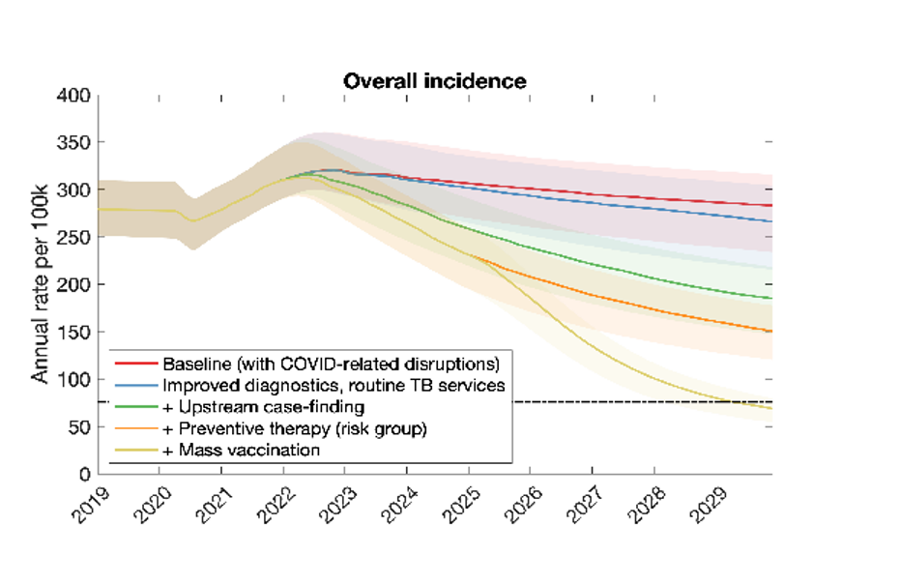
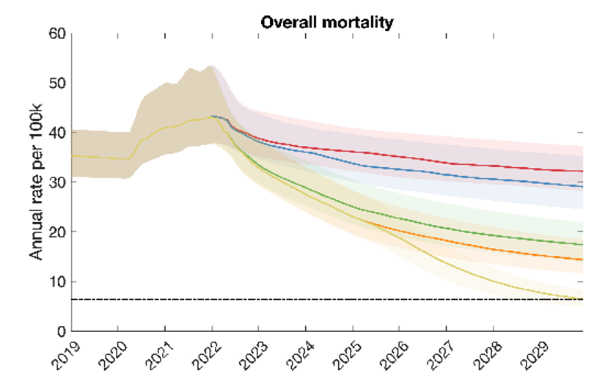
INCIDENCE & MORTALITY MODELING

Slide 5
REACH: Maximize the detection of all forms of TB in all individuals of all ages.
CURE: Ensure that all individuals diagnosed with TB complete treatment and are cured.
PREVENT: Stop the spread of new infections and progression from infection to active TB disease.
INNOVATE: Research, develop, introduce, and scale-up new tools and approaches to combat TB.
SUSTAIN: Build country-owned TB systems, led by local partners, that accelerate progress and support pandemic preparedness.
STRATEGIC OBJECTIVES

Slide 6
RESULTS FRAMEWORK
Measurements | Target
Impact | Reduce TB incidence rate by 35% by 2030 Reduce TB mortality rate by 52% by 2030
Outcome | 90% of incident TB cases diagnosed and initiated on treatment 90% of incident DR-TB cases diagnosed and initiated on treatment 90% treatment success rate (TSR) for DS-TB and DR-TB Provide TB preventive treatment (TPT) to 30,000,000
Process | All priority countries rapidly introduce new TB tools and approaches All priority countries have strong TB national networks and USAID partnerships inclusive of affected communities All priority countries include appropriate TB interventions in pandemic preparedness plans All priority countries have implemented plans to address socio-economic determinants and health-related risk factors that impact the TB epidemic

Slide 7
USAID Global TB Strategy (2023-2030) Targets - Alignment with END TB and UNGA Targets

Slide 8
USAID and WHO End TB Strategy Target Comparison
WHO END TB Strategy
Reduction in TB mortality (2015 baseline)
Reduction in TB incidence (2015 baseline)
SDG 2030 | End TB 2035 |  | USAID Target* | 2030
90% | 95% |  | 52% (2019 baseline) | 90% (2015 baseline)
80% | 90% |  | 35% (2019 baseline) | 80% (2015 baseline)
* Based on modeling assuming full scale up of 1) Improved diagnostics and routine TB services, and 2) Upstream case-finding interventions.

Slide 9
UNHLM TB Political Declaration Paragraph 48
Pledge to accelerate progress towards timely, quality universal access to tuberculosis services in both high and low burden countries, as outlined in the End TB Strategy, such that, by 2027:
a) at least 90% of the estimated number of people who develop tuberculosis are reached with quality assured diagnosis and treatment, with all those diagnosed having been initially tested with WHO-recommended rapid molecular tests, and supported to complete treatment, which translates to providing life-saving treatment for up to approximately 45 million people between 2023 and 2027, including up to 4.5 million children and up to 1.5 million people with drug-resistant tuberculosis;
b) at least 90% of people at high-risk of developing tuberculosis are provided with preventive treatment, which translates to providing up to approximately 45 million people with TB preventive treatment, including approximately 30 million household contacts of people with tuberculosis, including children and approximately 15 million people living with HIV, with the vision of reaching more people, including those who live in remote geographical regions or in areas difficult to access, in accordance with World Health Organization guidance; and,
c) 100% of people with tuberculosis have access to a health and social benefits package so they do not have to have to endure financial hardship because of their illness.

Slide 10
USAID and UNHLM Target Comparison
 | UNHLM |  | USAID
 | # by 2027 | # by 2027 (adjusted for USAID 24 countries*) | % | # by 2027 | # by 2030
TB diagnosed and treated: | 45,000,000 | 34,126,297 | 90% | ~ 34,022,657 | ~ 55,422,972
DR-TB diagnosed and treated: | 1,500,000 | 1,017,096 | 90% | 1,082,381 | 1,841,669
TPT enrollment in contacts: | 30,000,000 | 22,750,865 |  | 22,800,769 | 30,000,000
*TB figures multiplied by .76 and DR-TB figures multiplied by .68 based on estimated TB and DR-TB incidence in USAID countries vs all countries

Slide 11

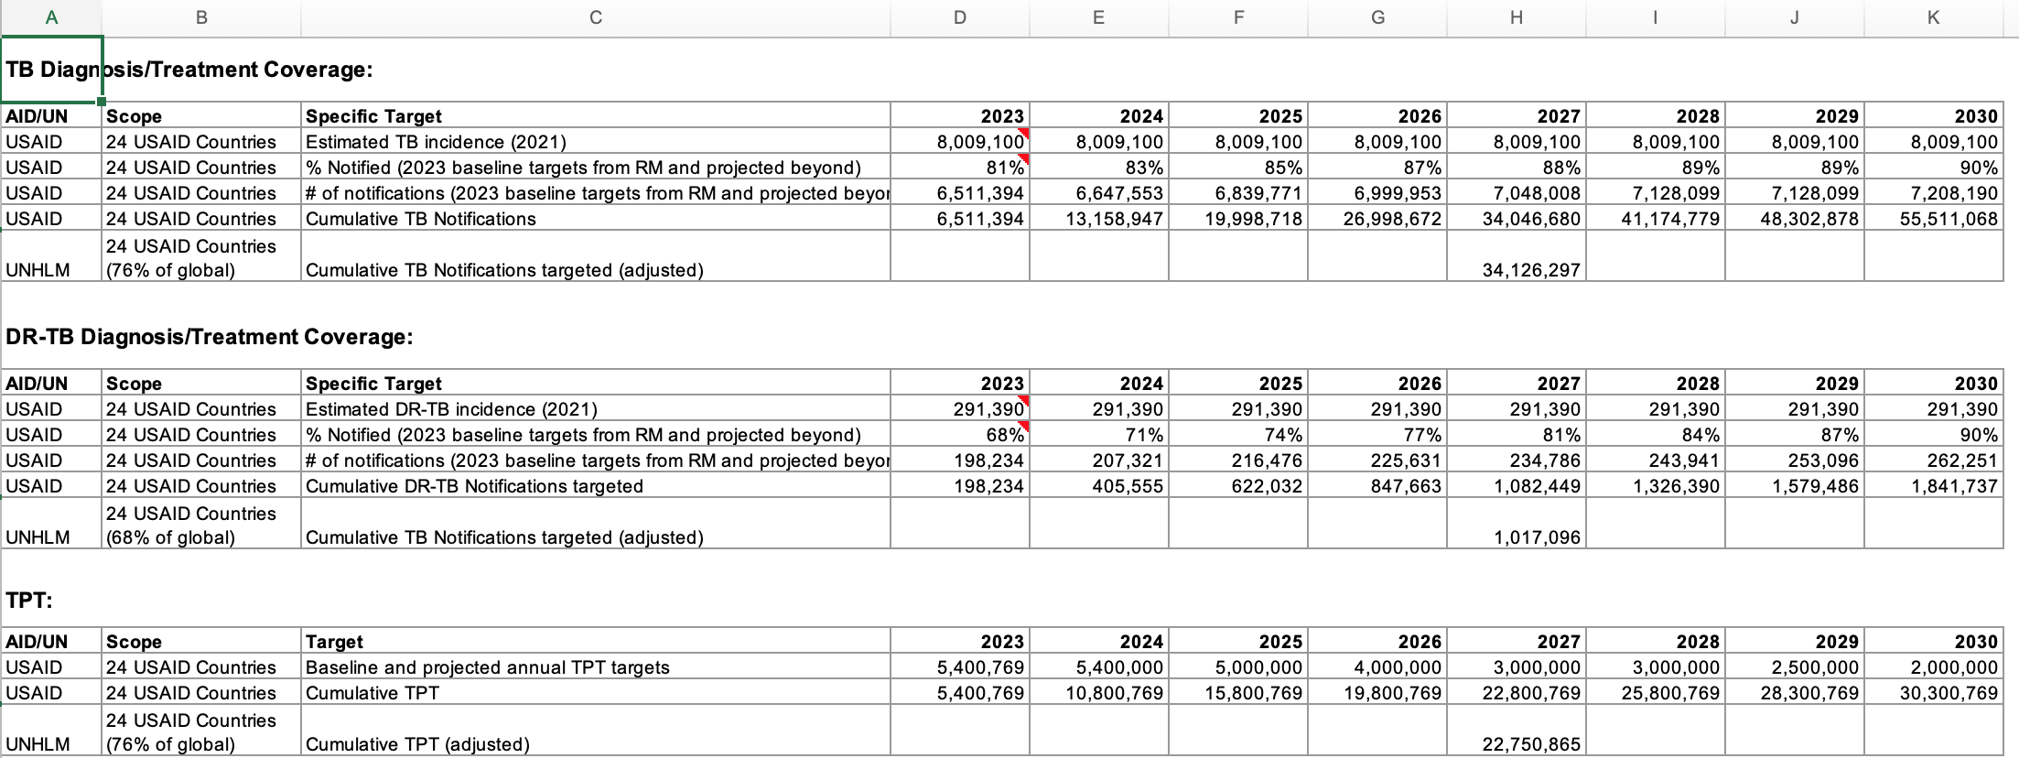
USAID TB Strategy Trajectories

Slide 12
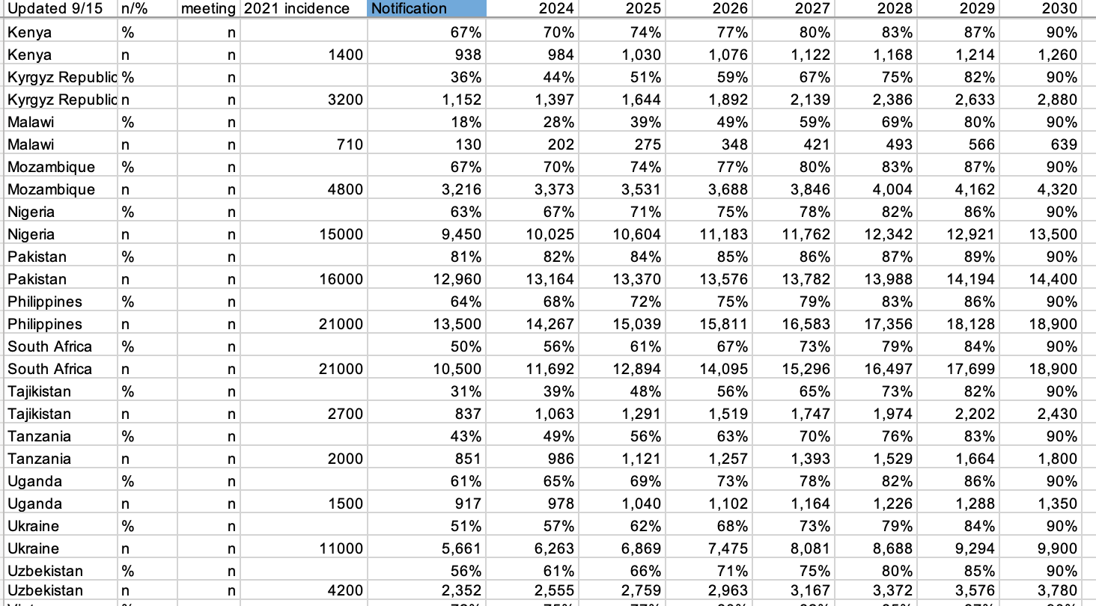
USAID TB Strategy Trajectories

Slide 13
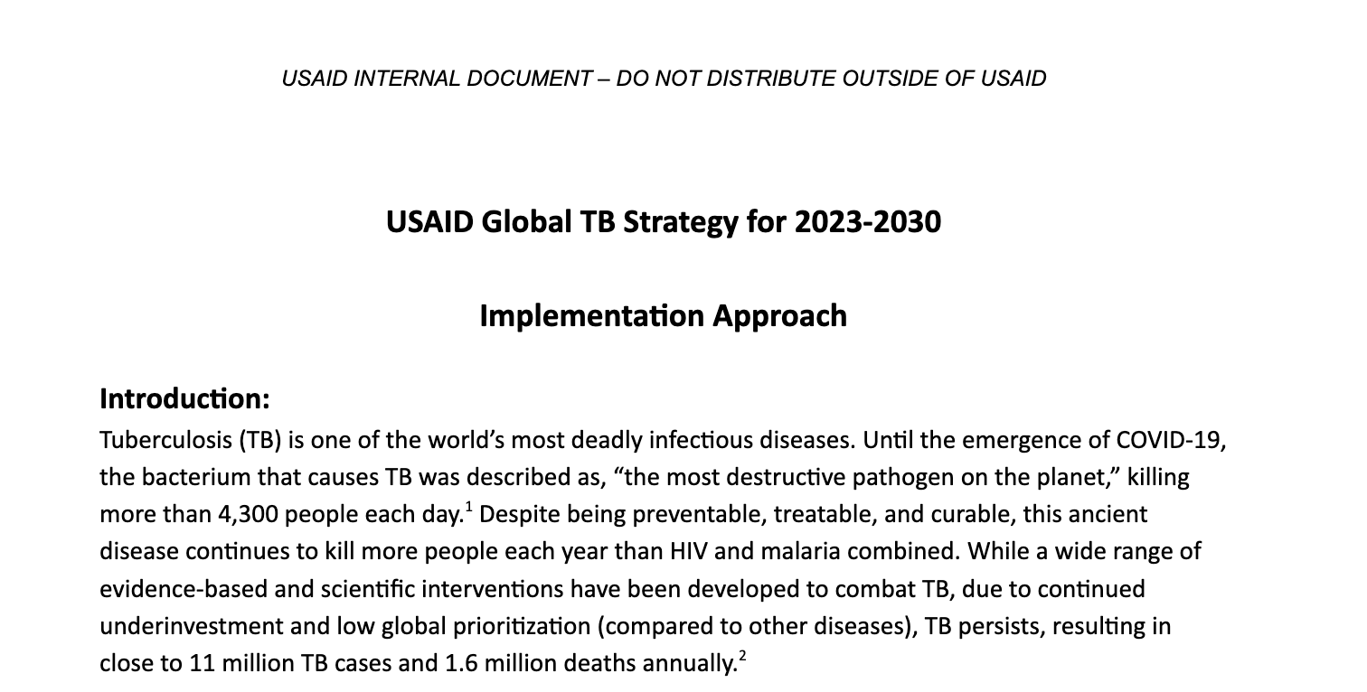

Slide 14
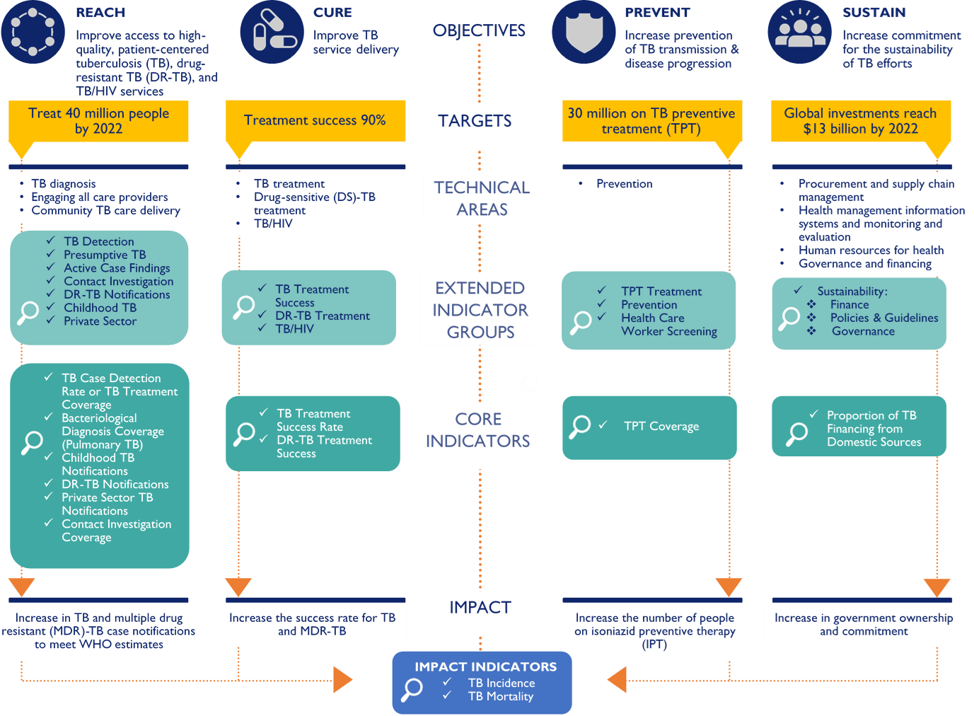

Slide 15
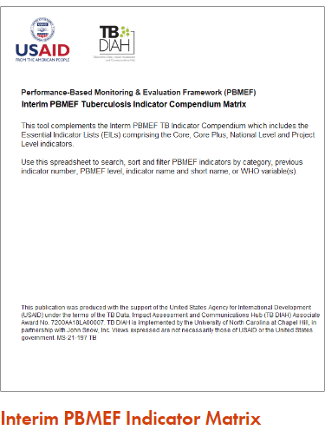
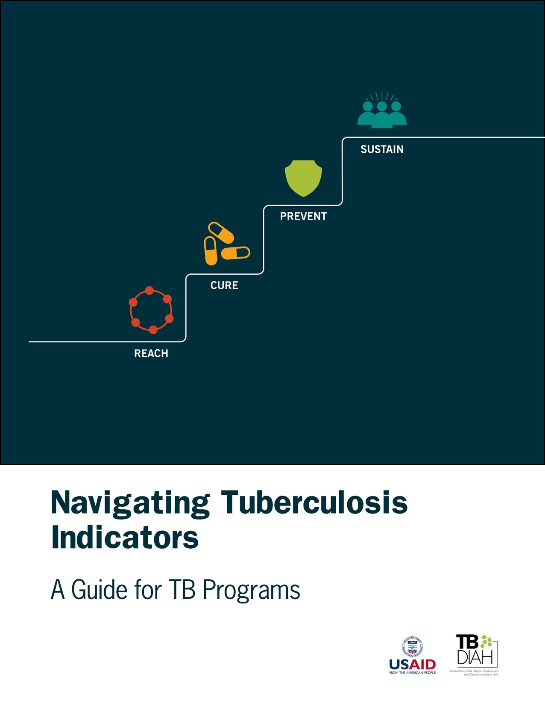
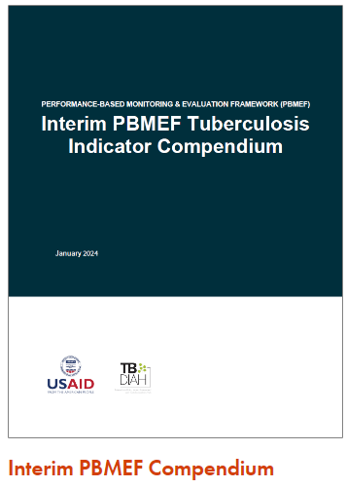
Performance-based M&E Framework (PBMEF)
Cornerstone of USAID’s efforts to ensure effective accountability of investments in TB at global, regional, and country levels and accelerate progress to end the TB epidemic.
PBMEF provides:​
A set of standardized indicators to measure essential TB program outputs and outcomes​
Details on the performance of TB programs in specific technical areas (e.g., diagnosis, treatment, TB/HIV, private sector, etc.)​
Treatment cascades and patient pathways that are critical to understanding where gaps are and where efforts need to be strengthened.
https://www.tbdiah.org/assessments/pbmef/

Slide 16
Refresher: Levels of the PBMEF
They allow more in-depth analysis of TB data and closer M&E of TB programs:
  Provide additional standard options to include in an M&E plan to bolster the justification for programming and funding for specific technical areas in the TB portfolio
  Can be used to construct treatment cascades and patient pathways that are critical to understanding where there are gaps and where efforts need to be strengthened
Core
Essential List of Indicators
Core Plus
National MEL
Project MEL
Extended*

Slide 17
PPR/ACCELERATOR
REPORTING
ACCELERATOR REPORTING
MISSION
REPORTING
MISSION
REPORTING
CORE INDICATORS
CORE
PLUS
MELs
NATIONAL LEVEL
MELs
PROJECT LEVEL
Critical to understanding the progress in TB control: NSP targets, UNGA, HLM.
Included in PPR an thus required for all countries receiving TB bilateral assistance
Reflect national level attainment and recommended for MELs as impact or outcome level measurements to assess the contribution of USAID investments
Some IPs may include for project specific sites for attribution purposes
Provide additional data to monitor toward the progress10 core indicators.
Prioritize key indicators for specific cascades of care
Reflect national level attainment and track the contribution of USAID investments
Expected to be included in MELs of IPs and will become part of bi-annual reporting during Accelerator calls of the TB Division
Provide granular data for in-depth understanding of the epidemiology and performance of program toward national targets
Help meet the reporting requirements articulated in the End TB Now Bill
Recommended for measuring the contribution of USAID investment to national program targets
Inclusion where possible at the project level for attribution
Provide more detailed data to monitor project performance and progress towards targets
Help meet the reporting requirements articulated in the End TB Now Bill
IPs are expected to include these in their MELs to monitor their project level performance and track USAID investments both contribution and attribution where possible

Slide 18






TB Monitoring, Evaluation & Learning Indicators (MELs MUST)
OBJECTIVES
&TARGETS
PPR/ACCELERATOR
ACCELERATOR REPORTING
MISSION REPORTING
CORE
INDICATORS
MELs
NATIONAL LEVEL
MELs
PROJECT LEVEL
CORE PLUS
Improve access to high-quality, patient-centered tuberculosis (TB), drug-resistant TB (DR-TB) and TB/HIV services
TB Detection (DT-3)
Bacteriological Coverage (DT-12)
Childhood TB Notifications (CH-5)
DR-TB Notifications (RN-1)
Private Sector TB Notifications (PR-1)
Contact Investigation Coverage (CI-1)
TB Notifications (DT-1)
Rapid diagnostic testing (DT-15)
Test results for rifampicin (DT-16)
Drug-susceptibility testing results for rifampicin among previously treated (DT-19)
Resistance to rifampicin and resistance to fluoroquinolones (DT-28)
Number needed to test (AF-8)
TB notifications (0-14 years-old) with bacteriological confirmation (CH-11)
Extrapulmonary TB notifications (0-14 years-old) with bacteriological confirmation
CH-12)
(more indicators than listed here)
Individuals screened for TB (AF-2)
Presumptive TB cases identified (AF-4)
Presumptive TB cases tested for TB (AF-5)
Presumptive TB cases with confirmed TB (AF-6)
(more indicators than listed here)
REACH
Treat 40 million people
by 2022
Decrease TB Mortality
DS-TB Treatment success rate (SS-1)
DR-TB Treatment success rate (RS-1)
DR-TB enrolled on treatment (RN-4)
DR-TB initiated on "all oral" short treatment regimen (RN-7)
DR-TB initiated on "all oral" longer treatment regimen (RN-8)
DR-TB cases who developed adverse reaction to DR-TB treatment (RS-6)
DS-TB treatment outcome: Died (SS-2); Treatment failed (SS-3); Lost to follow-up (SS-4); Not evaluated (SS-5)
DR-TB treatment outcome: Died (RS-2); Treatment failed (RS-3); Lost to follow-up (RS-4); Not evaluated (RS-5)
DS-TB patients who receive TB care package (SS-7)
DR-TB patients who receive DR-TB care package (RS-7)
Improve TB service delivery
CURE
90% treatment
success rate
Increase prevention of TB transmission & disease progression
TPT Coverage (PT-1)
TPT – adult household contacts and contacts >5 years coverage (PT-4)
Contacts of TB cases who were screened for TBI (PV-2)
Eligible individuals who started treatment for TBI (PV-3)
Individuals who completed treatment for TBI (PV-4)
Children (<5 years) household contacts initiated on TPT (PT-7)
PLHIV initiated on TPT (PT-8)
HCWs tested for TBI (HW-5))
PREVENT
Decrease TB Incidence
30 million on TB preventative treatment
Increase commitment for the sustainability of TB efforts
Stockout of first-line TB treatment drugs (SN-42)
Stockout of second-line TB treatment drugs (SN-43)"
Stockout of TB diagnostic products (SN-44)
TB stigma reduction (SN-32)
Domestic financing (SN-1)
TB patients covered by insurance (SN-9)
SUSTAIN
Global investments
reach $13 billion by 2022

Slide 19
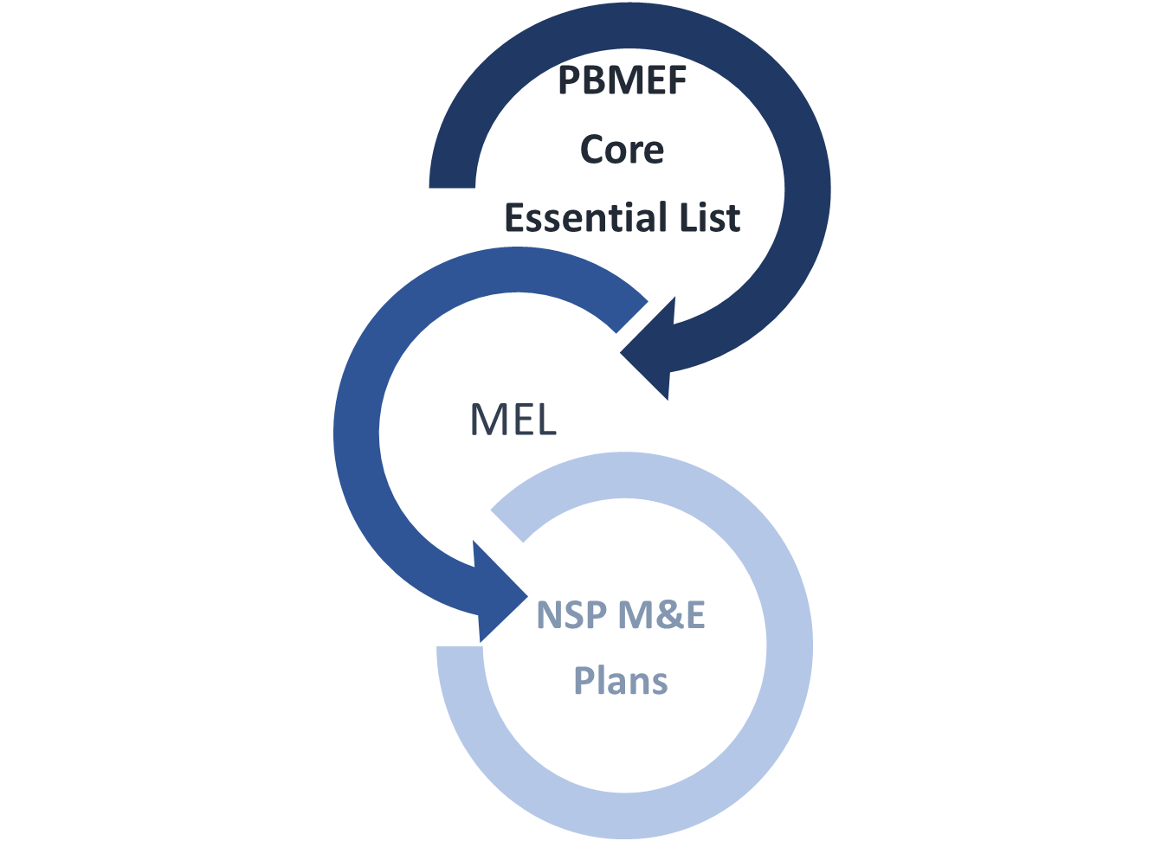
PBMEF Implementation Milestones
Alignment with WHO Guidelines
PPR(DIS)
Accelerator Data Calls
WHO Annual Reporting Process
Integration into:
National M&E and WHO systems
WHO reporting process

Slide 20
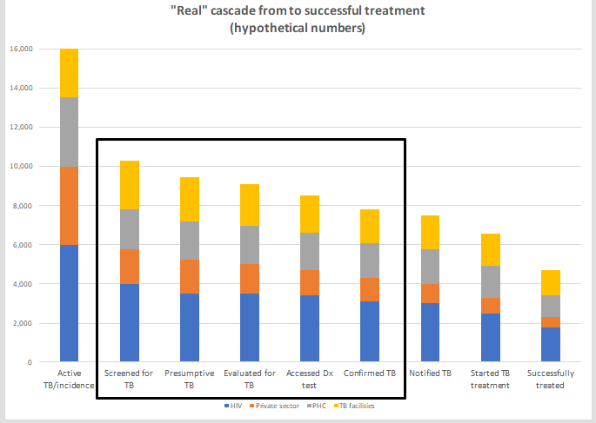
Why the PBMEF?

Slide 21
Notes:
Thank you again, and wish I was there in person.
Wishing you a very successful conference. Thank you again!

Slide 22
