Slide 1

PBMEF In-Depth: Core Indicators
TB PBMEF Cascades Group Work – All countries
Africa Regional Workshop
April 19, 2024
Notes:
Presenter: Stephanie
Notes: Briefly welcome everyone

Slide 2
DS-TB Cascades

Slide 3
ZAMBIA

Slide 4
OUTLINE for the DS-TB Cascade
 | Cases
Estimated incidence of TB (DT_RT) - denominator | 59000
# of people screened for TB (DT_SCRN) | 0
# of people with presumptive TB (DT_PRES) | 657234
# of people who received Dx Testing (DT_TST) | 605955
# of people tested with WRD (DT_WRD) | 543392
# of people with bacteriologically confirmed + clinical dx (BAC_CON)- denominator | 53824
# of people bacteriologically confirmed (BAC_CON)- numerator | 24911
# of people with rapid Dx testing at time of initial diagnosis (NEWREL_WRD) | 37676
# of people who initiatied DS-TB treatement (TX_DS_ENROLL) | 52745
# of people successfully treated (DS_TSR) - numerator | 48635

Slide 5
GRAPH

Slide 6
UGANDA

Slide 7
DST Cascade - Uganda

Slide 8
WHAT?
WHY?
Presumption (2.6%), below the 10%
Yield of TB cases among PTB diagnosed 8.2 %
>95% PBC’s initiated on treatment
44 M+ Screened, but not uniquely identified
Suspicion index is low at 2.6%
  This may vary based on the Target group/interventions
Robust systems for Linkage
  Capacity
  HF notifying expected to initiate treatment
  Bolstered commodity monitoring and availability

Slide 9
SOUTH AFRICA

Slide 10

South Africa – 2023 DS TB Cascade
TB incidence = WHO estimate 2022
Cascade developed using monthly aggregate data (PHC Tick Register, TB Identification Register)
Since March 2023, ‘presumptive’ includes all eligible for testing (symptomatic, TUTT, etc.)
92,9% testing rate for all eligible for a TB test
9,0% ‘positivity rate
92,6% bacteriological confirmation rate
89,5% treatment initiation rate

Slide 11
MALAWI

Slide 12
Cascade analysis of the Mobile Diagnostic units & facility level systematic TB screened in high burden & selected facilities.
Malawi

Slide 13
Mobile Diagnostic Units
Malawi has 12 MDU
Intervention started in March 2018
The target population : key population( urban ,prisoners ,and other key population
% presumptive :6.2%
% tested for TB : 90 %
% bact confirmed : 52 % vs national 70%
all had test result through Xpert utlra
99 % enrolled to TB treatment
treatment outcome : national average
NNS : 118 (Equals to 900/100000 population )

Slide 14
Interpretation
% presumptive :6.2%
  6-8 % in the prevalence survey
% tested for TB :
  90 % some patients failed to produce sputum –% with no test has declined after the cut of point score(CAD4) was revised
% bact confirmed : 52 % vs national 70%
  review of compliance to algorithm being conducted,
  Clinicians are part of the MDU to improve quality of diagnosis
All those that were tested were, tested on a GXP.
99 % enrolled to TB treatment
Treatment outcome : based on the national average & period review planned
National NNS : 118 (Yield of 900/100000 population; PS 1200/100K pop )
  Yield is within acceptable range compared to the prevalence finding survey (urban )

Slide 16
Interpretation
% presumptive TB comparable to the national expectation
Improved testing coverage from previous quarter(82%)
  Quality of TB screening to be strengthened
72% WRD testing coverage: improve coverage testing using WRD
Yield among testing (8%)-
Yield among total screened is relatively high – probably a result of targeting high burden districts (prioritization matrix )
Low prop bact confirmed cases compared to national average
  Review of compliance to national diagnostic algorithm to be strengthened

Slide 17
KENYA

Slide 18


DS TB Cascade

Slide 19
Cascade analysis explained
No. | Gap Identified | Intervention
1. | Low case identification Incidence: 128,000 Cases Identified and Notified: 97,243 Missing 24% of TB cases Target: Increase treatment coverage for DSTB and DRTB to 90% by 2028 | Expand Active Case Finding (ACF); Program Quality and Efficiency (PQE). Strengthen case finding among key vulnerable populations; identify TB hotspots and conduct targeted outreaches Engage all care providers; PPM Interventions scaled up to the whole country. 5 models - Health facility, pharmacy and chemists, diagnostics, workplace and informal service provider Leverage UHC and community systems Quickly adopt new technologies and Innovations; AI, mWRD, Tailoring interventions to sub-national epidemics Multisectoral Engagement - (MAF)
2. | Low presumptive rate among those screened (3%) | Adoption of more sensitive screening tools; digital X-ray fitted with AI Targeted screening among those at higher risk including targeted outreaches Improved and Expanded screening algorithms
3. | Low number of presumptive cases receiving diagnostic testing (60.8%) | Expand coverage for TB diagnostic services; DNO Strengthen and expand the sample referral system in the country Strengthen linkage to diagnosis; linkage assistants, support some private laboratories to offer TB diagnostic services; Documentation and follow up of presumptive cases to ensure they received a TB test

Slide 20
Cascade analysis explained
No. | Gap Identified | Intervention
4. | Low number of people tested with WRD (71% of all that received a diagnostic test) Low number of people with a rapid diagnostic test at the time of initial diagnosis (52%) | Scale up access to quality TB diagnostics services (mWRDs); universal access to DST; Placement of more molecular diagnostic tests and optimization of diagnostic tools Note: Genexpert/Truenat is the first diagnostic test for all presumptive TB cases in Kenya. Ensure uninterrupted supply of diagnostic commodities – Catridges have been a big challenge; strengthen quantification & procurement processes
5. | Low number of people bacteriologically confirmed (51%) | Expand coverage for TB diagnostic services; DNO Strengthen and expand the sample referral network in the country Strengthen linkage to diagnosis; linkage assistants, support some private laboratories to offer TB diagnostic services Documentation and follow up of presumptive cases to ensure they received a TB test
6. | Low TSR: 88% Target: 90% | Engage CHVs for patient support (treatment & psychosocial) and follow up Improve adherence and reduce LTFU; DAT currently being piloted in the country Adoption of shorter 4 months regimen for children; implementation commenced in January 2024 Reduce mortality to <5%, a) the TAP will help to reduce TB mortality among PLHIV b) Promote nutritional care and support for TB patients

Slide 21
TB CI Cascades

Slide 22
TANZANIA

Slide 23
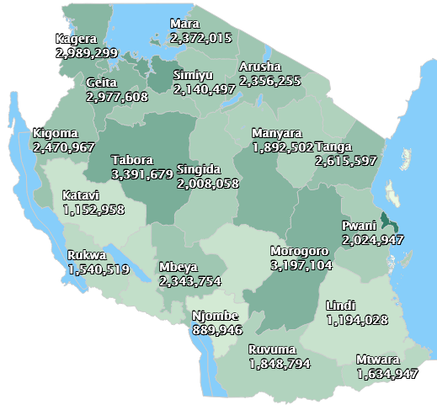
TB CONTACT INVESTIGATION CASCADE ANALYSIS-2023

Slide 25
Observations
  Only 21,943 (56%) of index bacteriologically TB patients initiated to TB CI
  83,462 (93%) of contacts were screened for TB
  1,394 (1.7%) diagnosed with active TB
  Out of eligible <5 years children for TPT, 22,553 (83%) received TPT
  TPT completion indicator started tracking 2023
  TB infection testing is an optional (Tz opted not to test for TB infection)
  Programmatic factors for the observation
  Low coverage of TBCI interventions
    Community health workers (ex-TB patients) are used to conduct TBCI who are few due low resources
  Access of Bacteriologically confirmed TB patients is limited
  Data quality
  Mobile populations like Miners and nomadic not being accessible By CHWs/DOT nurses
  Unclear policy guidelines for TBCI not mentioning the duration to conduct CI
  Insufficient Monitoring of TBCI intervention

Slide 26
NIGERIA

Slide 27
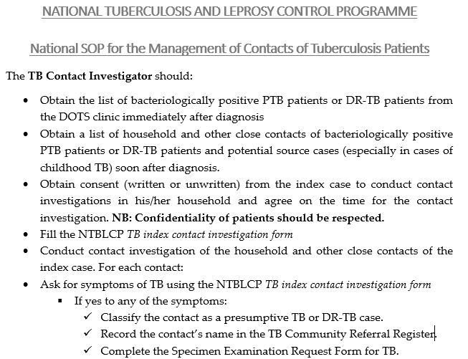
Program Area
.
*Note: Extended indicators are currently under revision

Slide 28
TBCI Cascade (Contacts who screen positive for active TB)
TBCI REPORT 2023
99%
30%
95%
7%
99%
92%
Notes:
Available online

Slide 29
TBCI Cascade (Contacts who screen negative for active TB)
TBCI REPORT 2023
(CON_TBI_TST): Nigeria does not implement TBI testing for contacts of index TB patients
Contacts who test negative for TB are eligible for TPT
88%
Notes:
Available online

Slide 30
ETHIOPIA

Slide 31
TBCI Cascade (Contacts who screen negative for active TB)

Slide 32
TBCI Cascade (Contacts who screen positive for active TB)

Slide 33
TPT Cascade

Slide 34
ZIMBABWE

Slide 35
Country X- TPT Cascade
Jan - Mar 2024

Slide 36
MOZAMBIQUE

Slide 37
Mozambique-TPT Cascade
Eligible for screening?
92%
67%

Slide 38
Mozambique TPT Cascade
Population: Children 0-14y
TPT enrollment: 90% of all eligible / TPT Completion: 90%
67%
61%
Low performance for both indicators (Suggestion: From the eligible who were screened)
Challenges:
System related
Enrollment:
- HCW knowledge? Commitment?
- HF patient flow / weaknesses in coordination between sectors
Completion:
TPT regimen (duration)
Side effects management difficulties
Lack of a robust M&E tools to capture all elements of the cascade
Patients related
Enrollment:
- Caregivers' refusal (lack of knowledge, beliefs, stigma)
- Low access to the TPT services due the long distances to the HFs
Completion:
Lack of information
Long Distance
Lack of care givers commitment
Side effects

Slide 39
THE DEMOCRATIC REPUBLIC OF CONGO

Slide 40
TPT Cascade

Slide 41
TPT Cascade

Slide 42
DS-TB cascade

Slide 43
DS-TB Cascade

Slide 44
Childhood TB Cascade

Slide 45
Pediatric (under 14 years old)* DS-TB Cascade

Slide 46
TB/HIV Cascade

Slide 47
TB/HIV Cascade

Slide 48
INTERNATIONAL GROUP

Slide 49
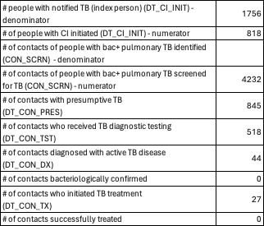
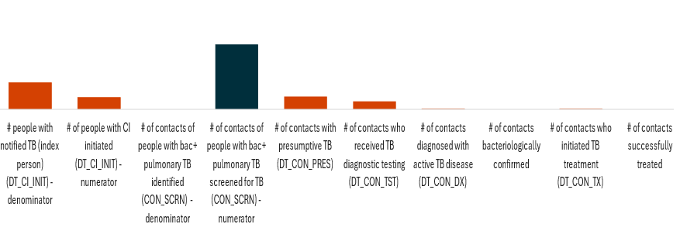
TB-CI Positive Cascade

Slide 50
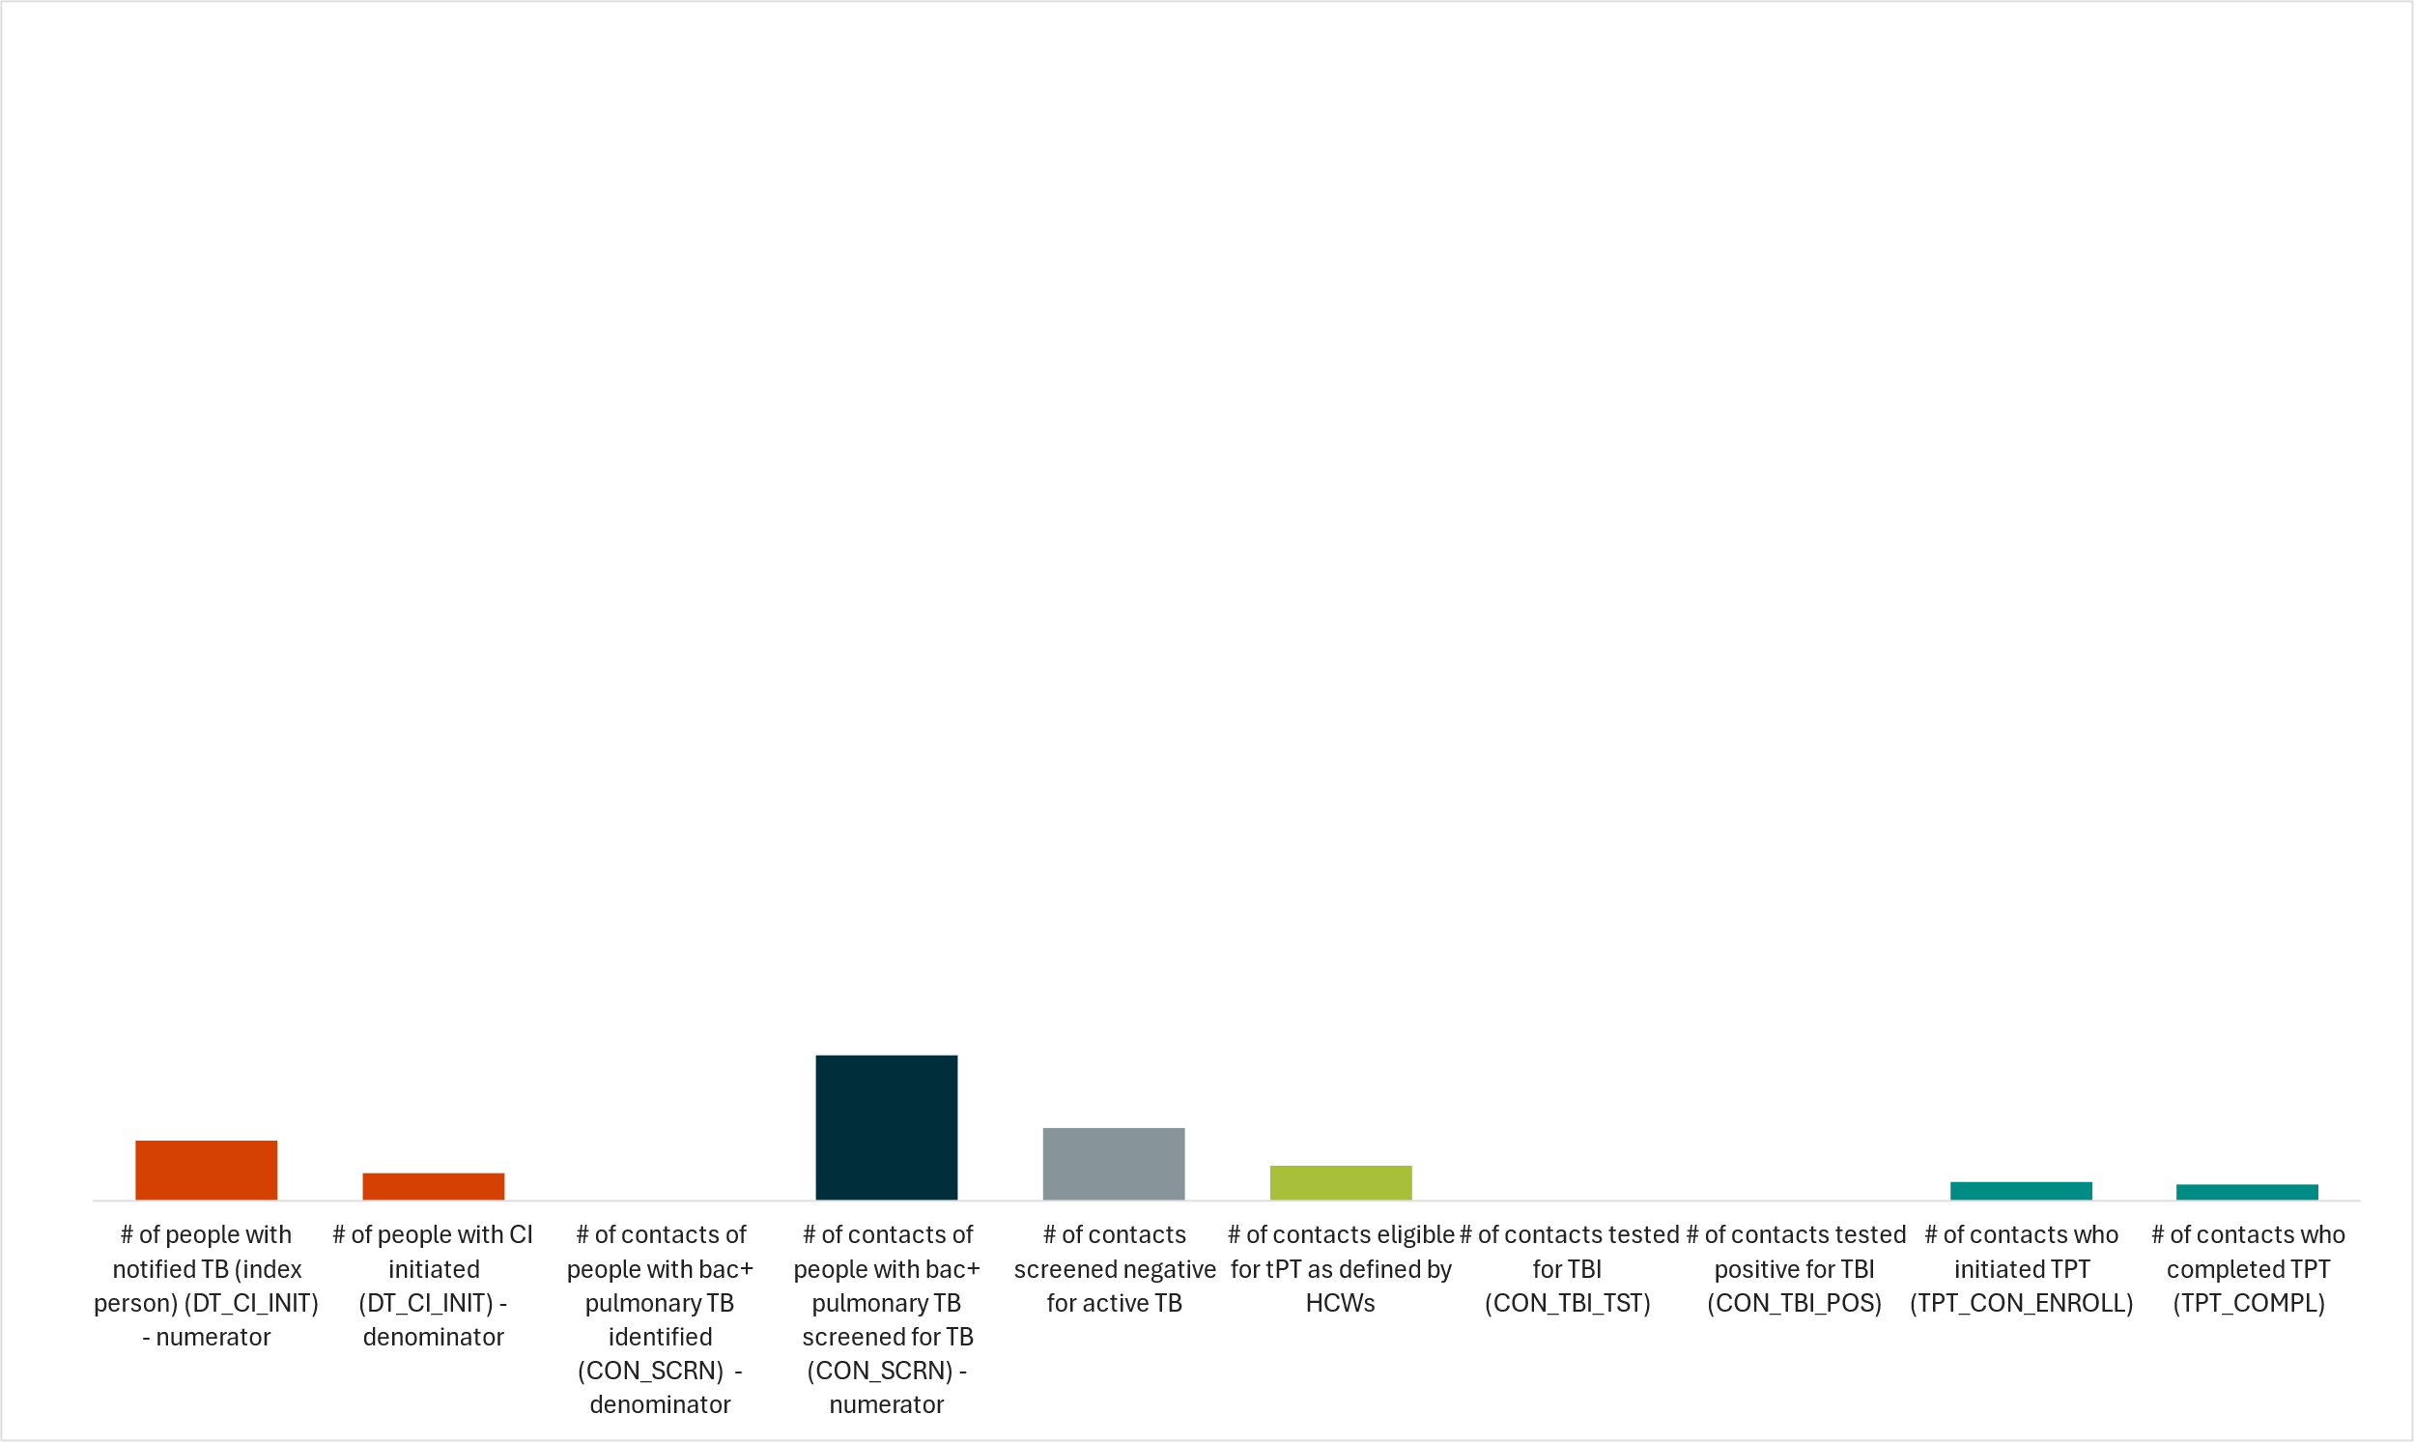
TB-CI Negative Cascade

