Slide 1
Performance-Based Monitoring and Evaluation Framework (PBMEF)
Background and Updates with Key Changes
Africa Regional Workshop
Meaghan Peterson Glenn
M&E Advisor, USAID/W

Slide 2
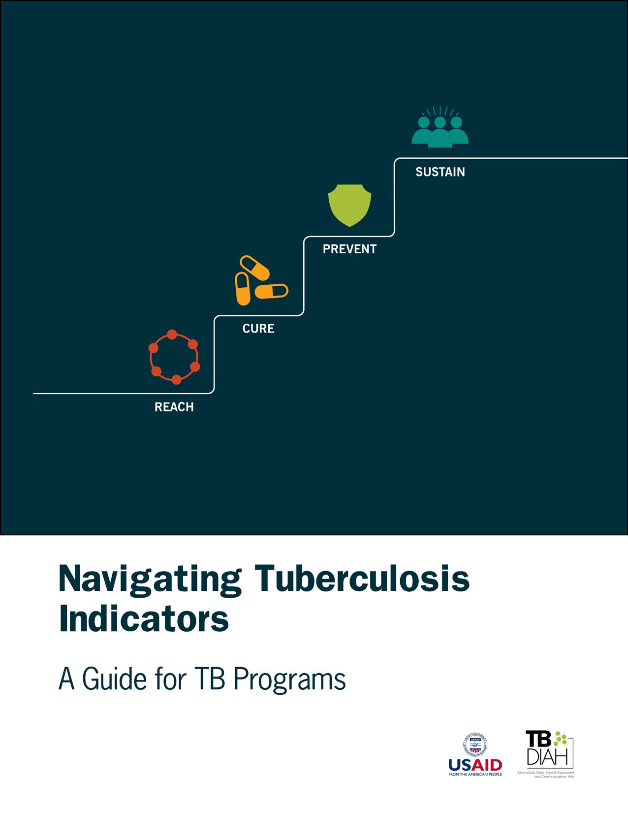
Performance-based M&E Framework (PBMEF)
USAID’s TB M&E Framework which allows for accountability in investments and helps with the standardization, analysis, and use of information across USAID TB priority countries
PBMEF provides:​
  A set of standardized indicators to measure essential TB program outputs and outcomes​
  Details on monitoring performance of TB programs in specific technical areas (e.g., diagnosis, treatment, TB/HIV, private sector, etc.)​

Slide 3
Performance-based M&E Framework (PBMEF) Continued
PBMEF provides (continued):
  Demonstrative cascades and patient pathways with guidance on use of PBMEF indicators to monitor key pathways and perform gap analysis.
Originally published in 2021, currently undergoing revisions
PBMEF will be continually updated to stay current
Governed by the TB Data Special Interest Group (SIG)

Slide 4
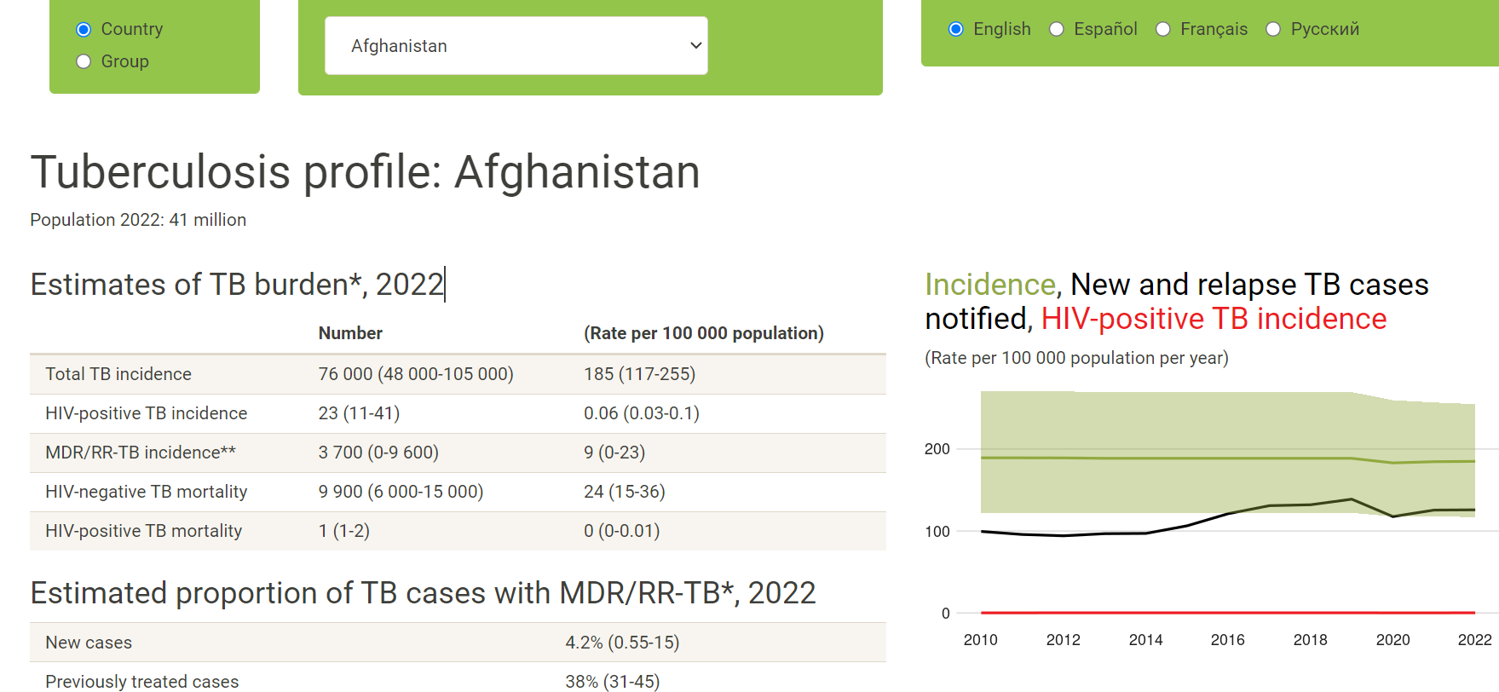

The PBMEF is Shaped by…
WHO Global TB Report and Global TB Database(s)
Notes:
USAID Global TB Strategy: https://www.usaid.gov/global-health/health-areas/tuberculosis/resources/publications/usaid-global-tuberculosis-strategy-2023-2030
WHO Global TB Report: https://www.who.int/teams/global-tuberculosis-programme/tb-reports/global-tuberculosis-report-2023
WHO GLobal TB Database: https://www.who.int/teams/global-tuberculosis-programme/data
UNHLM country level targets from STOP TB: https://www.stoptb.org/unhlm-2023-country-targets-0

Slide 5
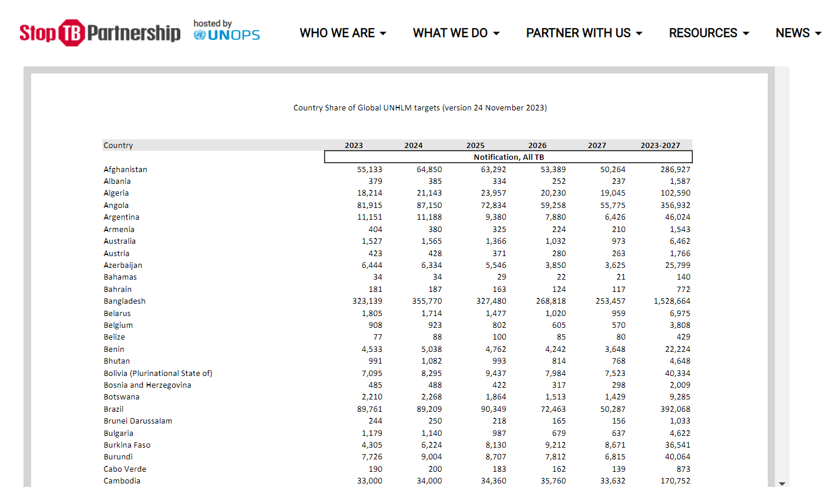
The PBMEF is Shaped by…
WHO Global TB Report and Global TB Database(s)
UNHLM declaration and country level targets from Stop TB Partnership
End TB strategy
Notes:
USAID Global TB Strategy: https://www.usaid.gov/global-health/health-areas/tuberculosis/resources/publications/usaid-global-tuberculosis-strategy-2023-2030
WHO Global TB Report: https://www.who.int/teams/global-tuberculosis-programme/tb-reports/global-tuberculosis-report-2023
WHO GLobal TB Database: https://www.who.int/teams/global-tuberculosis-programme/data
UNHLM country level targets from STOP TB: https://www.stoptb.org/unhlm-2023-country-targets-0

Slide 6
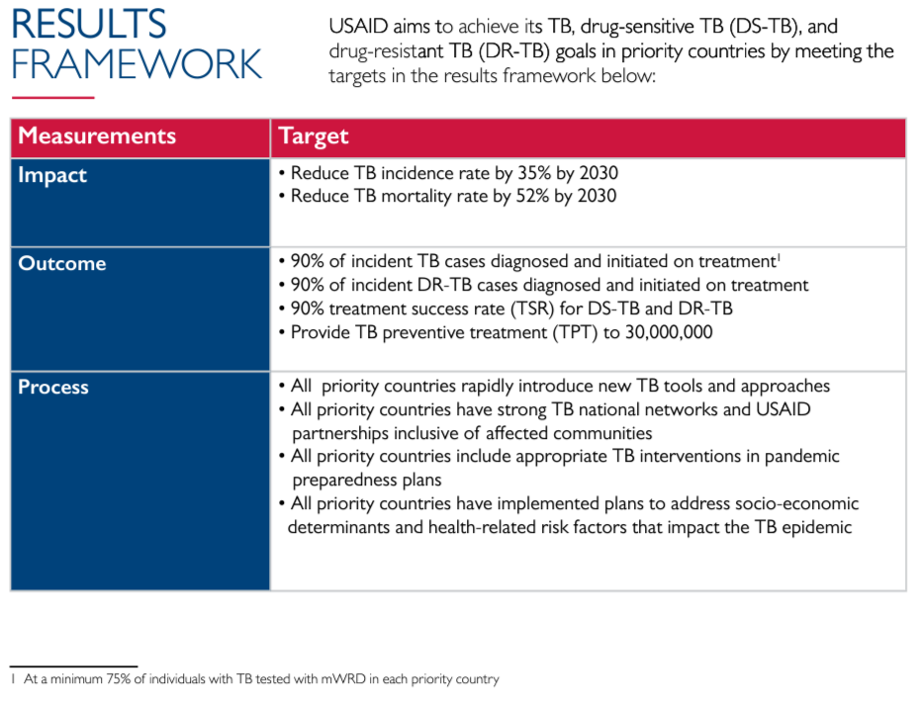
The PBMEF is Shaped by…
WHO Global TB Report and Global TB Database(s)
UNHLM declaration and country level targets from Stop TB Partnership
End TB strategy
USAID Global TB Strategy
  Especially the Results Framework (shown here), which is where the 90-90-90+prevention comes from
Notes:
USAID Global TB Strategy: https://www.usaid.gov/global-health/health-areas/tuberculosis/resources/publications/usaid-global-tuberculosis-strategy-2023-2030
WHO Global TB Report: https://www.who.int/teams/global-tuberculosis-programme/tb-reports/global-tuberculosis-report-2023
WHO GLobal TB Database: https://www.who.int/teams/global-tuberculosis-programme/data
UNHLM country level targets from STOP TB: https://www.stoptb.org/unhlm-2023-country-targets-0

Slide 7
The PBMEF is Shaped by…
Notes:
USAID Global TB Strategy: https://www.usaid.gov/global-health/health-areas/tuberculosis/resources/publications/usaid-global-tuberculosis-strategy-2023-2030
WHO Global TB Report: https://www.who.int/teams/global-tuberculosis-programme/tb-reports/global-tuberculosis-report-2023
WHO GLobal TB Database: https://www.who.int/teams/global-tuberculosis-programme/data
UNHLM country level targets from STOP TB: https://www.stoptb.org/unhlm-2023-country-targets-0

Slide 8
Key Updates to the PBMEF

Slide 9
PBMEF Revision
The PBMEF is undergoing revisions to align with:
  WHO indicators
  USAID strategy
  USAID congressional reporting requirements
Key updates
  Established the essential list of indicators
  Created standardized indicator reference sheets for all essential indicators
  Aligned indicator definitions with evolving global standards and new strategies/targets that have been released
  Reviewing guidance on analysis, reporting, data use, etc.
The TB Data SIG has been the main forum for seeking feedback throughout review and governing changes

Slide 10
TB Data SIG
As mentioned, the TB Data Special Interest Group (SIG) is the governing body for the PBMEF
The SIG also covers other TB data related topics; examples from past SIG presentations have included:
  Presentation on WHO TB M&E guidelines
  How to incorporate USAID’s PBMEF into activity MEL plans
The SIG generally meets once monthly
Members are people working with TB including staff from USAID missions, USAID advisors, and partner organizations
The chairs are Anna Meltzer and Amar Shah
For more information or to be added to the TB SIG mailing list, please contact ameltzer@usaid.gov

Slide 11
PBMEF Essential List of Indicators
Essential indicators have been identified with consultation from technical teams at USAID and input from the TB Data SIG as crucial indicators to TB program monitoring
This list builds on the established 10 core indicators and continues that system of grouping with core plus, national and project level
While all indicators are important, some may not be readily available in national reporting systems
Core
Essential List of Indicators
Core Plus
National Level
Project Level
Extended*
*Note: Extended indicators are currently under revision

Slide 12
PBMEF Essential List of Indicators
All have been identified as crucial indicators to TB program monitoring
Core: established 10 priority indicators; included in PPR reporting and bi-annual Accelerator reporting. All projects receiving TB funds must report on Core indicators
Note these will remain the only indicators reported for PPR.
Core
Essential List of Indicators
Core Plus
National Level
Project Level
Extended*
*Note: Extended indicators are currently under revision

Slide 13
PBMEF Essential List of Indicators
All have been identified as crucial indicators to TB program monitoring
Core Plus: essential details to understand core indicators; reported for our bi-annual TB Accelerator calls
Core
Essential List of Indicators
Core Plus
National Level
Project Level
Extended*
*Note: Extended indicators are currently under revision

Slide 14
PBMEF Essential List of Indicators
All have been identified as crucial indicators to TB program monitoring
National: additional data that should be available at national level and helps to complete key cascades; if these data aren’t available at national level they can be monitored at project level
Project: additional steps in cascades that may not be available at national level; if these data are available at national level they can also be monitored at national level.
Core
Essential List of Indicators
Core Plus
National Level
Project Level
Extended*
*Note: Extended indicators are currently under revision

Slide 15
PBMEF Essential List of Indicators
All have been identified as crucial indicators to TB program monitoring
Extended: index of additional standardized indicators to help meet project needs for specific activities, if more detail is wanted than what is provided by essential indicators.
Note the extended indicators are currently being revised for the new PBMEF. The essential list have been published in interim publications with reference sheets.
Core
Essential List of Indicators
Core Plus
National Level
Project Level
Extended*
*Note: Extended indicators are currently under revision

Slide 16
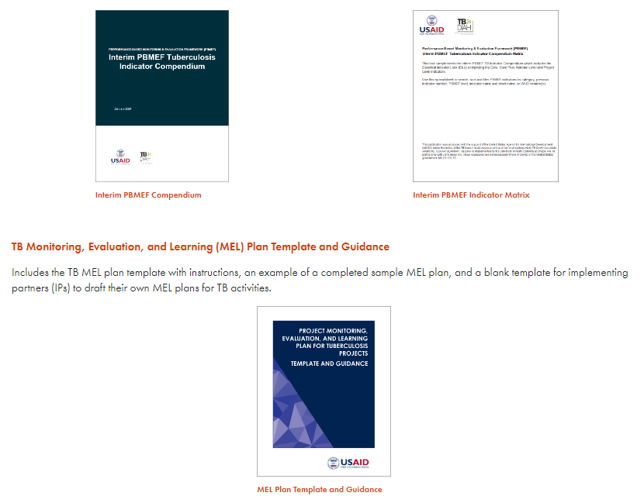
PBMEF Revision Continued
To date we have published interim publications focusing around the essential indicators; the remainder of the Guide document and the extended indicators are still under revision
Interim publications:
https://www.tbdiah.org/assessments/pbmef/
  Interim PBMEF Tuberculosis Indicator Compendium
  Interim PBMEF Indicator Matrix
  MEL Plan Template

Slide 17
Brief Overview of
Indicator Updates

Slide 18
Naming Conventions for Indicators
Indicator naming convention has been created with meaningful components for each indicator; the old numbers will still be mentioned in the indicator reference sheets for continuity but we encourage using the new names
Examples:
  DS_TSR: drug susceptible TB treatment success rate
    DS: DS-TB
    TSR: Treatment Success Rate
  TPT_ENROLL: number of TPT enrollments
    TPT: TB Preventive Treatment
    ENROLL: enrolled (i.e. initiated treatment)

Slide 19
Core Indicators: Updated Names (No Change to Definitions)
DT_RT: TB Detection Rate (Treatment Coverage)
BAC_CON: Percent Bacteriologically Confirmed
PEDS_NOTIF: Childhood TB Notifications
MDR_NOTIF: RR/MDR-TB Notifications
PR_NOTIF: Private Sector TB Notifications
CON_SCRN: Percent of Contacts Screened for TB
Updated from “Bacteriological coverage”
Updated from “CI Coverage”
DS_TSR: DS-TB Treatment Success Rate
DR_TSR: DR-TB Treatment Success Rate
TPT_ENROLL: TPT Initiations
SN_DOMESTICR: Percent of TB Financing Received from Domestic Sources

Slide 20
Core Indicators: Updated Definitions
DT_RT: TB Detection Rate (Treatment Coverage)
BAC_CON: Percent Bacteriologically Confirmed
PEDS_NOTIF: Childhood TB Notifications
MDR_NOTIF: RR/MDR-TB Notifications
PR_NOTIF: Private Sector TB Notifications
CON_SCRN: Percent of Contacts Screened for TB
Updated to include MDR only (no pre-XDR/XDR)
Name updated from “TPT Coverage”; will also be updated in next PPR measure TPT in contacts (no PLHIV)
DS_TSR: DS-TB Treatment Success Rate
DR_TSR: DR-TB Treatment Success Rate
Updated from “expected” to “received”
TPT_ENROLL: TPT Initiations
SN_DOMESTICR: Percent of TB Financing Received from Domestic Sources

Slide 21






TB Monitoring, Evaluation & Learning Indicators (MELs MUST)
OBJECTIVES
&TARGETS
PPR/ACCELERATOR
ACCELERATOR REPORTING
MISSION REPORTING
CORE
INDICATORS
MELs
NATIONAL LEVEL
MELs
PROJECT LEVEL
CORE PLUS
Improve access to high-quality, patient-centered tuberculosis (TB), drug-resistant TB (DR-TB) and TB/HIV services
TB Detection (DT-3)
Bacteriological Coverage (DT-12)
Childhood TB Notifications (CH-5)
DR-TB Notifications (RN-1)
Private Sector TB Notifications (PR-1)
Contact Investigation Coverage (CI-1)
TB Notifications (DT-1)
Rapid diagnostic testing (DT-15)
Test results for rifampicin (DT-16)
Drug-susceptibility testing results for rifampicin among previously treated (DT-19)
Resistance to rifampicin and resistance to fluoroquinolones (DT-28)
Number needed to test (AF-8)
TB notifications (0-14 years-old) with bacteriological confirmation (CH-11)
Extrapulmonary TB notifications (0-14 years-old) with bacteriological confirmation
CH-12)
(more indicators than listed here)
Individuals screened for TB (AF-2)
Presumptive TB cases identified (AF-4)
Presumptive TB cases tested for TB (AF-5)
Presumptive TB cases with confirmed TB (AF-6)
(more indicators than listed here)
REACH
Treat 40 million people
by 2022
Decrease TB Mortality
DS-TB Treatment success rate (SS-1)
DR-TB Treatment success rate (RS-1)
DR-TB enrolled on treatment (RN-4)
DR-TB initiated on "all oral" short treatment regimen (RN-7)
DR-TB initiated on "all oral" longer treatment regimen (RN-8)
DR-TB cases who developed adverse reaction to DR-TB treatment (RS-6)
DS-TB treatment outcome: Died (SS-2); Treatment failed (SS-3); Lost to follow-up (SS-4); Not evaluated (SS-5)
DR-TB treatment outcome: Died (RS-2); Treatment failed (RS-3); Lost to follow-up (RS-4); Not evaluated (RS-5)
DS-TB patients who receive TB care package (SS-7)
DR-TB patients who receive DR-TB care package (RS-7)
Improve TB service delivery
CURE
90% treatment
success rate
Increase prevention of TB transmission & disease progression
TPT Coverage (PT-1)
TPT – adult household contacts and contacts >5 years coverage (PT-4)
Contacts of TB cases who were screened for TBI (PV-2)
Eligible individuals who started treatment for TBI (PV-3)
Individuals who completed treatment for TBI (PV-4)
Children (<5 years) household contacts initiated on TPT (PT-7)
PLHIV initiated on TPT (PT-8)
HCWs tested for TBI (HW-5))
PREVENT
Decrease TB Incidence
30 million on TB preventative treatment
Increase commitment for the sustainability of TB efforts
Stockout of first-line TB treatment drugs (SN-42)
Stockout of second-line TB treatment drugs (SN-43)"
Stockout of TB diagnostic products (SN-44)
TB stigma reduction (SN-32)
Domestic financing (SN-1)
TB patients covered by insurance (SN-9)
SUSTAIN
Global investments
reach $13 billion by 2022

Slide 22

Q&A

Slide 23

For more information
Sevim Ahmedov
TB/HIV, Prevention and M&E Team Lead
AOR TB DIAH
Tuberculosis Division
Office of Infectious Disease,
Bureau for Global Health
USAID
Meaghan Peterson Glenn
TB Monitoring and Evaluation Advisor,
Tuberculosis Division
Office of Infectious Disease,
Bureau for Global Health
USAID
sahmedov@usaid.gov
meapeterson@usaid.gov
Notes:
Links for chat:
Sevim sahmedov@usaid.gov
Meaghan meapeterson@usaid.gov

Slide 24

Live Links
TBDIAH.org
http://www.tbdiah.org
PBMEF
https://www.tbdiah.org/assessments/pbmef/
QTSA
https://www.tbdiah.org/assessments/quality-of-tuberculosis-services-assessments/
D2AC
https://www.tbdiah.org/assessments/d2ac/
Data Analysis & Visualizations
http://hub.tbdiah.org

