Slide 1


Africa Regional Workshop on Strengthening TB Monitoring and Evaluation Systems
16-19 April, 2024 • Dar es Salaam, Tanzania
NTP UPDATES: Malawi

Slide 2
Country TB Profile and TB Situation Snapshot

Slide 3
Overview of the National TB/Leprosy Strategic Plan (NSP)
Vision: A TB and Leprosy free Malawi
Mission: Ensure effective, equitable and accessible TB and Leprosy prevention, diagnosis, treatment and care services in Malawi
Goals:
Reduce TB incidence by 50% and mortality by 75% from 2015 to end of 2025.
Reduce TB incidence to 97/100,000
  Reduce TB related mortality of all TB patients to 18/100,000
  Zero catastrophic costs due to TB among affected families (i.e. less than 20% of annual household income)
  Eliminate Leprosy in all districts by 2025 (less than 1 case per 10,000 pop.)
Pillars of the NSP:
Patient-centered care and prevention
TB co-morbidities and key populations
Bold policies and supportive systems
Program management, M&E, research & innovation
Notes:
On the goals and progress so far, perhaps let us use uniform parameters, if %age, then %age for both | if rate/100,000, then should be the same for both so that people can appreciate the progress made thus far.

Slide 4
Progress Towards End-TB targets
 | 2015 | 2022 | 2022-2015 | % of change | Milestone by 2025
Incidence TB per 100,000 | 197 | 125 | -72 | -37% | 50%
Incidence TB/HIV per 100,000 | 105 | 61 | -44 | -42%
Mortality hiv negative # | 3700 | 1900 | -1800 | -49% | 75%
mortality HIV pos # | 7800 | 3600 | -4200 | -54% | 75%
Incidence rate declined by 37 % --- anticipated to reach 50% by 2025
Overall mortality declined by 49(hiv negative ) & 54%(HIV positive ) individuals
With the current rate of decline - Malawi is projected to meet the 2025 milestones.

Slide 5
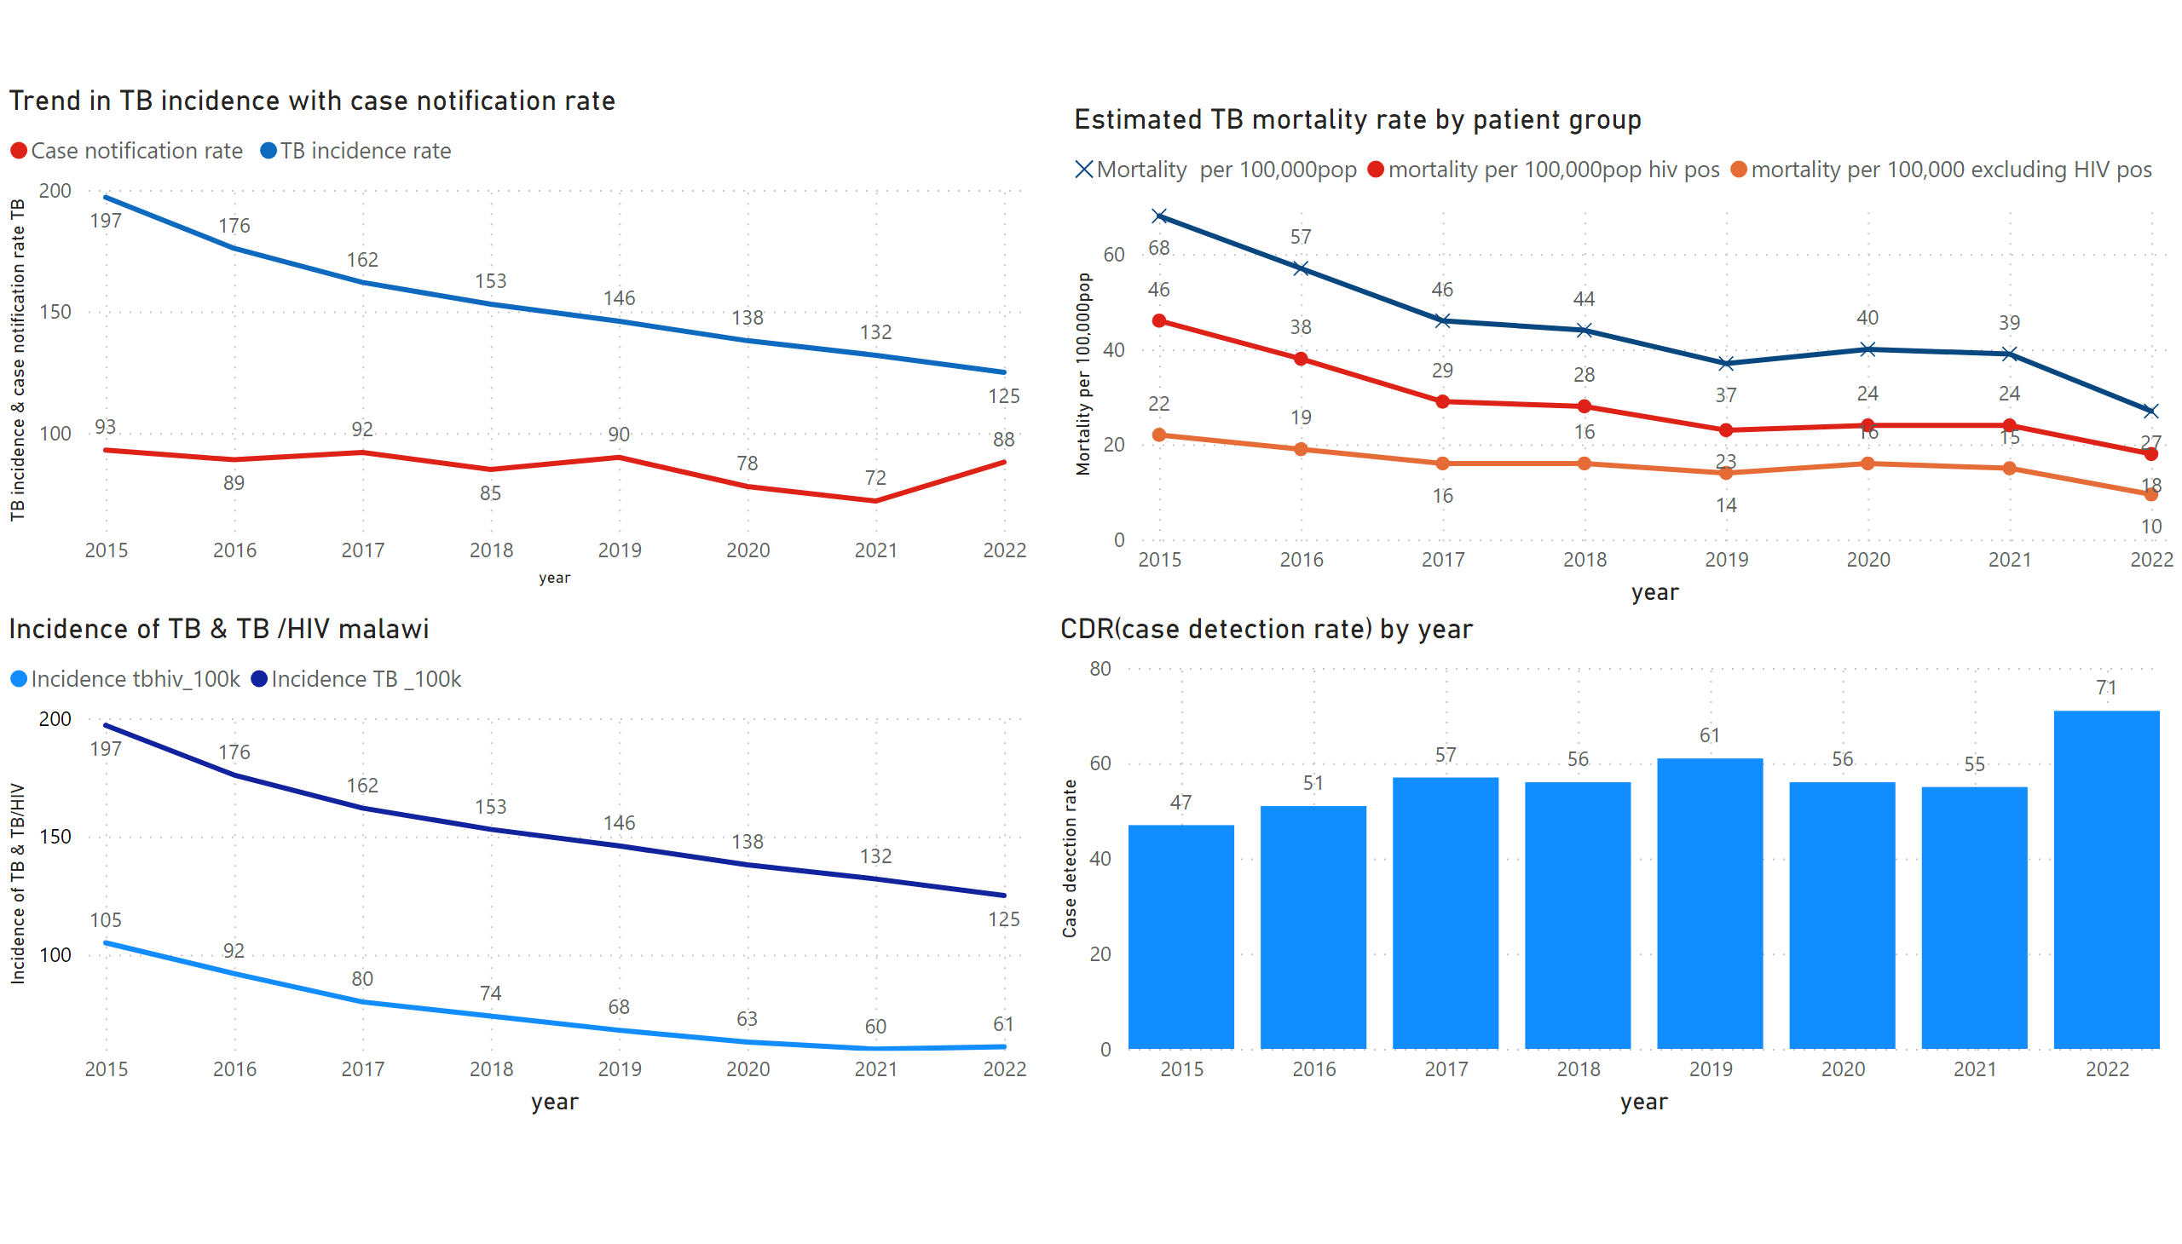
Page 2
Notes:
Trend in TB incidence with case notification rate
No alt text provided
Estimated TB mortality rate by patient group
No alt text provided
Incidence of TB & TB /HIV malawi
No alt text provided
columnChart
No alt text provided

Slide 6
Data-Driven Strategies:
Update on national TB M&E, surveillance, and data use

Slide 7
M&E Systems
Standardized guideline and tools
  National guidelines: Adopts international indicator definition for TB
  M&E plan costed with indicator reference sheet
  Use standard SOPs
  Training packages
Data management
  Mainly paper based
  DHIS 2 : all modules
  SMS technology : Gx alert
  E health – cascade presumptive TB ---to diagnosis in 55 facilities
  EMR- implemented in 30 high volume health factifies
  Scan form : to be introduced in selected TB registers

Slide 8
M&E Systems
TB/HV supervision
  SOP – for supervision
  SOP data management
  Data analysis –syntax
  Data quality assessment
Outputs
  Quarterly program update
  Annual program update
  annual reports
  PUDR / reporting to PEPFAR
  Balanced score card at district level

Slide 9
Data Collection System
Routine TB reporting system
NTP
TB/HIV integrated Supportive Supervision
TB.HIV team national level
Health facilities
Central referral laboratory ( external quality assurance )
Zonal lab supervisors
District lab officers
District TB officers
TB registration site
Central referral laboratories ( DST activities
Mobile diagnostic unit
Outreach activities to using MDU to reach key Population

Slide 10
Data Use
Implementation of SOC (Standard of care implementation)
  Facility level standard of care logbook
  Indicators/targets monitored
  Action plan developed & follow up
Balanced scorecard –
  Key indicators covering different thematic areas (Case detection , diagnosis , TPT, Treatment outcome & DR TB )
  Target set and categorization ---
National & zonal review meetings
Annual operational and strategic planning

Slide 11
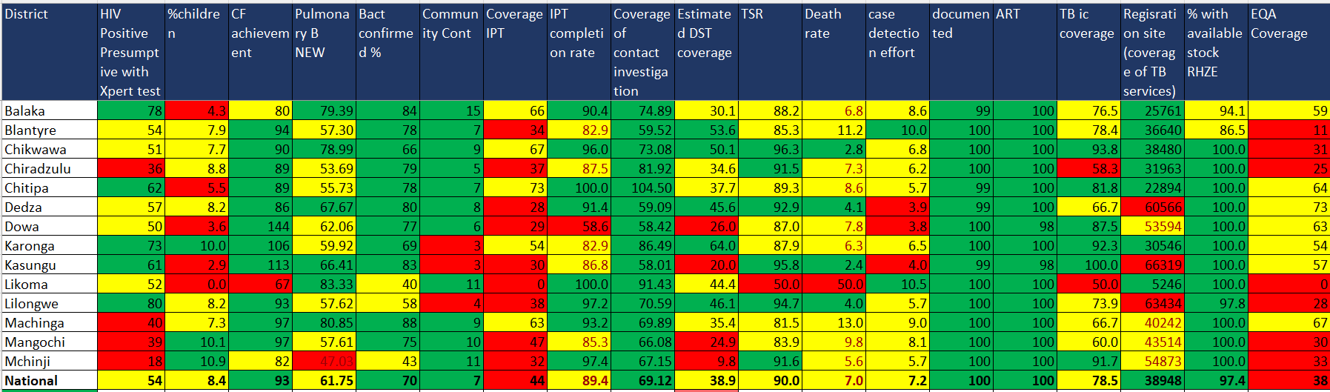

Score card
@UNIONCONFERENCE #UNIONCONF
worldlunghealth.org

Slide 12
Challenges
Key M&E Related Activities
Regular data quality review
TB /HIV supervision
Training to TB officers.
Review meetings
Presupervision workshops
TB officers at all districts
Collaborative TB/HIV activities
Data use for decision making: Prioritization matrix–
Referral interfacility
Lab test –duplicates /repeat test
Documentation – in presumptive register
Tracking contribution from different key population
Presumptive TB cases who can't produce sputum
Patient categorization diagnosed through LF-LAM
Limitation with subnational TB burden estimate

Slide 13
TB M&E Beyond Numbers: Understanding trends in
PBMEF core indicators

Slide 14
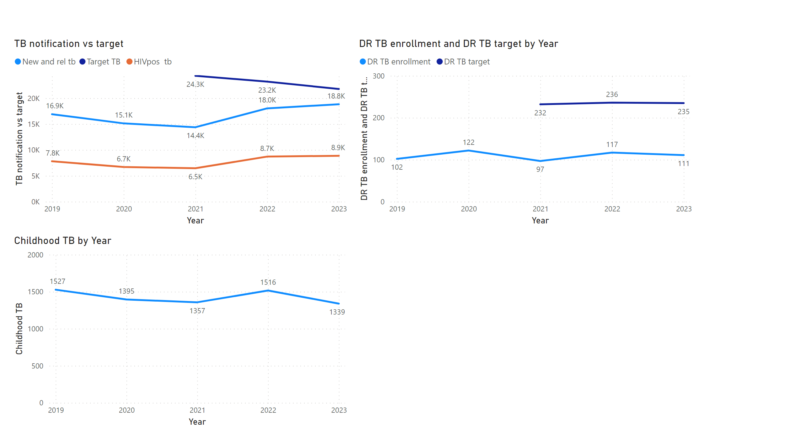
Page 1
DST coverage: expected to improve with expansion of Xpert sites (10 –color )
7.1%
Attributed to sputum production ,index of suspicion
A total 19.1k patients notified
Of which 18823 were new and relapse TB cases
Increase by 4.4%
Notes:
TB notification vs target
No alt text provided
lineChart
No alt text provided
lineChart
No alt text provided

Slide 15
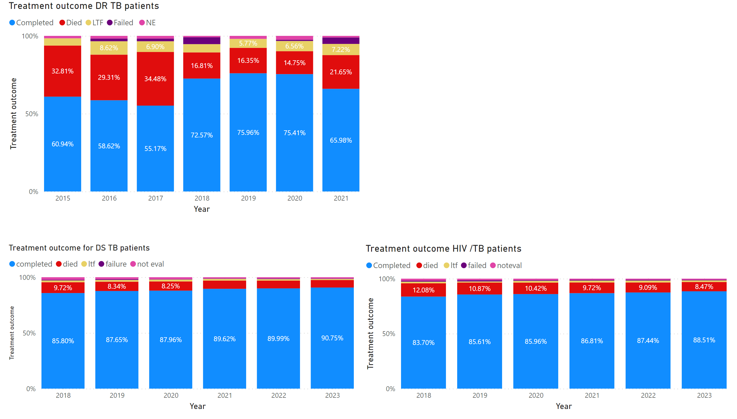
Page 2
Notes:
Treatment outcome DR TB patients
No alt text provided
Treatment outcome for DS TB patients
No alt text provided
Treatment outcome HIV /TB patients
No alt text provided

Slide 16
Key programmatic achievements and challenges
Achievement
  Increased TB case finding – -4.4% increase
  Sustained TSR for DS-TB at 90%
  Continued Implementation of FAST approaches (>100 facilities using different models)
  Started implementation of XDR testing in 3 sites
  Distributed 10 color machines to sites.
  Sustain performance HIV ascertainment and ART uptake
  Completed the pilot study for stool SOS
  Finalized the TB and Leprosy Guideline
Challenges
Low case finding for childhood TB
Low Xpert among PLHIV
Widening testing gap among presumptive TB patients
Maintenance of EMR- Sites and limited coverage

Slide 17
Action Points
Narrowing gap in case finding for TB & Leprosy
  Continue FAST /active case finding interventions(X-ray)
  Implement childhood TB algorithm & SOS
  Strengthen and maintain quality TB diagnostic network
  Strengthen quality of community TB services
Expansion of Drug sensitivity testing for TB & DR TB patients
Strengthen quality of TB/HIV,DR TB & Leprosy services
  TB-HIV services PSM, quality of treatment ,Quality improvement initiative & Post TB care
Maintain and expand e-health ( EMR ,ASPECT & DHIS 2)
Strengthen quality of TB surveillance and data use

