Slide 1
Performance Based Monitoring and Evaluation Framework (PBMEF) In-Depth: Part 1 (Core Indicators)
Africa Regional Workshop
PBMEF In-Depth: Core Indicators
Notes:
Presenter: Stephanie
Notes: Briefly welcome everyone

Slide 2
Levels of PBMEF Indicators
Core: established 10 priority indicators
Core Plus: more detail on the Core indicators
National: additional data that should be available at the National Level
Project: additional steps in cascades that may not be available at the National Level
Extended: index of additional standardized indicators to help meet project needs for specific activities, if more detail is wanted than what is provided by essential indicators
Core
Essential List of Indicators
Core Plus
National Level
Project Level
Extended*
*Note: Extended indicators are currently under revision

Slide 3
TB MONITORING, EVALUATION & LEARNING INDICATORS
INDICATOR TECHINCAL AREAS
MISSION REPORTING
USAID TARGETS
OBJECTIVES
PROCESS
(cross-cutting)
OUTCOME
IMPACT
PROJECT/PROGRAM PPR/ACCELERATOR
REACH
Extended Indicators
Project Level Indicators
National Level Indicators
CORE PLUS Indicators
CORE Indicators
90% of incident TB cases diagnosed and initiated on treatment
Active Case Finding Contact Investigation, Presumptive TB, TB Detection, Drug-Resistant TB (DR-TB) Notifications, Childhood TB, Private Sector
All priority countries have implemented plans to address socio-economic determinants and health related risk factors
Maximize the detection of all forms of TB in all individuals of all ages
CURE
90% for Drug-Sensitive TB (DS-TB) treatment success rate
Empower all individuals with TB to complete treatment and be cured
TB Treatment Success, DR-TB Treatment Success, TB/HIV
Decrease TB Mortality by 35% by 2030
All priority countries have strong TB national networks and USAID partnerships inclusive of affected communities
90% for DR-TB treatment success rate
PREVENT
Stop the spread of new infections and progression from infection to active TB disease
TB Preventive Treatment (TPT), Prevention, Healthcare Worker Screening
30 million on TPT
INNOVATE
All priority countries include appropriate TB interventions in pandemic preparedness plans
TBD
Research, develop, introduce, and scale-up new tools and approaches to combat TB
TBD
Decrease TB Incidence by 52% by 2030
SUSTAIN
Global investments reach $13 billion by 2022
All priority countries rapidly introduce new TB tools and approaches
Build country-owned TB systems, led by local partners, that accelerate progress and support pandemic preparedness
Finance, Policies & Guidelines, Governance, Procurement and Supply Chain Management
Notes:
PBMEF graphic updated to reflect new USAID TB Strategy

Slide 4
MISSION REPORTING
PERFORMANCE PLANS AND REPORT (PPR)/ACCELERATOR
REPORTING
ACCELERATOR REPORTING
MISSION REPORTING
CORE INDICATORS (10)
CORE
PLUS (11)
NATIONAL LEVEL (16)
PROJECT
LEVEL (30)
Critical to understanding the progress in TB control: NSP targets, UN General Assembly (UNGA), High-Level Meeting (HLM)
Included in PPR and thus required for all countries receiving TB bilateral assistance
Reflect National Level attainment and recommended for monitoring, evaluation, and learning (MEL) as impact or outcome level measurements to assess the contribution of USAID investments
Some implementing partners (IPs) may include for project specific sites for attribution purposes
Provide additional data to monitor toward the progress of the 10 Core indicators
Prioritize key indicators for specific cascades of care
Reflect National Level attainment and track the contribution of USAID investments
Expected to be included in MELs of IPs and will become part of biannual reporting during Accelerator calls of the TB Division
Provide granular data for in-depth understanding of the epidemiology and performance of program toward national targets
Help meet the reporting requirements articulated in the End TB Now Bill
Recommended for measuring the contribution of USAID investment to national program targets
Inclusion where possible at the Project Level for attribution
Provide more detailed data to monitor project performance and progress towards targets
Help meet the reporting requirements articulated in the End TB Now Bill
IPs are expected to include these in their MELs to monitor their Project Level performance and track USAID investments—both contribution and attribution where possible

Slide 5
PBMEF: Technical Areas
TB Technical Roadmap Area | Indicator Groups in the PBMEF | # of Core Indicators
REACH | TB Detection | 2
 | Contact Investigation | 1
 | Childhood TB | 1
 | DR-TB Notifications | 1
 | TB diagnosis
 | Private Sector | 1
 | Case Findings
CURE | TB Treatment Success | 1
 | TB/HIV
 | DR-TB Treatment | 1
PREVENT | TPT | 1
 | Prevention
 | Health Care Worker Screening
SUSTAIN | Sustainability | 1
Notes:
There are numerous indicators in the PBMEF: 10 core indicators and many more extended indicators. They fall under 14 technical areas or categories, as shown in the chart.
There are several extended indicators in each of the technical areas, but only 9 technical areas contain a core indicator.

Slide 6
PBMEF Core Indicators
Reported at the National Level for PPR/ Accelerator
At the Mission Level,
missions should be reporting on all these indicators through any combination of assigning them to partners
Partners should select as many of these as are applicable;
each partner receiving TB funding must include Core indicator(s) in MEL plans
Core
Essential List of Indicators
Core Plus
National Level
Project Level
Extended*
*Note: Extended indicators are currently under revision

Slide 7
Core Indicators
1
TB Case Detection Rate (Treatment Coverage)
Percent Bacteriologically Confirmed (Pulmonary TB)
Childhood TB Notifications
Rifampicin-Resistant/Multidrug-Resistant (RR/MDR-TB) Notifications
Private Sector TB Notifications
Percent of Contacts Screened for TB
DS-TB Treatment Success Rate
DR-TB Treatment Success Rate
TPT Initiations
Percent of TB Financing Received from Domestic Sources
2
3
4
5
6
7
8
9
10

Slide 8
Why these Core indicators?
Best reflect TB investments by USAID and the global community
Measure progress toward the targets:
U.S. Government’s Global TB Strategy
UNHLM on Ending TB
Are generally readily available through
National TB Programs’ (NTPs) existing monitoring and evaluation (M&E) systems
World Health Organization (WHO) database
Are already reported at the National Level

Slide 9
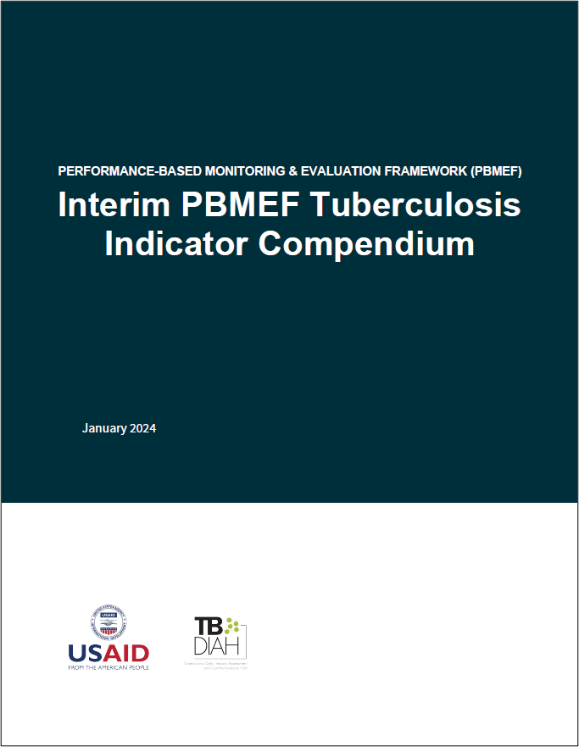
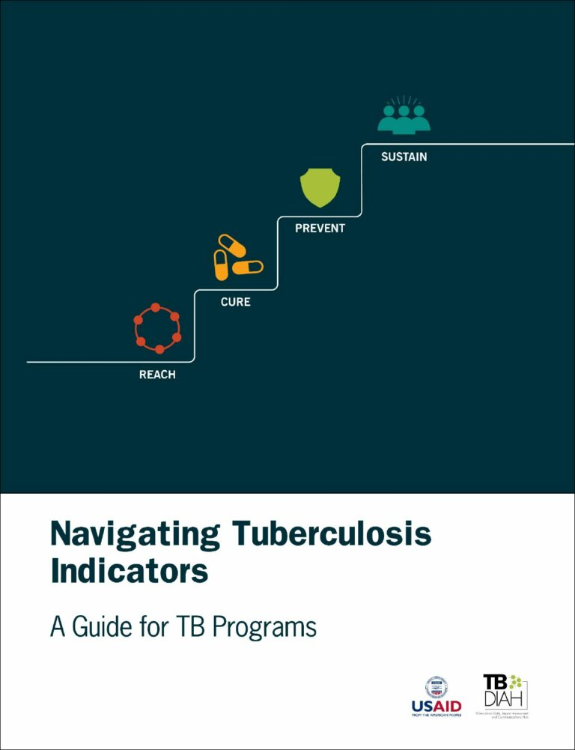
The TB PBMEF Framework
www.tbdiah.org/assessments/pbmef/
Current Resources Available
PBMEF Guide (Also available in Portuguese, French, and Russian)
Interim PBMEF Indicator Compendium
MEL Plan Template and Guidance

Slide 10
What does the TB Indicator compendium contain?
Overview of USAID’s global TB strategy and targets
Explanation of the PBMEF and how it can be used as a data management tool
Standard indicator reference sheets for the essential indicators (Core, Core Plus, National and Project Level)
Demonstration of a cascade approach
Overview on data quality
Description of data reporting
Notes:
The guide provides an overview of USAID’s strategic M&E framework to achieve global targets, describes standard core and extended indicators to monitor progress toward reaching TB targets in USAID priority countries, and encourages consistent use of the indicators to monitor and evaluate USAID investments in TB programs.

Slide 11
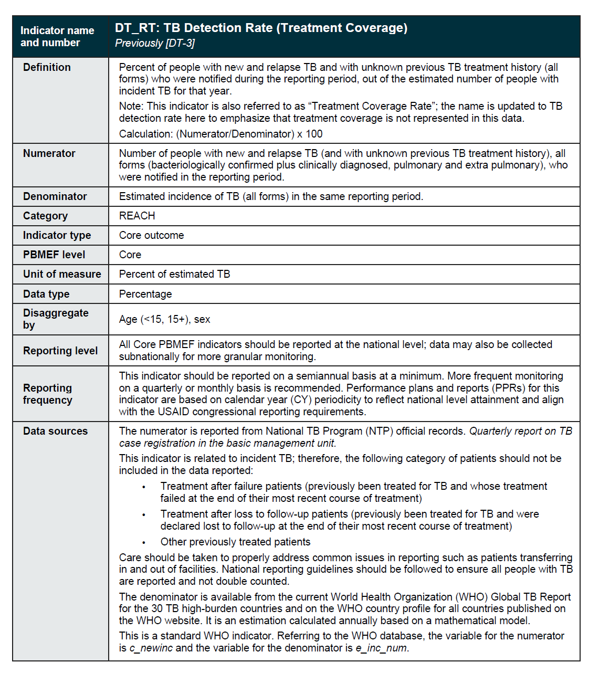
Indicator Reference Sheets
Comprehensive information about each indicator
Assists with standardized data collection and reporting
e.g. TB treatment coverage Rate
Notes:
Indicators must be clear and unambiguous, especially if they are to be standardized. With USAID’s expert review, full indicator reference sheets were developed for each of the 10 core indicators to help define and calculate the data, understand how the data should be disaggregated, report the data, etc.

Slide 12
Contents of Indicator Reference Sheets
Indicator definition
Numerator definition
Denominator definition
Indicator type
Type of data being collected
Disaggregations of interest for using the indicator
Levels of reporting
Reporting frequency
Data sources
Description of why the indicator is important
Details about how the indicator can be used (alone or in conjunction with other indicators)
Potential visualizations

Slide 13
Core Indicators Up Close

Slide 14
DT_RT: TB Detection Rate (Treatment Coverage)
REACH
Definition: Percent of people with new and relapse TB and with unknown previous TB treatment history (all forms) who were notified during the reporting period, out of the estimated number of people with incident TB for that year.
Note: This indicator is also referred to as “Treatment Coverage Rate”; the name is updated to TB detection rate here to emphasize that treatment coverage is not represented in this data.
Calculation: (Numerator/Denominator) x 100
Numerator: Number of people with new and relapse TB (and with unknown previous TB treatment history), all forms (bacteriologically confirmed plus clinically diagnosed, pulmonary and extra pulmonary), who were notified in the reporting period.
Denominator: Estimated incidence of TB (all forms) in the same reporting period

Slide 15
DT_RT: TB Detection Rate (Treatment Coverage)
REACH
Unit of Measure: Percent of estimated TB
Data Type: Percentage
Disaggregate by: Age , sex
Reporting level: All Core PBMEF indicators should be reported at the national level; data may also be collected subnationally for more granular monitoring.
Reporting frequency: This indicator should be reported on quarterly basis at a minimum. More frequent monitoring on a monthly basis is recommended. PPRs for this indicator are based on calendar year (CY) periodicity to reflect national level attainment and align with the USAID congressional reporting requirements.

Slide 16
DT_RT: TB Detection Rate (Treatment Coverage)
Data Sources: The numerator is reported from National TB Program (NTP) official records. Quarterly report on TB case registration in the basic management unit.
This indicator is related to incident TB; therefore, the following category of patients should not be included in the data reported:
Treatment after failure patients (previously been treated for TB and whose treatment failed at the end of their most recent course of treatment)
Treatment after loss to follow-up patients (previously been treated for TB and were declared lost to follow-up at the end of their most recent course of treatment)
Other previously treated patients
Care should be taken to properly address common issues in reporting such as patients transferring in and out of facilities. National reporting guidelines should be followed to ensure all people with TB are reported and not double counted.
The denominator is available from the current World Health Organization (WHO) Global TB Report for the 30 TB high-burden countries and on the WHO country profile for all countries published on the WHO website. It is an estimation calculated annually based on a mathematical model.
This is a standard WHO indicator. Referring to the WHO database, the variable for the numerator is c_newinc and the variable for the denominator is e_inc_num.
REACH

Slide 17
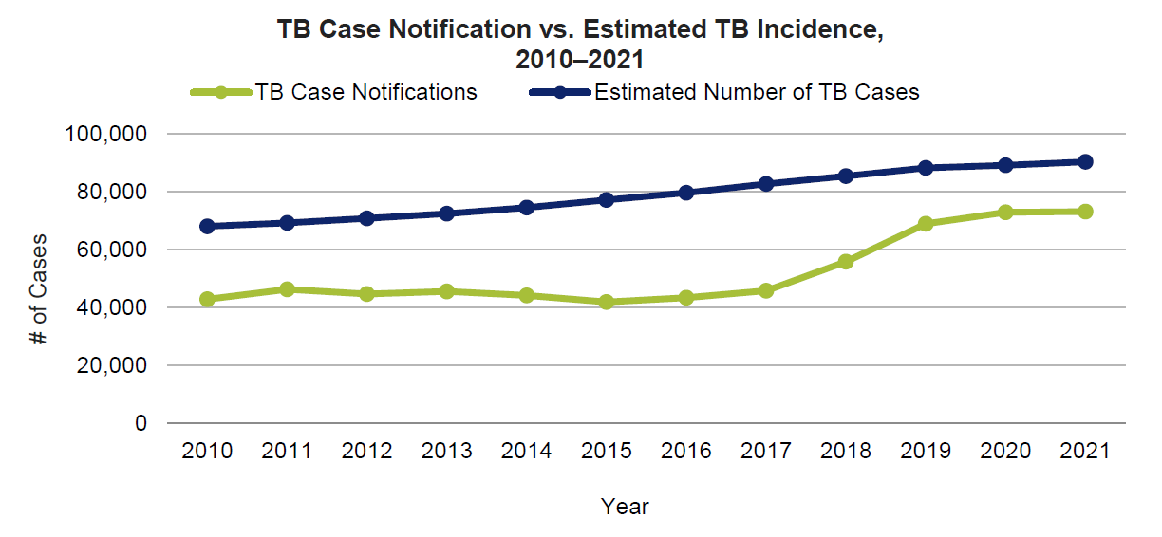
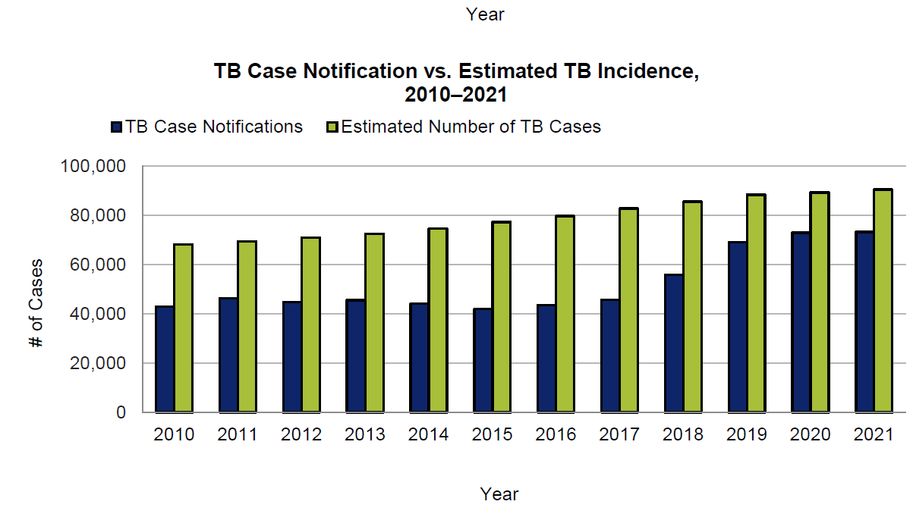
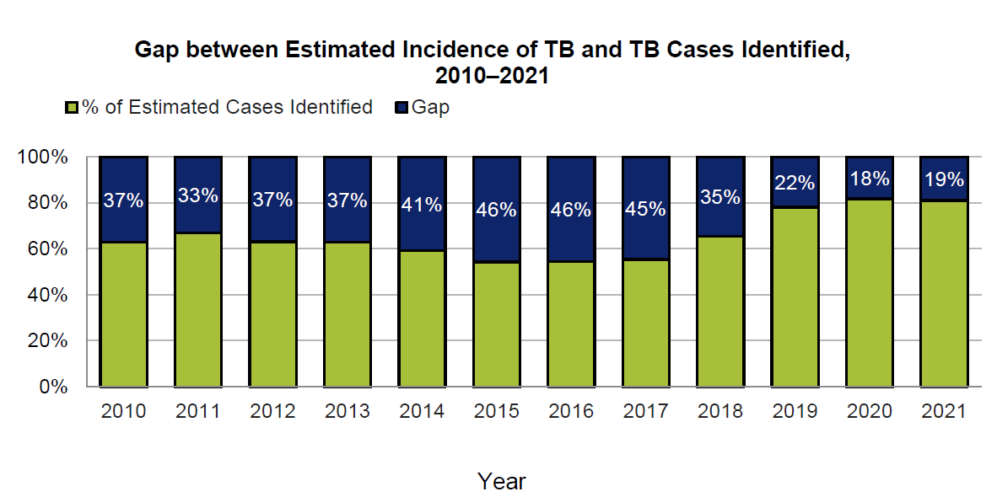
DT_RT: TB Detection Rate (Treatment Coverage)
REACH

Slide 18
BAC_CON: Percent Bacteriologically Confirmed
Definition: Percent of people with new and relapse pulmonary TB who are bacteriologically confirmed.
Bacteriologically confirmed: Smear positive for TB or culture positive for TB or positive for TB by a World Health Organization-recommended rapid diagnostics test (WRD): FluoroType® MTBDR (Hain), Loopamp™ MTBC detection kit (TB-LAMP), Xpert® MTB/RIF, Xpert® MTB/RIF Ultra, Truenat® MTB or MTB Plus, RealTime MTB (Abbott), BD MAX™ MDR-TB, cobas® MTB (Roche), or LF-LAM.
Note: LF-LAM is included as a recommended TB test for people living with HIV (PLHIV). LF-LAM is not recommended to confirm TB in all populations and notably should not be used in outpatient settings for adults, adolescents, and children without symptoms of TB or in those with a CD4 count > 200 cells/mm3. At the time of this publication, Alere Determine™ TB LAM Ag is the only commercially available LF-LAM test. Full guidance on the use of LF-LAM can be found at: https://www.who.int/publications/i/item/9789241550604.
Calculation: (Numerator/Denominator) x 100
REACH
Numerator: Number of new and relapse bacteriologically confirmed pulmonary TB notifications (smear positive or culture positive or positive by WHO-recommended rapid diagnostics test [WRD]) during the reporting period.
Denominator: Number of people with new and relapse pulmonary TB (bacteriologically confirmed plus clinically diagnosed) during the reporting period

Slide 19
BAC_CON: Percent Bacteriologically Confirmed
REACH
Unit of Measure: Percent of people
Data Type: Percentage
Disaggregate by: Age (0–4, 5–14, 15+), sex, HIV status
Reporting level: All Core PBMEF indicators should be reported at the national level; data may also be collected subnationally for more granular monitoring.
Reporting frequency: This indicator should be reported on a semiannual basis at a minimum. More frequent monitoring on a quarterly, monthly, or real-time basis is recommended. Performance plans and reports (PPRs) for this indicator are based on calendar year (CY) periodicity to reflect national level attainment and align with the USAID congressional reporting requirements.

Slide 20
BAC_CON: Percent Bacteriologically Confirmed
REACH
Data Sources:
Both the numerator and denominator are reported from National TB Program (NTP) official records. Quarterly report on TB case registration in the basic management unit.
This standard WHO indicator can also be calculated using data from the WHO TB database.
The variables for the numerator are: new_labconf plus ret_rel_labconf. The variables for the denominator are: new_clindx plus ret_rel_clindx plus new_labconf plus ret_rel_labconf.

Slide 21
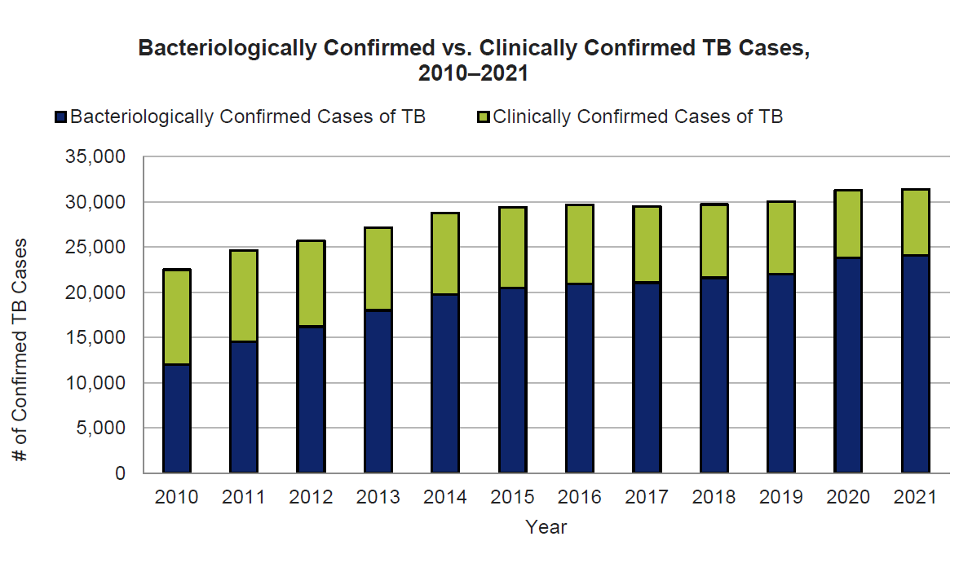
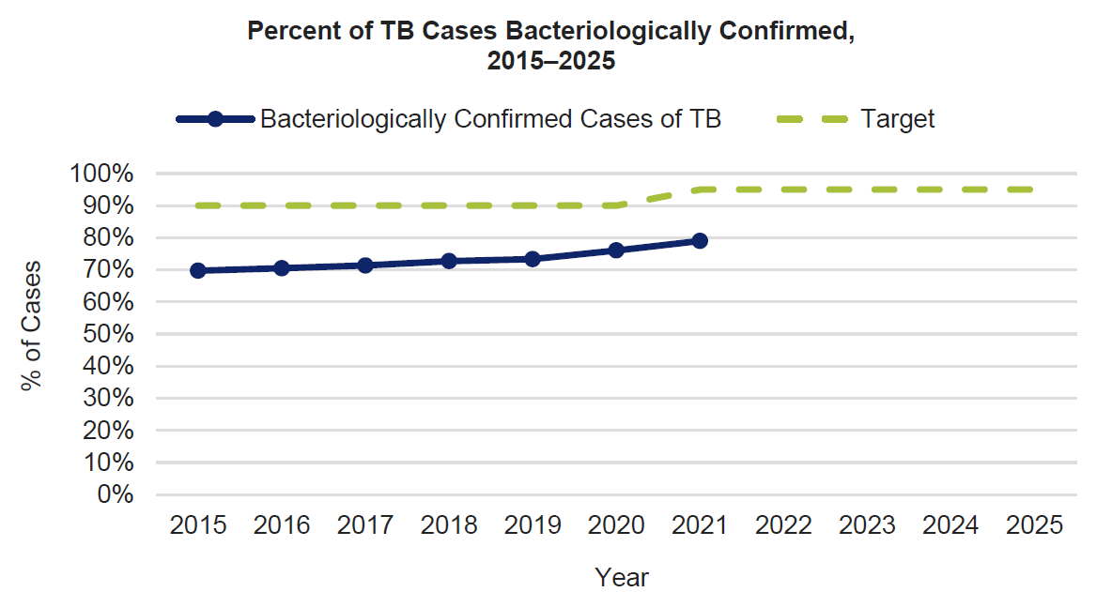
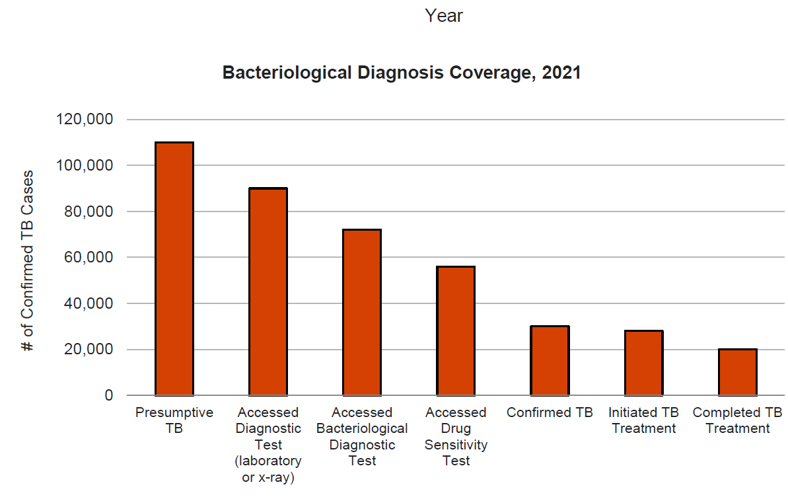
BAC_CON: Percent Bacteriologically Confirmed
REACH

Slide 22
PEDS_NOTIF: Childhood TB Notifications
REACH
Definition: Number of children and adolescents (0–14 years) with new and relapse TB or with unknown previous TB treatment history, all forms, who were notified in a reporting period
Numerator: Number of children and adolescents (0–14 years) with new and relapse TB or with unknown previous TB treatment history, all forms, who were notified in a reporting period
Denominator: N/A
Unit of Measure: Number of children/adolescents
Data Type: Integer
Disaggregate by: Age (0–4, 5–14), sex, HIV status

Slide 23
PEDS_NOTIF: Childhood TB Notifications
REACH
Reporting level: All Core PBMEF indicators should be reported at the national level; data may also be collected subnationally for more granular monitoring.
Reporting frequency: This indicator should be reported on a semiannual basis at a minimum. More frequent monitoring on a quarterly, monthly, or real-time basis is recommended. Performance plans and reports (PPRs) for this indicator are based on calendar year (CY) periodicity to reflect national level attainment and align with the USAID congressional reporting requirements.
Data sources: This indicator is reported from National TB Program (NTP) official records. Quarterly report on TB case registration in the basic management unit.
This standard WHO indicator can also be calculated using the WHO database variables: newrel_f014 plus newrel_m014 plus newrel_sexunk014.

Slide 24
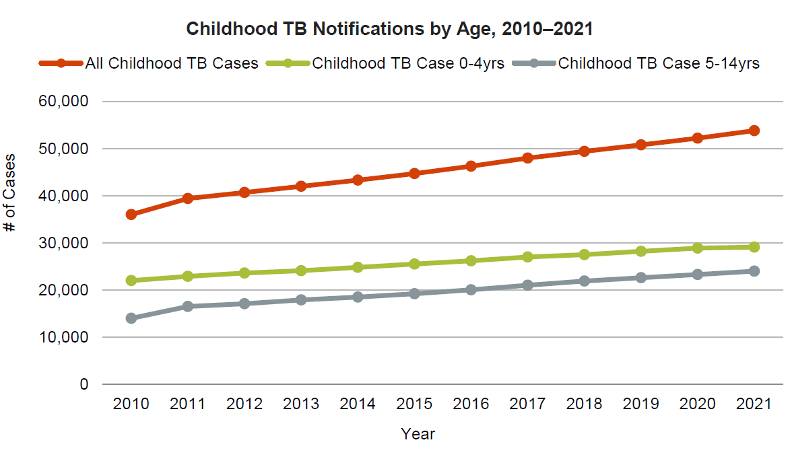
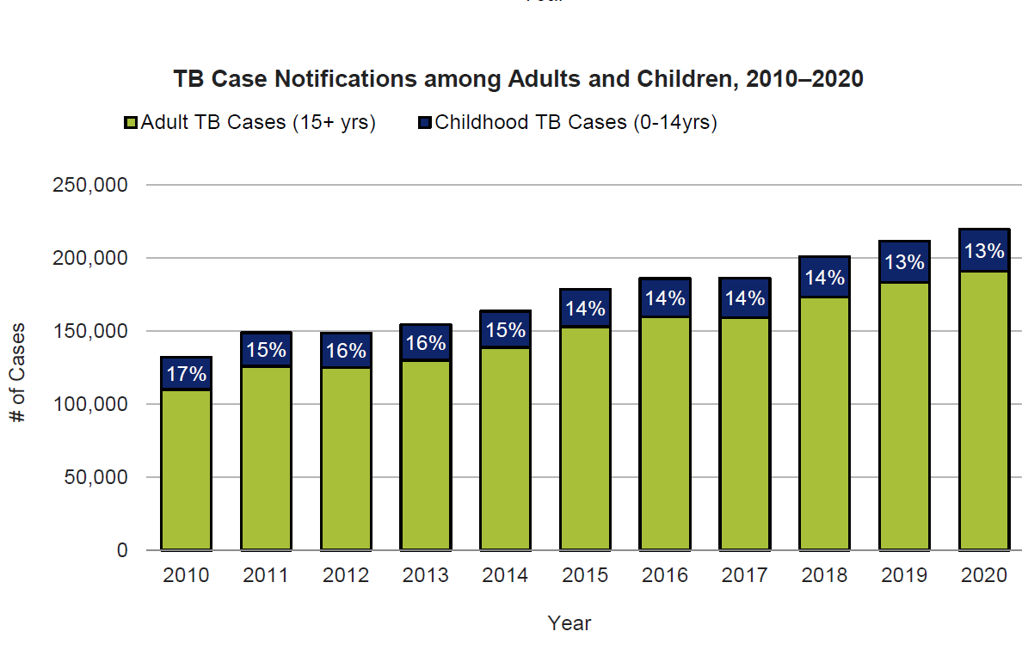
PEDS_NOTIF: Childhood TB Notifications
REACH

Slide 25
MDR_NOTIF: RR/MDR-TB Notifications
REACH
Definition: Number of people with rifampicin-resistant (RR) and multidrug-resistant (MDR) TB notified during the reporting period.
RR/MDR TB: RR-TB is TB caused by Mycobacterium Tuberculosis (M. tuberculosis) strains that are resistant to rifampicin; MDR-TB strains are resistant to at least both rifampicin and isoniazid.
Note: This indicator no longer includes pre-extensively drug-resistant (pre-XDR) and extensively drug-resistant (XDR) TB; these data should be reported separately under the core plus indicator for XDR. Values for these indicators should not be added together. This indicator might include patients with polydrug resistant TB (PDR-TB), if they are part of the RR/MDR recording in the national database. However, if PDR-TB is reported separately, they should not be included in this analysis.
Numerator: Number of people with RR-TB and MDR-TB notified during the reporting period.
Denominator: N/A

Slide 26
MDR_NOTIF: RR/MDR-TB Notifications
Unit of Measure: Number of people
Data Type: Integer
Disaggregate by: Age (<15, 15+), sex
Reporting level: All Core PBMEF indicators should be reported at the national level; data may also be collected subnationally for more granular monitoring.
Reporting frequency: This indicator should be reported on a semiannual basis at a minimum. More frequent monitoring on a quarterly, monthly, or real-time basis is recommended. Performance plans and reports (PPRs) for this indicator are based on calendar year (CY) periodicity to reflect national level attainment and align with the USAID congressional reporting requirements.
Data sources: This indicator is reported from National TB Program (NTP) official records. Quarterly report on TB case registration in the basic management unit.
The WHO equivalency for this indicator is: conf_rr_nfqr (lab confirmed RR/MDR)
REACH

Slide 27
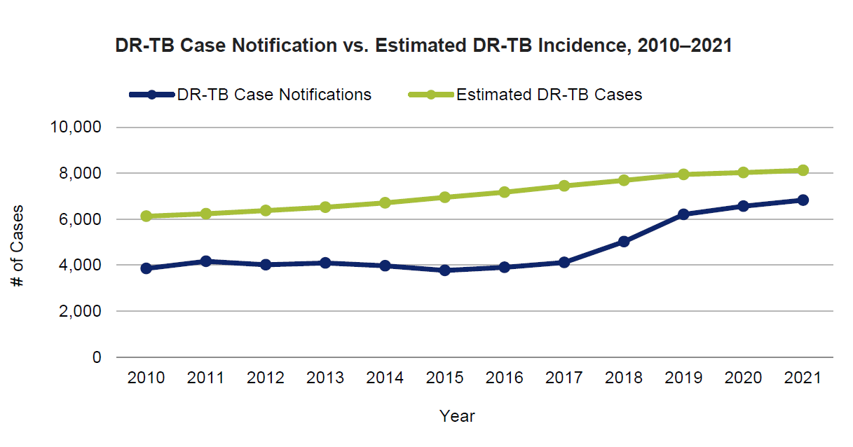
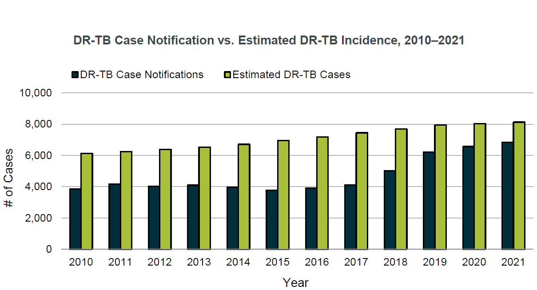
MDR_NOTIF: RR/MDR-TB Notifications
REACH

Slide 28
PR_NOTIF: Private Sector TB Notifications
REACH
Definition: Number of people with new and relapse TB of all forms (bacteriologically confirmed plus clinically diagnosed) notified by private non-national TB program (NTP) providers in the reporting period.
Per the World Health Organization’s (WHO) definition/database, private non-NTP providers include private individual and institutional providers, corporate/business sector providers, mission hospitals, and other clinics or hospitals managed by nongovernmental organizations (NGOs) and faith-based organizations.
Numerator: Number of people with new and relapse TB of all forms (bacteriologically confirmed plus clinically diagnosed) notified by private non-NTP providers in the reporting period.
Denominator: N/A

Slide 29
PR_NOTIF: Private Sector TB Notifications
REACH
Unit of Measure: Number of people
Data Type: Integer
Disaggregate by: Age (<15, 15+), sex
Reporting level: All Core PBMEF indicators should be reported at the national level; data may also be collected subnationally for more granular monitoring.
Reporting frequency: This indicator should be reported on a semiannual basis at a minimum. More frequent monitoring on a quarterly, monthly, or real-time basis is recommended. Performance plans and reports (PPRs) for this indicator are based on calendar year (CY) periodicity to reflect national level attainment and align with the USAID congressional reporting requirements.
Data sources: This indicator is reported from NTP official records. Some NTPs may include private sector notifications in their quarterly report on TB case registration, but this may vary country to country.
This standard WHO indicator can also be calculated using the WHO database variable priv_new_dx.

Slide 30
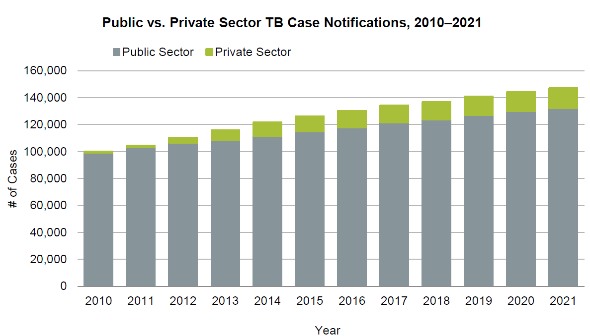
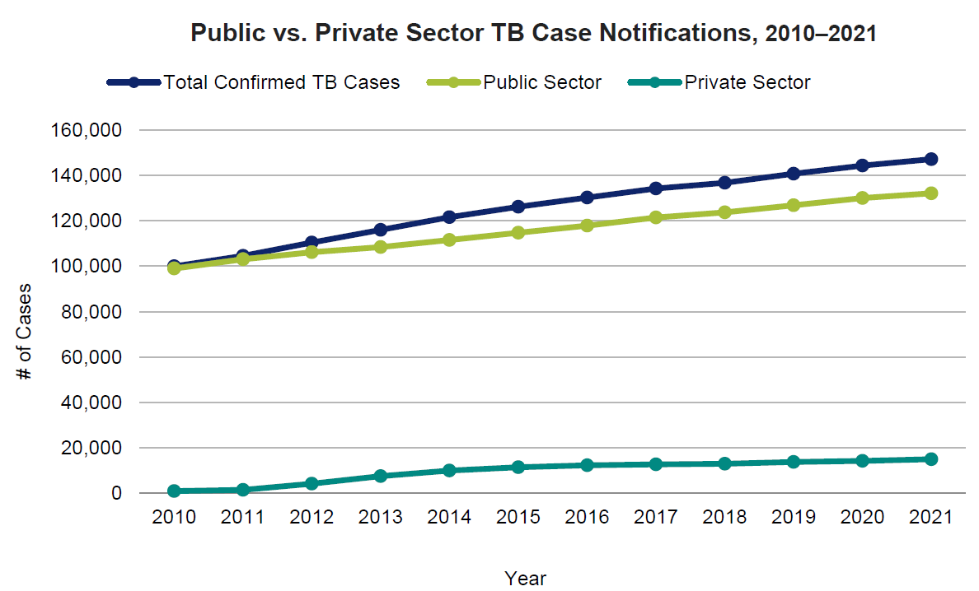
PR_NOTIF: Private Sector TB Notifications
REACH

Slide 31
CON_SCRN: Percent of Contacts Screened for TB
Definition: Percent of contacts of people with bacteriologically confirmed pulmonary TB (index cases) who were screened for active TB disease, among all contacts identified during the reporting period.
Contact investigation (CI) is a systematic process to identify people (contacts) who were exposed to active pulmonary TB disease, assess contacts for signs or symptoms of active TB disease, provide diagnostic testing to confirm or exclude active disease or diagnose TB infection, and provide contacts with treatment for TB disease or infection. CI consists of identification of contacts, prioritization of contact at highest risk, clinical evaluation and diagnostic testing, and treatment as clinically indicated.
Calculation: (Numerator/Denominator) x 100
REACH
Numerator: Number of contacts of people with notified new and relapse bacteriologically confirmed pulmonary TB who were screened for active TB disease during the reporting period.
Denominator: Number of contacts of people with notified new and relapse bacteriologically confirmed pulmonary TB identified during the reporting period.
Unit of Measure: Percent of contacts
Data Type: Percentage

Slide 32
CON_SCRN: Percent of Contacts Screened for TB
REACH
Disaggregate by: Age (0–4, 5–14, 15+), sex
Reporting level: All Core PBMEF indicators should be reported at the national level; data may also be collected subnationally for more granular monitoring.
Reporting frequency: This indicator should be reported on a semiannual basis at a minimum. More frequent monitoring on a quarterly, monthly, or real-time basis is recommended. Performance plans and reports (PPRs) for this indicator are based on calendar year (CY) periodicity to reflect national level attainment and align with the USAID congressional reporting requirements.
Data sources: This indicator is reported on National TB Program (NTP) official records, such as contact registers. If these registers do not exist, data can be collected from implementing partners (IPs) supporting CI interventions. The denominator can also be estimated by taking the estimated average household size, assuming the index cases come from different households. See indicator CI-2 for more information.
This indicator was introduced in the World Health Organization (WHO) 2020 Global Data Collection Form and can be calculated using the WHO database. The variable for the numerator is newinc_con_screen and the denominator is newinc_con.

Slide 33
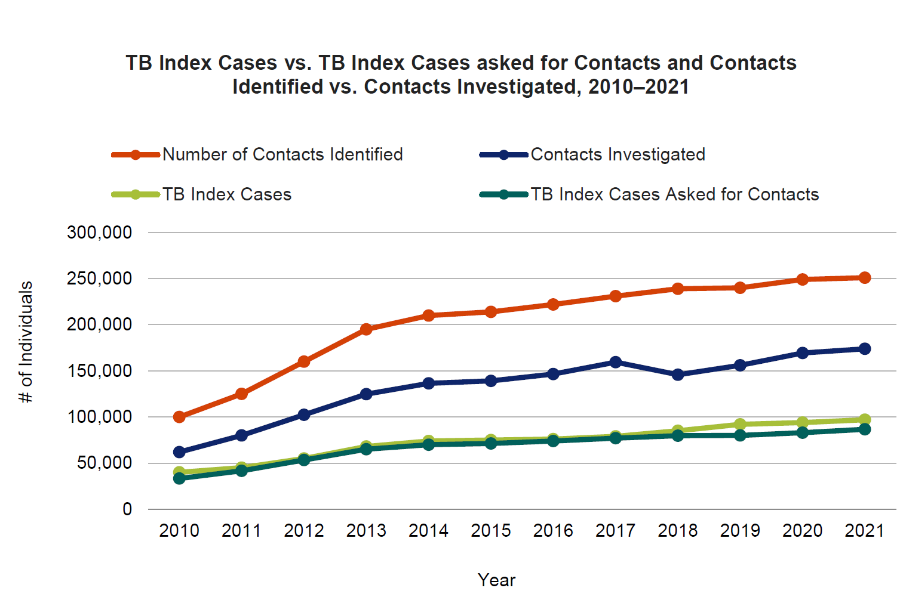
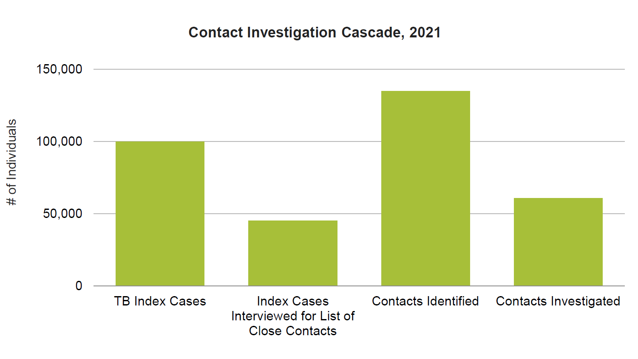
CON_SCRN: Percent of Contacts Screened for TB
REACH

Slide 34
DS_TSR: DS-TB Treatment Success Rate
Definition: Percent of people with new and relapse drug- sensitive tuberculosis (DS-TB) (bacteriologically confirmed or clinically diagnosed, pulmonary or extrapulmonary) who were notified in a specified period that were cured or treatment completed, among the total people with new and relapse TB who were initiated on treatment during the same reporting period (excluding those moved to rifampicin-resistant (RR) treatment cohort).
Treatment outcomes are defined by the time period of initiation on treatment; e.g., “2018 cases successfully treated” reflect those who were initiated on treatment in 2018, even though treatment may have extended into 2019. For this reason, reports of treatment outcome data lag by one year.
Calculation: (Numerator/Denominator) x 100
CURE
Numerator: Number of people with new and relapse DS-TB (bacteriologically confirmed or clinically diagnosed, pulmonary or extrapulmonary), who were registered in a specified period that were cured or treatment completed.
Denominator: Number of people with new and relapse DS-TB (bacteriologically confirmed or clinically diagnosed, pulmonary or extrapulmonary) who initiated treatment in the same period.

Slide 35
DS_TSR: DS-TB Treatment Success Rate
Unit of Measure: Percent of people
Data Type: Percentage
Disaggregate by: Age (<15, 15+), sex, HIV status
Reporting level: All Core PBMEF indicators should be reported at the national level; data may also be collected subnationally for more granular monitoring.
Reporting frequency: This indicator should be reported on a semiannual basis at a minimum. More frequent monitoring on a quarterly, monthly, or real-time basis is recommended. Performance plans and reports (PPRs) for this indicator are based on calendar year (CY) periodicity to reflect national level attainment and align with the USAID congressional reporting requirements.
Data sources: This indicator is reported by National TB Program (NTP) official records. Quarterly report on TB treatment outcomes in the basic management unit and Form 07: Combined annual outcomes report for basic TB and for RR-/multidrug-resistant (MDR)-TB.
This standard World Health Organization (WHO) indicator can also be calculated using the WHO database. The variable for the numerator is newrel_succ and the denominator is newrel_coh.
CURE

Slide 36
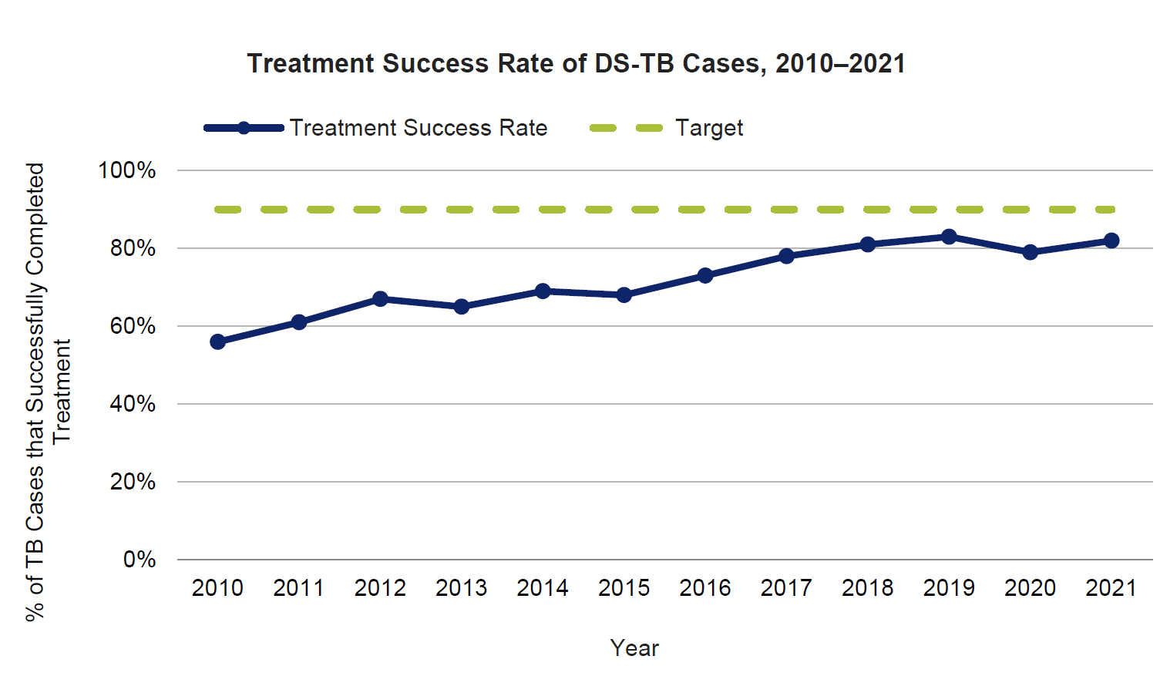
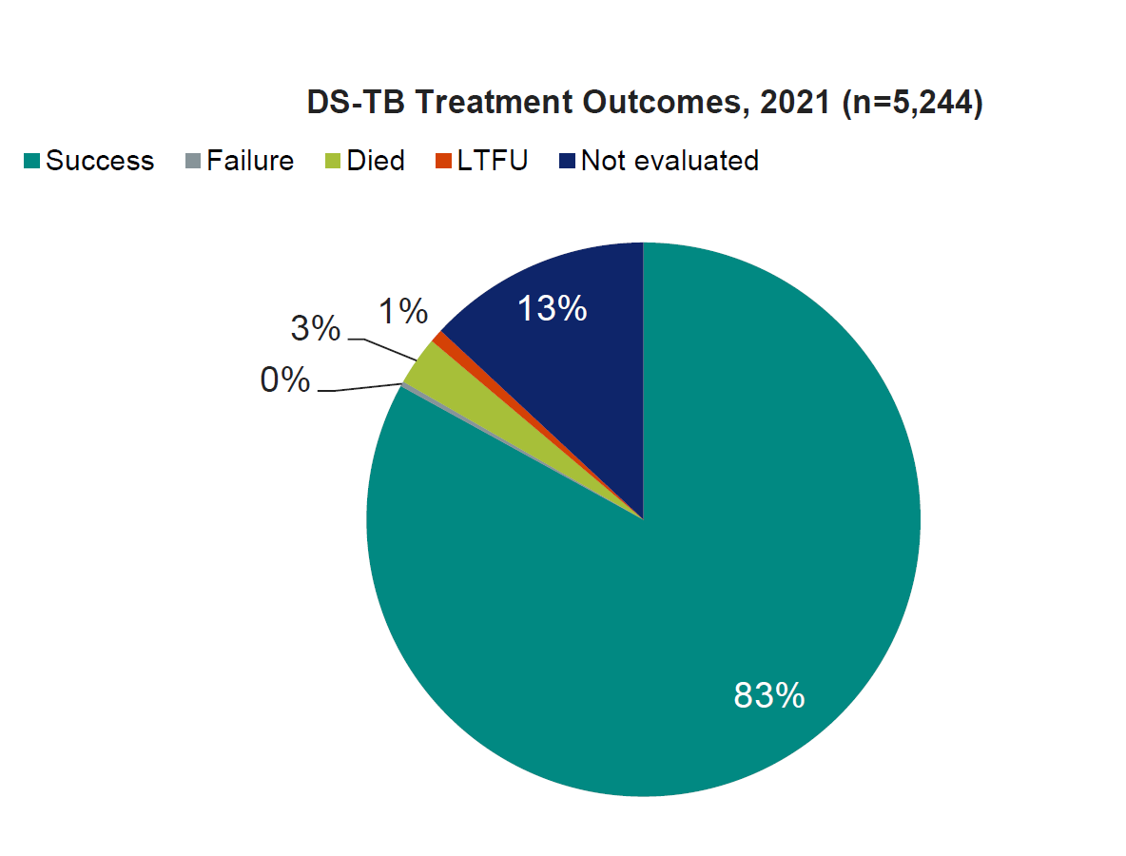
DS_TSR: DS-TB Treatment Success Rate
CURE

Slide 37
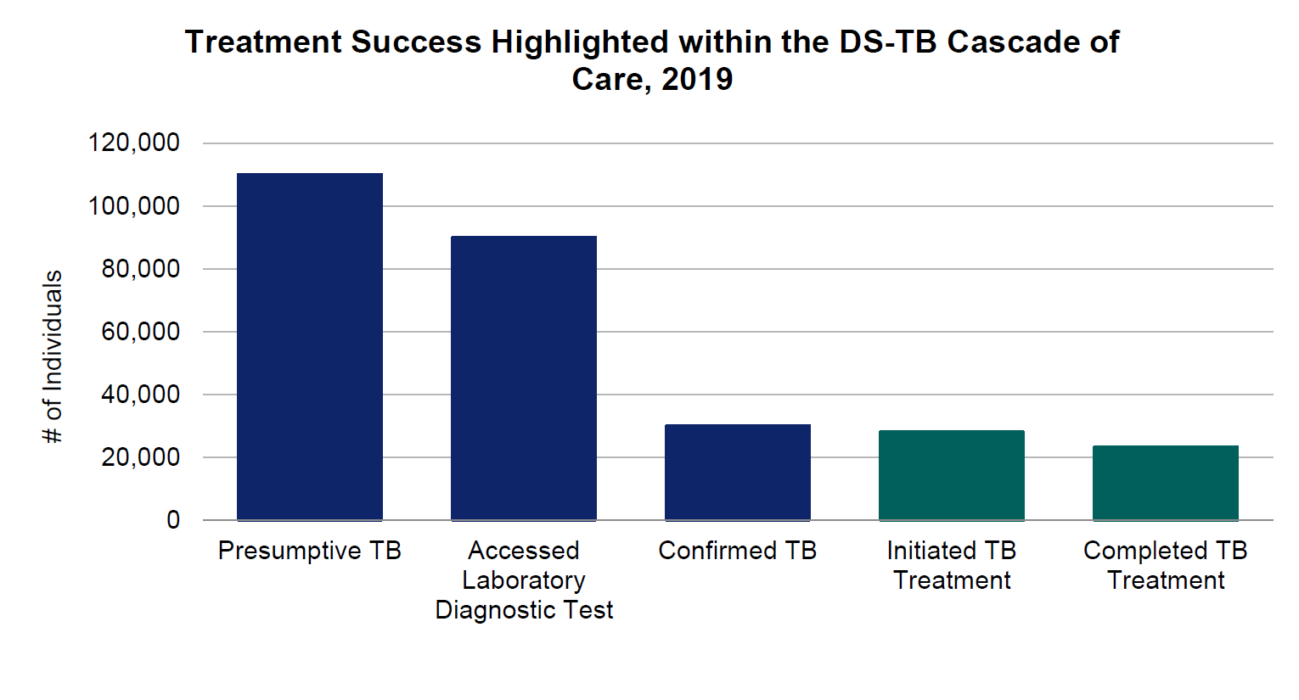
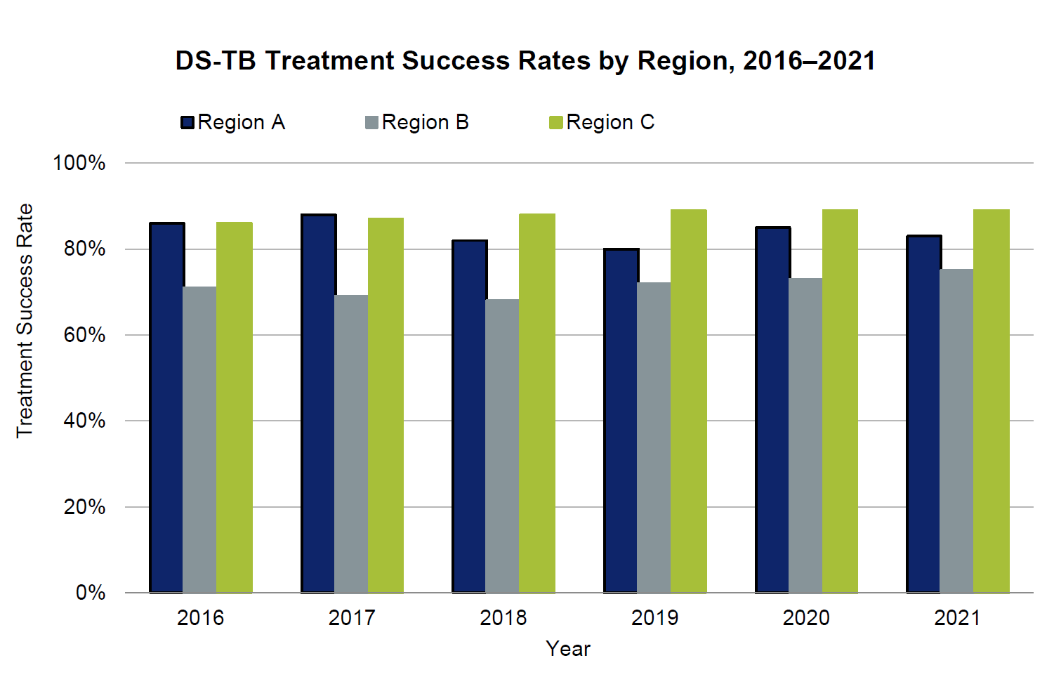
DS_TSR: DS-TB Treatment Success Rate
CURE

Slide 38
DR_TSR: DR-TB Treatment Success Rate
Definition: Percentage of people with drug-resistant tuberculosis (DR-TB) (rifampicin-resistant [RR-TB]/ multidrug-resistant [MDR]-TB, pre-extensively drug-resistant [pre-XDR]-TB, and extensively drug-resistant [XDR]-TB) successfully treated (cured or treatment completed) among all people with DR-TB who were initiated on treatment during the reporting period.
Note: This indicator might include patients with polydrug resistant TB (PDR-TB) if they are part of the RR/MDR recording in the national database. However, if PDR-TB is reported separately, they should not be included in DR-TB TSR calculations. Treatment outcomes are defined by the time period of initiation on treatment; e.g., “2018 cohort successfully treated” reflect those who were initiated on treatment in 2018, even though treatment may have extended into 2020. For this reason, reports of treatment outcome data lag by 2 years.
Calculation: (Numerator/Denominator) x 100
CURE
Numerator: Number of people with DR-TB (RR/MDR-TB and pre-XDR/XDR-TB) who were cured or treatment completed during the reporting period.
Denominator: Number of people with DR-TB (RR/MDR-TB and pre-XDR/XDR-TB) who were initiated on DR-TB treatment during the same reporting period.

Slide 39
DR_TSR: DR-TB Treatment Success Rate
Unit of Measure: Percent of people
Data Type: Percentage
Disaggregate by: Age (<15, 15+), sex
Reporting level: All Core PBMEF indicators should be reported at the national level; data may also be collected subnationally for more granular monitoring.
Reporting frequency: This indicator should be reported on a semiannual basis at a minimum. More frequent monitoring on a quarterly, monthly, or real-time basis is recommended. Performance plans and reports (PPRs) for this indicator are based on calendar year (CY) periodicity to reflect national level attainment and align with the USAID congressional reporting requirements.
Data sources: This indicator is reported by National TB Program (NTP) official records. Quarterly report on TB treatment outcomes in the basic management unit and Combined annual outcomes report for basic TB and for MDR-TB/RR-TB.
This standard World Health Organization (WHO) indicator can also be calculated using the WHO database. The variable for the numerator is mdr_succ plus xdr_succ and the denominator is mdr_coh plus xdr_coh.
CURE

Slide 40
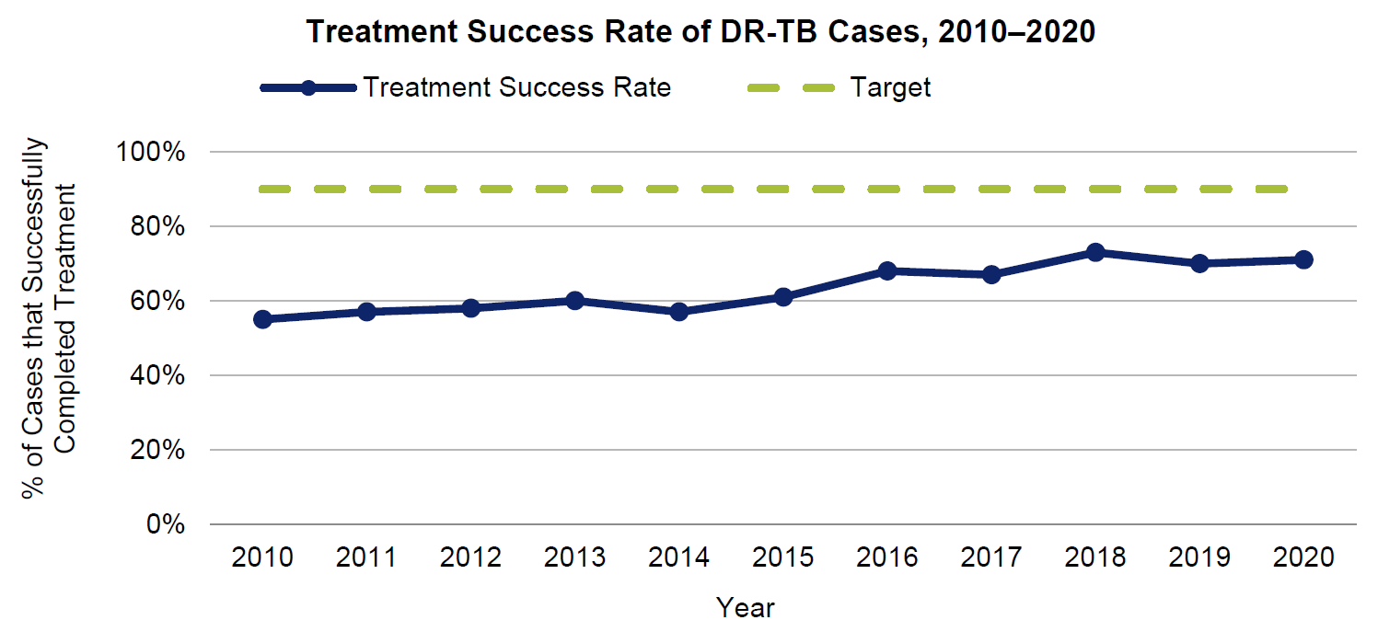
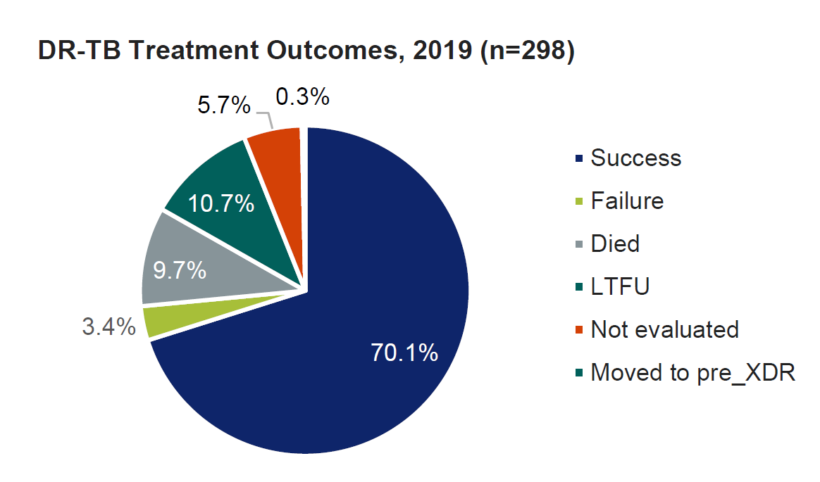
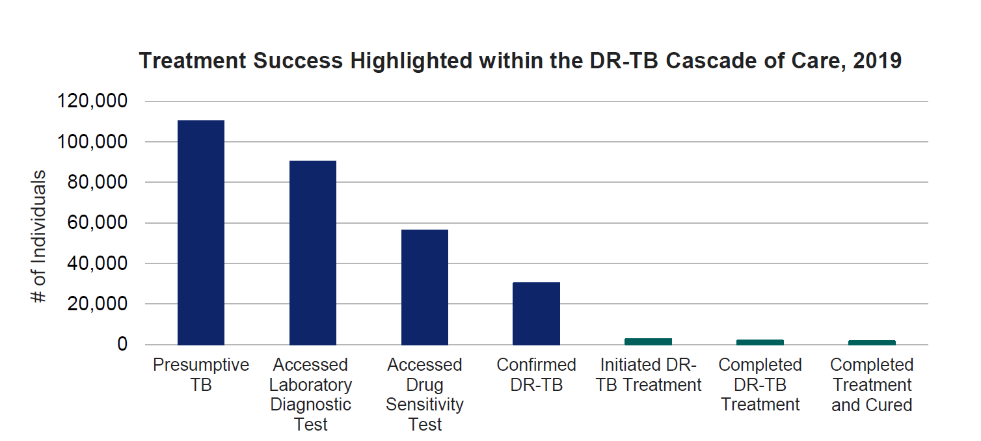
DR_TSR: DR-TB Treatment Success Rate
CURE

Slide 41
TPT_ENROLL: TPT Initiations
Definition: Number of people who were initiated on TB preventive treatment (TPT). This includes: (1) household and other close contacts of people with notified, bacteriologically confirmed pulmonary TB (adults, adolescents, and children <5 years), and (2) people living with HIV (PLHIV).
Household contact: a person who shared the same enclosed living space as the index case for one or more nights or for frequent or extended daytime periods during the 3 months before the initiation of current treatment.
“Other” close contacts will be assessed by clinical judgment or experience. In general, this may include someone who may not live in the same house as the index patient but spends considerable time there or spent time elsewhere when the index case was present. It may also be someone who the index case may have spent time in close contact in other settings such as in school or in the workplace.
PREVENT
Numerator: Number of people who were initiated on TPT during the reporting period, which includes: 1) Household and other close contacts of people with notified, bacteriologically confirmed pulmonary TB (children <5 and 5 plus )
2) PLHIV
Denominator: N/A

Slide 42
TPT_ENROLL: TPT Initiations
Unit of measure: Number of people initiated on TPT
Data type: Integer
Disaggregate by: Age (0–4, 5–14, 15+), sex, risk group (contacts, PLHIV)
Reporting level: All Core PBMEF indicators should be reported at the national level; data may also be collected subnationally for more granular monitoring.
Reporting frequency: This indicator should be reported on a semiannual basis at a minimum. More frequent monitoring on a quarterly, monthly, or real-time basis is recommended. Performance plans and reports (PPRs) for this indicator are based on calendar year (CY) periodicity to reflect national level attainment and align with the USAID congressional reporting requirements.
Data sources: National TB Program (NTP) official records report on this indicator. Some NTPs may include TPT initiation on the quarterly report on TB case registration or quarterly report on TB treatment outcomes, but this may vary country to country. In other settings, this data is available at the individual (case-based) levels through the NTP for contacts and the HIV/AIDS program for PLHIV. This standard WHO indicator can also be calculated using the WHO database variable: newinc_con_prevtx plus hiv_ipt_reg_all
PREVENT

Slide 43
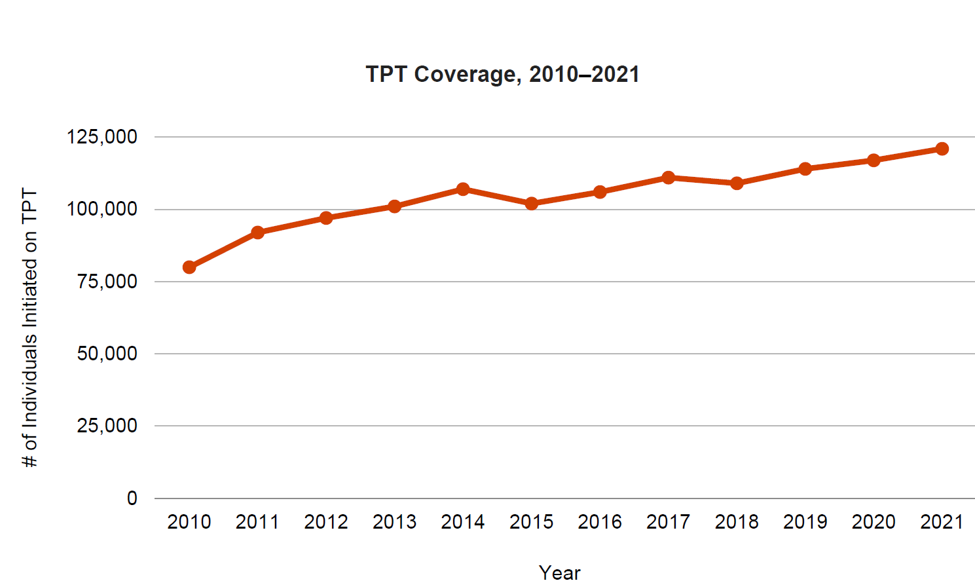
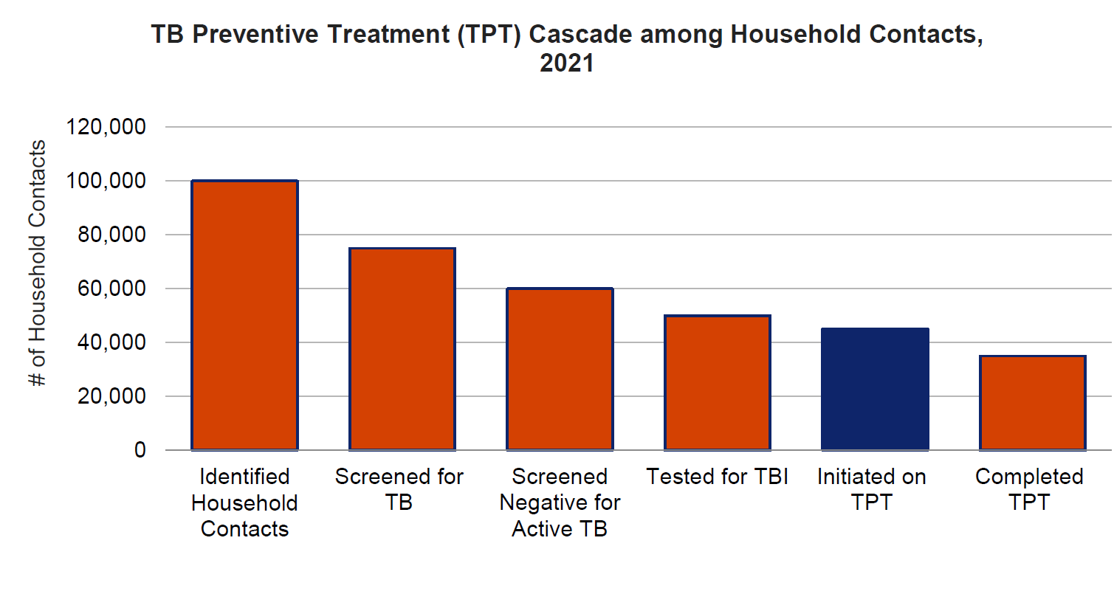
TPT_ENROLL: TPT Initiations
PREVENT

Slide 44
SN_DOMESTICR: Percent of TB Financing Received from Domestic Sources
SUSTAIN
Definition: Percent of National TB Program (NTP’s) budget received from domestic sources during the reporting period.
Calculation: (Numerator/Denominator) x 100
Numerator: The amount of NTP’s budget received from domestic sources (including loans) during the reporting period (in U.S. dollars).
Denominator: The amount of NTP’s budget received from all sources (domestic, the Global Fund to Fight AIDS, Tuberculosis and Malaria, USAID, and other sources) during the reporting period (in U.S. Dollars).
Unit of measure: Percent of funding
Data type: Percentage

Slide 45
SN_DOMESTICR: Percent of TB Financing Received from Domestic Sources
SUSTAIN
Disaggregate by:
Reporting level: All Core PBMEF indicators should be reported at the national level; data may also be collected subnationally for more granular monitoring.
Reporting frequency: This indicator should be reported on a semiannual basis at a minimum. More frequent monitoring on a quarterly, monthly, or real-time basis is recommended. Performance plans and reports (PPRs) for this indicator are based on calendar year (CY) periodicity to reflect national level attainment and align with the USAID congressional reporting requirements.
Data sources: NTPs report this indicator on an annual basis to the World Health Organization (WHO); where missions are not able to get a direct value from the NTP, the value included in the most recent WHO Global TB Report should be used for reporting purposes.
The WHO indicator for the numerator is rcvd_tot_domestic (funding received from domestic sources, including loans [US dollars]), and the denominator is rcvd_tot_sources (total funding received from all sources [US dollars]).

Slide 46
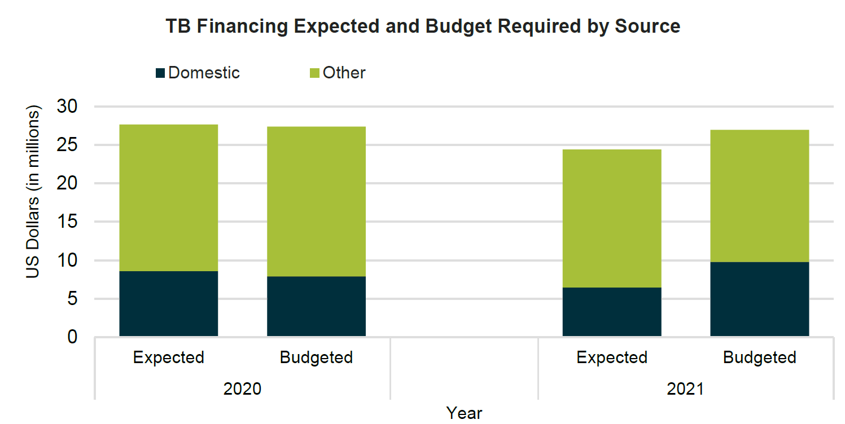
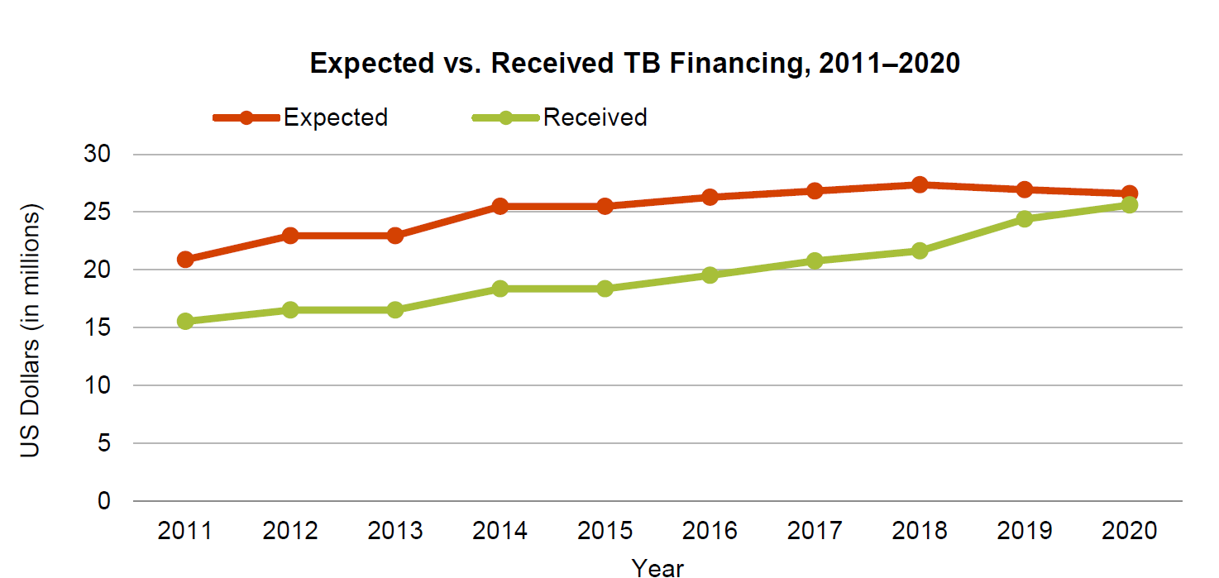
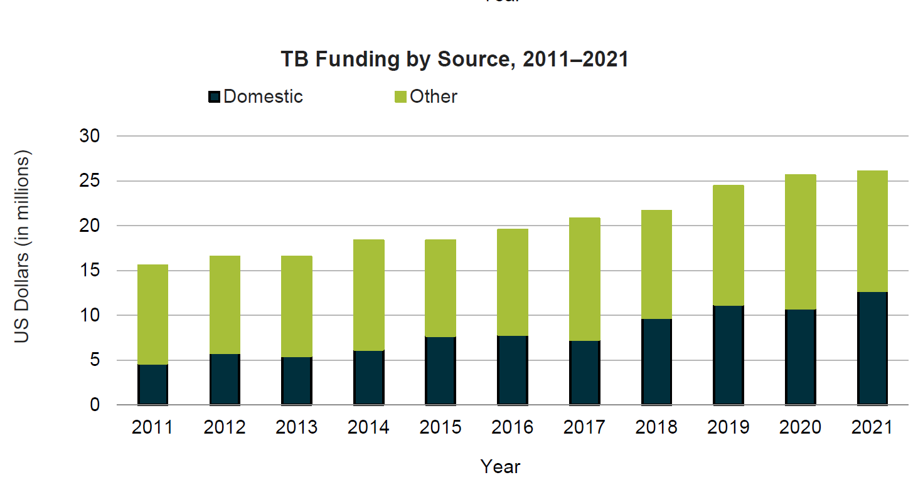
SN_DOMESTICR: Percent of TB Financing Received from Domestic Sources
SUSTAIN

Slide 47
Key messages
Core indicators are core indicators because they are CORE:
Help measure TB investments by USAID and the global community
Measure progress toward the targets: US Global TB Strategy, UNHLM,
Are generally readily available data
Limitations
high level
lack granularity for in-depth analysis
cascade analysis

Slide 48
Q&A

Slide 49
For more information
Sevim Ahmedov TB/HIV, Prevention and M&E Team Lead AOR TB DIAH Tuberculosis Division Office of Infectious Disease, Bureau for Global Health
USAID
Meaghan Peterson TB Monitoring and Evaluation Advisor, Tuberculosis Division Office of Infectious Disease, Bureau for Global Health
USAID
sahmedov@usaid.gov
meapeterson@usaid.gov
Notes:
Links for chat:
Sevim sahmedov@usaid.gov
Meaghan meapeterson@usaid.gov

Slide 50
Live Links
TBDIAH.org
http://www.tbdiah.org
PBMEF
https://www.tbdiah.org/assessments/pbmef/
QTSA
https://www.tbdiah.org/assessments/quality-of-tuberculosis-services-assessments/
D2AC
https://www.tbdiah.org/assessments/d2ac/
Data Analysis & Visualizations
http://hub.tbdiah.org

Slide 51
Boilerplate

