Slide 1

Africa Regional Workshop on Strengthening TB Monitoring and Evaluation Systems
16-19 April, 2024 • Dar es Salaam, Tanzania
NTP UPDATES: United Republic of Tanzania

Slide 2
Country TB Profile and TB Situation Snapshot

Slide 3
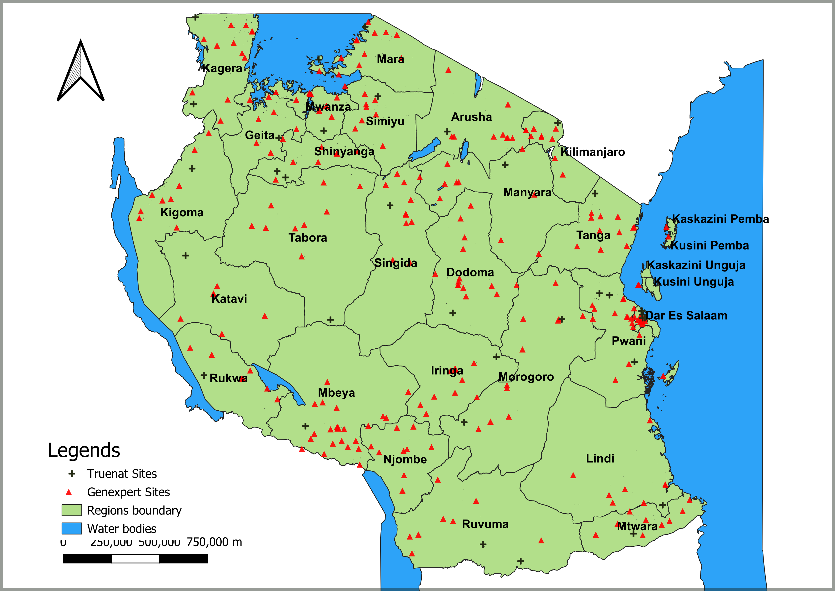


TB Profile 2023
61.7 M pop
  51% female
Treatment
9,366 Health facilities 39.9% Private owned
5,597 (59.7%) TB Treatment Centres
Diagnostic
341 mWRDs sites : 304 GeneXpert ,35 TrueNat & 2 both
6 Zonal Culture laboratories, 1 Reference Laboratory.+ Sample transportation system
Decentralization & Outreaches
305 MDR-TB Treatment Centres
5 TB Mobile vans
21 CAD4TB (5 in Mobile vans and 16 in District Hospitals )
1,773 TB Diagnostic Centres
Zonal Lab

Slide 4
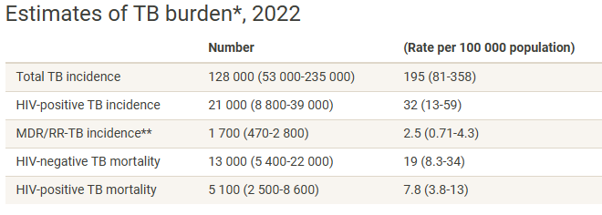
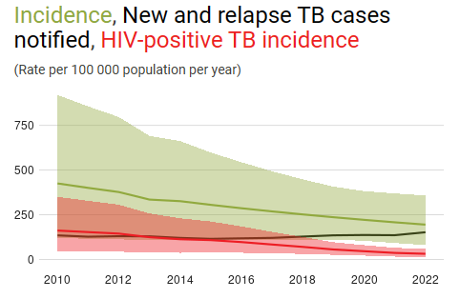
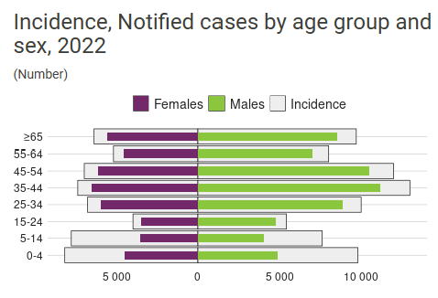
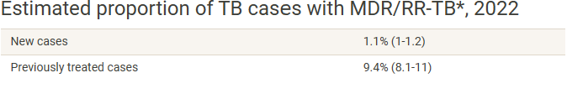
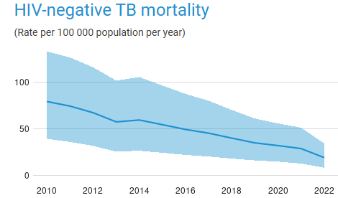
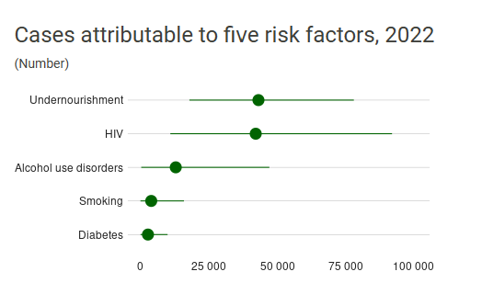
TB burden 2022
Notes:
TB contributed 41% of all HIV deaths in Tanzania

Slide 5
Data-Driven Strategies:
Update on national TB M&E, surveillance, and data use

Slide 6
AGENDA
NTLP M&E: scope, organization, resources, sources of data and tools
TB surveillance; status , success & challenges
Data use: strategies, success stories, challenges in data quality and use and analysis
Plans for the future

Slide 7
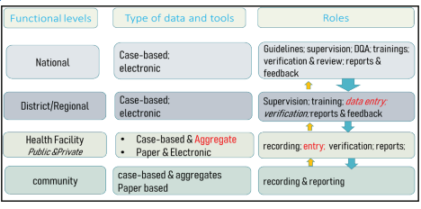
TB M&E
Scope:
Resources
Organization
NSP VI 2020-2026 END TERM REVIEW
Treatment coverage
TB diagnostic
TB in children
RR/MDR-TB
Co morbidities
Miners
Leprosy
Supportive systems
M&E and research
Costed M&E plan
ETL eLMIS, TBLIS GX alert
National: Strategic information unit : M&E and data officials *
Regional: TB Coordinators*
District : TB Coordinators *
(with Laptop for data collection)
Facility: DOT Provider
Community: Community health care workers and Volunteers *
(with tablets for data collection)
In puts
Out puts
Out come
Impact
Progress & performance of Program
Learning for improvement
One Impact
Data sources: Routine quantitative & qualitative, Surveys, Other programs, NBS
Reflection and learning: Quarterly and Bi-annual Data Review meetings
*= Implementing Partners MEL officials
Notes:
With Laptop for data Collection

Slide 8
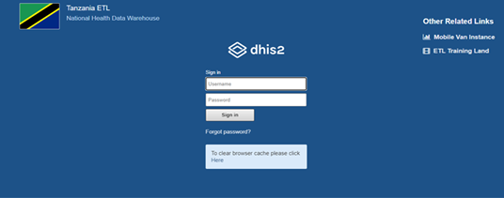
TB surveillance: status, successes, and challenges
2020-2021
2023-2024
2013
2016
2017
2018
Aggregate DHIS2
Case-based Roadmap /Blue print
DHIS2 ETL
DHIS2 ETL
DHIS2 ETL-
DHIS2 ETL-
Adopted DHIS2
Contract to UDSM & Requirement gathering & Design
Pilot, Training and Evaluation for country rollout
Country roll out + Private facilities
WHO S&B Assessment
Merged registers – DS & DR TB
Community app
RDQA
TPT
Gxpert
WHO S&B Assessment

Slide 9
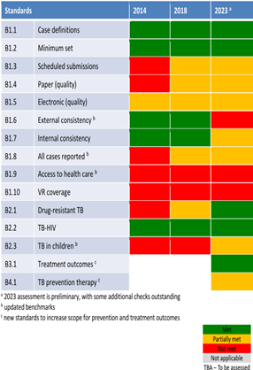
TB surveillance: status, successes, and challenges
Successes
Challenges
Mitigation
Data entry is mainly by a district level manager ; few facilities have ability to enter data into DHIS2 ETL (520/5,597)
  Inadequate trained staff at the facility level in using DHIS2 tracker
  Inadequate ICT infrastructure at facility level
Low Data Quality
Inadequate knowledge on data analysis and data use at subnational level
Not yet interoperable with EMRs
Develop and train existing DOT nurses/CTC Data officer for data entry
Conduct need assessment and mobilize resources for ICT infrastructures-R/CHMT/IP
Conduct Routine Data Quality Assurance
Conduct training to R/DTLC on data analysis, and interpretation
Link ETL with EMRs
5 years-case based -ETL
Country-wide, all stakeholders
Integration

Slide 10
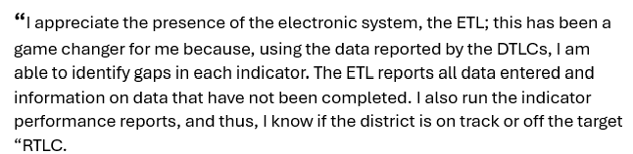
Data use: strategies; success stories; and challenges in data quality, use, and analysis
DATA USE STRATEGIES
  Community and facility data review meetings (exchange meetings?)
  Regional quarterly review meetings
  National biannual data review meetings
  Data use and analysis guidelines
  Annual best performer recognition – since 2016 to date
GIS-based analyses informed Gx pert placement (MATCH Analysis) -2020
Case-based data analysis facilitated COVID 19 mitigation plans -2020
Data availability facilitates performance review for target achievements -2021
Case-based data facilitates in-depth analysis of B+ indicator performance -2023

Slide 11
Plans for the Future
PLANS
Conduct routine data quality assessments
Capacity building: National – advanced analysis and visualization
Subnational – Data use and analysis guidelines training
GIS-enabled analyses and mapping
Integrations – GX pert
Interoperability – EMRs and others
Learning from what is and is not working
Surveys

Slide 12
TB M&E Beyond Numbers: Understanding trends in
PBMEF core indicators

Slide 13
Proportion of bacteriologically confirmed TB cases notified

Slide 14
RR/MDR TB NOTIFICATION TREND

Slide 15
ASANTE SANA

