Slide 1

Performance Based Monitoring and Evaluation Framework (PBMEF) In-Depth: Part 2
Africa Regional Workshop
Notes:
In addition to the 10 core indicators, there are also numerous indicators in the PBMEF that can be used to monitor the performance of interventions and investment in TB, either through USAID or other global initiatives. These include Core Plus, National, and Project, as well as many more extended indicators. They fall under 14 technical areas or categories, as shown in the chart.

Slide 2
In-Depth Analysis Using PBMEF Indicator Levels
The different levels allow more in-depth analysis of TB data and closer monitoring and evaluation (M&E) of TB programs:
  Provide additional standard options to include in an M&E plan to bolster the justification for programming and funding for specific technical areas in the TB portfolio
  Can be used to construct treatment cascades and patient pathways that are critical to understanding where there are gaps and where efforts need to be strengthened
Core
Essential List of Indicators
Core Plus
National Level
Project Level
Extended*
Notes:
The PMBEF indicators can be represented and seen as a pyramid, with the core 10 indicators in the top layer and the extended indicators, at the base of the pyramid with several indicators.
Overall, the sub-groups allow for an in-depth understanding of TB program performance.

Slide 3
3
PBMEF Indicator Level | Purpose | # of indicators
Core Plus | Provide additional data to monitor toward the progress of the 10 core indicators Prioritize key indicators for specific cascades of care Reflect national level attainment and track the contribution of USAID investments | 11
National Level | Provide granular data for in-depth understanding of the epidemiology and performance of program toward national targets Help meet the reporting requirements articulated in the End TB Now Bill Recommended for measuring the contribution of USAID investment to national program targets | 16
Project Level | Provide more detailed data to monitor project performance and progress towards targets Help meet the reporting requirements articulated in the End TB Now Bill | 30
Extended | Provide additional standard options to include in an M&E plan to bolster the justification for programming and funding for specific technical areas in the TB portfolio Can be used to construct treatment cascades and patient pathways that are critical to understanding where there are gaps and where efforts need to be strengthened | 200+
Notes:
The 10 Core indicators are crucial for USAID's 90-90-90+ prevention strategic results, demonstrating project contribution to national and international targets, providing standard comparisons across priority countries, and being included in TB roadmaps.
Reiterate the PBMEF indicators' pyramid structure, and utilize the number of indicators in each sub-group to validate the previous slide's pyramid chart.
Emphasize how each indicator subgroup adds value, particularly in relation to the core indicators and how USAID's investment is contributing to the national program targets.

Slide 4




ACCELERATOR
OBJECTIVES
& TARGETS
PPR/ACCELERATOR
MISSION REPORTING
CORE INDICATORS (10)
CORE PLUS (11)
NATIONAL LEVEL (16)
PROJECT LEVEL (30)
Improve access to high-quality, patient-centered TB, drug-resistant TB (DR-TB) and TB/HIV services
DT_RT: TB Detection Rate
BAC_CON: Percent Bacteriologically Confirmed
PEDS_NOTIF: Childhood TB Notifications
MDR_NOTIF: RR/MDR Notifications
PR_NOTIF: Private Sector TB Notifications
CON_SCRN: Percent of Contacts with Contact Investigation Initiated
NEWREL_WRD: Rapid diagnostic testing at time of initial diagnosis
NEWREL_DST: Percent of people with new and relapse TB with drug susceptibility testing (DST)
RET_DST: Percent of people with previously treated TB with drug susceptibility testing (DST)
XDR_NOTIF: Pre-XDR/XDR notifications
PEDS_BAC_CON: Percent of children and adolescents (0-14 years) with new and relapse pulmonary TB who are bacteriologically confirmed
PEDS_MDR_NOTIF: MDR-TB notifications amon children and adolescents (0-14 years)
DT_CI_INIT: Percent of people with notified TB with a contact investigation initiated
(more indicators than listed here)
DT_SCRN: Number of people screened
for TB
DT_SCRN_COMM: Number of people screened for TB disease outside of health facilities
DT_PRES: Number of people with presumptive TB
(more indicators than listed here)
REACH
90% diagnosed and on treatment
Decrease TB Mortality
TX_DR_ENROLL: DR-TB enrolled on treatment
TX_STR_ENROLL: DR-TB “all oral” short regimen initiations
TX_LTR_ENROLL: DR-TB “all oral” longer regimen initiations
TX_DR_ADR: Number of people with adverse reactions to DR-TB treatment
TX_DS_OUT: DS-TB treatment outcomes
TX_DR_OUT: DR-TB treatment outcomes
PEDS_TSR: Treatment success rate in children and adolescents (0-14 years)
PLHIV_TSR: Treatment success rate PLHIV
TX_DS_ENROLL: DS-TB treatment initiations
TX_DS_SUPPORT: Percent of people on DS-TB treatment who received treatment support
TX_DR_SUPPORT: Percent of people on DR-TB treatment who received treatment support
(more indicators than listed here)
Improve TB service delivery
DS_TSR: DS-TB Treatment Success Rate
DR_TSR: DR-TB Treatment Success Rate
CURE
90% DS and DR-TB treatment success rate
Increase prevention of TB transmission & disease progression
TPT_ENROLL: TPT Initiations
TPT_CON_ENROLL: TPT initiations among contacts
TPT_COMPL: TPT completions
TPT_CON_04: Number of TPT initiations amon contacts <5
TPT_PLHIV_ENROLL: Number of TPT initiations in PLHIV
HCW_SCRN: Percent of HCWs screened for TB
HCW_TBI_POS: Percent of HCWs diagnosed with TBI
TPT_ADR: Number of people with adverse reations to TPT
(more indicators than listed here)
PREVENT
Decrease TB Incidence
30 million on TB preventive treatment
SN_MQS: TB drugs meeting international minimum quality standards
SN_CQI: Continuous Quality Improvement (CQI) program in place
STKOUT_FLD: Stockout of any first-line TB treatment drugs
STKOUT_SLD: Stockout of any second-line TB treatment drugs
STKOUT_WRD: Stockout of TB rapid molecular test and related commondities
(more indicators than listed here)
Increase commitment for the sustainability of TB efforts
SN_DOMESTICR: Domestic Financing
SN_TB_INSUR: Existence of national or social health insurance system whose benefit package includes TB clinical services
SUSTAIN
Global investments
reach $22 billion by 2027
Notes:
Indicators that relate to the objectives are available in the core plus, national, and project level indicators, just like in the core indicator. Under each of the objective and targets are the core plus, nationwide, and project-level metrics.
Core Plus: REACH (4); CURE (4), PREVENT (2); and SUSTAIN (1)
National : REACH (7); CURE (5), PREVENT (2); and SUSTAIN (2)
Project: REACH (15); CURE (4), PREVENT (5); and SUSTAIN (6)

Slide 5






OBJECTIVES
& TARGETS
PPR/ACCELERATOR
ACCELERATOR
MISSION REPORTING
CORE INDICATORS (10)
CORE PLUS (11)
NATIONAL LEVEL (16)
PROJECT LEVEL (30)
Improve access to high-quality, patient-centered tuberculosis (TB), drug-resistant TB (DR-TB) and TB/HIV services
DT_RT: TB Detection Rate (Treatment Coverage)
BAC_CON: Percent Bacteriologically Confirmed
PEDS_NOTIF: Childhood TB Notifications
MDR_NOTIF: RR/MDR Notifications
PR_NOTIF: Private Sector TB Notifications
CON_SCRN: Percent of Contacts with Contact Investigation Initiated
NEWREL_WRD: Rapid diagnostic testing at time of initial diagnosis
NEWREL_DST: Percent of people with new and relapse TB with drug susceptibility testing (DST)
RET_DST: Percent of people with previously treated TB with drug susceptibility testing (DST)
XDR_NOTIF: Pre-XDR/XDR notifications
PEDS_BAC_CON: Percent of children and adolescents (0-14 years) with new and relapse pulmonary TB who are bacteriologically confirmed
PEDS_MDR_NOTIF: MDR-TB notifications amon children and adolescents (0-14 years)
DT_CI_INIT: Percent of people with notified TB with a contact investigation initiated
(more indicators than listed here)
DT_SCRN: Number of people screened
for TB
DT_SCRN_COMM: Number of people screened for TB disease outside of health facilities
DT_PRES: Number of people with presumptive TB
(more indicators than listed here)
REACH
90% diagnosed and on treatment
Decrease TB Mortality
DS_TSR: DS-TB Treatment Success Rate
DR_TSR: DR-TB Treatment Success Rate
TX_DR_ENROLL: DR-TB enrolled on treatment
TX_STR_ENROLL: DR-TB “all oral” short regimen initiations
TX_LTR_ENROLL: DR-TB “all oral” longer regimen initiations
TX_DR_ADR: Number of people with adverse reactions to DR-TB treatment
TX_DS_OUT: DS-TB treatment outcomes
TX_DR_OUT: DR-TB treatment outcomes
PEDS_TSR: Treatment success rate in children and adolescents (0-14 years)
PLHIV_TSR: Treatment success rate PLHIV
TX_DS_ENROLL: DS-TB treatment initiations
TX_DS_SUPPORT: Percent of people on DS-TB treatment who received treatment support
TX_DR_SUPPORT: Percent of people on DR-TB treatment who received treatment support
(more indicators than listed here)
Improve TB service delivery
CURE
90% DS and DR-TB treatment
success rate
Increase prevention of TB transmission & disease progression
TPT_ENROLL: TPT Initiations
TPT_CON_ENROLL: TPT initiations among contacts
TPT_COMPL: TPT completions
TPT_CON_04: Number of TPT initiations amon contacts <5
TPT_PLHIV_ENROLL: Number of TPT initiations in PLHIV
HCW_SCRN: Percent of HCWs screened for TB
HCW_TBI_POS: Percent of HCWs diagnosed with TBI
TPT_ADR: Number of people with adverse reations to TPT
(more indicators than listed here)
PREVENT
Decrease TB Incidence
30 million on TB preventive treatment
Increase commitment for the sustainability of TB efforts
SN_MQS: TB drugs meeting international minimum quality standards
SN_CQI: Continuous Quality Improvement (CQI) program in place
STKOUT_FLD: Stockout of any first-line TB treatment drugs
STKOUT_SLD: Stockout of any second-line TB treatment drugs
STKOUT_WRD: Stockout of TB rapid molecular test and related commondities
(more indicators than listed here)
SN_DOMESTICR: Domestic Financing
SN_TB_INSUR: Existence of national or social health insurance system whose benefit package includes TB clinical services
SUSTAIN
Global investments
reach $22 billion by 2027

Slide 6


CORE PLUS INDICATORS
www.tbdiah.org/assessments/pbmef/
Core
Core Plus
National Level
Project Level
Extended*

Slide 7
CORE PLUS
NEWREL_WRD: Rapid diagnostic testing at time of initial diagnosis
NEWREL_DST: Percent of people with new and relapse TB with drug susceptibility testing (DST)
RET_DST: Percent of people with previously treated TB with drug susceptibility testing (DST)
XDR_NOTIF: Pre-XDR/XDR Notifications
REACH
Provide additional data to monitor toward the progress of the 10 core indicators
Prioritize key indicators for specific cascades of care
Reflect National Level attainment and track the contribution of USAID investments
Expected to be included in monitoring, evaluation, and learning (MELs) of implementing partners (IPs) and will become part of biannual reporting during Accelerator calls of the TB Division
TX_DR_ENROLL: DR-TB treatment initiations
TX_STR_ENROLL: DR-TB "all oral" short treatment regimen initiations
TX_LTR_ENROLL: DR-TB "all oral" longer treatment regimen initiations
TX_DR_ADR: Number of people with adverse reactions to DR-TB treatment
CURE
TPT_CON_ENROLL: TPT initiations among contacts
TPT_COMPL: TPT Completions
PREVENT
SN_TB_INSUR: Existence of a national or social health insurance system whose benefit package includes TB clinical services
SUSTAIN
Notes:
The 11 core plus indicators are listed below, arranged by goal areas. While PREVENT and SUSTAIN have two and one indicator(s), respectively, REACH and CURE have four each.
The subsequent slides went into great detail about each indicator per objective area, that is anatomy of indicators such as definitions, numerators, and denominators when appropriate.

Slide 8
8
REACH
Indicator short name | Indicator Name | Definition | Numerator | Denominator | Disaggregation | WHO variables
NEWREL_ WRD | Rapid diagnostic testing at time of initial diagnosis | Percent of people with new and relapse TB who were tested using a WHO-recommended rapid diagnostic test (WRD): FluoroType® MTBDR (Hain), Loopamp™ MTBC detection kit (TB-LAMP), Xpert® MTB/RIF, Xpert® MTB/RIF Ultra, Truenat® MTB or MTB Plus, RealTime MTB (Abbott), BD MAX™ MDR-TB, cobas® MTB (Roche), or LF-LAM at the time of initial TB diagnosis (regardless of test result). Calculation: (Numerator/Denominator) x 100 | Number of people with new and relapse TB notified during the reporting period who were tested using a WRD: FluoroType® MTBDR (Hain), Loopamp™ MTBC detection kit (TB-LAMP), Xpert® MTB/RIF, Xpert® MTB/RIF Ultra, Truenat® MTB or MTB Plus, RealTime MTB (Abbott), BD MAX™ MDR-TB, cobas® MTB (Roche), or LF-LAM at the time of initial TB diagnosis (regardless of test result). | Number of people with notified new and relapse TB during the reporting period | Age (0–4, 5–14, 15+), sex, type of diagnostic test
NEWREL_ DST | Percent of people with new and relapse TB with drug susceptibility testing (DST) | Percent of people with new and relapse pulmonary TB who have drug susceptibility testing (DST) results for 1) rifampicin, 2) isoniazid, 3) fluoroquinolones, 4) bedaquiline, and 5) linezolid Calculation: (Numerator disaggregate: DST type (1,2,3,4 or 5*)/Denominator) x 100 *Note 5 separate proportions should be calculated, one for each drug type. | Number of people with new and relapse pulmonary TB who have drug susceptibility test (DST) results for 1) rifampicin, 2) isoniazid, 3) fluoroquinolones, 4) bedaquiline, and 5) linezolid | Number of people with bacteriologically confirmed new and relapse pulmonary TB | DST type: rifampicin fluoroquinolones isoniazid-bedaquiline linezolid Age (0–4, 5–14, 15+), sex, HIV status
Notes:
According to USAID requirements, indicators must be unambiguous and clear. A comprehensive indicator reference sheet for the indicators in the core plus, national, and project has been created and approved by USAID and the SIG. The IRS provides help in defining the indicator, figuring out how the data should be reported, and so forth.

Slide 9
9
REACH
Indicator short name | Indicator Name | Definition | Numerator | Denominator | Disaggregation | WHO variables
RET_DST | Percent of people with previously treated TB with drug susceptibility testing (DST) | Percent of people with previously treated (including relapse) pulmonary TB who have DST results for 1) rifampicin, 2) isoniazid, 3) fluoroquinolones, 4) bedaquiline, and 5) linezolid Calculation: (Numerator disaggregate: DST type (1,2,3,4 or 5*)/Denominator) x 100 *Note 5 separate proportions should be calculated, one for each drug type. | Number of people with previously treated (including relapse) pulmonary TB who have drug susceptibility test (DST) results for 1) rifampicin, 2) isoniazid, 3) fluoroquinolones, 4) bedaquiline, and 5) linezolid | Number of people with bacteriologically confirmed previously treated (including relapse) pulmonary TB | DST type: rifampicin fluoroquinolones isoniazid-bedaquiline linezolid Age (0–4, 5–14, 15+), sex, HIV status | Components of this indicator found in WHO: Numerator: Rifampicin: r_rlt_ret Isoniazid: dst_rlt_ret Denominator: pulm_labconf_ret
XDR_NOTIF | Pre-XDR/XDR Notifications | Number of people with pre-extensively drug-resistant (pre-XDR) and extensively drug-resistant (XDR) TB notified during the reporting period. Pre-XDR/XDR-TB: XDR-TB is caused by a strain of M. tuberculosis complex that is resistant to rifampicin (and may also be resistant to isoniazid), and that is also resistant to at least one fluoroquinolone (levofloxacin or moxifloxacin) and to at least one other “Group A” drug (bedaquiline or linezolid); pre-XDR-TB meets these qualifications but is resistant to a fluoroquinolone or a “Group A” drug, but not both. Note: This indicator is reported separately from rifampicin-resistant (RR) and multidrug-resistant (MDR) notifications. Values for these indicators should not be added together. | Number of people with laboratory-confirmed or clinically diagnosed drug-resistant (DR)-TB (RR/MDR-TB and pre-XDR/XDR-TB) who initiated treatment for DR-TB during the reporting period. | N/A | Age (<15, 15+), sex | conf_rr_fqr (lab confirmed pre XDR and XDR)

Slide 10
10
CURE
Indicator short name | Indicator Name | Definition | Numerator | Denominator | Disaggregation | WHO variables
TX_DR_ ENROLL | DR-TB "all oral" short treatment regimen initiations | Number of people with laboratory-confirmed or clinically diagnosed DR-TB (RR/MDR-TB and pre-XDR/XDR-TB) who initiated treatment for DR-TB during the reporting period. RR/MDR-TB: RR-TB is TB caused by Mycobacterium Tuberculosis (M. tuberculosis) strains that are resistant to rifampicin; MDR-TB strains are resistant to at least both rifampicin and isoniazid. Pre-XDR/XDR-TB: XDR-TB is caused by a strain of M. tuberculosis complex that is resistant to rifampicin (and may also be resistant to isoniazid), and that is also resistant to at least one fluoroquinolone (levofloxacin or moxifloxacin) and to at least one other “Group A” drug (bedaquiline or linezolid); pre-XDR-TB meets these qualifications but is resistant to a fluoroquinolone or a “Group A” drug, but not both. | Number of people with laboratory-confirmed or clinically diagnosed DR-TB (RR/MDR-TB and pre-XDR/XDR-TB) who initiated treatment for DR-TB during the reporting period | N/A | Age (<15, 15+), sex, HIV status | unconf_rr_nfqr_tx plus conf_rr_nfqr_tx plus conf_rr_fqr_tx
TX_STR_ ENROLL | DR-TB "all oral" longer treatment regimen initiations | Number of people with DR-TB (RR/MDR-TB and pre-XDR/XDR-TB) initiated on “all oral” short treatment regimen during the reporting period. "Short treatment regimens" refer to regimens with a duration of 12 months or less. | Number of people with DR-TB (RR/MDR-TB and pre-XDR/XDR-TB) initiated on "all oral" short treatment regimen during the reporting period | N/A | Age (<15, 15+), sex | mdr_alloral_short_tx

Slide 11
11
CURE
Indicator short name | Indicator Name | Definition | Numerator | Denominator | Disaggregation | WHO variables
TX_LTR_ ENROLL | DR-TB "all oral" longer treatment regimen initiations | Number of people with DR-TB (RR/MDR-TB and pre-XDR/XDR-TB) who initiated an “all oral” longer treatment regimen during the reporting period. "Longer treatment regimens" refer to regimens with a duration of 14 months or more, usually lasting 18–24 months. | Number of people with DR-TB (RR/MDR-TB and pre-XDR/XDR-TB) who initiated an “all oral” longer treatment regimen during the reporting period | N/A | Age (<15, 15+), sex | mdrxdr_alloral_tx
TX_DR_ADR | Number of people with adverse reactions to DR-TB treatment | Number of people on DR-TB treatment (RR/MDR-TB and pre-XDR/XDR-TB) who developed at least one adverse drug reaction (ADR) to DR-TB treatment during the reporting period; this includes all people on treatment during the specified reporting period and is not related to a cohort. An ADR (sometimes referred to as an “adverse event”) is any negative medical occurrence that may present in a person with TB during treatment with a pharmaceutical product, but which does not necessarily have a causal relationship with this treatment. More information on monitoring of ADRs in DR-TB can be found here, and information on ADR grading can be found at https://rsc.niaid.nih.gov/sites/default/files/corrected-grading-table-v-2-1-with-all-changes-highlighted.pdf. | Number of people on DR-TB treatment (RR/MDR-TB and pre-XDR/XDR-TB) who developed at least one ADR to DR-TB treatment during the reporting period; this includes all people on treatment during the specified reporting period and is not related to a cohort. | N/A | Age (<15, 15+), sex, type of adverse reaction (e.g., vomiting, dizziness, reduced appetite, gastritis) | mdrtx_adverse_events

Slide 12
12
PREVENT
Indicator short name | Indicator Name | Definition | Numerator | Denominator | Disaggregation | WHO variables
TPT_CON_ ENROLL | TPT initiations among contacts | Number of household contacts and other close contacts of people with bacteriologically confirmed, notified pulmonary TB who initiated TB preventive treatment (TPT) during the reporting period. This indicator is a subset of the core indicator “TPT initiations.” "Other” close contacts will be assessed by clinical judgment or experience. In general, this may include someone who may not live in the same house as the index patient but spends considerable time there or spent time elsewhere when the index case was present. It may also be someone who the index case may have spent time in close contact in other settings such as in school or in the workplace. | Number of adult, adolescent, and children <5 years who are household or other close contacts of people with bacteriologically confirmed, notified pulmonary TB who initiated TPT during the reporting period | N/A | Age (0–4, 5–14, 15+), sex, public vs private | newinc_con_prevtx
TPT_COMPL | TPT Completions | Number of contacts or other eligible people who completed TPT during the reporting period. During a given reporting period, the cohort of people who initiated TPT should be tracked to monitor the number who complete TPT. Completion data should be disaggregated by: * Household contacts aged <5 years * Household contacts 5 years and up * People living with HIV (PLHIV) | Number of contacts or other eligible people who completed TPT during the reporting period | N/A | Age (0–4, 5–14, 15+), sex, risk group (contacts, PLHIV) | newinc_con_prevtx_cmplt plus hiv_all_tpt_completed

Slide 13
13
SUSTAIN
Indicator short name | Indicator Name | Definition | Numerator | Denominator | Disaggregation | WHO variables
SN_TB_INSUR | Existence of a national or social health insurance system whose benefit package includes TB clinical services | Country has a national or social health insurance (NHI/SHI) scheme whose benefit package includes TB clinical services. National/social health insurance: forms of health insurance that are often administered by the government or a quasi-governmental agency, funded through contribution from taxes and/or employers and employees, and cover a package of services. Community based health insurance (CBHI) schemes are usually voluntary and characterized by community members pooling funds to offset the cost of healthcare. Some countries with CBHI schemes are adjusting the model towards integration into broader NHI/SHI schemes. For the purpose of this indicator, NHI/SHI/CBHI schemes should only be scored as being “available” if they exceed the following threshold: >50% population coverage and >2% of current health expenditure comes from pre-payment. These schemes should include diagnosis, treatment, and prevention of all forms of TB, including MDR-TB, for all populations of the country. This indicator is intended to measure whether a country is able to source funding for TB from an insurance scheme; countries with no insurance scheme should score “0” (even if TB care is free). | 0 = EITHER No national/social health insurance scheme OR national/social health insurance available but DS-TB & DR-TB (diagnosis and treatment costs) are excluded 2 = National/social health insurance is available and includes diagnosis and treatment costs for DS- or DR-TB but not both 4 = National/social health insurance is available and includes diagnosis and treatment costs for both DS- and DR-TB | N/A | N/A

Slide 14
NATIONAL LEVEL INDICATORS
www.tbdiah.org/assessments/pbmef/
Core
Core Plus
National Level
Project Level
Extended*

Slide 15
NATIONAL LEVEL
PEDS_BAC_CON: Percent children and adolescents (0–14 years old) with new and relapse pulmonary TB who are bacteriologically confirmed
PEDS_MDR_NOTIF: MDR-TB notifications among children and adolescents (0-14 years)
DT_CI_INIT: Percent of people with notified TB with a contact investigation initiated
DT_CON_PRES: Number of contacts with presumptive TB
DT_CON_TST: Number of contacts who received TB diagnostic testing
DT_CON_DX: Number of contacts diagnosed with active TB disease
DT_CON_TX: Number of contacts who initiated TB treatment
TPT_CON_04: Number of TPT initiations among contacts <5
TPT_PHLIV_ENROLL: Number of TPT initiations among PLHIV
REACH
PREVENT
Provide granular data for in-depth understanding of the epidemiology and performance of program toward national targets
Help meet the reporting requirements articulated in the End TB Now Bill
Recommended for measuring the contribution of USAID investment to national program targets
Inclusion where possible at the project level for attribution
SN_CQI: Continuous Quality Improvement (CQI) programs in place
SN_MQS: TB drugs meeting international minimum quality standards
SUSTAIN
TX_DS_OUT: DS-TB treatment outcomes
TX_DR_OUT: DR-TB treatment outcomes
PEDS_TSR: Treatment success rate in children and adolescents (0-14 years)
PLHIV_TSR: Treatment success rate among PLHIV
TX_DS_ENROLL: DS-TB treatment initiations
CURE
Notes:
The national level has seven indicators for the REACH objective and targets, five for CURE, and two pieces for PREVENT and SUSTAIN, much as the Core Plus.

Slide 16
16
REACH
Indicator short name | Indicator Name | Definition | Numerator | Denominator | Disaggregation | WHO variables
PEDS_BAC _CON | Percent children and adolescents (0–14 years old) with new and relapse pulmonary TB who are bacteriologically confirmed | Percent of children and adolescents (0–14 years) with new and relapse pulmonary TB who are bacteriologically confirmed. Bacteriologically confirmed: Smear positive for TB or culture positive for TB by a World Health Organization-recommended rapid diagnostics test (WRD): FluoroType® MTBDR (Hain), Loopamp™ MTBC detection kit (TB-LAMP), Xpert® MTB/RIF, Xpert® MTB/RIF Ultra, Truenat® MTB or MTB Plus, RealTime MTB (Abbott), BD MAX™ MDR-TB, cobas® MTB (Roche), or LF-LAM. Note: This is a subset of the core indicator “Percent Bacteriologically Confirmed.” Calculation: (Numerator/Denominator) x 100 | Number of children and adolescents (0–14 years) with new and relapse pulmonary TB who are bacteriologically confirmed during a reporting period | Number of children and adolescents (0–14 years) with new and relapse pulmonary TB during the reporting period | Age (0–4, 5–14), sex
PEDS_MDR _NOTIF | MDR-TB notifications among children and adolescents (0-14 years) | Number of children and adolescents (0–14 years) with rifampicin-resistant (RR)-TB/multidrug-resistant (MDR)-TB notified during the reporting period; pre-extensively drug-resistant (pre-XDR) TB, and extensively drug-resistant (XDR) TB should not be reported in addition to the RR/MDR-TB notifications. RR/MDR-TB: is TB caused by Mycobacterium Tuberculosis (M. tuberculosis) strains that are resistant to rifampicin; MDR-TB strains are resistant to at least both rifampicin and isoniazid. Note: pre-XDR/XDR notifications should not be added to RR/MDR-TB notifications to avoid double counting of DR-TB notifications. Children who are diagnosed with pre-XDR and XDR-TB will already have been identified and recorded as having RR/MDR-TB. The number of RR/MDR-TB notifications should therefore equal the total number of DR-TB notifications. | Number of children and adolescents (0–14 years) with notified RR/MDR-TB during the reporting period (both lab-confirmed and clinically diagnosed). | N/A | Age (0–4, 5–14), sex
Notes:
Available online

Slide 17
17
REACH
Indicator short name | Indicator Name | Definition | Numerator | Denominator | Disaggregation | WHO variables
DT_CI_INIT | Percent of people with notified TB with a contact investigation initiated | Percent of people with notified pulmonary TB with a contact investigation (CI) initiated. CI initiated: For the purpose of this indicator, "initiated" refers to the process of enumeration of all known contacts to an index TB case. CI will include the evaluation of those contacts to determine if any have active TB disease or TB infection (TBI) through symptom screening, diagnostic testing, chest X-ray (CXR), or clinical evaluation. Index case: Person with pulmonary TB who is notified to health authorities. Calculation: (Numerator/Denominator) x 100 | Number of people with notified pulmonary TB with a CI initiated | Number of people with notified pulmonary TB during the reporting period | Age (0–4, 5–14), sex
DT_CON_PRES | Number of contacts with presumptive TB | Number of contacts to a person with notified pulmonary TB who have signs or symptoms of TB, as defined by the WHO 4 symptom screen or the NTP (i.e., have presumptive TB). Presumptive TB: a person who has one or more signs or symptoms of active TB disease and should be referred for diagnostic testing to diagnose or rule out active disease. | Number of contacts with presumptive TB | N/A | Age (0–4, 5–14), sex
DT_CON_TST | Number of contacts who received TB diagnostic testing | Number of contacts to a person with notified pulmonary TB with signs or symptoms of TB (e.g., presumptive TB) who received diagnostic testing for TB. Diagnostic testing includes smear, culture or a World Health Organization recommended rapid diagnostics test (WRD): FluoroType® MTBDR (Hain), Loopamp™ MTBC detection kit (TB- LAMP), Xpert® MTB/RIF, Xpert® MTB/RIF Ultra, Truenat® MTB or MTB Plus, RealTime MTB (Abbott), BD MAX™ MDR-TB, cobas® MTB (Roche), or LF- LAM. | Number of contacts to a person with notified pulmonary TB who received diagnostic testing for presumptive TB | N/A | Age (0–4, 5–14), sex
Notes:
Available online

Slide 18
18
REACH
Indicator short name | Indicator Name | Definition | Numerator | Denominator | Disaggregation | WHO variables
DT_CON_DX | Number of contacts diagnosed with active TB disease | Number of contacts diagnosed with TB disease (both bacteriologically and clinically confirmed) among all contacts who were screened for TB disease during the reporting period | Number of contacts who were diagnosed with TB disease (both bacteriologically and clinically confirmed) | N/A | Age (0–4, 5–14), sex
DT_CON_TX | Number of contacts who initiated TB treatment | Number of contacts diagnosed with active TB disease who initiated TB treatment | Number of contacts who initiated TB treatment | N/A | Age (0–4, 5–14), sex
Notes:
Available online

Slide 19
19
CURE
Indicator short name | Indicator Name | Definition | Numerator | Denominator | Disaggregation | WHO variables
TX_DS_ ENROLL | DS-TB treatment initiations | Number of people with laboratory-confirmed or clinically diagnosed DS-TB who initiated treatment for DS-TB during the reporting period. | Number of people with laboratory-confirmed or clinically diagnosed DS-TB who initiated treatment for DS-TB during the reporting period | N/A | Age (<15, 15+), sex, HIV status, public
TX_DS_OUT | DS-TB treatment outcomes | Number of people with DS-TB (new and relapse), all forms, with each defined DS-TB treatment outcome, among the cohort of people who were initiated DS-TB treatment during a reporting period. Cohort reporting: Treatment outcomes are defined by the time of initiation on treatment; e.g., “2018 cohort successfully treated” reflect those who were initiated on treatment in 2018, even though treatment may have extended into 2019. For this reason, reports of treatment outcome data lag by one year. | Number of people with DS-TB (new and relapse), all forms, with each defined DS-TB treatment outcome (defined below), among the cohort of people who were initiated DS-TB treatment during a reporting period. DS-TB Treatment outcomes: • Successfully treated: Cure or Completed treatment • Cure • Completed treatment • Lost to follow-up (LTFU) • Treatment failed • Died • Not Evaluated Note: Full definitions of each outcome available in the linked indicator reference sheet available online at: https://www.tbdiah.org/assessments/pbmef/ | N/A (cohort size reported under core DS-TB TSR indicator) | Age (<15, 15+), sex, HIV status, treatment outcome (defined above) | Successfully treated: newrel_succ LTFU: newrel_lost Treatment failed: newrel_fail Died: newrel_died Not Evaluated: newrel_neval Definitions for DS-TB (Ch.10): https://tbksp.org/en/node/617
Notes:
Available online

Slide 20
20
CURE
Indicator short name | Indicator Name | Definition | Numerator | Denominator | Disaggregation | WHO variables
TX_DR_OUT | DR-TB treatment outcomes | Number of people with DR-TB (RR/MDR-TB and pre-XDR/XDR-TB) with each of the defined DR-TB treatment outcomes, among the cohort of people who were initiated on DR-TB treatment during a defined reporting period. Cohort reporting: Treatment outcomes are defined by the time of initiation on treatment; e.g., “2018 cohort successfully treated” reflect those who were initiated on treatment in 2018, even though treatment may have extended into 2019 or 2020. For this reason, reports of DR-TB treatment outcome data lag by 1–2 years.. | Number of people with DR-TB (RR/MDR-TB and pre-XDR/XDR-TB) with each of the treatment outcomes (defined below), among the cohort of people who were initiated on DR-TB treatment during a defined reporting period. DR-TB Treatment outcomes: • Successfully treated: Cure or Completed treatment • Cure • Completed treatment • Lost to follow-up (LTFU) • Treatment failed • Died • Not evaluated Note: Full definitions of each outcome available in the linked indicator reference sheet available online at:: https://www.tbdiah.org/assessments/pbmef/ | N/A (cohort size reported under core TSR indicator) | Age (<15, 15+), sex, HIV status, treatment outcome (defined above) | Successfully tx: mdr_succ plus xdr_succ LTFU: mdr_lost plus xdr_lost Treatment failed: mdr_fail plus xdr_fail Died: mdr_died plus xdr_died Not Evaluated: c_mdr_neval plus c_xdr_neval Definitions for DR-TB (Ch.10): https://tbksp.org/en/node/617
Notes:
Available online

Slide 21
21
CURE
Indicator short name | Indicator Name | Definition | Numerator | Denominator | Disaggregation | WHO variables
PEDS_TSR | Treatment success rate in children and adolescents (0-14 years) | Percent of people living with HIV (PLHIV) with new and relapse TB among PLHIV (bacteriologically confirmed or clinically diagnosed, pulmonary or extrapulmonary) who were notified in a specified period that were cured or treatment completed, among the total number of people with new and relapse TB (bacteriologically confirmed or clinically diagnosed, pulmonary or extrapulmonary) who were initiated on treatment during the same reporting period (excluding those moved to RR-TB treatment cohort). Treatment outcomes are defined by the time of initiation on treatment; e.g., “2018 cases successfully treated” reflect those who were initiated on treatment in 2018, even though treatment may have extended into 2019. For this reason, reports of treatment outcome data lag by one year. Calculation: (Numerator/Denominator) x 100 | Number of PLHIV with new and relapse TB (bacteriologically confirmed or clinically diagnosed, pulmonary or extrapulmonary), who were registered in a specified period that were cured or treatment completed | Number of PLHIV with new and relapse TB (bacteriologically confirmed or clinically diagnosed, pulmonary or extrapulmonary) who initiated treatment in the same period | Age (<15, 15+), sex
Notes:
Available online

Slide 22
22
CURE
Indicator short name | Indicator Name | Definition | Numerator | Denominator | Disaggregation | WHO variables
PLHIV_TSR | Treatment success rate among PLHIV | Percent of people living with HIV (PLHIV) with new and relapse TB among PLHIV (bacteriologically confirmed or clinically diagnosed, pulmonary or extrapulmonary) who were notified in a specified period that were cured or treatment completed, among the total number of people with new and relapse TB (bacteriologically confirmed or clinically diagnosed, pulmonary or extrapulmonary) who were initiated on treatment during the same reporting period (excluding those moved to RR-TB treatment cohort). Treatment outcomes are defined by the time of initiation on treatment; e.g., “2018 cases successfully treated” reflect those who were initiated on treatment in 2018, even though treatment may have extended into 2019. For this reason, reports of treatment outcome data lag by one year. Calculation: (Numerator/Denominator) x 100 | Number of PLHIV with new and relapse TB (bacteriologically confirmed or clinically diagnosed, pulmonary or extrapulmonary), who were registered in a specified period that were cured or treatment completed | Number of PLHIV with new and relapse TB (bacteriologically confirmed or clinically diagnosed, pulmonary or extrapulmonary) who initiated treatment in the same period | Age (<15, 15+), sex
Notes:
Available online

Slide 23
23
PREVENT
Indicator short name | Indicator Name | Definition | Numerator | Denominator | Disaggregation | WHO variables
TPT_CON_04 | Number of TPT initiations among contacts <5 | Number of household contacts under 5 years old of bacteriologically confirmed pulmonary new and relapse TB cases notified in the reporting period who were started on TB preventive treatment (TPT). | Number of household contacts under 5 years old of bacteriologically confirmed pulmonary new and relapse TB cases notified in the reporting period who were started on TPT. | N/A | Sex | newinc_con04_prevtx
TPT_PLHIV_ ENROLL | Number of TPT initiations among PLHIV | Number of PLHIV who were started on TPT during the reporting period. | Number of PLHIV who were started on TPT during the reporting period. | N/A | Age (0–4, 5–14, 15+), sex | hiv_ipt_reg_all
Notes:
Available online

Slide 24
24
SUSTAIN
Indicator short name | Indicator Name | Definition | Numerator | Denominator | Disaggregation | WHO variables
SN_CQI | CQI programs in place | Existence of a continuous quality improvement (CQI) platform(s) at all levels of the health system for 1) TB clinical care, 2) TB laboratory, 3) TB commodities, and 4) other whereby TB service delivery and relevant data and indicators are systematically monitored, their quality assessed, and decisions are made to address any operational problems or challenges identified. | Existence of a continuous quality improvement (CQI) platform(s) at all levels of the health system for the following : -TB clinical care CQI program? Yes/No -TB laboratory CQI program? Yes/No -TB commodities CQI program? Yes/No -Other CQI? Yes/No (if yes, please describe) CQI programs may take multiple forms; one example may be regular or systematic data review and monitoring meetings that NTPs conduct at district, provincial, and national levels where problems, gaps, bottlenecks, delays, etc. that impact patient care are assessed. Impacts on patient care could include impacts on case detection, treatment outcomes, TPT completion, etc., thereby encompassing multiple steps in the TB care and prevention cascade. | N/A | N/A
SN_MQS | TB drugs meeting international minimum quality standards | Percent of anti-TB medicines procured locally or internationally which meet international minimum quality standards within a country. “International minimum quality standards” are defined and documented in the batch certificate. Standards and the reference organizations considered to be acceptable include WHO Prequalification of Medicines Programme (PQP)/ stringent regulatory authorities (SRAs)/ Expert Review Panel (ERP). Calculation: (Numerator/Denominator) x 100 | Number of batches of anti-TB medicines procured locally or internationally for which a batch certificate showed acceptable results during the reporting period | Number of batches received of anti-TB medicines (procured during the reporting period) | N/A
Notes:
Available online

Slide 25
PROJECT LEVEL INDICATORS
www.tbdiah.org/assessments/pbmef/
Core
Core Plus
National Level
Project Level
Extended*

Slide 26
CURE
PROJECT LEVEL
DT_SCRN_COMM: Number of people screened for TB disease outside of health facilities
DT_SCRN: Number of people screened for TB
DT_PRES: Number of people with presumptive TB
DT_TST: Number of people with presumptive TB who received diagnostic testing
DT_WRD: Number of people with presumptive TB who were tested with a rapid diagnostic test
DT_CXR: Number of people with presumptive TB who received a chest X-ray (CXR)
NNS: Number needed to screen
NNT: Number needed to test
DR_CI_INIT: Percent of people with DR-TB who had contact investigations initiated
CON_TBI_TST: Number of contacts tested for TBI
PR_BAC_CON: Percent bacteriologically confirmed in private sector
MH_SCRN: Percent of people diagnosed with TB and screened for mental health disorders
TAT_SUBMIT: Turnaround time (TaT): Percent of specimens submitted to a laboratory within specified target timeframe
TAT_TST: Turnaround time (TaT): Percent of specimens received at testing laboratory and tested within specified target timeframe
TAT_RPRT: Turnaround time (TaT) Percent of specimens tested and results report to referring facility (or provider) within specified target timeframe
TX_DS_SUPPORT: Percent of people on DS-TB treatment who received treatment support
TX_DR_SUPPORT: Percent of people on DR-TB treatment who received treatment support
MH_TX: Percent of people with TB who received psychotherapeutic interventions
DM_SCRN_POS: Percent screened positive for diabetes among people confirmed with TB
REACH
Provide more detailed data to monitor project performance and progress towards targets
Help meet the reporting requirements articulated in the End TB Now Bill
IPs are expected to include these in their MELs to monitor their project level performance and track USAID investments—both contribution and attribution where possible
CON_TBI_POS: Number of contacts tested positive for TBI
HCW_SCRN: Percent of HCWs screened for TB
HCW_TBI_POS: Percent of HCWs diagnosed with TBI
TPT_ADR: Number of people with adverse reactions to TPT
SN_IPC: Congregate settings with IPC
PREVENT
HWC_TRN: Percent of HCWs who received TB-related training
STKOUT_FLD: Stockout of any first-line TB treatment drugs
STKOUT_SLD: Stockout of any second-line TB treatment drugs
STKOUT_WRD: Stockout of TB rapid molecular tests and related commodities
SN_STGMA_NSP: TB stigma reduction in NSP
SN_STGMA_ASSESS: TB stigma assessment/gap analysis available
SUSTAIN
Notes:
The Project level has fifteen (15) indicators for the REACH objective and targets, four for CURE, 5 for PREVENT, and six for SUSTAIN. The following slides provide an anatomy of each indicator in the project-level indicators:

Slide 27
27
REACH
Indicator short name | Indicator Name | Definition | Numerator | Denominator | Disaggregation | WHO variables
DT_SCRN | Number of people screened for TB | The number of people who are screened for signs or symptoms of active TB disease either by verbal screening or other methods including CXR. “Screening” is defined as verbal screening for signs and symptoms of TB which identifies persons who are symptomatic, or radiologic screening using CXR and further referral for clinical evaluation and/or diagnostic testing. Screening may also include assessment for TB infection combined with or without testing by TST or IGRA. Number of people with presumptive TB identified during the reporting period. Presumptive TB: People who screened positive for any signs or symptoms of TB are considered to have suspected TB disease and are said to have presumptive TB; these people should receive diagnostic testing with WHO-recommended rapid diagnostics (WRD). | Number of people screened for TB during the reporting period | N/A | Age (0–4, 5–14, 15+), sex, screening method (symptoms only, CXR), location of screening (health facility, community)
DT_PRES | Number of people with presumptive TB | Number of people with presumptive TB identified during the reporting period. Presumptive TB: People who screened positive for any signs or symptoms of TB are considered to have suspected TB disease and are said to have presumptive TB; these people should receive diagnostic testing with WHO-recommended rapid diagnostics (WRD). | Number of people with presumptive TB identified during the reporting period | N/A | Age (0–4, 5–14, 15+), sex
Notes:
Available online

Slide 28
28
REACH
Indicator short name | Indicator Name | Definition | Numerator | Denominator | Disaggregation | WHO variables
DT_TST | Number of people with presumptive TB who received diagnostic testing | Number of people with presumptive TB who received diagnostic testing to confirm or exclude active TB disease during the reporting period. Diagnostic testing for active TB disease includes smear, culture, and WHO-recommended rapid diagnostics (WRD): FluoroType® MTBDR (Hain), Loopamp™ MTBC detection kit (TB-LAMP), Xpert® MTB/RIF, Xpert® MTB/RIF Ultra, Truenat® MTB or MTB Plus, RealTime MTB (Abbott), BD MAX™ MDR- TB, cobas® MTB (Roche), or LF-LAM. | Number of people with presumptive TB who were tested for TB during the reporting period | N/A | Age (0–4, 5–14, 15+), sex, diagnostic test type
DT_WRD | Number of people with presumptive TB who were tested with a rapid diagnostic test | Number of people who screened positive with signs and symptoms of TB (i.e., presumptive TB) and who were tested with a rapid diagnostic test to confirm or exclude active TB disease during the reporting period. Rapid diagnostic testing for active TB disease includes WHO- recommended rapid diagnostics (WRD): FluoroType® MTBDR (Hain), Loopamp™ MTBC detection kit (TB-LAMP), Xpert® MTB/RIF, Xpert® MTB/RIF Ultra, Truenat® MTB or MTB Plus, RealTime MTB (Abbott), BD MAX™ MDR- TB, cobas® MTB (Roche), or LF-LAM. | Number of people with presumptive TB who were tested for TB with a WRD during the reporting period. | N/A | Age (0–4, 5–14, 15+), sex, diagnostic test type
Notes:
Available online

Slide 29
29
REACH
Indicator short name | Indicator Name | Definition | Numerator | Denominator | Disaggregation | WHO variables
DT_CXR | Number of people with presumptive TB who received a chest X-ray (CXR) | Number of people with presumptive TB who had a chest X-ray (CXR) to rule out active TB disease during the reporting period. Note: CXR may also be used as a screening approach to rule out TB in high risk populations. These instances of CXR may also be included here. The number needed to screen (NNS) is the number of people that must be screened for symptoms of active TB disease to identify one person with TB during the reporting period. "Screening" is defined at a minimum as verbal screening for TB symptoms to identify people to be referred for further clinical evaluation or testing for TB disease. It may include mobile CXR, an increasingly important intervention in high TB burden settings. Calculation: Numerator/Denominator | Number of people with presumptive TB who had a CXR to rule out active TB disease during the reporting period | N/A | Age (0–4, 5–14, 15+), sex
NNS | Number needed to screen | The number needed to screen (NNS) is the number of people that must be screened for symptoms of active TB disease to identify one person with TB during the reporting period. “Screening” is defined at a minimum as verbal screening for TB symptoms to identify people to be referred for further clinical evaluation or testing for TB disease. It may include mobile CXR, an increasingly important intervention in high TB burden settings. Calculation: Numerator/Denominator | Number of people screened for TB in a given period | Number of people diagnosed with TB in a given period | Age, sex, setting
Notes:
Available online

Slide 30
30
REACH
Indicator short name | Indicator Name | Definition | Numerator | Denominator | Disaggregation | WHO variables
NNT | Number needed to test | The number needed to test is the number of individuals that must be tested with a bacteriological test to identify one person with TB during the reporting period. These tests include all WHO-recommended bacteriological testing options, including: FluoroType® MTBDR (Hain), Loopamp™ MTBC detection kit (TB-LAMP), Xpert® MTB/RIF, Xpert® MTB/RIF Ultra, Truenat® MTB or MTB Plus, RealTime MTB (Abbott), BD MAX™ MDR-TB, cobas® MTB (Roche), or LF-LAM. Calculation: Numerator/Denominator | Number of people with presumptive TB with a test result indicating bacteriological confirmation of TB disease during the reporting period or for a specific case finding approach | Number of people with bacteriologically confirmed TB during the reporting period or for a specific case finding approach | Age, sex, setting
DR_CI_INIT | Percent of people with DR-TB who had contact investigations initiated | Percent of people with notified DR-TB (RR/MDR-TB and pre-XDR/XDR-TB) who had a contact investigation (CI) initiated. CI initiated: For the purpose of this indicator, "initiated" refers to the process of enumeration of all known contacts to an index DR-TB case. CI will include the evaluation of those contacts to determine if any have active TB disease or TB infection (TBI) through symptom screening, diagnostic testing, CXR or clinical evaluation. Index case: Person with DR-TB who is notified to health authorities. Note: This indicator is a subset of the National-Level indicator "DT_CI_INIT" | Number of people with notified DR-TB (RR/MDR-TB and pre-XDR/XDR-TB) in the reporting period who had a CI initiated | Number of people with notified DR-TB (RR/MDR-TB and pre-XDR/XDR-TB) during the reporting period | Age (0-4, 5-14, 15+), sex
Notes:
Available online

Slide 31
31
REACH
Indicator short name | Indicator Name | Definition | Numerator | Denominator | Disaggregation | WHO variables
CON_TBI_TST | Number of contacts tested for TBI | Number of contacts of new/relapse pulmonary TB patients who were tested for TBI during the reporting period (TBI testing includes tuberculin skin test [TST], interferon-gamma release assay [IGRA], and TB antigen-based skin tests [TBST]). | Number of contacts of new/relapse pulmonary TB patients who were tested for TBI during the reporting period (TBI testing includes TST, IGRA, TBST) | N/A | Age (0–4, 5–14, 15+), sex, diagnostic method (bacteriologically confirmed vs clinically diagnosed)
PR_BAC_CON | Percent bacteriologically confirmed in private sector | Percent of new and relapse pulmonary TB notifications in the private sector that are bacteriologically confirmed. Bacteriologically confirmed: Smear positive for TB or culture positive for TB or positive for TB by World Health Organization-recommended rapid diagnostic test (WRD): FluoroType® MTBDR (Hain), Loopamp™ MTBC detection kit (TB-LAMP), Xpert® MTB/RIF, Xpert® MTB/RIF Ultra, Truenat® MTB or MTB Plus, RealTime MTB (Abbott), BD MAX™ MDR-TB, cobas® MTB (Roche), or LF-LAM. Calculation: (Numerator/Denominator) x100 | Number of new and relapse bacteriologically confirmed pulmonary TB notifications in the private sector (smear positive or culture positive or positive by WHO-recommended rapid diagnostics test (WRD) during the reporting period. | Number of new and relapse pulmonary TB notifications in the private sector (bacteriologically confirmed plus clinically diagnosed) during the reporting period. | Age (0–4, 5–14, 15+), sex
MH_SCRN | Percent of people diagnosed with TB and screened for mental health disorders | Percent of people diagnosed with TB during the reporting period who are screened for mental health disorders. | Number of people with notified TB during the reporting period who were screened for mental health disorders | Number of people with notified TB during the reporting period | Age (<15, 15+), sex, mental health screening result (positive, negative)
Notes:
Available online

Slide 32
32
REACH
Indicator short name | Indicator Name | Definition | Numerator | Denominator | Disaggregation | WHO variables
TAT_SUBMIT | Turnaround time (TaT): Percent of specimens submitted to a laboratory within specified target timeframe | Percent of specimens submitted to the laboratory for WHO- recommended rapid diagnostic (WRD) testing within a specified target TaT from collection to lab submission during the reporting period. The specified TaT should align with the National TB Program (NTP) standard for target TaTs for specimen collection, submission, testing, and reporting, which may vary from country to country. Calculation: (Numerator/Denominator) x 100 | Number of specimens submitted to the laboratory for WRD testing within a specified TaT for time from collection to submission | Total number of specimens submitted to a laboratory for WRD testing during the reporting period | Type of specimens
TAT_TST | Turnaround time (TaT): Percent of specimens received at testing laboratory and tested within specified target timeframe | Percent of specimens received at laboratories for WHO-recommended rapid diagnostic (WRD) testing and tested within specified target timeframe during the reporting period. The timeframe should align with the NTP standard for target TaTs for specimen collection, submission, testing and reporting, which may vary from country to country. Calculation: (Numerator/Denominator) x 100 | Number of specimens received at the laboratory for WRD testing and tested within a specified target timeframe during the reporting period | Number of specimens received at the laboratory for WRD testing during the reporting period | Type of specimens
TAT_RPRT | Turnaround time (TaT) Percent of specimens tested and results report to referring facility (or provider) within specified target timeframe | Percent of specimens tested at laboratories using a WHO- recommended rapid diagnostic (WRD) test and with results reported back to the referring facility or provider within specified target timeframe during the reporting period. The timeframe should align with the NTP standard for target TaTs for specimen collection, submission, testing, and reporting, which may vary from country to country. Calculation: (Numerator/Denominator) x 100 | Number of specimens tested using a WRD with results reported to the referring facility (or provider) during the reporting period within specified target timeframe | Number of specimens tested using a WRD with results reported to the referring facility (or provider) during the reporting period | Type of specimens
Notes:
Available online

Slide 33
33
CURE
Indicator short name | Indicator Name | Definition | Numerator | Denominator | Disaggregation | WHO variables
TX_DS_ SUPPORT | Percent of people on DS-TB treatment who received treatment support | Percent of people with DS-TB who received nonmedical interventions or benefits, aimed at improving treatment adherence during the reporting period. This may include adherence support, food assistance, psychological, educational, mental counseling, transportation reimbursement, or other social or economic support. | Number of people with new and relapse TB (all forms) who received any non-medical treatment support during the reporting period | Number of people with new and relapse TB (all forms) enrolled on DS-TB treatment in the same reporting period. | Age (0–4, 5–14, 15+), sex
TX_DR_ SUPPORT | Percent of people on DR-TB treatment who received treatment support | Percent of people with DR-TB (RR/MDR-TB and pre-XDR/XDR-TB) who received nonmedical interventions or benefits, aimed at improving treatment adherence and reduction of catastrophic cost during a specified period, among people with DR-TB who were initiated on treatment during the reporting period. This may include adherence support, food assistance, psychological, educational, mental counseling, transportation reimbursement, or other social or economic support. | Number of people with DR-TB (RR/MDR-TB and pre-XDR/XDR-TB) who receive nonmedical interventions or benefits, aimed at improving treatment adherence and reduction of catastrophic cost during a specified period | Number of people with DR- TB who were on treatment during the same reporting period | Age (0–4, 5–14, 15+), sex
Notes:
Available online

Slide 34
34
CURE
Indicator short name | Indicator Name | Definition | Numerator | Denominator | Disaggregation | WHO variables
MH_TX | Percent of people with TB who received psychotherapeutic interventions | Percent of people diagnosed with TB during the reporting period who received evidence-based psychotherapeutic interventions, among those who were identified as having mental health disorders. | Number of people with notified TB during the reporting period who received evidence-based psychotherapeutic interventions | Number of people with notified TB during the reporting period who were identified as having mental health disorders | Age (<15, 15+), sex, mental health disorder, type of intervention
DM_SCRN_POS | Percent screened positive for diabetes among people confirmed with TB | Percent of people diagnosed with TB who were screened for diabetes before initiating TB treatment and who screened positive for diabetes. Screening for diabetes may include symptoms, e.g., polyuria, polydipsia, urine dipstick, blood glucose, or Hemoglobin A1c (HbA1c). | Number of people diagnosed with TB who screened positive for diabetes before initiating TB treatment | Number of people diagnosed with TB who were screened for diabetes | Age (<15, 15+), sex
Notes:
Available online

Slide 35
35
PREVENT
Indicator short name | Indicator Name | Definition | Numerator | Denominator | Disaggregation | WHO variables
CON_TBI_POS | Number of contacts tested positive for TBI | Number of contacts of people with new/relapse pulmonary TB who tested positive for TB infection during the reporting period. | Number of contacts of people with new/relapse pulmonary TB who tested positive for TB infection during the reporting period | N/A | Age (0–4, 5–14, 15+), sex
HCW_SCRN | Percent of HCWs screened for TB | Percent of healthcare workers (HCWs) screened for active TB disease during the reporting period, in line with national policies for HCWs. National policy for screening of HCWs may include specific high risk settings, e.g., TB clinics, outpatient departments (OPDs), emergency room (ER), staff providing inpatient care, laboratory workers, community health workers, or community-based volunteers (CBVs) involved with mobile outreach or TBCIs. HCW: A frontline HCW who is providing direct services including TB screening, contact evaluation, diagnosis, treatment, and patient care or support | Number of HCWs screened for active TB disease in line with national policy during the reporting period | Number of HCWs who were working in the country in the clinical or community settings in line with national policy during the reporting period | Sex, workplace setting (hospital, TB clinic, TBCI staff, OPD, ER, other clinical or community setting), type of HCW (e.g., nurse, doctor, CHW/CBV), type of facility (private or public)
HCW_TBI_POS | Percent of HCWs diagnosed with TBI | Percent of healthcare workers (HCWs) tested positive for TB infection (TBI) during the reporting period, among those who were tested for TBI. HCW: A frontline HCW who is providing direct services including TB screening, contact evaluation, diagnosis, treatment, and patient care or support. | Number of HCWs who tested positive for TBI during the reporting period | Number of HCWs who were tested for TBI during the reporting period | Sex, type of HCW (e.g., nurse, doctor, community outreach worker), type of facility (private or public), TBI diagnostic method, (e.g., TST or IGRA)
Notes:
Available online

Slide 36
36
PREVENT
Indicator short name | Indicator Name | Definition | Numerator | Denominator | Disaggregation | WHO variables
TPT_ADR | Number of people with adverse reactions to TPT | Number of people on TB preventive treatment (TPT) who develop at least one adverse drug reaction (ADR) to treatment during the reporting period. An ADR (often referred to as an “adverse event”) is any negative medical occurrence that presents in a person during TB preventive treatment with a WHO approved regimen that may or may not have a causal relationship with the prescribed treatment. More information on ADR and grading ADRs can be found here. | Number of people on TPT who developed at least one ADR to treatment during the reporting period | N/A | Age (0–4, 5–14, 15+), sex, type of adverse reaction (e.g., rash, nausea, vomiting, dizziness, reduced appetite, gastritis, jaundice), severity (1 = mild, 2 = moderate, 3 = severe (requiring hospitalization), 4 = life threatening, 5 = death), TPT regimen (1HP, 3HP, 3HR, 4R, 6H)
SN_IPC | Congregate settings with IPC | Percent of congregate settings with infection prevention and control (IPC) measures in place. Congregate settings: A mix of institutional (non-healthcare) settings where people reside in close proximity to each other. Congregate settings include correctional facilities (prisons and jails), homeless shelters, refugee camps, army barracks, dormitories and nursing homes; data may be reported on these individual settings based on country prioritization and availability of data (WHO guidelines on TB IPC, 2019 update) IPC measures include designated IPC focal person, IPC facility committee and plan, regularly scheduled meetings, monitoring of HCWs for TB and TBI through annual screening with TST, IGRAs, or CXR. Calculation: (Numerator/Denominator) x 100 | Number of congregate settings with IPC measures in place | Number of congregate settings in the given area | Congregate setting type where data is coming from (jails/prisons, homeless shelters, refugee camps, etc.)
Notes:
Available online

Slide 37
37
SUSTAIN
Indicator short name | Indicator Name | Definition | Numerator | Denominator | Disaggregation | WHO variables
HCW_TRN | Percent of HCWs who received TB-related training | Percent of healthcare workers (HCWs) trained on the use of new TB diagnostic tools (e.g., Point of care testing, TST, IGRAs, digital X-rays), new treatment therapies as they become available, or approaches to expand TB active case finding, contact investigations, and patient support during the reporting period. HCW: A frontline HCW who is providing direct services including TB screening, contact evaluation, diagnosis, treatment, and patient care or support. Trained: This can refer to in-service training or continuous professional development in TB. “In-service training” refers to any training provided to HCWs who are currently employed in the health workforce to develop or update skills relevant to their job. “Continuous professional development” refers to the requirement by licensing bodies as a condition of renewing licensure that HCWs accumulate professional credits to keep their skills updated and perform to current standards. | Number of HCWs trained on the use of new TB diagnostic tools and treatment therapies, expanded TB active case finding, contact tracing, and patient support. | Number of HCWs who were working in the country during the reporting period | Sex, type of HCW (e.g., nurse, doctor, community outreach worker), training topic, type of facility (public or private)

Slide 38
38
SUSTAIN
Indicator short name | Indicator Name | Definition | Numerator | Denominator | Disaggregation | WHO variables
STKOUT_FLD | Stockout of any first-line TB treatment drugs | Occurrence of stockout of one or more first-line drugs (FLDs) for TB treatment at any TB treatment site (i.e., Basic Management Unit) or drug storage facility during the reporting period (quarter/annual). WHO defines a stockout as the complete absence of a required drug at a storage point or delivery point for at least one day. | This is a Yes/No response for the initial part of the indicator. Only if Yes, then detailed disaggregated data should be provided: *Generic names of TB treatment drugs *Geographic locations *Treatment site/drug storage facility *Central/regional/ district level | N/A | Generic names of TB treatment drugs, treatment site/drug storage facility, central/regional/district level
STKOUT_SLD | Stockout of any second-line TB treatment drugs | Occurrence of stockout of one or more second-line drug (SLD) for TB treatment at any TB treatment site or drug storage facility during the reporting period (quarter/annual). WHO defines a stockout as the complete absence of a required drug at a storage point or delivery point for at least one day. | This is a Yes/No response for the initial part of the indicator. Only if Yes, then detailed disaggregated data should be provided: *Generic names of TB treatment drugs *Geographic locations *Treatment site/drug storage facility | N/A | Generic names of TB treatment drugs, treatment site/drug storage facility, central/regional/district level
STKOUT_WRD | Stockout of TB rapid molecular tests and related commodities | Occurrence of stockout of one or more WHO-recommended rapid diagnostic tests or related testing commodities at any facility (e.g., Basic Management Unit) or storage facility (central or subnational) at the end of reporting period (quarter/annual). WHO defines a stockout as the complete absence of a required commodity at a storage point or delivery point for at least one day. | This is a Yes/No response for the initial part of the indicator Only if Yes, then detailed disaggregated data should be provided: *Names of TB diagnosis commodities *Geographic locations *Diagnostic site/commodity storage facility *Central/regional/ district level | N/A | Names of TB diagnosis commodities, locations, diagnostic site/commodity storage facility, central/regional/district level

Slide 39
39
SUSTAIN
Indicator short name | Indicator Name | Definition | Numerator | Denominator | Disaggregation | WHO variables
SN_STGMA_ NSP | TB stigma reduction in NSP | TB stigma reduction is included in the NTP annual plan and/or national strategic plan (NSP) and includes 3 elements: interventions; indicators; assigned budget line. The NTP annual plan and/or NSP state that it is illegal to discriminate against anyone with TB, citing law where relevant, and includes interventions aimed at reducing stigma as a barrier to TB services; specifically: the NTP/NSP mentions activities to reduce stigma, including stigma against vulnerable populations who may already be stigmatized when accessing the health system; the NTP/NSP provides data from a stigma assessment; appropriate context-specific activities are described to respond to stigma; indicators with targets are included to reduce stigma; and a defined budget is allocated for stigma-reduction activities | Use the following scoring system: 0 = No mention of any of those 3 elements in the NTP annual plan/NSP 1 = 1 element (out of 3 elements) is included in the annual plan/NSP 2 = 2 elements (out of 3 elements) are included in the annual plan/NSP 3 = All 3 elements are included in the annual plan/NSP | N/A | N/A
SN_STGMA_ ASSESS | TB stigma assessment/gap analysis available | Stigma assessment/gap analysis conducted; the NTP annual plan or national strategic plan (NSP) mentions the findings of stigma assessment and clearly aligns the findings to TB stigma reduction activities and communication strategy. Calculation: (Numerator/Denominator) x 100 | Use the following scoring system: 0 = No assessment conducted 1= Assessment conducted 2= Assessment conducted and annual plan/NSP mentions the findings of stigma assessment; communication strategy/interventions align with it and specifically mention stigma as one of the objectives of communication | N/A | N/A

Slide 40
Contents of Indicator Reference Sheets
Levels of reporting
Reporting frequency
Data sources
Description of why the indicator is important
Details about how the indicator can be used (alone or in conjunction with other indicators)
Example visualizations
Indicator definition
Numerator definition
Denominator definition
Indicator type
Type of data being collected
Disaggregations of interest for using the indicator

Slide 41
EXTENDED INDICATORS
www.tbdiah.org/assessments/pbmef/
Core
Core Plus
National Level
Project Level
Extended*

Slide 42

Using the Extended Indicators
The Essential Indicators allow standard comparisons across USAID’s TB-priority countries and provide structure to answer such questions as:
  Are we making progress toward our targets?
  Are we reaching our targets?
However, the Core Indicators lack more granular data needed to address:
  Why is our country not achieving its targets?
  What course corrections do we need to take in each technical area?
  Which gaps in programming may require additional resources?
Additional layer of indicators may be needed to answer such questions?
Notes:
Using an indicator cascade with the extended indicators can help answer such questions and understand the gaps
The Core plus, National, project and extended indicators help in building comprehensive cascades for treatment, TB/HIV, pediatric TB, TPT, and CI program areas, identifying gaps and where more work needs to be done for quality service delivery. While not mandatory, the extended indicators offer standardized choices and can function as an all-inclusive list for USAID and its IPs to incorporate in M&E plans to support funding and programming for particular technical areas.

Slide 43
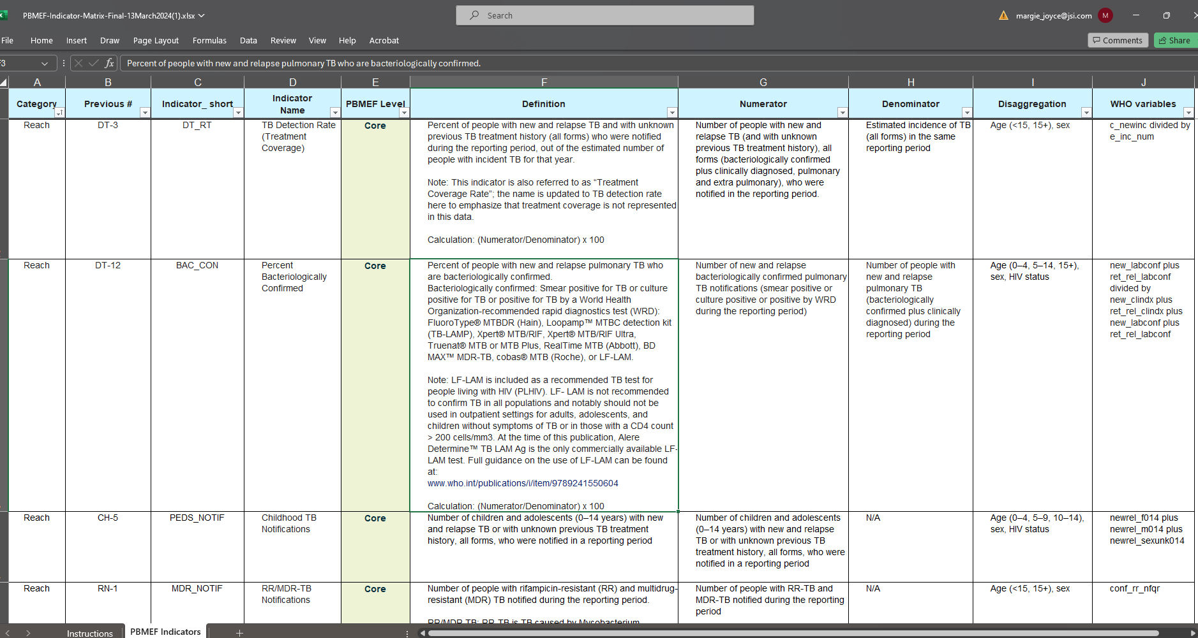
Interim PBMEF Indicator Matrix (Excel)
www.tbdiah.org/assessments/pbmef/
Notes:
Available online

Slide 44
Indicator Cascade Approach
Notes:
The PBMEF's core, core plus, national, project, and extended indicators work together to form a cascade that could reveal gaps in the patients' care, support, or monitoring. The next several slides for the TB program or technical areas such DS-TB, childhood TB, TPT, etc., provide examples of the cascade drafted from the PBMEF.

Slide 45
Indicator Cascade Approach
The framework has indicator cascades built into it so that TB data can be analyzed using the cascade approach to find gaps in programs.
A cascade can quantify, track, and visualize how health and development programs are performing for the target population at progressive stages toward an expected outcome. The data can answer such questions as:
Which TB services are not performing as well as expected: diagnostic or treatment services?
Are we missing specific target groups?
Are we missing specific geographic areas?
What other combinations of these gaps exist?

Slide 46
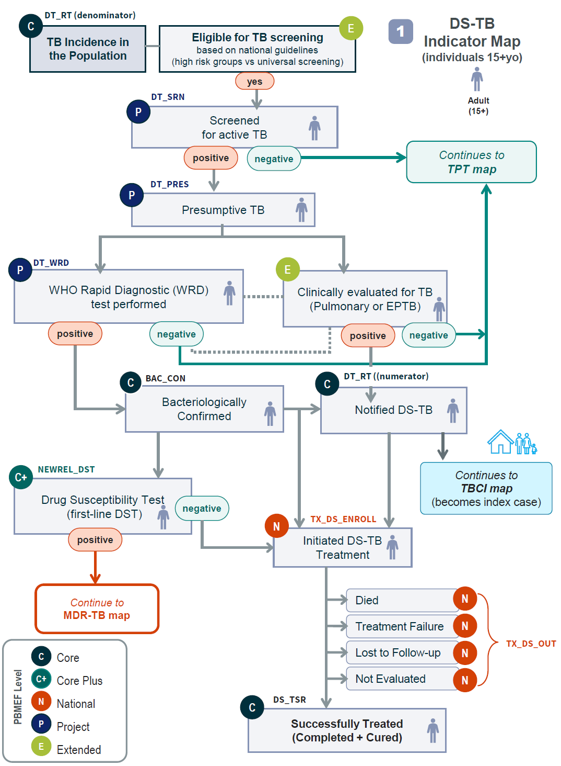
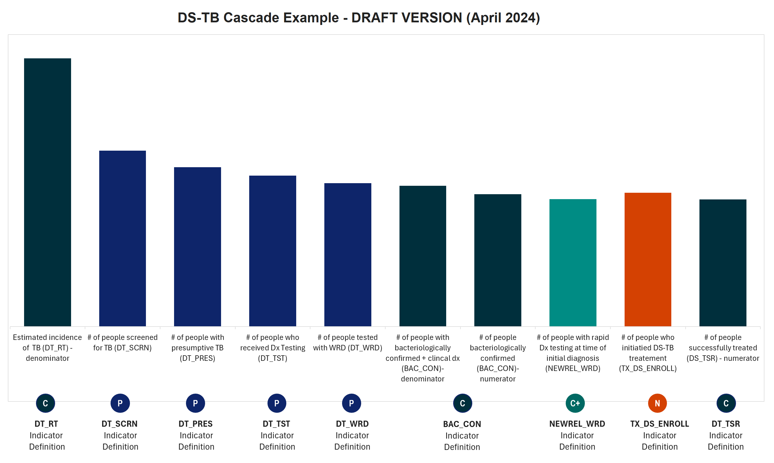
Illustrative Indicator Mapping & Cascades (in progress): DS-TB
DRAFT
Notes:
Available online

Slide 47
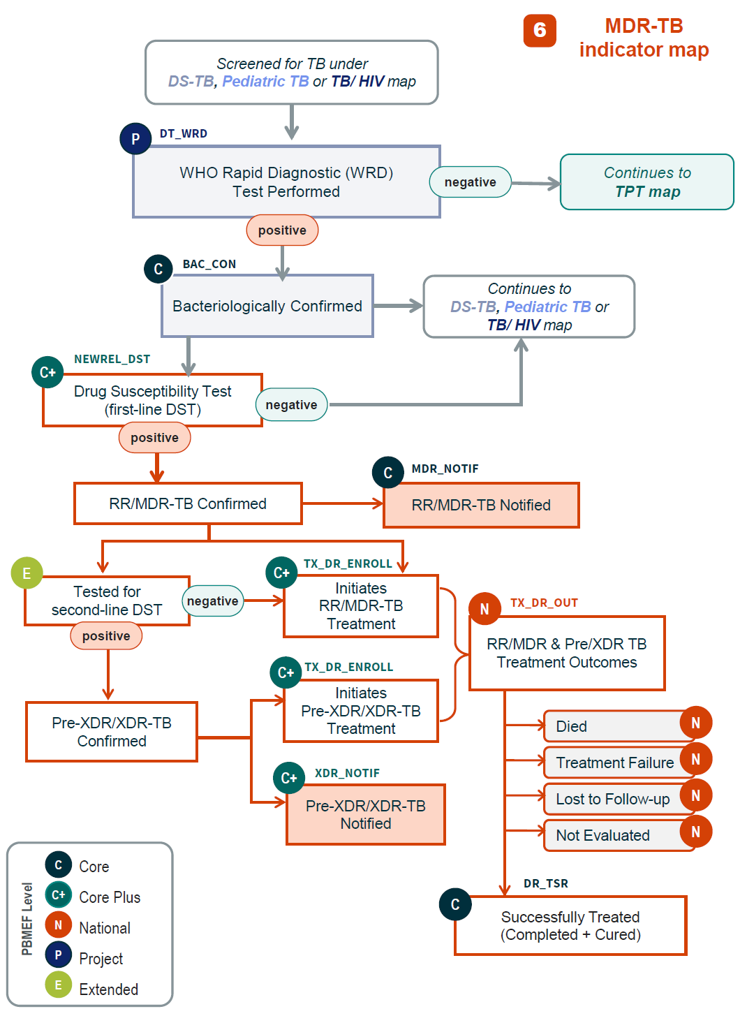
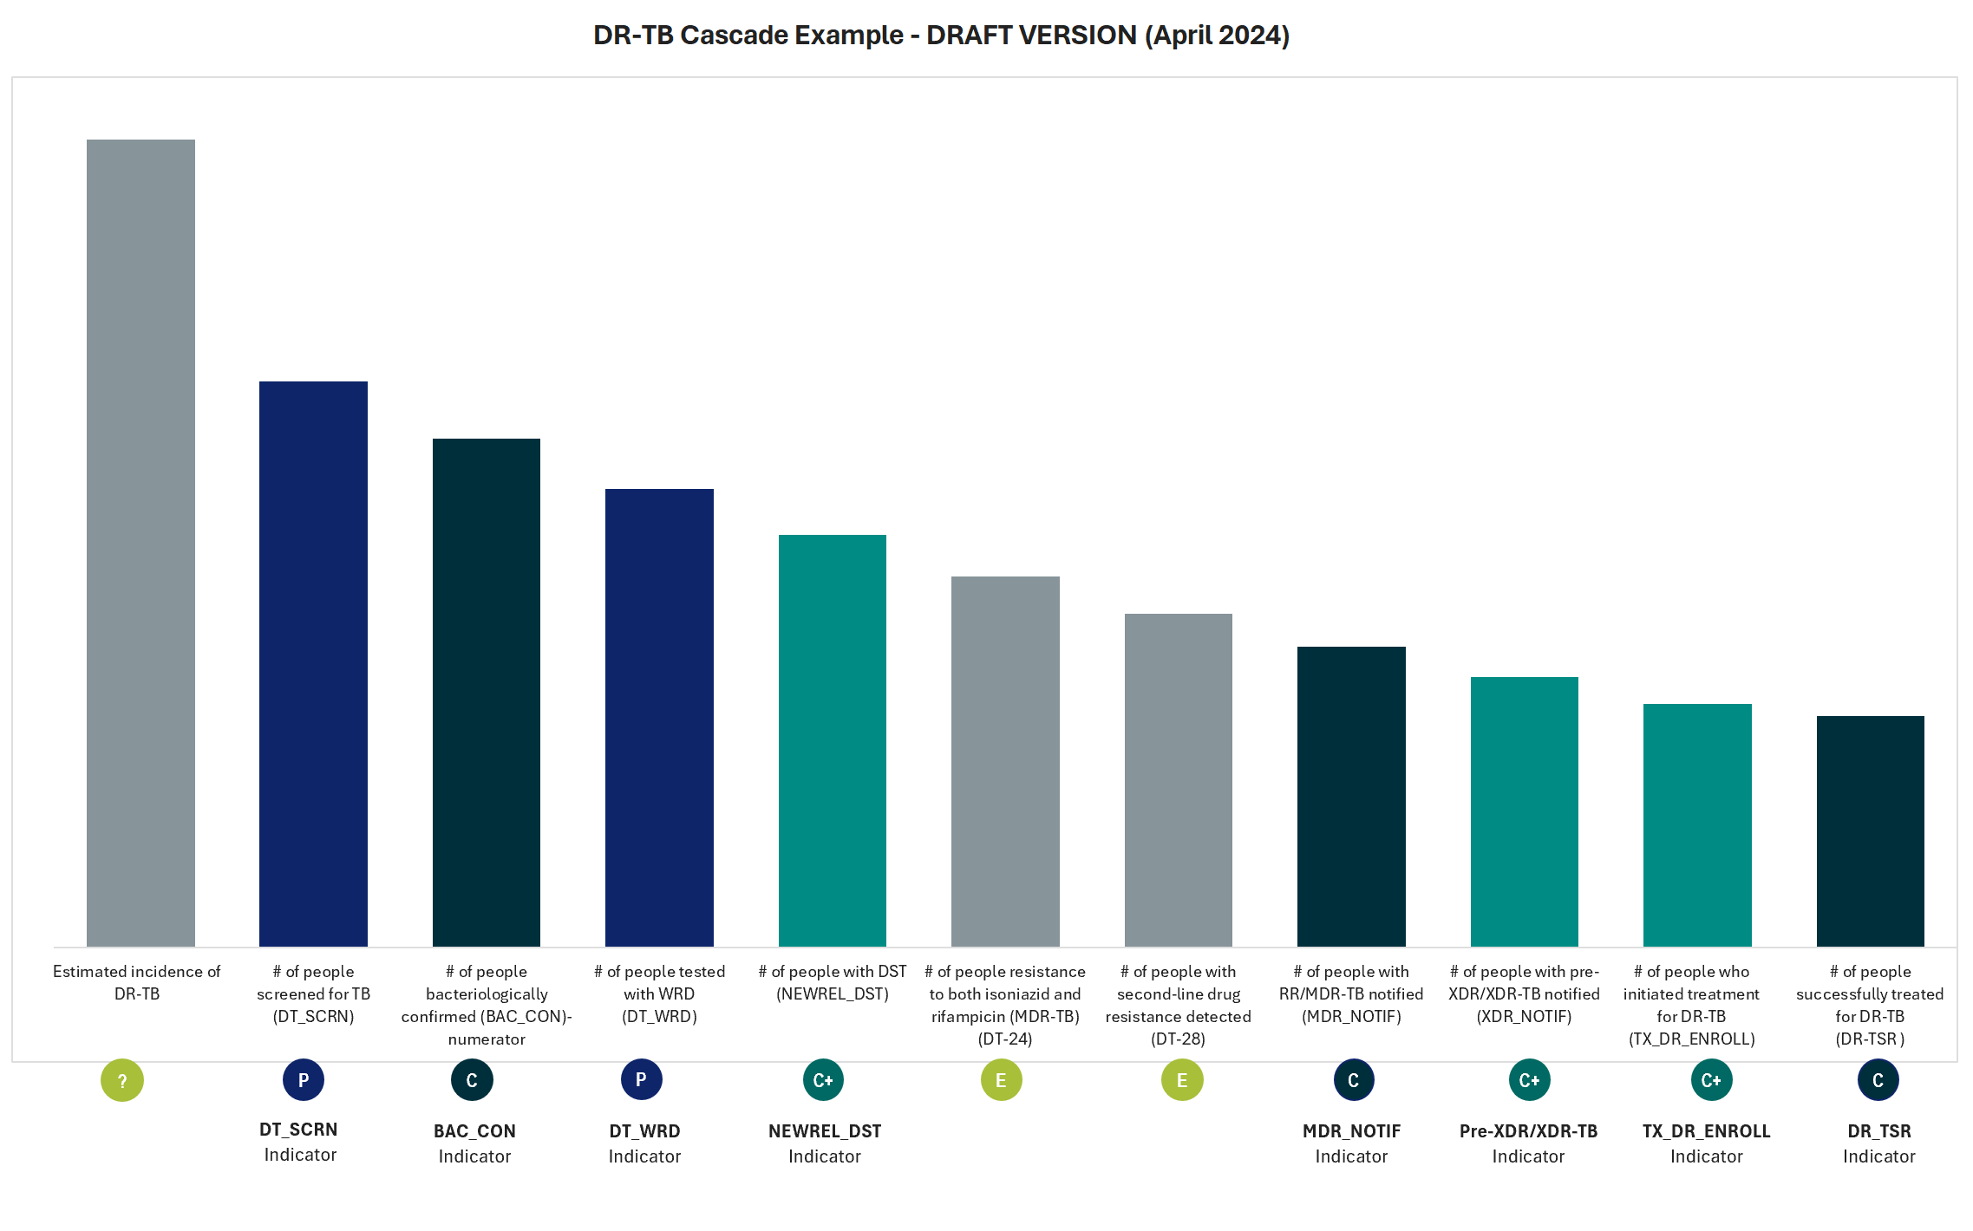
Illustrative Indicator Mapping & Cascades (in progress): DR-TB
DRAFT
Notes:
Available online

Slide 48
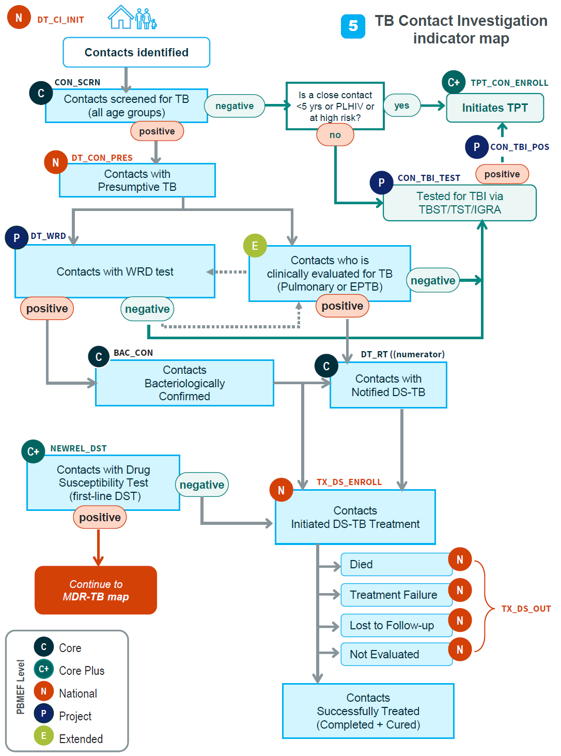
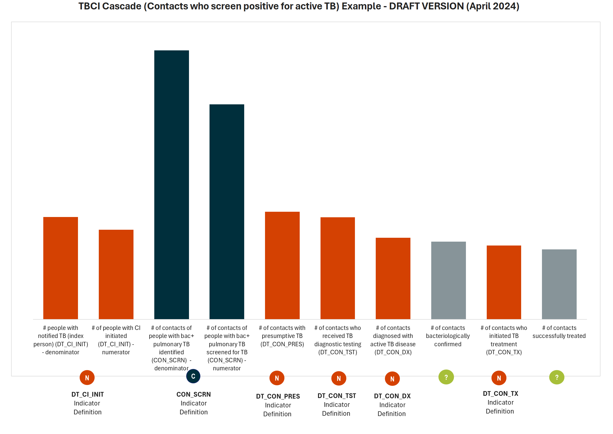
Illustrative Indicator Mapping & Cascades (in progress): TBCI Positive
DRAFT
Notes:
Available online

Slide 49
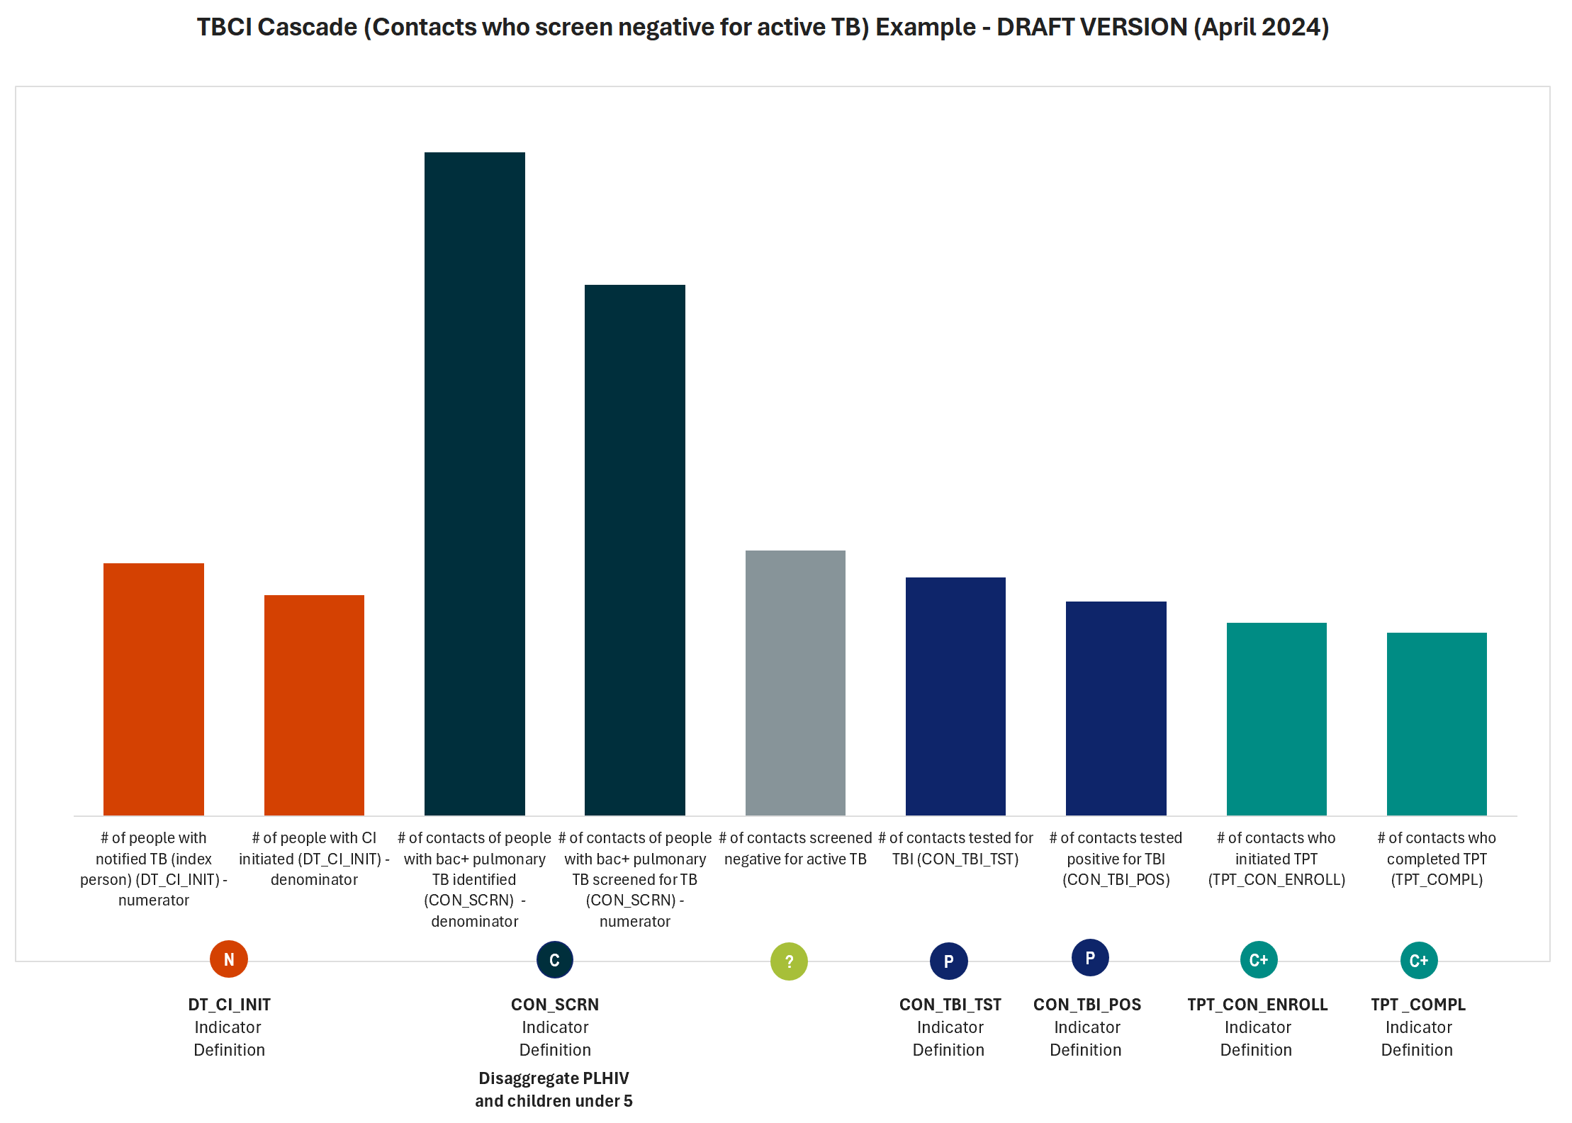
Illustrative Indicator Mapping & Cascades (in progress): TBCI Negative
DRAFT
Notes:
Available online

Slide 50
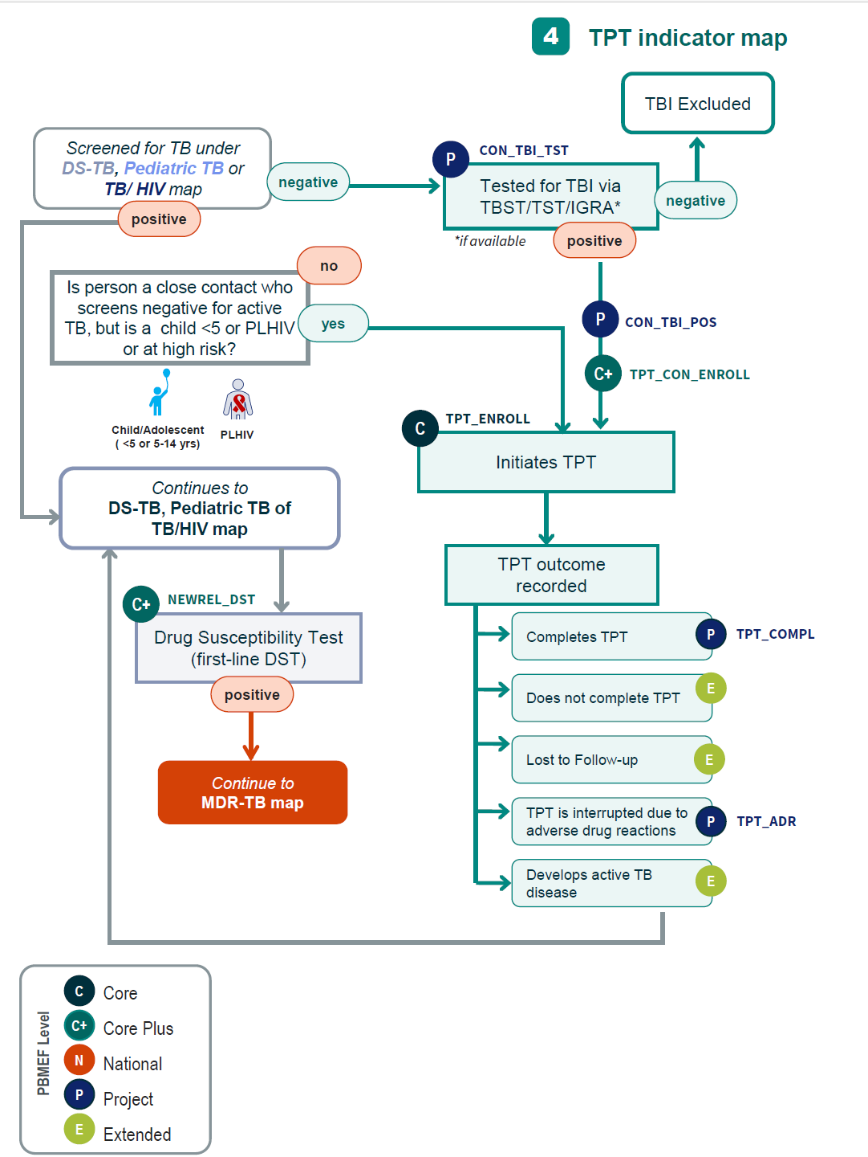
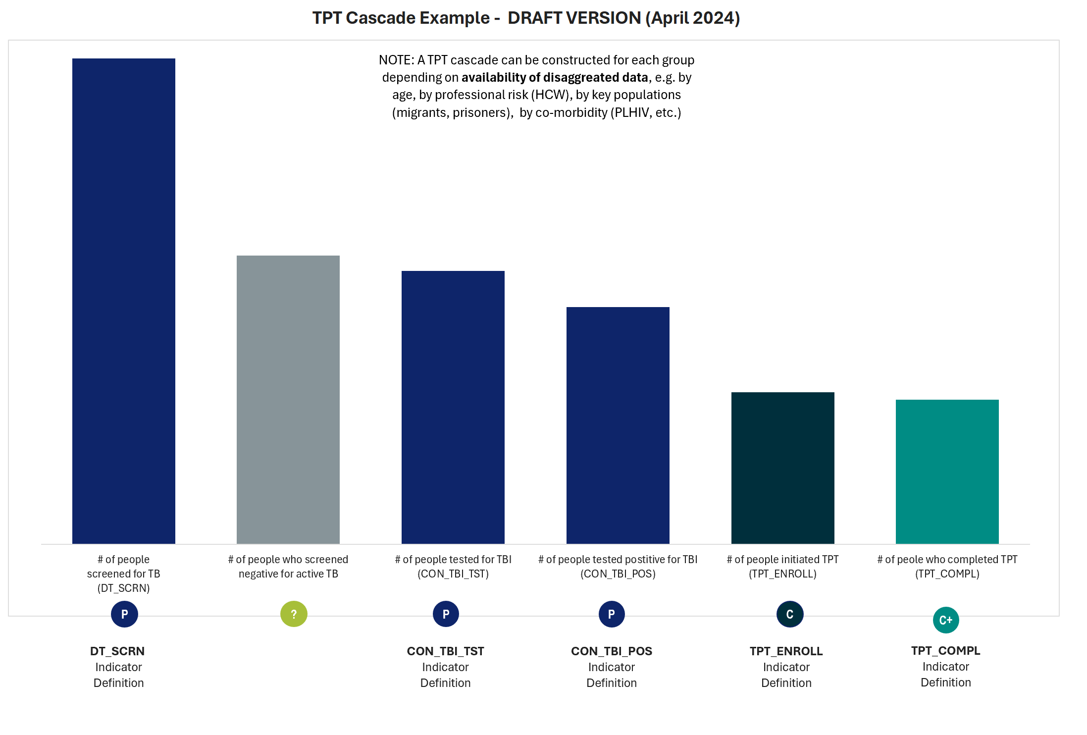
Illustrative Indicator Mapping & Cascades (in progress): TPT
DRAFT
Notes:
Available online

Slide 51
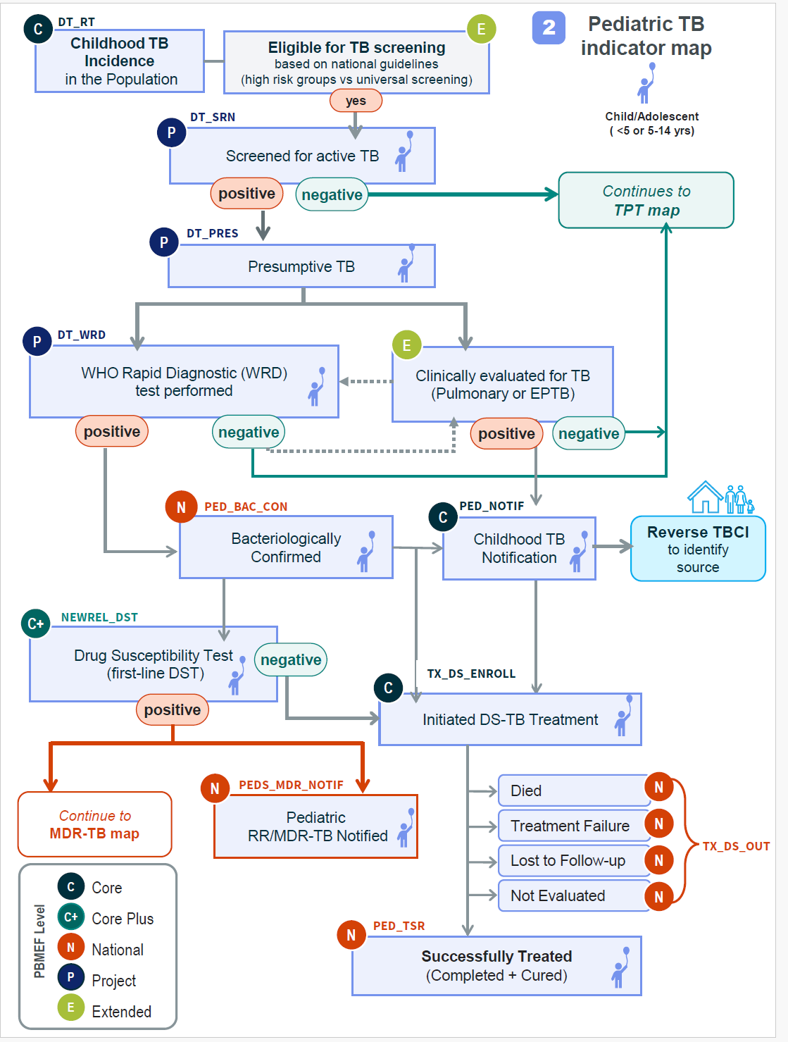
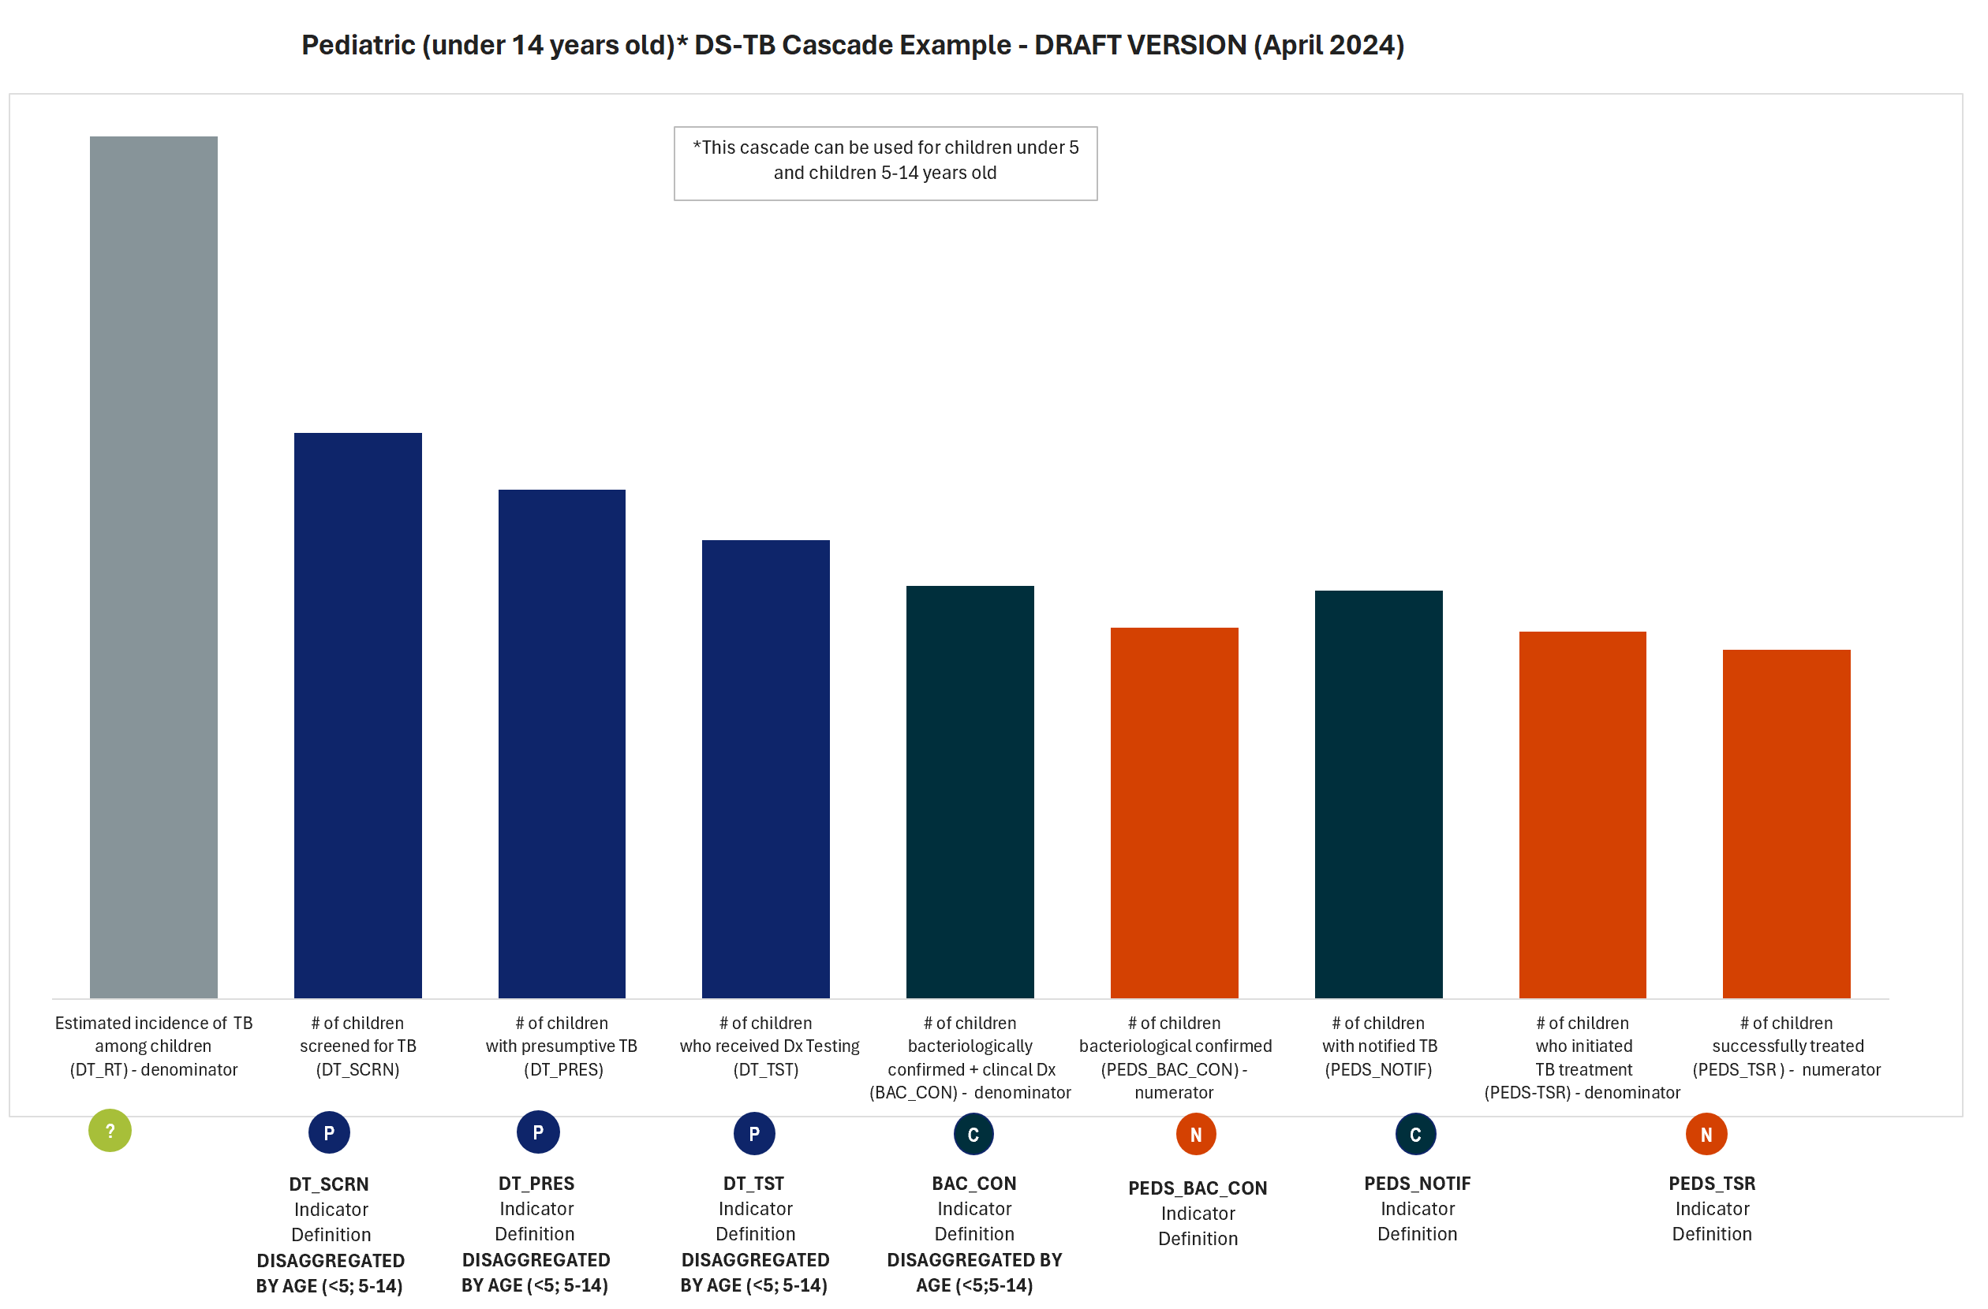
Illustrative Indicator Mapping & Cascades (in progress): Pediatric TB
Notes:
Available online

Slide 52
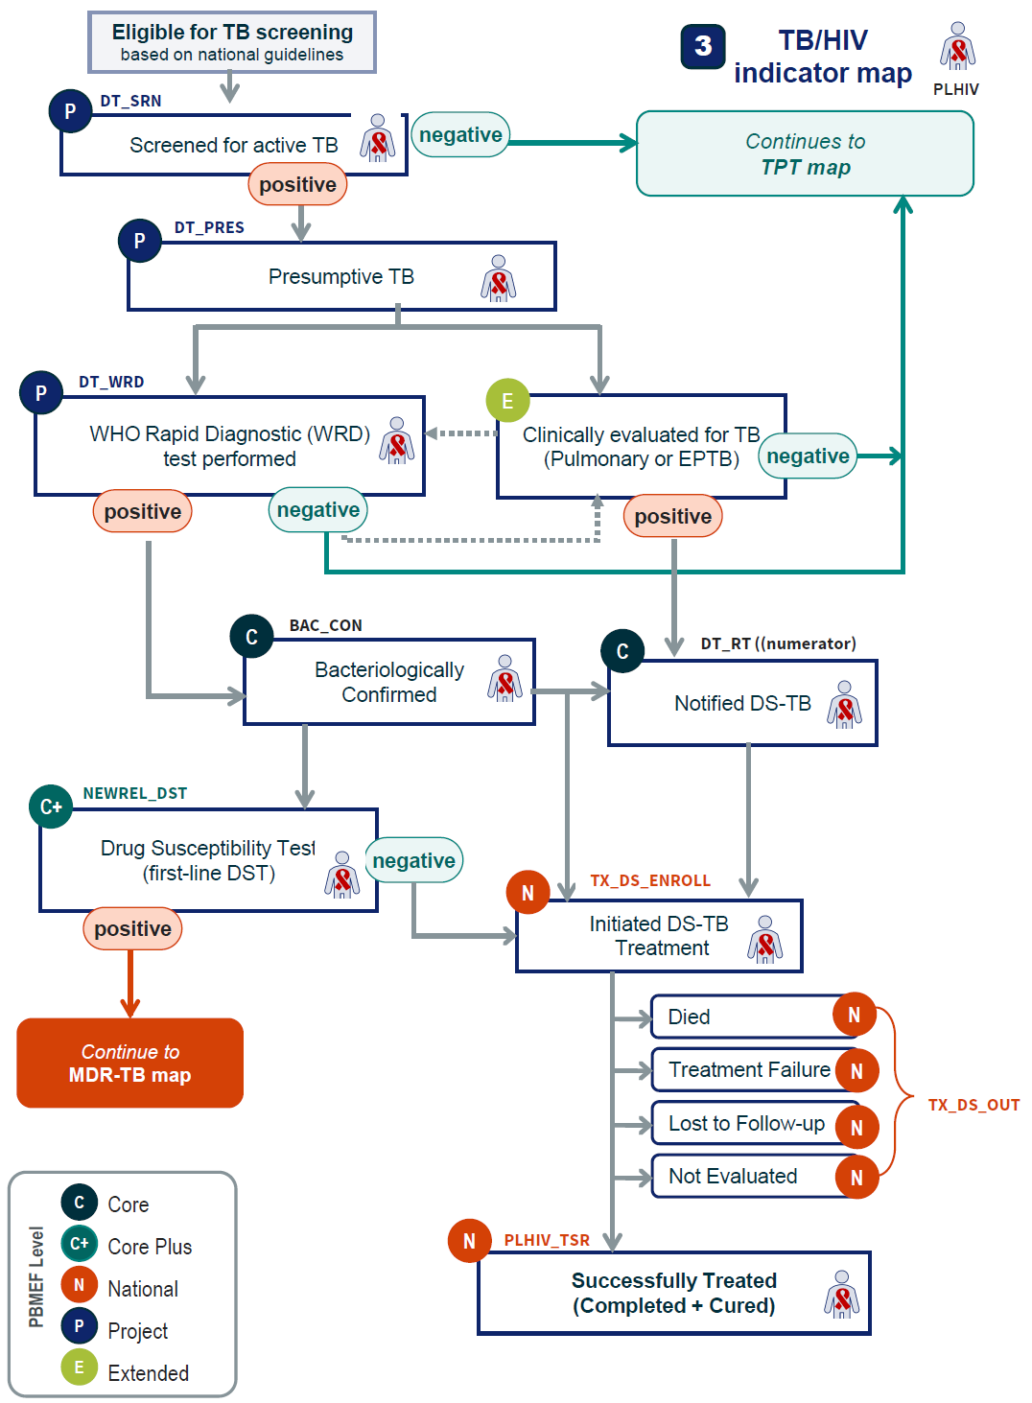
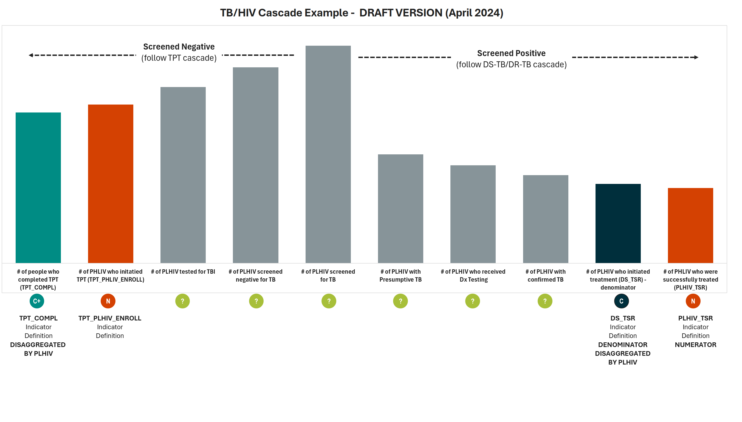
Illustrative Indicator Mapping & Cascades (in progress): TB/HIV
DRAFT
Notes:
Available online

Slide 53
Interim PBMEF Indicator Matrix (Excel)
www.tbdiah.org/assessments/pbmef/
Notes:
Available online

Slide 54
Wrapping Up
Notes:
The benefits, instances of PBMEF's application in Nigeria, and cascades will be covered in the upcoming session.

Slide 55

Key Links
TBDIAH.org
http://www.tbdiah.org
PBMEF
https://www.tbdiah.org/assessments/pbmef
E-Learning
https://training.tbdiah.org/
Data Analysis & Visualizations
http://hub.tbdiah.org

Slide 56

For More Information
For more information please contact:
Rebecca Oser, TB DIAH Communications Director
  roser@unc.edu
Sevim Ahmedov, TB/HIV, Prevention and M&E Team Lead/AOR TB DIAH
  sahmedov@usaid.gov

Slide 57
Boilerplate

