Slide 1





DEMOCRATIC REPUBLIC OF THE CONGO
Capacity Building on TB M&E
April 17, 2024

Slide 2
I. Introduction

Slide 3
TB DIAH DRC Work Plan (1/3)
USAID through TB DIAH supported the DRC to implement its M&E plan by contracting with PONT SANTE AFRICA (POSAF), a local organization, as the implementer in line with the Agency Policy and Requirements.
TB DIAH began collaboration with POSAF in 2021.
Technical assistance (TA) to the PNLT M&E Division was in the form of strengthening capacity at the central, provincial and zonal levels in TB data management and dissemination (e.g., data gathering, recording, analysis, use of TB data decision making and actions, etc.).
3

Slide 4
TB DIAH DRC Work Plan (2/3)
Twenty (20) keys actions were planned and implemented from June 2022 to February 2024.
Work streams
  Capacity Building: M&E training at all levels with emphasis on quantitative and qualitative data analyses
  Support review meetings for data validation and use at the national, provincial, and zonal levels, and dissemination (Epidemiological TB reports)
  Support the operationalization of DHIS2
  Support for operational research
4

Slide 5
TB DIAH DRC Work Plan (3/3)
The final or indirect beneficiaries are people with TB enrolled and 46,959,991 (38%). population in 9 USAID’s supported provinces
Population DRC : 123,472,956
Mapping of 9 USAID-supported Provinces (2023)

Slide 6
II. Keys Workstream and Achievements

Slide 7
Develop and Implement TB M&E Capacity Building
Strategy
  A collaborative model
  Cascade Stepwise approach:
      Curriculum, ToT, provincial training
Achievements
Successful Preparation
  Agenda setting based on PNLT priorities
  Selecting relevant participants
  Translation of training materials
National curriculum developed
  Led by PNLT
  Resource persons: PNLT, USAID,
  TB DIAH, IPs
ToT conducted
  Provincial managers + ME focal persons
  9 provinces
  Joint facilitation: 50% PNLT, 30 % TB DIAH, 20% IPs
Provincial curriculum customization + Training
Notes:
These were approved activities in 2020 and we’d like to revisit these in the current context.

Slide 8
Strengthen Capacity for Data Use
Achievements
Data review meetings: National & provincial
Data Quality Review (DQR) conducted
Annual TB report printed and disseminated
Supported data storage online platform
Conducted operational research

Slide 9
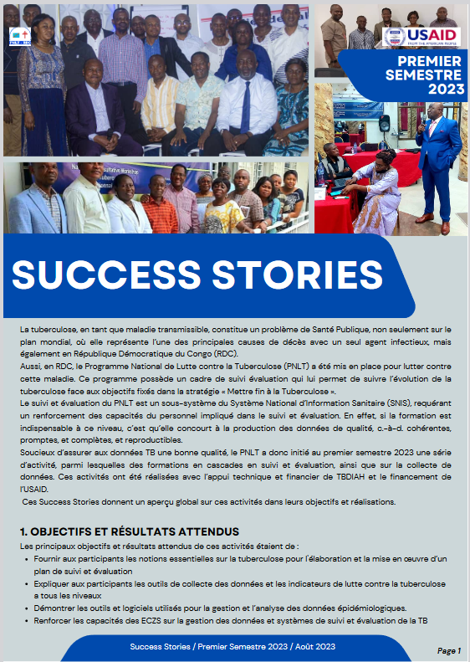
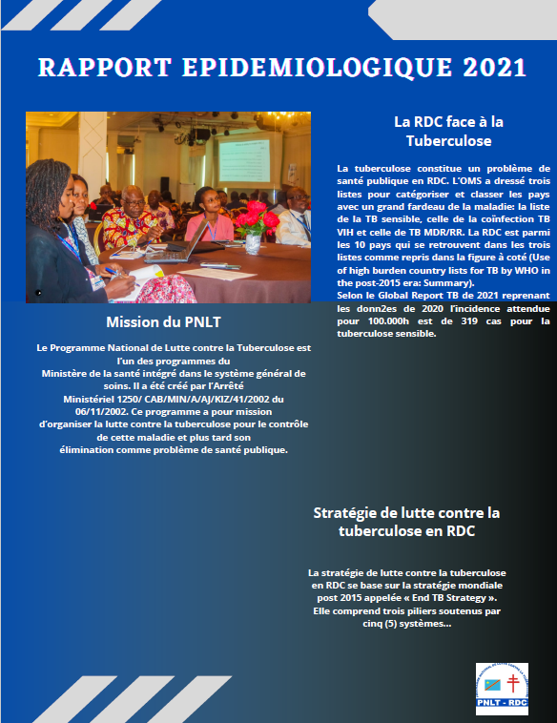
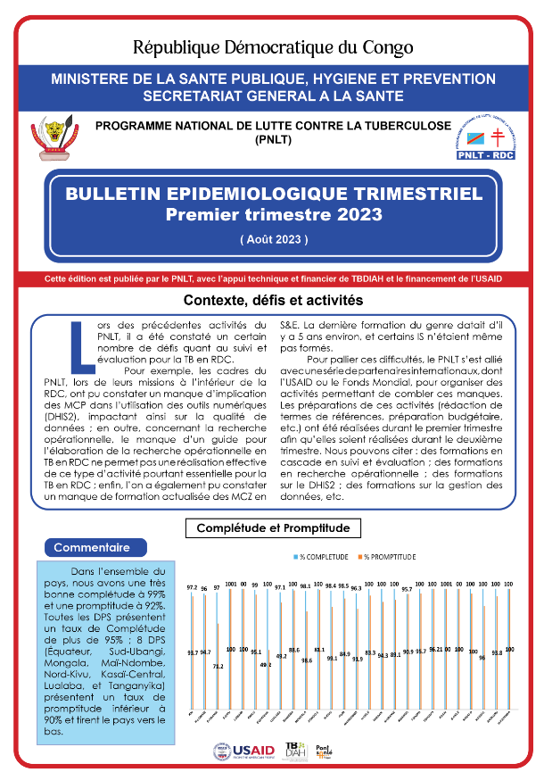
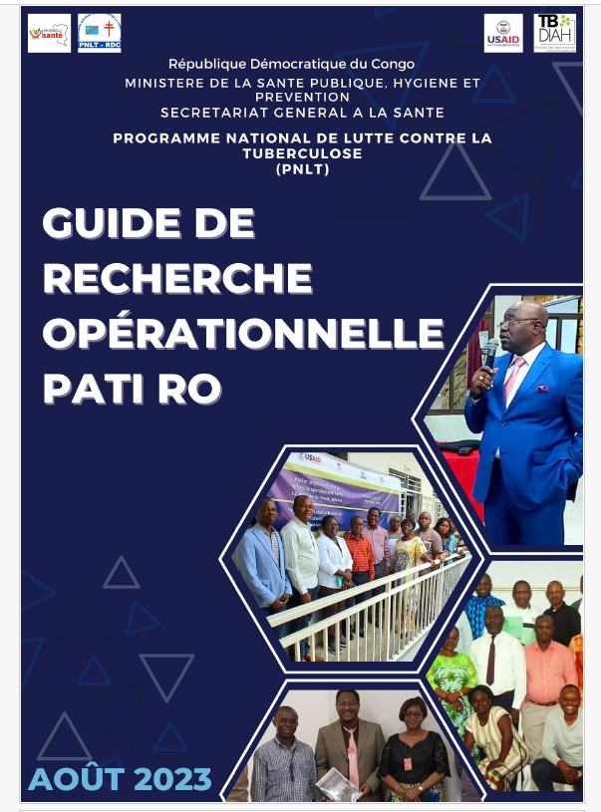
Data Use and Sharing

Slide 10
Summary of project performance
Table 2:
Sub-Activities |  | Deliverables | Progress (Started, going on, Completed)
Workstream 1: Provide training sessions for stakeholders in M&E with emphasis on quantitative and qualitative data analyses.
 | Provide training for national staff: data collection and reporting. | Training report | COMPLETED
b) | Provide a training in data management the national level. | Training report | COMPLETED
c) | Conduct a cascade training: Provincial Health Department. | Training report | COMPLETED
Workstream 2: Support review meetings for data validation and use at the national, provincial, and zonal levels, and dissemination
d) | Conduct DQR. | DQR report | COMPLETED
e) | Support the semi-annual data validation meeting at the central level. | Review meeting reports | COMPLETED
f) | Support data validation meetings at provincial and zonal levels. | Program review meeting report | COMPLETED
g) | Annual tuberculosis surveillance report in the DRC. | Annual TB surveillance report | COMPLETED
h) | Disseminate the annual TB surveillance report in the DRC. | Report disseminated, online | COMPLETED
i) | Quarterly epidemiological bulletin for TB. | Epidemiological bulletin | COMPLETED: 1st, 2nd, 3rd
j) | TA on how to discuss data use with decision-makers. | TA report | COMPLETED
Workstream 3: Support the operationalization of DHIS2.
k) | Support specific M&E supervision/ Support to EDR Web system. | Supervision / Assessment report | COMPLETED
l) | Support annual trip from the intermediate level to health zones. | Supervision report | COMPLETED
m) | Equip the M&E team at central and provincial level. |  | COMPLETED
Workstream 4: Support operational research.
n) | Provide operational research guide. | OR guideline completed | COMPLETED
o) | Training the central unit of the NTP in operational research. | Training report | COMPLETED
p) | Support TWG/ OR committee meeting. |  | COMPLETED
q) | Conduct pilot OR. | One OR completed | COMPLETED
r) | Conduct big scale OR. | One OR manuscript developed | COMPLETED
s) | Disseminate QTSA results. | Event report. | COMPLETED
t) | Develop and share success stories. | Two success stories developed | COMPLETED
10

Slide 11
III. Conclusion

Slide 12
Collaborating and Working Closely with Local Organization and IPs
Builds a strong partnership to effectively end TB
  Improves TB case notification, treatment success rate, prevention, innovation, ownership and sustainability.
  With CLA we can reach a clear, frank and sincere dialogue; get greater impact and outcome, but also improve transparency and accountability
  TB DIAH facilitates the use of data for decision making and quality improvement of services.
Notes:
CLA = Collaboration, learning and Adapting

Slide 13
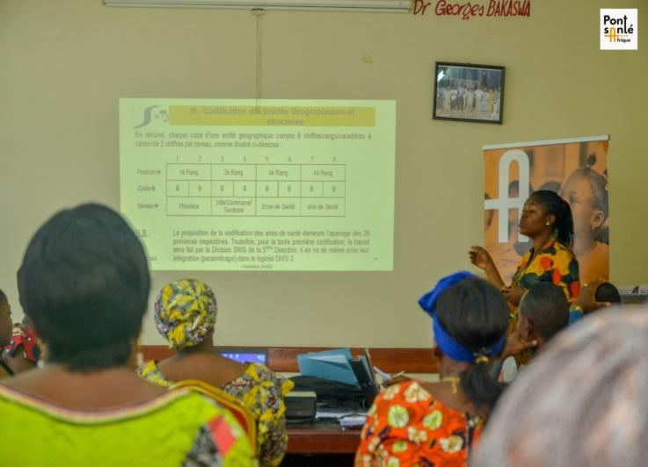
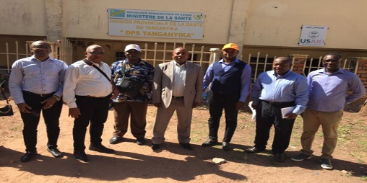
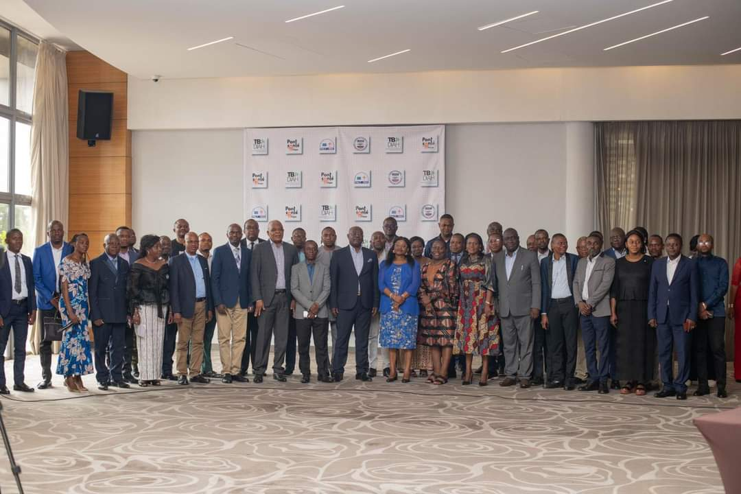
Photos: Field Activities

Slide 14
Q & A

