Slide 1
Implementing the Automated Partners Progress Report (APPR) System and Data Quality Review
Africa Regional Workshop on Strengthening TB M&E Systems
Serena Hotel, Dar es Salaam, Tanzania (April 20, 2024)

Slide 2
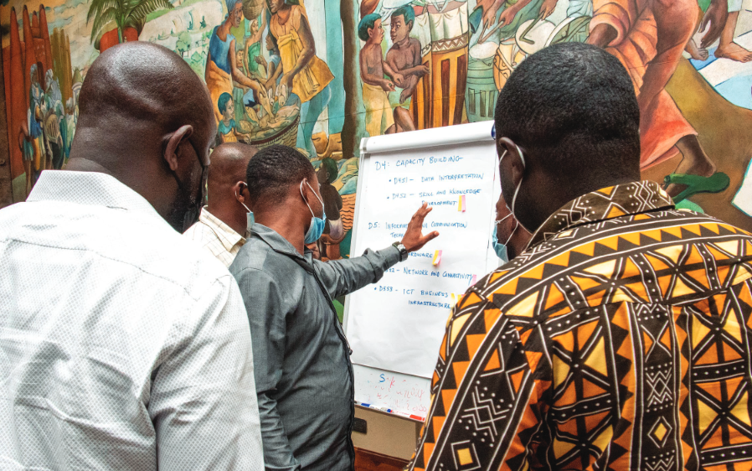
Part of the Global Accelerator to End TB
Global, five-year (2018-2023) associate award, $36M cooperative agreement
Small team of M&E and TB experts working to clarify TB data in way that helps USAID monitor its TB investments in its TB priority countries
Helps countries use data to share their story
Notes:
TB Accelerator – other activities include (TIFA, STAR, LON) – {define}
Goal: 40 million people on treatment from 2018-2022
Strategic objective Ensure demand, analysis, and use of tuberculosis (TB) data for performance management and to inform interventions and policies
The mechanism assists with developing and implementing performance-based measurement systems to maximize resources.

Slide 3
What does TB DIAH do?
Surveillance (Data)
Reporting (Information)
Communications (Knowledge)
1
Result 1: Strengthen the collection, analysis, and use of routine and surveillance TB data
2
Result 2: Improve performance-based (M&E) frameworks and information gathering processes: tools, methods, and technical guidance to meet user needs
3
Result 3: Strengthen reporting and communication to address knowledge gaps and share methods, tools, and approaches

Slide 4
What does TB DIAH do?
Performance-based M&E Framework
Contains the 10 core and extended indicators to help Missions track progress against TB targets and manage USAID’s TB investments—all in one place
PBMEF
M&E and Surveillance Systems Assessment
An overview of M&E and surveillance systems in each USAID TB priority country
MESSA
Assessment of Data Collection, Reporting and Analysis Capacity
Measures a country’s capacity to collect, report, and analyze PBMEF indicators
WORK STREAMS
ARC
Surveillance System Strengthening Plan
Systematic and multi-faceted assessment of a country’s TB M&E and surveillance system
Identifies strengths and gaps across the system, examines the quality of the data, and develops the implementation of a costed action plan
STEP
Quality of TB Services Assessment
Provides periodic data to inform NTPs, USAID missions, and other stakeholders of the current state of quality of TB care and what strategic investments and actions may be needed to improve TB services
QTSA

Slide 5
What does TB DIAH do?
TB Data-to-Action Continuum
Measures the progress of countries as they work toward improving their TB M&E and surveillance systems
D2AC
Centers of Excellence
Establish Centers of Excellence to test and model best practices in TB M&E and surveillance
COEs
National TB Programs Websites
Work with priority countries’ NTPs to adapt their websites and increase their transparency scores using the Stop TB Partnership’s Governance of TB Programs criteria
WORK STREAMS
NTPW
TBDIAH.org - Data Hub and Repository
A one-stop shop website offering public and secure work areas to support USAID TB program managers, technical advisors, and country stakeholders with data analysis and reporting, and access to tools, resources, and guidance to contextualize and apply data to their programming
TBDIAH.org
E-Learning – training.tbdiah.org
Online courses for frontline workers, community health staff and in TB Contact Investigation, Finding cases among those living with HIV, and TB Monitoring & Evaluation
E-Learning

Slide 6
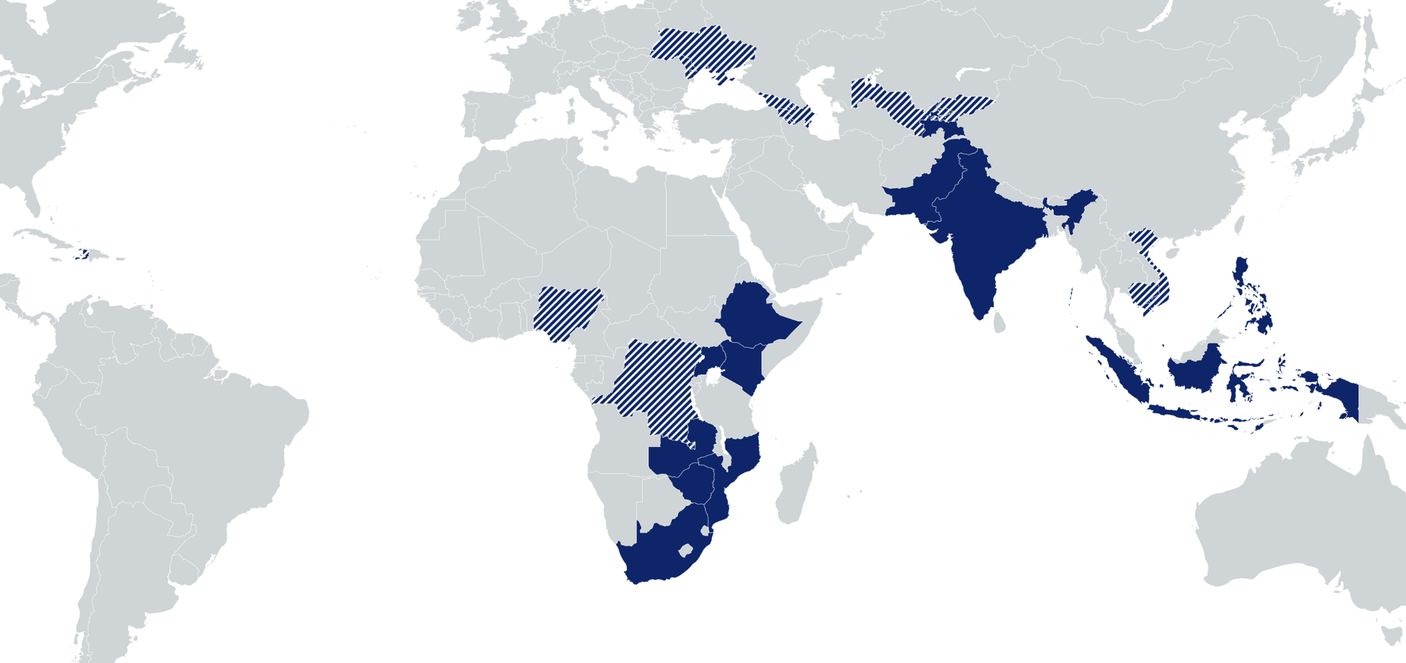
Where does TB DIAH work?
Kyrgyz Republic: Capacity building for NTP for TB surveillance, reporting, and M&E skills ; M&E plan; GHS
Eastern Europe & Eurasia: Regional Center of Excellence and support to 4 countries; semiannual regional meetings
Uzbekistan: ARC, MESSA, D2AC
Haiti: M&E plan and ARC
Vietnam: QTSA
Nigeria: TB Situation Rooms and APPR analyses; Assessed and improved M&E surveillance; strengthened M&E capacity; NTP website supported
Cambodia: M&E planning and capacity assessment; ARC implementation; research capacity building
DRC: Assessed and improved M&E surveillance; strengthened M&E capacity; QTSA study
USAID TB priority countries
Countries with TB DIAH activities

Slide 7
Outline
Introduction to the APPR
APPR development and process flow
APPR architecture
Alignment of Performance Based Monitoring and Evaluation Framework (PBMEF) and APPR—indicators and data elements
APPR dashboards
APPR administrative maintenance
Data quality in APPR
Benefits of APPR

Slide 8
APPR: What is it?
USAID Nigeria’s HIV and TB team’s system of record, which is utilized in the performance management of implementing partners (IPs) providing HIV, AIDS, TB (HAT), and COVID-19 services to clients all over Nigeria.
One integrated point for data synthesis—supporting customized analytics, performance monitoring, and course correction across HAT
USAID data management platform configured on a DHIS 2 backbone and architecture
Goal:
Optimize availability and ease of use of data
Provide strategic direction and oversight to ensure quality across the HAT PEPFAR data continuum
Facilitate ease of reporting and data exchange with other platforms

Slide 9
Why APPR?
Data Visibility
Data visibility is enhanced so that the donor, and stakeholders can visualize the dashboard, performance indicators, and targets
Data Use
Supports decision making and maximizes the use of data for real time performance monitoring of TB data
Data Quality and Governance
Data quality is assured, and data governance and organizational structure is entrenched
Timeliness and completeness

Slide 10
APPR Development and Process Flow
CONCEPTUALIZATION
DESIGN
ACTIVATION
Development of concept note
Approval of concept note by USAID
Digital Health Systems enhancement drive
In-house brainstorming and reviews
Creation of TB program data structure; form designs; onboarding data elements; data sets; organizational unit definition and upload; intervention mapping
Capacity building
Development of user guide and change management procedure
Data entry
1
2
3
4
5
6
PLANNING
IMPLEMENTATION
Transition from dev instance to production instance
Refinement of custom forms, validation rules, data elements, and indicators
Creation of dashboard
Linkage to CARD
DEPLOYMENT
Consensus building
Requirement gathering
Defining data elements and indicators
Intervention
User acceptability testing and launch of production instance
Ongoing maintenance and support

Slide 11
ALIGNMENT OF PBMEF AND APPR – INDICATORS AND DATA ELEMENTS
INDICATOR TECHINCAL AREAS
USAID TARGETS
OBJECTIVES
DATA ELEMENTS IN APPR
OUTCOME
REACH
Number of clients screened for TB
Number of clients presumed to have TB
Number of presumptive cases evaluated for TB
Number of clients diagnosed with DS-TB
Number of clients diagnosed with DR-TB
Number of clients diagnosed with all forms of TB
Number of clinically diagnosed TB patients
Number of bacteriologically diagnosed TB patients
Number of DS-TB patients started on treatment
Number of DR-TB patients started on treatment
Number of all forms of TB patients started on treatment
Number of all clients new and relapse TB Cases
Bacteriologically – new and relapse TB cases
90% of incident TB cases diagnosed and initiated on treatment
Maximize the detection of all forms of TB in all individuals of all ages
TB detection rate/treatment coverage
Bacteriological coverage
Childhood TB notification
Drug-resistant TB (DR-TB) notification
Contact investigation coverage
Private sector notification
Presumptive TB
90% treatment success rate
Decrease TB Mortality by 35% by 2030
CURE
Number of DS-TB cases reported in previous 12 months
Number of DS-TB cases reported - Cured
Number of DS-TB cases reported - Died
Number of DS-TB cases reported - Loss to follow up
Number of DS-TB cases reported - Not evaluated
Number of DS-TB cases reported - Treatment completed
Number of DS-TB cases reported - Treatment failure
Number of DS-TB cases removed from register
Number of DR-TB cases reported in previous 24 months
Number of DR-TB cases reported - Cured
Number of DR-TB cases reported - Died
Number of DR-TB cases reported - Loss to follow up
Number of DR-TB cases reported - Not evaluated
Number of DR-TB cases reported - Treatment completed
Number of DR-TB cases reported - Treatment failure
30 million on TPT
Empower all individuals with TB to complete treatment and be cured
Drug-sensitive TB (DS-TB) treatment success
DR-TB treatment success
TBD
Decrease TB Incidence by 52% by 2030
PREVENT
Number of contacts screened for TB
Number tested for TBI
Number of contacts eligible for TPT
Number of contacts started on TPT
Number placed on 3HR
Number placed on 6H
Number placed on 1HP
Stop the spread of new infections and progression from infection to active TB disease
TB preventive treatment (TPT)
Prevention
Global investments reach $13 billion by 2022
SUSTAIN
Build country-owned TB systems, led by local partners, that accelerate progress and support pandemic preparedness
TB financing expected from domestic sources
N/A
Notes:
OPTION 3

Slide 12
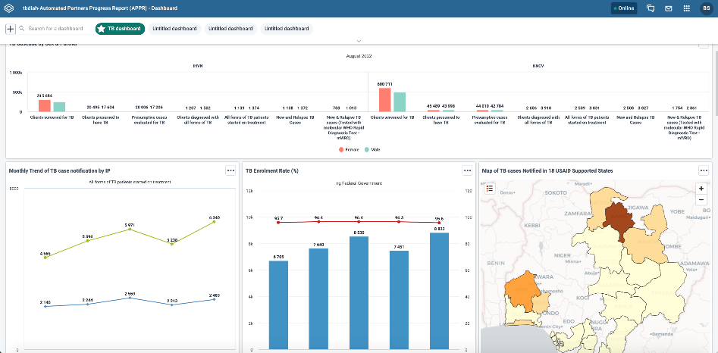
APPR Architecture
APPR architecture
Web dashboard
Org units
Data elements
Interventions
Datasets
Administrative Maintenance

Slide 13
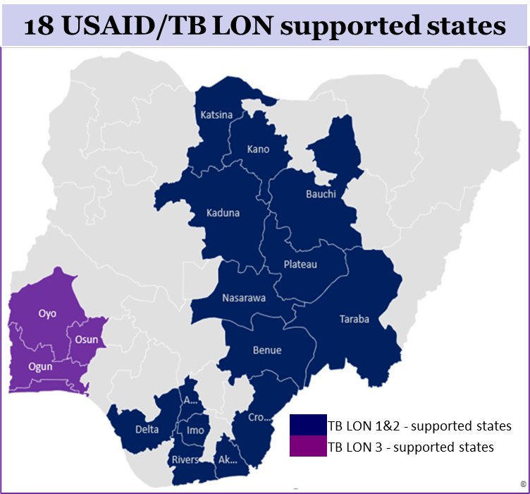
APPR Architecture: Organizational Unit
Federal Govt.
State Govt.
(#18)
Local Government Areas
(#342)
Ward
(#2518)
Facility
(#4500)

Slide 14
Intervention Mapping in the APPR
Standalone Laboratory
Intensified Case Finding
Private laboratories aligned with the NTP, diagnosis and referral of presumptive cases, TB cases
Disaggregation by public and private health facilities
Screening, diagnosis, treatment and monitoring
Community Level
Contact Investigation
Captured interventions are community active case finding (ACF), patent and proprietary medicine vendors, community pharmacies, informal private care providers, and referral of presumptive cases
Involving disaggregation by age and type of TPT regimen:
0-4 years, 5-14 years, 15 years and above
6H, 3HP, and 1HR
Wellness on Wheels
ACF – Special Population
Mobile TB diagnosis and treatment using the specialized containers; diagnosis and initiation of treatment of TB cases
Intervention areas include schools, prisons, Nomads, Internally displaced persons (IDP) camps, etc.

Slide 15
APPR Data Entry Page

Slide 16
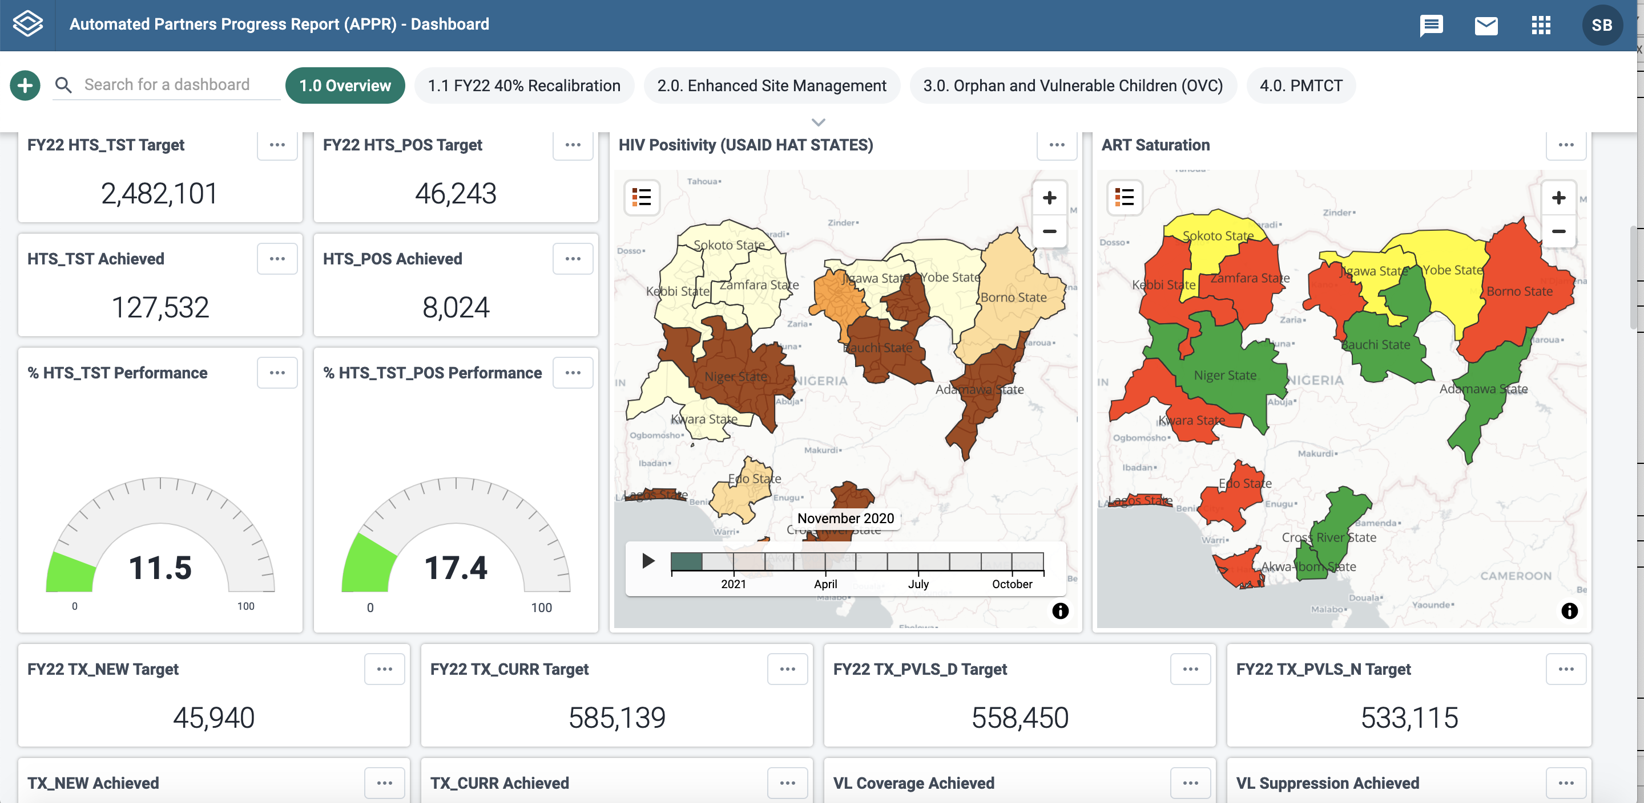
APPR Dashboard (Landing Page) at Inception

Slide 17
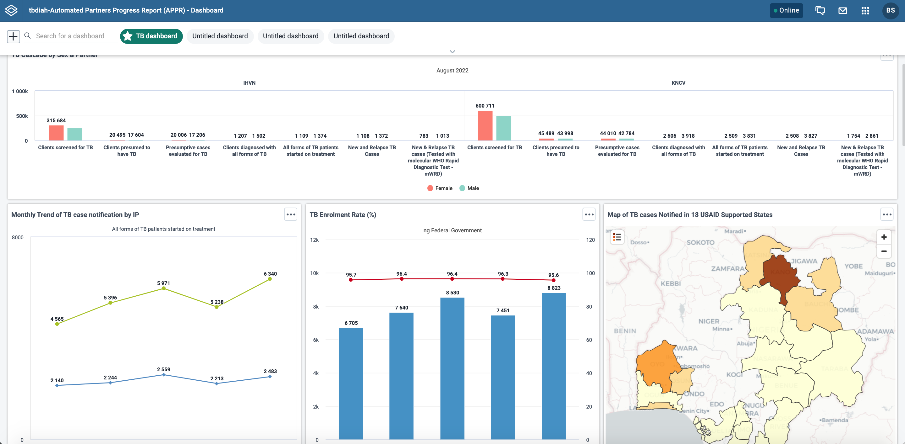
Current TB APPR Dashboard (Landing Page)

Slide 18
Data exchange in APPR
APPR enbales seamless data integration across different data platforms and improves data quality by minimizing manual entries and data imputation errors
Key:
TB LON: Tuberculosis Local Organization Network
APPR: Automated Partners Progress Report
DIS: Development Information Solution
CARD: Comprehensive Access and Review Dashboard portal

Slide 19
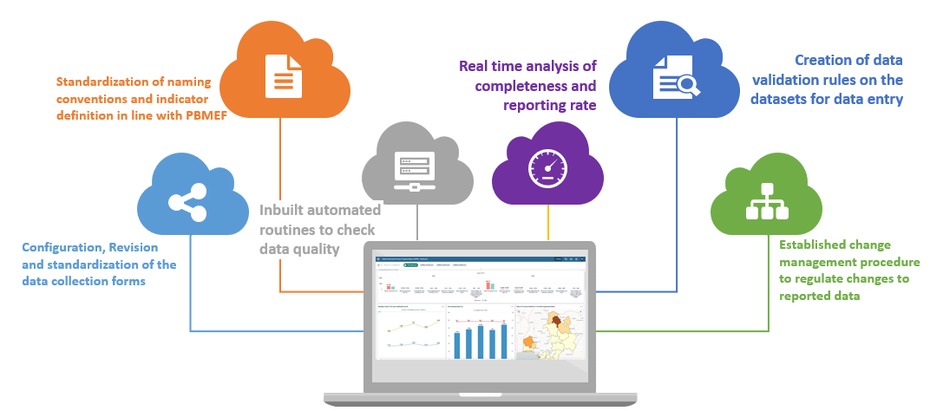
Data Quality Assurance in APPR
System Level
Program Level
Periodic data quality reviews, analysis, and feedback by TB DIAH
Support to IPs through ongoing capacity building and mentorship
Establish data management SOPs and CMP
Collaboration with partners to promote information use at data collection points
Promoting data harmonization at subnational levels

Slide 20
Benefits of APPR
Improves data management support for the Mission and IPs by establishing a database and facilitating data analysis and use.
Facilitates alignment with PBMEF guidance through standardizing reporting requirements and timelines across IPs, thus improving data quality.
Reduces the data entry workload and improves data analytics and visualization.
Facilitates IPs’ transition from an Excel-based data system to DHIS 2 and interoperability and data exchange among data platforms.

Slide 21
TB APPR Web Address:
https://tb.hatappr.org/dhis-web-dashboard/#/

Slide 22
Live Links
TBDIAH.org
http://www.tbdiah.org
PBMEF
https://www.tbdiah.org/resources/publications/navigating-tuberculosis-indicators-a-guide-for-tb-programs/
QTSA
https://www.tbdiah.org/assessments/quality-of-tuberculosis-services-assessments/
D2AC
https://www.tbdiah.org/assessments/d2ac/
Data Analysis & Visualizations
http://hub.tbdiah.org

Slide 23
For more information
Sevim Ahmedov TB/HIV, Prevention and M&E Team Lead AOR TB DIAH
sahmedov@usaid.gov

Slide 24
Boilerplate

