Slide 1
DEVELOPING A the weekly TB situation room:
experience from Zambia
E Mushota Kabaso, PhD
USAID National TB M&E Advisor
Ministry of Health
Zambiia

Slide 2
What is TBSR
The TB Situation Room (TBSR) is
An initiative of the NTLP in Zambia’s Ministry of Health
Designed to track the weekly performance of the TB program across the country
Key performance indicators in the TB program (examples)
Drug Susceptible TB Notifications
DR TB Notifications
# of presumptive cases screened in the lab
# with bacteriologically confirmed TB
# of clinically diagnosed TB; etc.

Slide 3
Origins of the TBSR
Zambia notified
1st Cases of COVID-19
Zambia established TB Situation Room

Slide 4
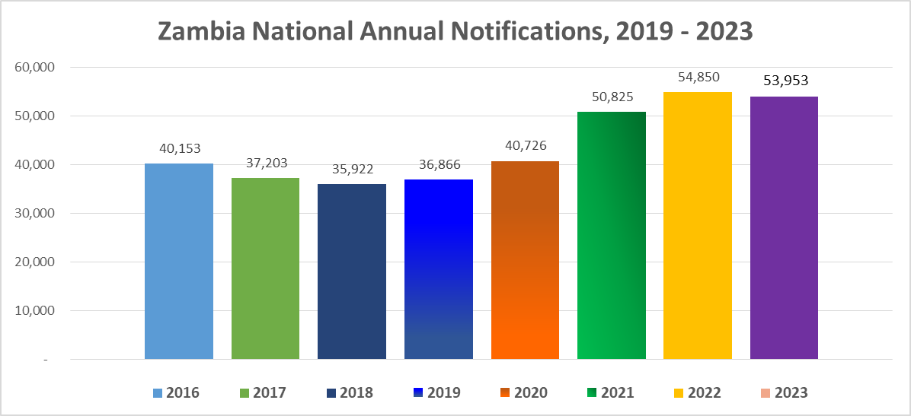
The Result:
Total notifications in Zambia, 2016 - 2023

Slide 5
How it is done : data management
Data collected on a simple weekly template
TB treatment and diagnostic facilities in all districts
HFs submit to District TB coordinators
Districts submit to Provincial TB coordinators
Ten provincial reports received at National HQ for processing and updates
Data quality is assured in the back and forth between health facility/district/National levels

Slide 6
How it is done : data analysis & visualizations
Analysis of specific metrics of importance
Pivot tables developed for the meeting on pre-determined template/dashboards
Proportion of pediatric notifications
Proportion of DR TB
Proportion of bacteriologically confirmed TB
Ratio of contacts traced per TB index person
Tracking of the weekly performance against established targets per week
Tracking Cumulative performance from beginning of the year up to the week in review
This summary is then shred with all districts before the SR meeting for validation and analysis for inclusive participation.

Slide 7
How it is done : beyond the data
The forum is used as a platform to
Showcase high performing facilities/districts/provinces
Share initiatives/activities yielding positive results
Share activities they did differently in the week before
Replicate positive initiatives/activities elsewhere
Low-performing facilities/districts/provinces encouraged to catch up and contribute to national targets in the process
Lively debate usually ensues with more than 80 participants logging into the Zoom call on a weekly basis at 2:00 pm every Thursday.
Link to TBSR Report Week 38 2023

Slide 8
Conclusion and recommendations
The TBSR is conducted 11 times each week in the country
Provincial teams conduct their versions before the national meeting
Technological considerations critical
26,600 records in excel is not very efficient
Web-based applications recommended option
DHIS2
Power BI
Other API capable solutions
If possible, align TBSR KPI data with routine notification formats
An important tool for case finding in TB programming (program and project level)

Slide 9
Thank You

