Slide 1

Overview of the Performance Based Monitoring and Evaluation Framework (PBMEF) Guide: Basic Principles of Cascade Analyses Using PBMEF Indicators and Experience from Nigeria
Africa Regional Workshop

Slide 2

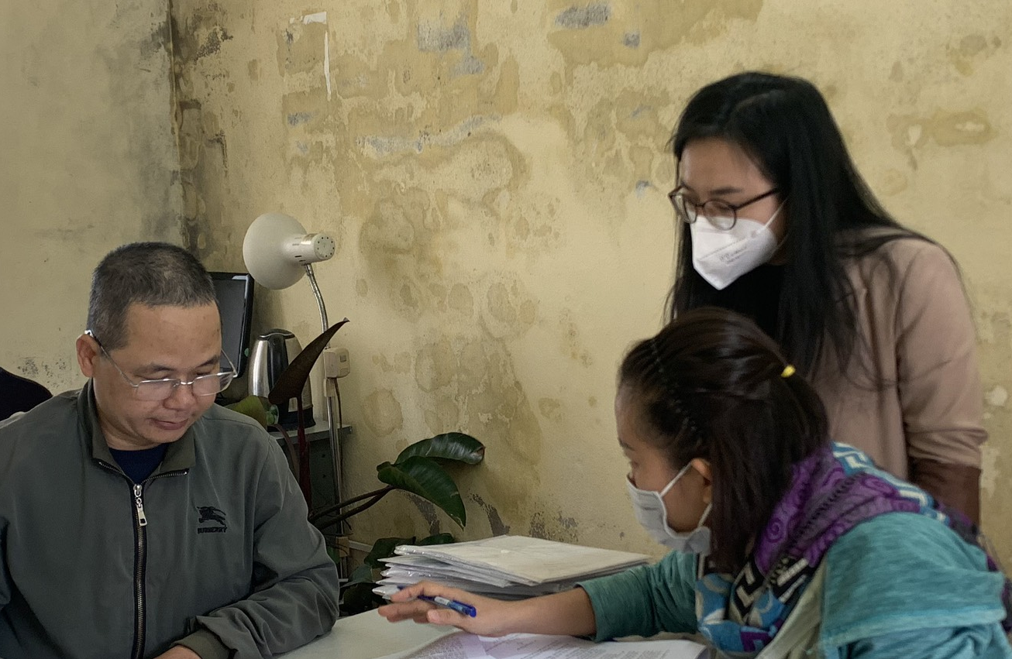


Part of the Global Accelerator to End TB
Global, five-year (2018-2023) associate award, $36M cooperative agreement
Small team of M&E and TB experts working to clarify TB data in way that helps USAID monitor its TB investments in its TB priority countries
Helps countries use data to share their story
Notes:
TB Accelerator – other activities include (TIFA, STAR, LON) – {define}
Goal: 40 million people on treatment from 2018-2022
Strategic objective
Ensure demand, analysis, and use of tuberculosis (TB) data for performance management and to inform interventions and policies
The mechanism assists with developing and implementing performance-based measurement systems to maximize resources.

Slide 3
What does TB DIAH do?
Surveillance
(Data)
Reporting
(Information)
Communications (Knowledge)
1
Result 1: Strengthen the collection, analysis, and use of routine and surveillance TB data
2
Result 2: Improve performance-based (M&E) frameworks and information gathering processes: tools, methods, and technical guidance to meet user needs
3
Result 3: Strengthen reporting and communication to address knowledge gaps and share methods, tools, and approaches

Slide 4
What does TB DIAH do?
Performance-based M&E Framework
Contains the 10 core and extended indicators to help Missions track progress against TB targets and manage USAID’s TB investments—all in one place
PBMEF
M&E and Surveillance Systems Assessment
An overview of M&E and surveillance systems in each USAID TB priority country
MESSA
Assessment of Data Collection, Reporting and Analysis Capacity
Measures a country’s capacity to collect, report, and analyze PBMEF indicators
WORK STREAMS
ARC
Surveillance System Strengthening Plan
Systematic and multi-faceted assessment of a country’s TB M&E and surveillance system
Identifies strengths and gaps across the system, examines the quality of the data, and develops the implementation of a costed action plan
STEP
Quality of TB Services Assessment
Provides periodic data to inform NTPs, USAID missions, and other stakeholders of the current state of quality of TB care and what strategic investments and actions may be needed to improve TB services
QTSA

Slide 5

What does TB DIAH do?
TB Data-to-Action Continuum
Measures the progress of countries as they work toward improving their TB M&E and surveillance systems
D2AC
Centers of Excellence
Establish Centers of Excellence to test and model best practices in TB M&E and surveillance
COEs
National TB Programs Websites
Work with priority countries’ NTPs to adapt their websites and increase their transparency scores using the Stop TB Partnership’s Governance of TB Programs criteria
WORK STREAMS
NTPW
TBDIAH.org - Data Hub and Repository
A one-stop shop website offering public and secure work areas to support USAID TB program managers, technical advisors, and country stakeholders with data analysis and reporting, and access to tools, resources, and guidance to contextualize and apply data to their programming
TBDIAH.org
E-Learning – training.tbdiah.org
Online courses for frontline workers, community health staff and in TB Contact Investigation, Finding cases among those living with HIV, and TB Monitoring & Evaluation
E-Learning

Slide 6
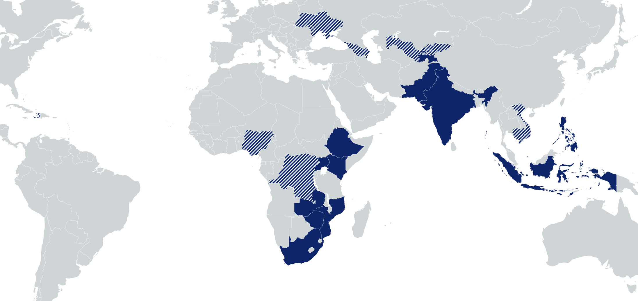
Where does TB DIAH work?
Kyrgyz Republic: Capacity building for NTP for TB surveillance, reporting, and M&E skills ; M&E plan; GHS
Eastern Europe & Eurasia:
Regional Center of Excellence and support to 4 countries; semiannual regional meetings
Uzbekistan: ARC, MESSA, D2AC
Haiti: M&E plan and ARC
Vietnam: QTSA
Nigeria: TB Situation Rooms and APPR analyses; Assessed and improved M&E surveillance; strengthened M&E capacity; NTP website supported
Cambodia: M&E planning and capacity assessment; ARC implementation; research capacity building
DRC: Assessed and improved M&E surveillance; strengthened M&E capacity; QTSA study
USAID TB priority countries
Countries with TB DIAH activities

Slide 7
Outline
Introduction
Basic Principles
Nigeria Experience
Lessons Learned

Slide 8
Introduction

Slide 9
Concept of TB Cascade Analysis
TB Care Cascade
TB Cascade Analysis
Outlines a series of necessary steps and services each patient must go through to achieve a positive health outcome
Represents the proportion of people reaching important milestones in the care pathway for TB
Some of the necessary steps include accessing testing, receiving a diagnosis, initiating treatment, completing treatment, and surviving post-TB treatment follow-up
Evaluates the gaps between each milestone, accounting for the proportion of people lost at each stage of care
Gap identification is the hallmark of TB cascade analysis
This gap identification concept helps programmers design and implement targeted interventions at various stages of the care cascade where losses and drop-outs occur most frequently
https://doi.org/10.1016/S1473-3099(23)00375-4

Slide 10
Rationale
Why Conduct a TB Cascade Analysis?
TB care cascades and cascade analysis concept is a valuable approach for evaluating the quality of TB care within a TB Program or health system
Enhances patient-centredness
Improves patient quality of care and overall health outcomes
Improves program and care optimization
Promotes accountability and demand for TB services
https://doi.org/10.1016/j.jctube.2020.100193

Slide 11
Basic Principles

Slide 12
Basic Principles
Understand PBMEF Indicators
Understand the Program
Make Data Available
Maintain a good grasp of the essential list of the PBMEF/WHO indicators (Core, Core Plus, National and Project Level)
  Core Plus and National Level indicators provide more details to build a comprehensive cascade
Ensure that collected data aligns with the intended meaning of the data elements
Continually build capacity to understand indicators required to facilitate the necessary steps required for constructing the care cascade
Develop sound program understanding of TB
Maintain good knowledge of the series of necessary steps and services each patient must go through to achieve a positive health outcome
Institute program review systems to help identify missing opportunities to be addressed
Integrate data required for constructing TB cascade into the routine surveillance system
Ensure availability of Recording & Reporting (R&R) tools; update to capture relevant data sets/elements
Build team capacity on the proper use of these tools
Develop and update guidelines and data management guidelines/standard operating procedures
https://www.tbdiah.org/wp-content/uploads/2024/02/Compendium-PBMEF-Indicators_MS-21-197-TB_508_FINAL.pdf

Slide 13








Practical Application
TB cascade analysis involves a multistep process that includes identifying, testing, evaluating, and treating people with TB infection.
The analysis of these steps helps to identify the missing opportunities along the cascade of care.
Eligible population
Screened
Identified Presumptive TB
Evaluated Presumptive TB
Diagnosed TB cases
Enrolled on TB Treatment
Successfully treated
72,112
Target population eligible for TB Screening
52,054
Screening rate
(72%)
9,910
Presumptive Yield
(19%)
8,762
Evaluation rate
(88%)
445
TB Yield
(5%)
438
Enrollment rate
(98%)
368
Treatment success rate
(84%)

Slide 14
Nigeria Experience

Slide 15
The Nigeria Experience
TB care cascade and analysis have been in use in Nigeria, but not in an established or systematic manner until now.
  The onion model by Piot et al., reported by Damian Walker and Warren Stevens, informed this concept.
Began to gain prominence during the USAID funded Challenge TB Project 2015-2019 and was was further enhanced by the introduction of TB Cascade review meetings during the SHOPS project in early 2020.
  Cascade analysis and review meetings continued on the TB-LON project with improved cascade reporting templates and efficiency using benchmarking.
Nigeria’s National TB Program (NTP) and other funding streams are beginning to see the value associated with TB cascade analysis.
Conducting the TB cascade in Nigeria goes beyond visualizations; the emphasis is on the efficiency cascade indicators, which provide an objective view of gaps along the cascade.
https://pubmed.ncbi.nlm.nih.gov/12614188/#:~:text=2003%20Mar%3B4,doi%3A%2010.1517/14656566.4.3.359

Slide 16

Strategies
Instituted TB Cascade Review meetings, identifying and defining indicators, benchmarks, and standards
Performance Review Meeting
Sharing of Best Practices
Onsight Data Quality Assessment

Slide 17
Strategies: Performance Review Meetings
Data triangulation
Efficiency benchmarks and scorecards analysis
Periodic deep dive analysis
02
01
03

Slide 18
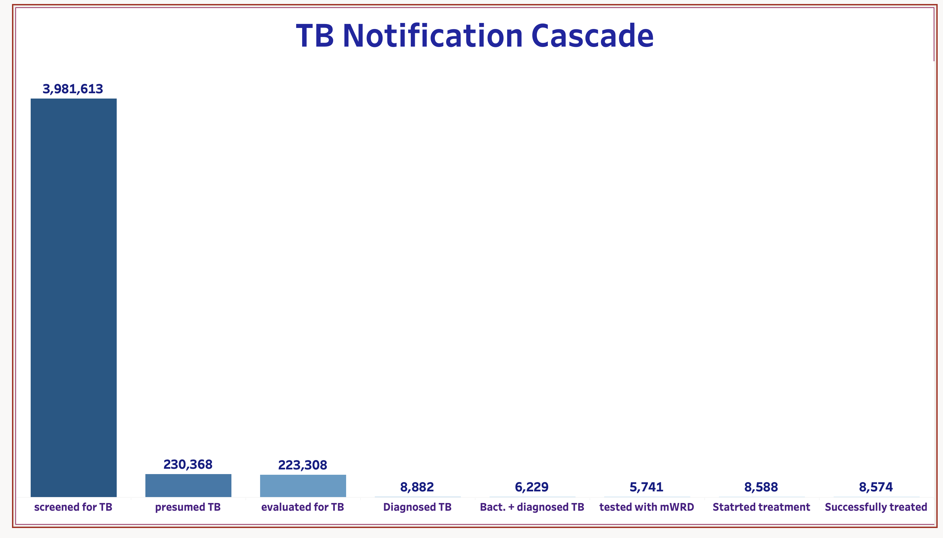
Data source: USAID TB LON project, Nigeria

Slide 19
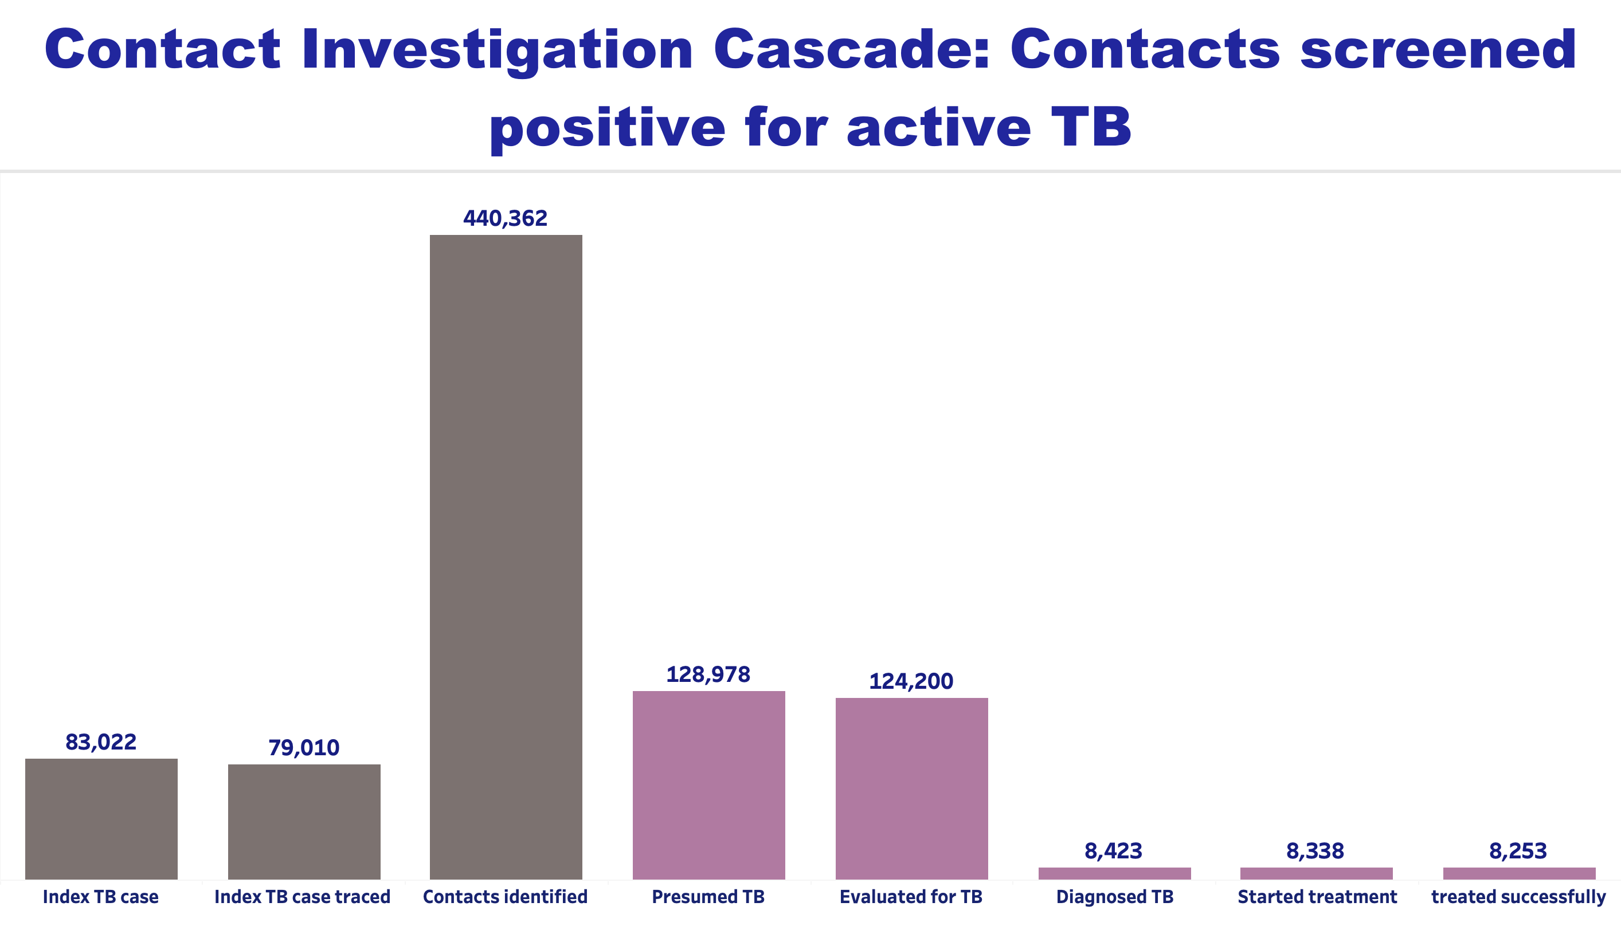
Data source: USAID TB LON project, Nigeria

Slide 20
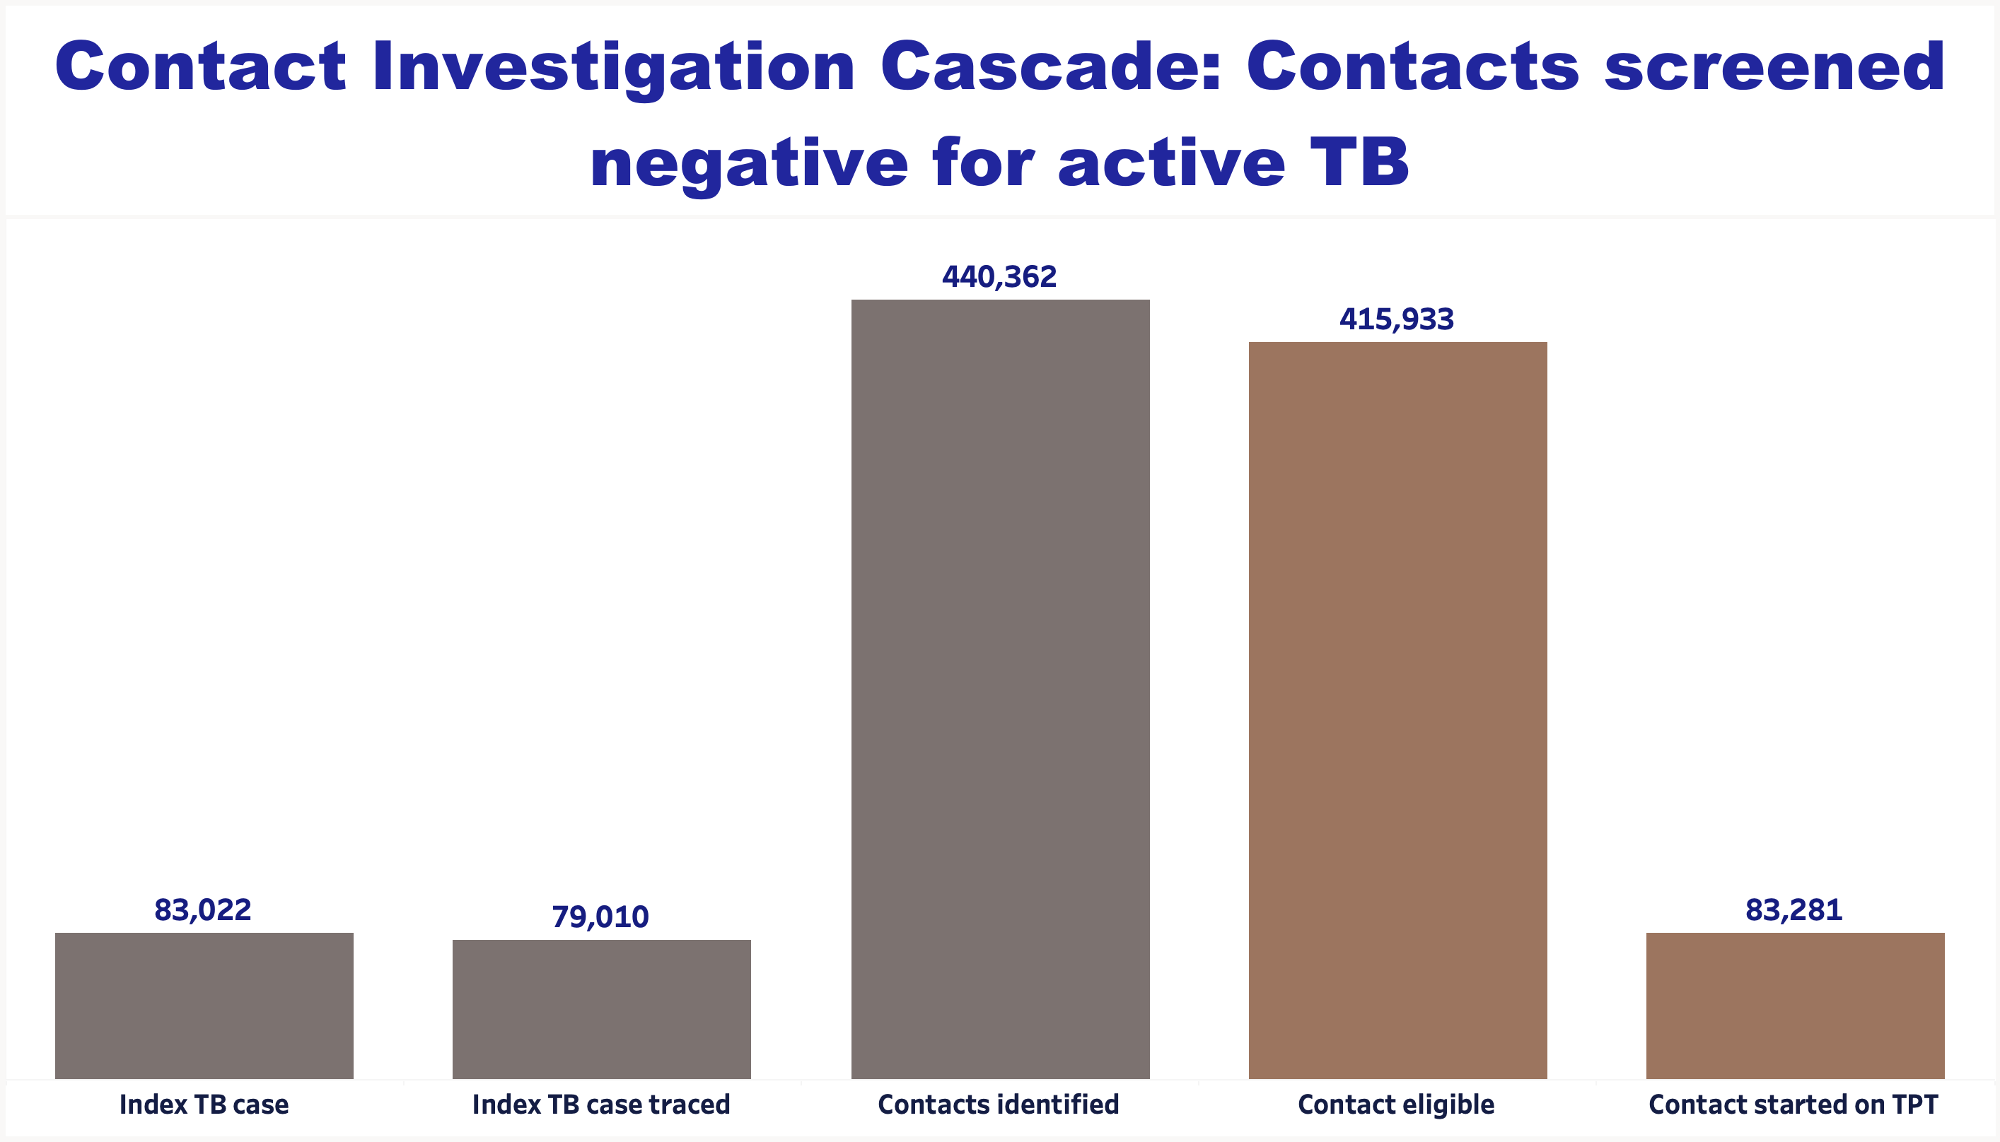
Data source: USAID TB LON project, Nigeria

Slide 21
Comparative Cascade Analysis
Comparative TB cascade analysis dashboards are used for sub-national performance reviews.
  Benchmarks are used to optimise performance, improve efficiency, and for peer reviewing among states.
Cascade analysis is done for each intervention to evaluate the performance, efficiency and gaps along the cascade of care pathway.
Stimulate robust interactive discussion on the data and visuals and facilitate course correction within the program.
Contributed to improved data quality through the rigorous deep dive analysis of granular data.
Resulted in increased data demand and use by all USAID stakeholders

Slide 22
Performance Review Meetings: Program Areas
Private Sector
Community
Public Sector
Private facility intervention
PPMV/CP
Contact investigation
Standalone laboratory
Community ACF
WOW and PDX
ACF – Special population (prisons, schools, nomads, etc.)
Acronyms
PPM – Public-private Mix
CP – Community Pharmacist
ACF – Active Case Finding
WOW – Wellness on Wheel
PDX – Portable digital X-ray
Public facility intervention
Contact investigation

Slide 23
Performance Review Meetings: Sample State Dashboard
Data source: USAID TB LON project, Nigeria

Slide 24
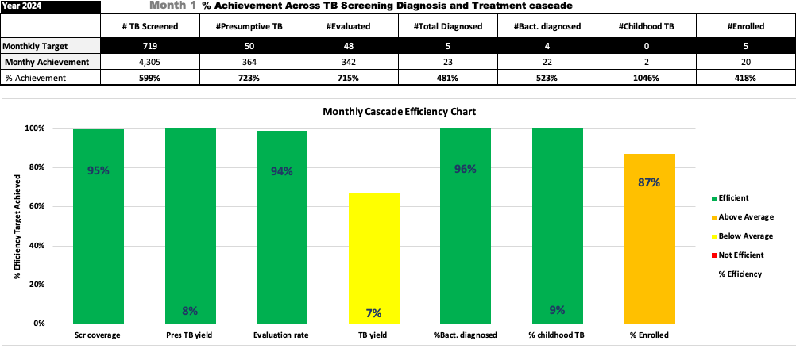
Performance Review Meetings: Standalone Labs Intervention Cascade
Data source: USAID TB LON project, Nigeria

Slide 25
Lessons Learned

Slide 26
Lessons Learned
TB cascade analysis is a valuable tool for improving program accountability and performance.
For TB cascade analysis to work:
  Deliberate effort must be put into instituting systems for accurate data collection and regular reviews.
  A sound understanding of the TB program and PBMEF indicators is needed, which is essential for conducting a meaningful TB cascade analysis.
The Core Plus and National Level indicators are critical to conducting a detailed TB cascade analysis.

Slide 27

Live Links
TBDIAH.org
http://www.tbdiah.org
PBMEF
https://www.tbdiah.org/resources/publications/navigating-tuberculosis-indicators-a-guide-for-tb-programs/
QTSA
https://www.tbdiah.org/assessments/quality-of-tuberculosis-services-assessments/
D2AC
https://www.tbdiah.org/assessments/d2ac/
Data Analysis & Visualizations
http://hub.tbdiah.org

Slide 28

For more information
Sevim Ahmedov
TB/HIV, Prevention and M&E Team Lead
AOR TB DIAH
sahmedov@usaid.gov

Slide 29
Boilerplate

