Slide 1


Africa Regional Workshop on Strengthening TB Monitoring and Evaluation Systems
16-19 April, 2024 • Dar es Salaam, Tanzania
NTP UPDATES: Ethiopia

Slide 2
Presentation out line
Country TB Profile and TB Situation Snapshot
Data-Driven Strategies: Update on national TB M&E, surveillance, and data use
TB M&E Beyond Numbers: Understanding trends in
PBMEF core indicators

Slide 3
Country TB Profile and TB Situation Snapshot

Slide 4
Global and national TB situation
Global
National
10.6 million people who become ill with active TB each year
1.3 million death
One-fourth of the world’s population infected with Mycobacterium TB.
Ethiopia is among the 30 high TB and TB/HIV burden countries globally.
TB Incidence rate stands at 126/100,000 pop.
Estimated 156,000(105 000-217 000) incident TB cases in 2022
TB Mortality rate stands at 17/100,000 populations with an estimated 21,000 (13 000-31 000)
DR-TB estimation 2000

Slide 5
Multiple and complex challenges in Ethiopia resulted in first time increase in TB burden after 2 decades of decline – early sign of reversal in the achievements.
TB incidence declined by 38% between 2015-2021 in Ethiopia, but increased by 5.9% in 2022 from 2021.
TB mortality rate declined by 38.4% between 2015-2021; increase by 6.3% from 2021 in 2022.

Slide 6
UN HLM 2018-2022 achievements
Indicators | Estimated targets | Achievements | National% | Global (%)
TB diagnosis and treatment | 619'800 | 550,364 | 88.7% | 84%
Child TB | 68'900 | 55,518 | 80.57% | 74%
TPT for PLHIV | 161,899 | 162,792 | 100.5 | 100%
TPT for contacts | 280,070 | 143619 | 51.27 | 52%
DR-TB | 5'893 | 3483 | 59.1 | 55%

Slide 7
An 18.3% increase in notified cases in 2023 compared with 2022.
Notified TB cases 2012 -2023
TB Treatment coverage: 2017 -2023

Slide 8
DR-TB Notification
Recent increase (average of 13% per year) in RR/MDR-TB notification and Treatment coverage in Ethiopia following increased investment to improve access to mWRDs

Slide 9
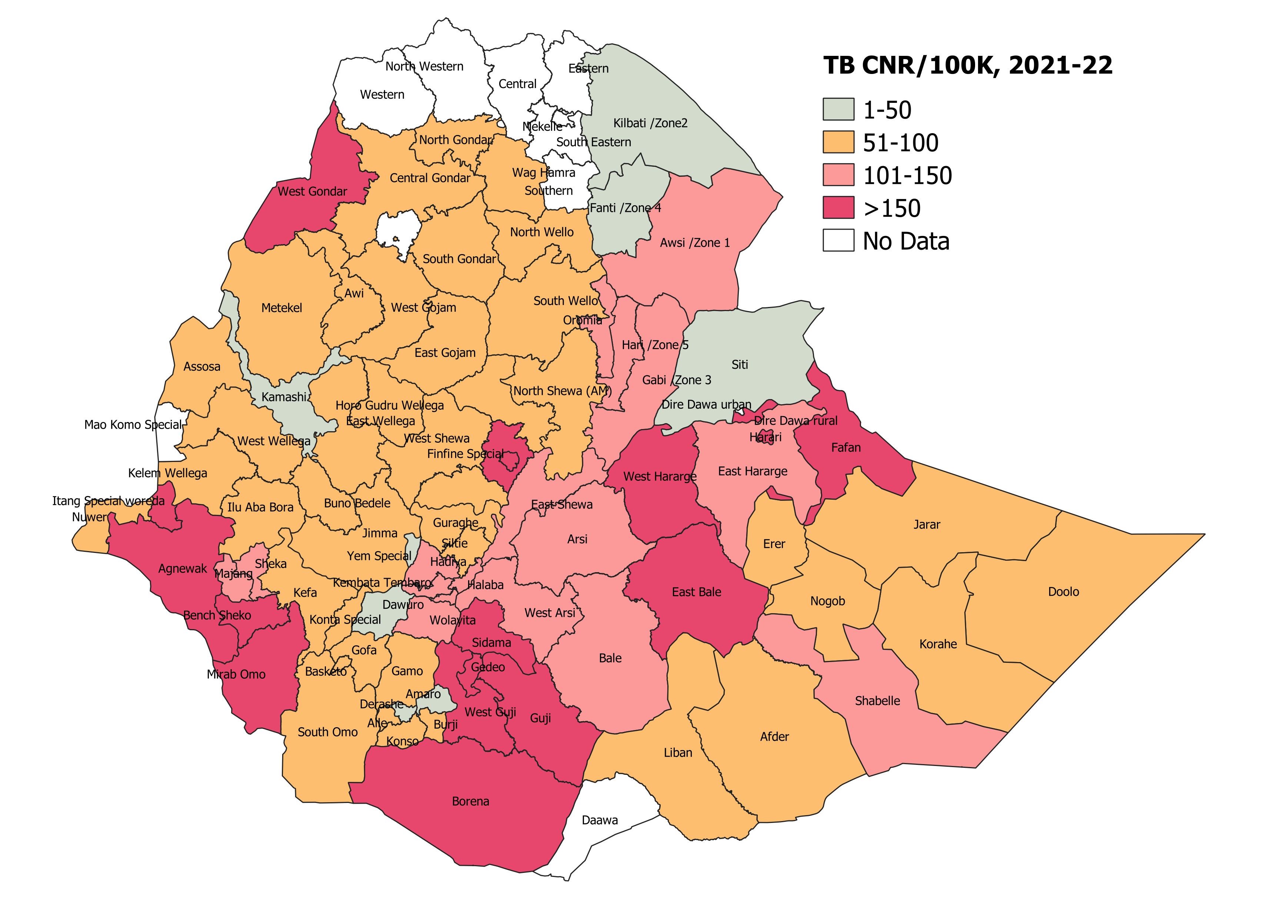
Notable Variations in TB Burden and persistently High TB notification zones forming a belt of high transmission areas

Slide 10
Data-Driven Strategies:
Update on national TB M&E, surveillance, and data use

Slide 11
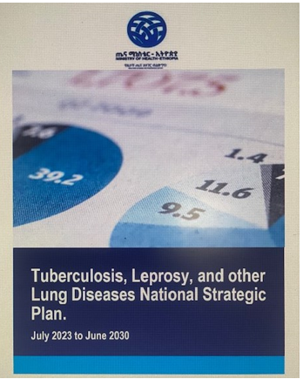
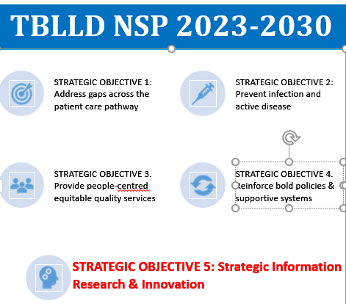
Strategies in place for effectively using national TB data
Routine TBL program monitoring system
  Program review and country wide supervision
  Annual TBL Bulletin, data published yearly
  Annual TB research conference
  Quarterly basis TWG with stockholders
DHIS 2 is the routine data source for the program in monthly basis
  Monthly basis program data analysis and use

Slide 12
Improvements and changes made recently to the national TB M&E system
Currently we have paper-based data source
Indicator revision starting from July 2022
  TBL reporting shifted from Quarterly to Monthly reporting system
  Indicator revision and Inclusion of important data elements and indicators
MDR TB Tracker – electronic case-based reporting system DR TB TICs since 2021
TB
TB Unit register
TB Contact & TPT follow up register
DR-TB (inline with electronic based source)
DR-TB Treatment Card
Leprosy
Leprosy Register
DR-TB Register
DR-TB Follow up register
Leprosy register for care after completion of treatment
Cards( patient record; VMT /ST)
Community TB
Presumed TB referral pad
TB Treatment Supporter Card
Contacts and presumed TB register

Slide 13

Successful data-driven initiatives; success stories in TB data collection, analysis, and utilization
With the support of USAID/JSI, “improve data quality and information at all level “ initiatives
  Developed TBL M and E training manual for facility as well as program managers
  Trained 1000 high load facility TB focal
  Conducted RDQA of 207 HFs
The initiatives is still not finalized
The manual covers
Introduction to TBL program monitoring and evaluation
TBL program recording and reporting system
Indicator definition, data analysis and use

Slide 14
Summery RDQA finding from 207 HFs reported first six month of the year
Data element
 | Recount | Report from hard copy | Report/DHIS2 | Recount | Report from hard copy | Report/DHIS4
# of all forms of TB cases | 9719 | 8829 | 9972 | 110.1 | 97.5 | 88.5
# of TB cases successfully treated | 8686 | 7603 | 8862 | 114.2 | 98.0 | 85.8
TB cases referred f CBTB contribution) | 858 | 842 | 983 | 101.9 | 87.3 | 85.7
# of TB cases from PPM contribution) | 1605 | 1239 | 1542 | 129.5 | 104.1 | 80.4
# of BCPTBC with DST result at least for rifampicin | 3829 | 2938 | 3040 | 130.3 | 126.0 | 96.6
# of TB patients initially tested with mWRD | 4340 | 3177 | 3511 | 136.6 | 123.6 | 90.5
Number of DR TB cases detected/notified (RR, MDR,) | 1025 | 981 | 1090 | 104.5 | 94.0 | 90.0
# of BCPT TB case contacts screened | 9105 | 8647 | 9943 | 105.3 | 91.6 | 87.0
# of under 15 years old contacts of BCPTB cases put on TPT | 5325 | 5201 | 5906 | 102.4 | 90.2 | 88.1
# of TB cases with documented HIV test result | 8176 | 6300 | 6831 | 129.8 | 119.7 | 92.2
# of TB-HIV co-infected patients put on ART | 3042 | 2754 | 2905 | 110.5 | 104.7 | 94.8

Slide 15
Vision for the future of data-driven TB control in your country
Upcoming initiatives or plans
Decision for the TBL prevention and control activities will be data driven which will lead us to elimination of the disease in the country
Expedite transition from paper-based to electronic case-based TBL information system
Complete transition to digital case-based TB reporting & surveillance system by 2030
The transition shall be in a phased approach
The first phase of the transition will involve scaling up EMR for DS-TB at all TICs and TFCs
Facility readiness assessment conducted project concept note developed

Slide 16
Common challenges in TB data quality, collection, analysis, and utilization and potential solutions
Common challenges
potential solutions
Data quality issues due to different reason
Shortage of budget for program monitoring
Suboptimal higher official engagement
Budget support from different partner and improve domestic funding
Continue training of TBL M and E training and strengthen follow up
Shift from paper based to electronic case based reporting

Slide 17
TB M&E Beyond Numbers: Understanding trends in
PBMEF core indicators

Slide 18
Despite COVID and other emergencies a TB treatment coverage improved from 2017 by increased 1-10% (CDR)
Treatment coverage
DST for five years

Slide 19

Thank You!

